Slide 1
Your Good Friends in NLP Research
Roy
Notes:
Hello everyone. As you can see from the title my power-point, today I am going to introduce some good friends of mine in my own research. Hope they can really help you guys.

Slide 2
Outline
Useful Command-line Skills
Memory Consumption in Deep Neural Nets Training
Saving GPU memory
Gradient accumulation
Gradient checkpointing
Notes:
Here is the outline of my talk. First I will talk about some useful command-line skills that could be used in our daily researching.
Next I introduce the memory consumption in deep neural network training.
At last, I will present two approaches for saving GPU memory usage.

Slide 3
Outline
Useful Command-line Skills
Memory Consumption in Deep Neural Nets Training
Saving GPU memory
Gradient accumulation
Gradient checkpointing
Notes:
So let’s first get into the useful command-line skills part.

Slide 4
Useful Command-line Skills
Basics
IO redirection, nohup, tmux
File search
find, fzf
Machine resource monitor
nvidia-smi, nvtop, htop, iotop
Program inspecting/tracing
py-spy, strace
Notes:
I divide all command-line skills I am about to introduce today into 4 parts:
The first part includes some basic job controlling skills, such as IO redirection, setting program to hang-up-immune status and terminal multiplxer tool.
The second part includes some file finding tools.
The third part is about monitoring various machine resources.
And the last part is about program inspecting and tracing.

Slide 5
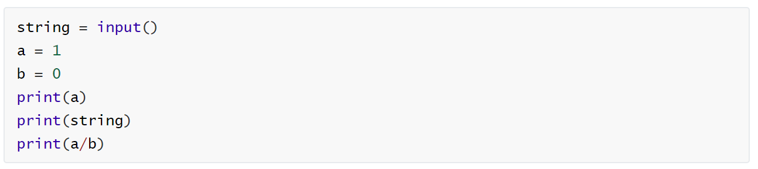

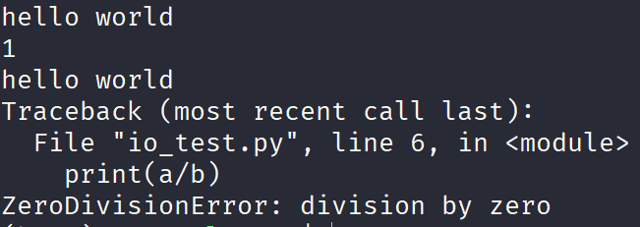
Useful Command-line Skills
A python example:
Standard IO
Terminal is also a file: /dev/pts/xxx
terminal
Command:
0
1
2
……
0
1
2
……
File descriptors:
Output:
shell process
fork
your working process
Notes:
On the Linux server we are using, each running process owns a set of file descriptors that serve for different usage.
As we log into a server, for example, Galaxy, we will first land in the shell process. The first three file descriptors 0,1,2 represent the files for standard input, standard output, and standard error.
Quiz:
Here is a simple question, which files do these file descriptors point to?
They all point to the terminal associated with the shell process, and the terminal is a character special file located in /dev/pts/ directory.
When we run a program, the running process is forked from the shell process, hence inheriting the file descriptors owned by shell process.
And here is a python example:
It read input from terminal and assign it to “string”, the values of “a” and “string” are output to the terminal, as well as the zerodivisionerror message.

Slide 6

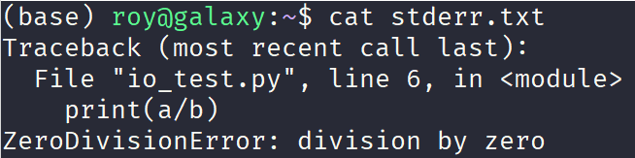
Useful Command-line Skills
A python example:
IO redirection
Terminal is also a file: /dev/pts/xxx
terminal
input.txt
stdout.txt
stderr.txt
Command:
0
1
2
……
0
1
2
……
File descriptors:
Output:
shell process
fork
your working process
Notes:
IO redirection refers to explicitly changing the default files that file descriptors 0,1,2 represent.
For example, we may want our program to read input data from a specified file “input.txt” and output results or error messages to another specified files.
We can simply redirect the IO when typing command in the terminal, as shown in the right figures.
We can specify the input file after the “left arrow” and output/error file after the “right arrow”.
Now the same python program looks like this:

Slide 7

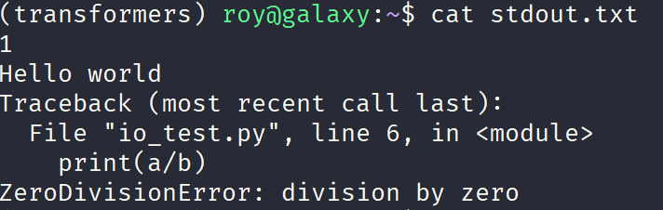
Useful Command-line Skills
A python example:
IO redirection
Terminal is also a file: /dev/pts/xxx
terminal
input.txt
stdout.txt
stderr.txt
Command:
0
1
2
……
0
1
2
……
File descriptors:
Q: what does the output look like?
shell process
fork
your working process
Notes:
Here comes another simple quiz: what does the output look like?

Slide 8




Useful Command-line Skills
nohup
used to invoke a program immune to hangups signal(SIGHUP).
open my local terminal
ssh to galaxy
run our SOTA model training program in the background
click ❌ to close my terminal
who killed my program?
one day later
close terminal
shell receives SIGHUP
shell resends SIGHUP to child processes
you lose your program
Notes:
nohup is a utility tool in Linux to invoke a program that is immune to hang-up signal.
Some beginners that are new to operating on Linux server may encounter this situation:
We open up the local terminal
Use ssh to connect to Galaxy
Run our SOTA model training script in the background
Click the cross to exit terminal.
One day later, when we check the results and found the program didn’t run as we expect.
The reason behind is that when we click cross to close the terminal, …
Nohup can be used here make your program immune to hang-up signal.

Slide 9
Useful Command-line Skills
tmux
A widely used terminal multplexer.
Each panel is an individual shell process.
tmux
Session 1
Session 2
Window 1
Window 2
Window 1
Window 2
Panel 1
Panel 2
Panel 1
Panel 2
Panel 1
Panel 2
Panel 1
Panel 2
……
Panel 3
Panel 4
Panel 3
Panel 4
Panel 3
Panel 4
Panel 3
Panel 4
Notes:
tmux is a widely used terminal multiplexer tool.
It offers flexible functionality to create multiple sessions serving different purposes.
For instance we can manage different projects in different sessions, which makes the work flow more convenient.
Within one Session, we can further create multiple windows. We can for example run the model training program in window1, and run a GPU monitoring program in window2.
The most useful functionality tmux offers is that it can save the snapshot of the shell and terminal upon detaching one Session. When attaching to the same session again, it will restore the exact status.
So basically if you use tmux, the “nohup” command will not be so useful.

Slide 10
Useful Command-line Skills
find
search for file in a dictionary recursively.
find all python files in current directory:
find . –name “*.py”
find all python files in current directory that are larger than 1KB:
find . –name “*.py” –size +1k
find all python files in current directory that are larger than 1KB and count total line number:
find . –name “*.py” –size +1k | xargs wc -l
Notes:
The “find” command is a useful tool to search and locate files or directories.
The first argument to the “find” command is the root path in which we want to start our searching.
We can pass values to several options:
The “name” option allows for passing regular expression to match certain patterns.
The “size” option allows for filtering files that do not meet the given size requirement.
For example, …

Slide 11
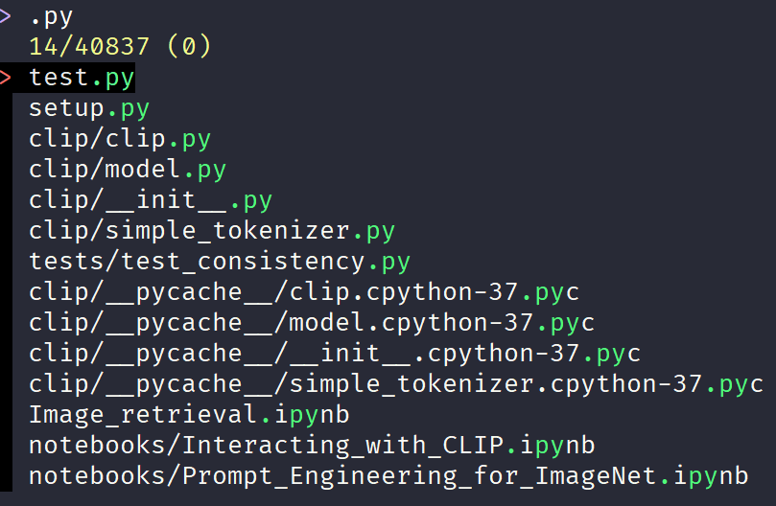
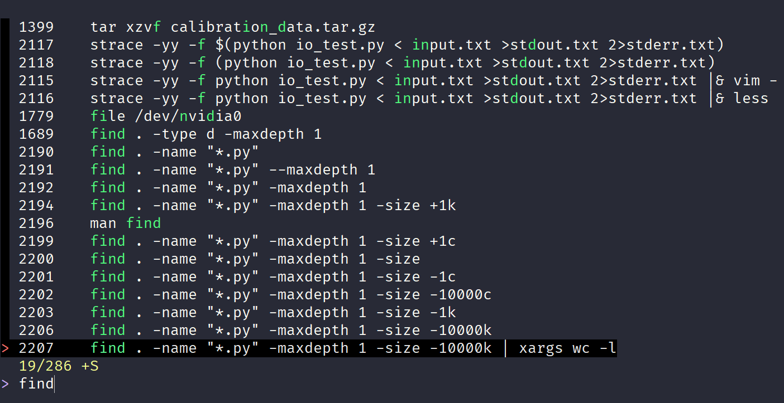
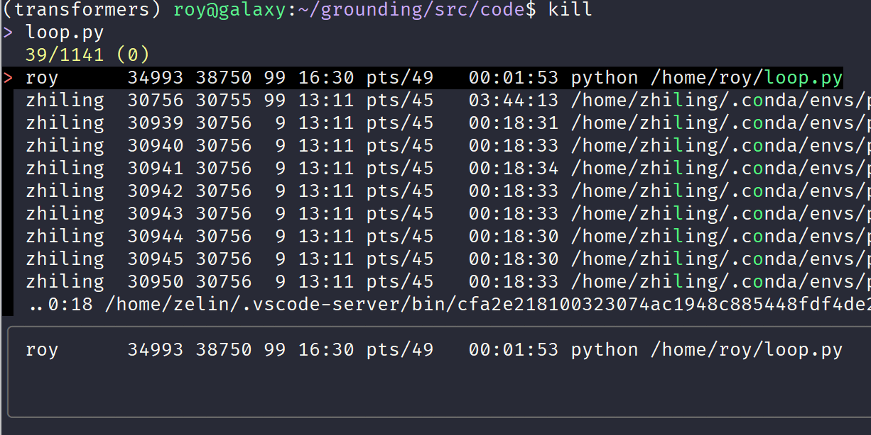
Useful Command-line Skills
fzf
fuzzy search tool.
ctrl+t to search for files.
ctrl+r to search for history command.
vim $(fzf): search and open file in vim.
kill tab: search and kill process.
ctrl+t
ctrl+r
kill tab
Notes:
fzf is a popular open-source fuzzy search command-line tool.
It can be used to search files and history commands.
In the terminal, we can press CTRL+T to search for files under current directory.
We can also press CTRL+R to search for history commands, which is faster than roll back by pressing “up” arrow.
fzf can also be integrated in other commands, such as the Vim editor and kill command.
We can type vim $(fzf), and the searched files will be directly opened in Vim.
We can also type kill as prefix, and then press TAB to use fzf as the process finder.

Slide 12
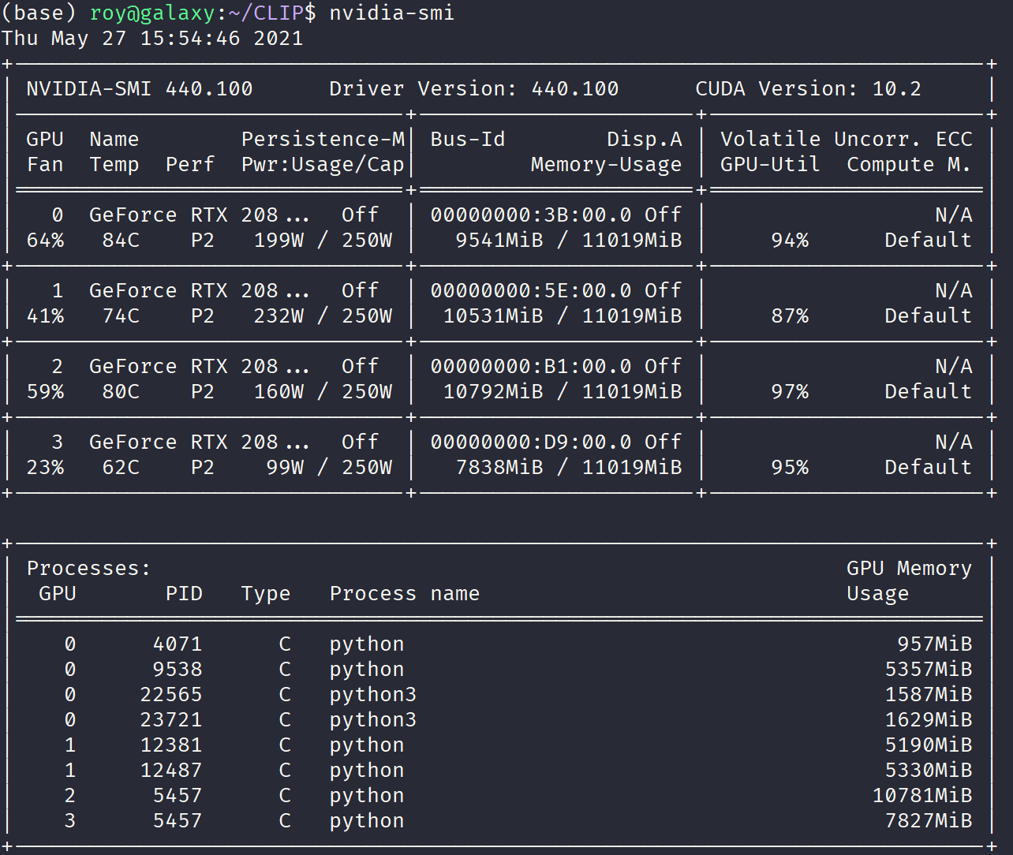
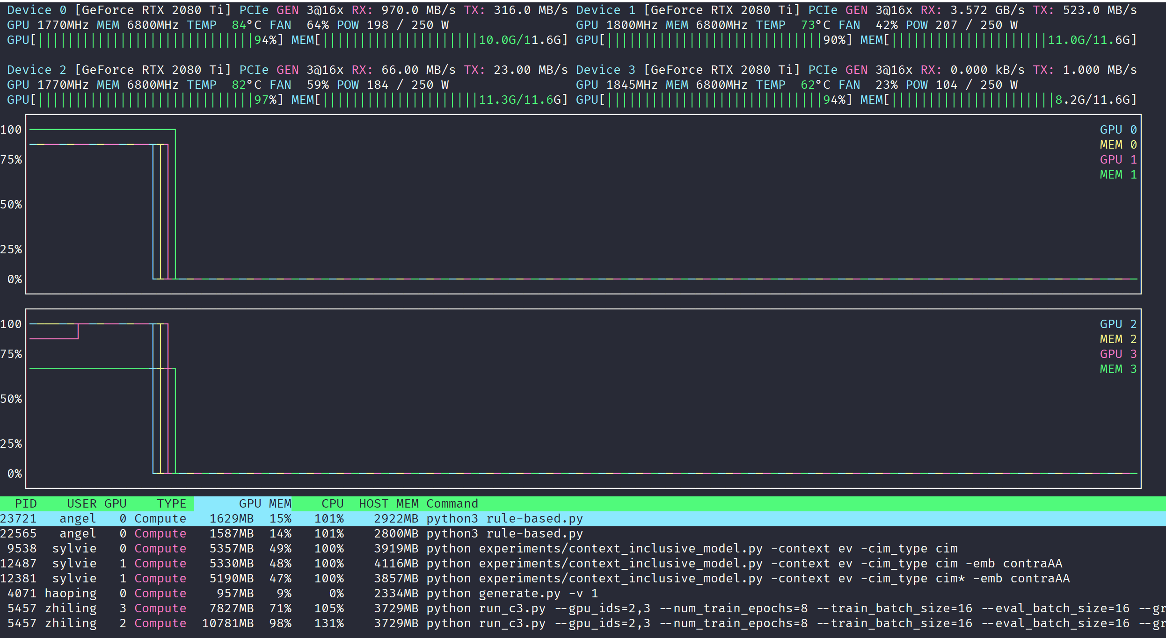
Useful Command-line Skills
nvidia-smi & nvtop
monitoring GPU activity.
nvidia-smi is static(“watch –n1 nvidia-smi” will make it dynamic).
nvtop is dynamic and more verbose.
nvidia-smi
nvtop
Notes:
Next is the GPU monitoring tools.
For DL-based NLP project, we care much about the GPU usage status.
Nvidia-smi is an official command-line tool from NVIDIA to monitor GPU status, including the temperature, the memory usage.
By default nvidia-smi is static, which means that it only displays the current GPU status. We can combine it with the “watch” command to make it dynamic.
Nvtop is another open-source GPU monitoring tool that provides dynamic and colorful GPU usage information.
Besides the information nvidia-smi can provide, nvtop also show verbose information about processes that are currently running on GPU.

Slide 13
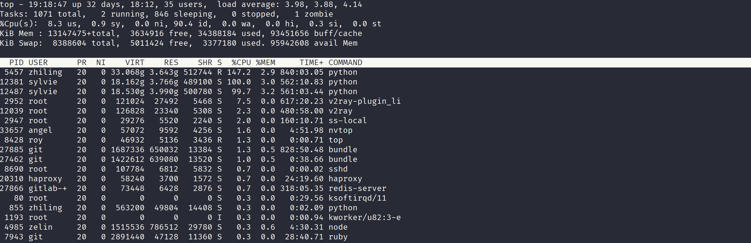
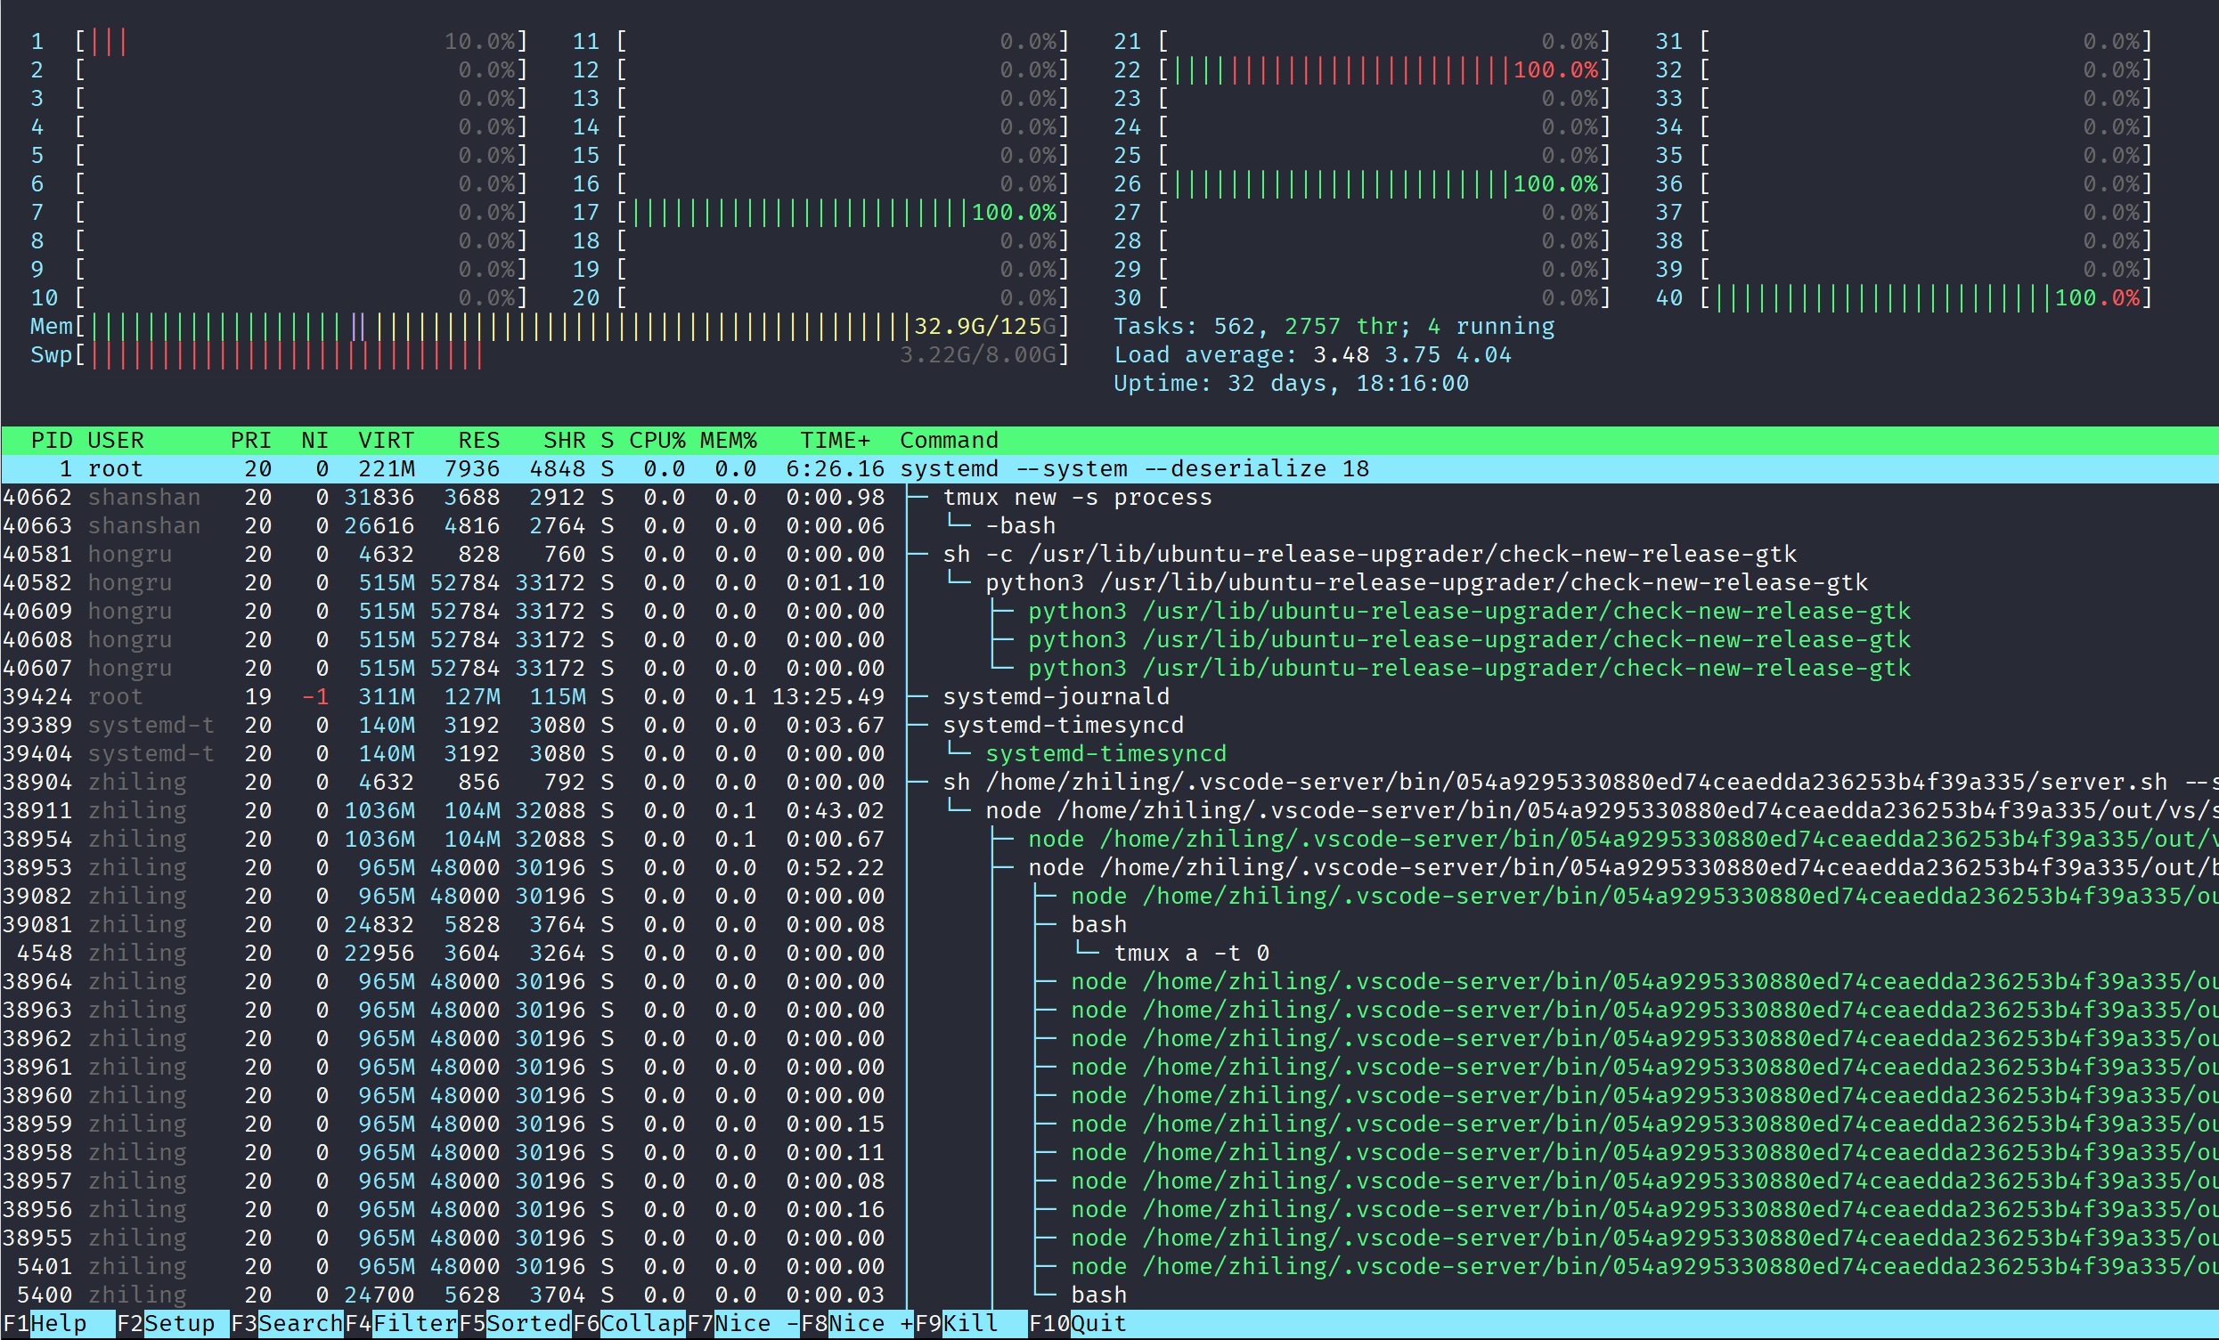
Useful Command-line Skills
top/htop
monitoring CPU and memory status.
htop is colorful and support mouse operation.
top
htop
Notes:
In terms of monitoring CPU and the DRAM status, top and htop are the most widely used command-line tools.
Top and htop are both dynamic, but htop offers a colorful interface and allows for more flexible operation.
For example,
we can search for process by name
we can display processes sorted by specified indicator, such as memory consumption and CPU usage.
we can kill a process using our mouse instead of using kill command.

Slide 14
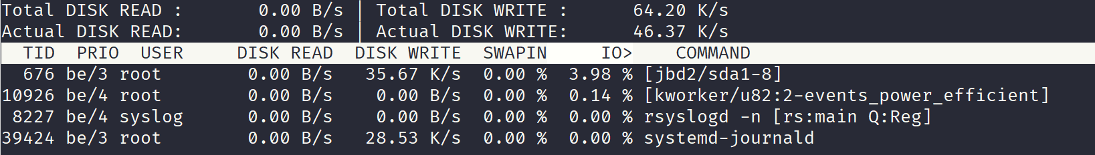
Useful Command-line Skills
iotop
monitoring process IO activity.
iotop -o: display information about processes reading/writing from/to disk.
iotop -p pid: display information about given process.
Processes currently doing IO
Notes:
In addition to CPU, GPU and main memory, we may also want to monitor the system IO status.
The “iotop” command is used to monitor the disk read and disk write behavior of running process.
iotop –o display information about processes reading/writing from/to disk.
iotop -p display information about given process.

Slide 15
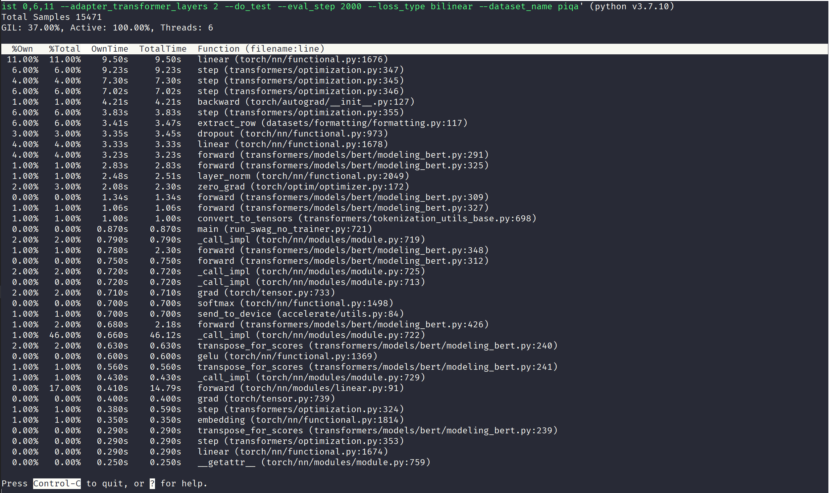
Useful Command-line Skills
py-spy
python program profiling tool.
sudo py-spy top --pid pid: attach to a running process specified by pid.
py-spy top -- python your_python_program.py: launch and attach to a new program.
Notes:
When it comes to debugging and optimizing performance of python programs, “py-spy” is a useful profiling tool.
py-spy has three modes, here I only show the most useful mode, which is invoked by the “top” argument.
It dynamically display the accumulated running time for each functions.
For an already running process, it requires “sudo” privilege because the process is not a child process of current shell process.
We can also launch a new process by passing the command after double hypen.

Slide 16
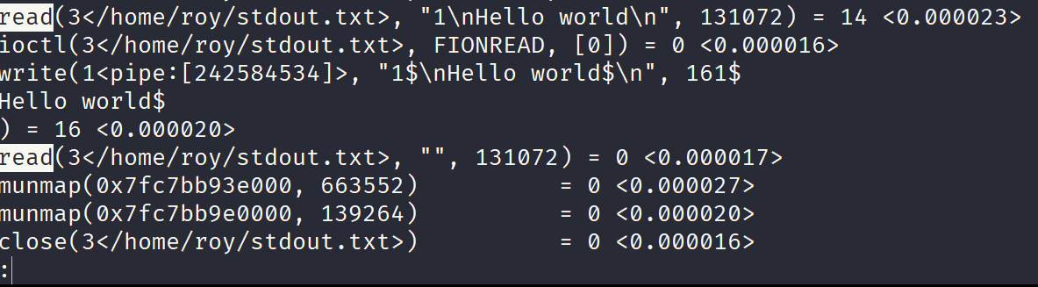
Useful Command-line Skills
strace: trace system calls and signals.
strace -p pid:
attach to process specified by pid.
strace –p pid -e trace=open,read,write,close:
attach to process specified by pid and only show file related system calls.
-yy: show complete file path for file descriptors.
-f: also show system calls of processes forked from the attached process.
-T: show CPU time spent on each system call.
Notes:
Finally we come to last one of useful command-line tools, which is strace.
strace is more of a lower-level system utility tool and is typically used to trace system calls and signals.
The basic usage is attaching to a process specified by id and display the system call information in the terminal.
The “-e” option allows for only showing desired type of system calls. For example we can only show the IO related system calls.
The “-yy”…
The “-T” shows the time spent on each system call.

Slide 17
Outline
Useful Command-line Skills
Memory Consumption in Deep Neural Nets Training
Saving GPU Memory
Gradient accumulation
Gradient checkpointing
Notes:
Now let’s move to the second part: memory consumption in deep neural nets training.

Slide 18
Types of Memory
Model memory
model parameters
Optimizer memory
gradients
momentum statistics
Dynamic memory
intermediate output
intermediate gradients
Notes:
The GPU memory involved in DL-based NLP project can be categorized into 3 types.
The first part is called model memory, which involves model parameters.
The second part is called optimizer memory, which includes buffers for storing gradients and momentum statistics.
The third part is called dynamic memory, which consists of intermediate output and intermediate gradients.

Slide 19
Types of Memory
Model memory
BERT-base: 110,000,000 * 4B = 0.41GB
BERT-large: 336,000,000 * 4B = 1.25GB
RoBERTa-base: 125,000,000 * 4B = 0.46GB
RoBERTa-large: 355,000,000 * 4B = 1.32GB
GPT-2-base: 117,000,000 * 4B = 0.43GB
GPT-2-large: 774,000,000 * 4B = 2.88GB
BART-base: 139,000,000 * 4B = 0.52GB
BART-large: 406,000,000 * 4B = 1.51GB
Independent of input data size!
Notes:
The first type of memory is referred to as model memory.
Model memory is static with respect to data magnitude and is only related to the model design.
We can see the model memory consumption for some popular pre-trained language models.
The model memory can be calculated by multiplying the number of parameters and the space for each parameter.
For most models, the space for each parameter is 4 bytes, which is the space used for a sing-precision floating point number.
The bigger the model, the more model memory it comsume.

Slide 20
Types of Memory
Optimizer memory
Depending on the specific optimizer
For SGD with momentum:
~ 2 x model parameters
For Adam:
~ 3 x model parameters
Quiz: why 3x here?
gradients + first-order momentum + second-order momentum
Independent of input data size!
Notes:
The second type of memory is referred to as optimizer memory.
Optimizer memory is also static with respect to data magnitude, it’s only related to the model design and choice of optimizer.
For Stochastic Gradient Descent optimizer with momentum, it consumes 2 times space as the model memory, because it requires two buffers, one for gradients, another for momentum statistics.
For Adam optimizer, it consumes 3 times space as the model memory.
Here is another quiz?

Slide 21
Types of Memory
Dynamic memory
intermediate output
intermediate gradient
For NLP tasks, dynamic memory is highly related to :
batch size
sequence length
Dependent of input data size!
Notes:
The second type of memory is referred to as dynamic memory.
It consists of intermediate output and intermediate gradient.
For NLP tasks, the dynamic memory is highly related to batch size and sequence length of our input data.

Slide 22








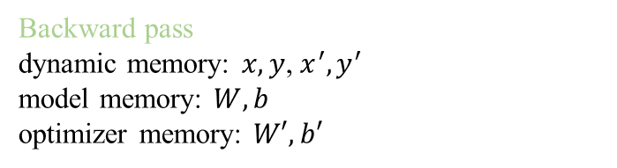

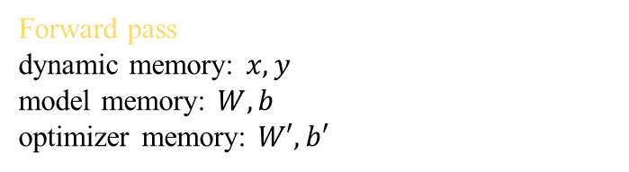
An Intuitive Example
$$y=f(Wx+b)$$
Feed forward layer FFN:
$$FFN_{i−1}$$
$$FFN_{i}$$
$$y$$
$$FFN_{i+1}$$
$$x$$
$$x′$$
$$y′$$
$$loss$$
Forward pass
dynamic memory: $x, y$
model memory: $W, b$
optimizer memory: $W′, b′$
Backward pass
dynamic memory: $x, y$, $x^{′}, y^{′}$
model memory: $W, b$
optimizer memory: $W′, b′$
Notes:
Here is an intuitive example.
Suppose we have a simple feed forward layer: y=f(Wx+b). It takes as input a vector x and output another vector y.
During training, in the forward pass, the total memory consumption includes:
In the backward pass, the total memory consumption includes:

Slide 23
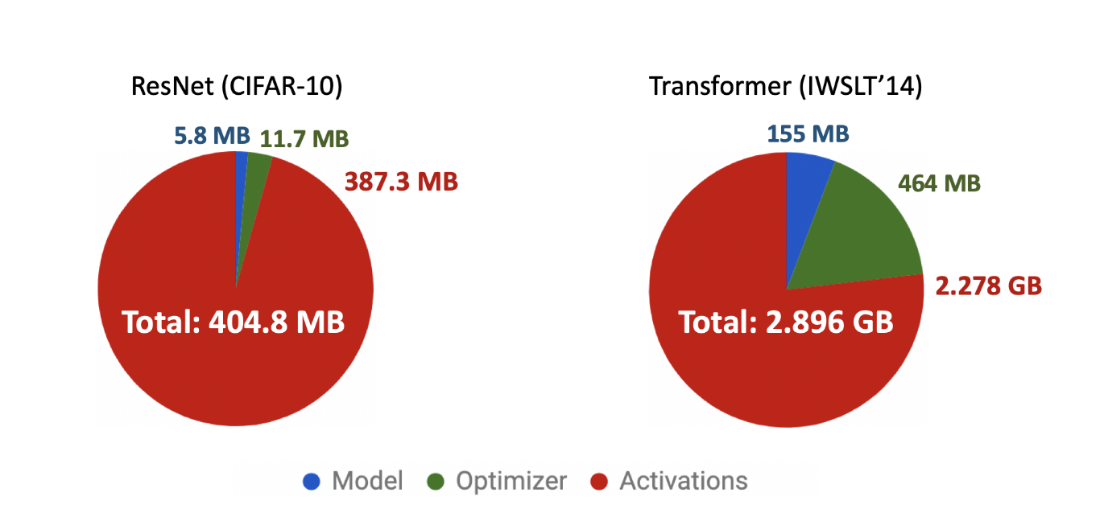
Real Model
bigger model -> larger model and optimizer memory
dynamic memory accounts for the majority of GPU memory usage.
Notes:
Here is the pie chart of memory usage ratio for real models used in experiments.
For ResNet trained on CIFAR-10 dataset on image classification task, the dynamic memory accounts for 95 percent of total memory.
For seq2seq Transformer model on machine translation task, the dynamic memory accounts for 75% of total memory.
Obviously, the dynamic memory occupies the majority of GPU memory.

Slide 24
Outline
Useful Command-line Skills
Memory Consumption in Deep Neural Nets Training
Saving GPU Memory
Gradient accumulation
Gradient checkpointing
Notes:
Now we know how GPU memory is used for different purpose, next I will introduce two techniques to reduce the GPU memory that can be potentially useful in our research.

Slide 25
Gradient Accumulation
Larger batch size versus smaller batch size:
more robust learning signal 🥰
faster convergence speed 🥰
better utilization of GPU’s parallel computation 🥰
larger dynamic memory consumption 🥺
Gradient accumulation simulates large batch size by accumulating gradients of smaller batch, hence reducing dynamic memory.
Notes:
The first technique is called gradient accumulation.
It is a consensus that training with larger batch size has multiple advantages over smaller batch size:
1.
2.
3.
But large batch size also brings larger dynamic memory consumption, which is undesirable when we have GPU with limited memory.
Gradient accumulation offers a way to simulates large batch size by accumulating gradients of smaller batch, hence reducing dynamic memory.
Here “simulate” large batch size means that we can obtain similar training effect as large batch size.

Slide 26
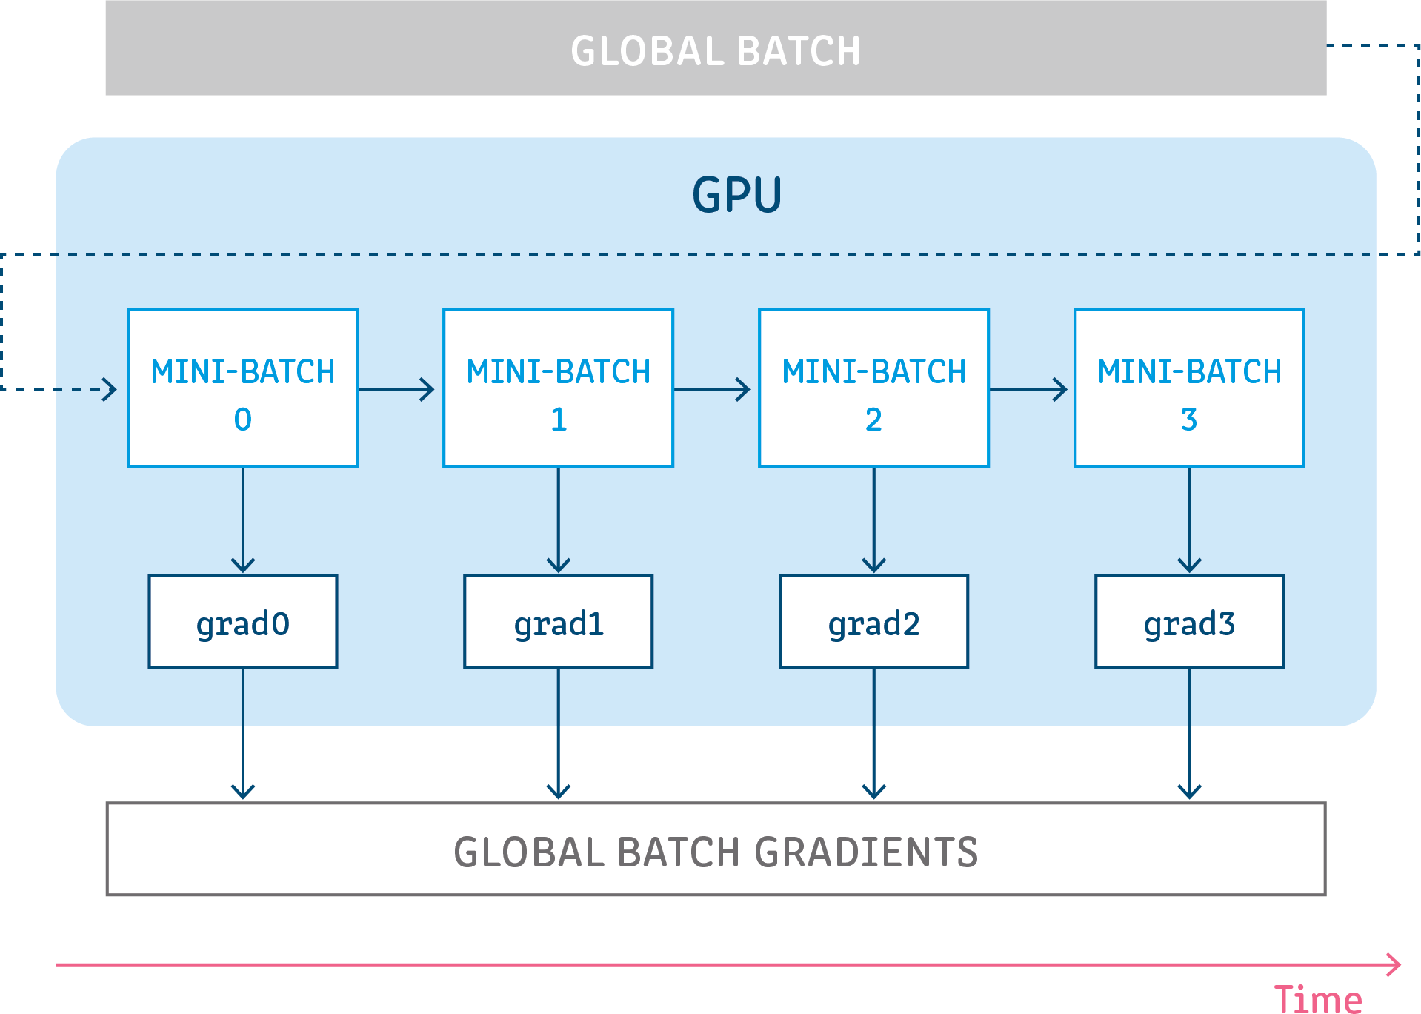
Gradient Accumulation
We can only fit 8 samples in a batch and we want to simulate batch size of 32.
Consider every 32/8=4 consecutive batches as a group, for each batch:
Compute the loss averaged over all samples in this batch.
Divide the loss by 4.
Call “loss.backward()”.
If it is the last batch in the group, call “optimizer.step()”.
Notes:
Suppose we can only fit 8 samples in a batch and we want to simulate a batch size of 32.
Gradient accumulation works by considering every 4 consecutive batches as a group. And then for each batch within the group:
compute the loss averaged over all samples in this batch
Devide the loss by 4.
Call “loss.backward()”
If it is the last batch in the group, call “optimizer.step()”.

Slide 27



Gradient Checkpointing
What if we cannot even fit 1 sample into GPU?
we need another way to reduce dynamic memory.
Recall what constitutes dynamic memory:
intermediate output
intermediate gradient
Q: Why do DL frameworks normally save intermediate output? 🤔
A: To compute gradient of model parameters.
For a linear layer:
$$y=Wx+b$$
$$\frac{∂loss}{∂W}=\frac{∂loss}{∂y}⋅x^{T}$$
$$\frac{∂loss}{∂b}=\frac{∂loss}{∂y}$$
intermediate gradient
intermediate output
Notes:
Although gradient accumulation is effective and easy to use, it still cannot deal with situations where we cannot even fit 1 sample into GPU.
To this regard, we may need another way to save dynamic memory.
First recall what consititues dynamic memory?
Here is an example of a linear layer: y=Wx+b.
WE can see from the partial deriviatives here that:
The gradient of loss with respect to weight matrix W requires the intermediate gradient w.r.t y and intermediate output x.
The gradient of loss w.r.t bias b also requires the intermediate gradient w.r.t y.

Slide 28
Gradient Checkpointing
Gradient checkpointing works by trading computation time for memory.
Before:
checkpointed
checkpointed
After:
Notes:
Here are the visualization of how a simple multi-layer perceptron model works in the forward pass and backward pass.
The first line of nodes represent the intermediate outputs. Solid nodes indicate that the corresponding intermediate outputs are currently saved in memory, and hollow nodes means that the corresponding intermediate outputs are not currently saved in memory.
The second line of nodes represent the gradients w.r.t model parameters and intermediate output.
Normally, in the forward pass, all the intermediate outputs are saved in memory to be able to directly compute gradients for model parameters. And this part contributes most to the memory footprint.
If we perform gradient checkpointing on these two nodes, their outputs will not be saved in the forward pass. Instead, their outputs are re-computed in the backward pass, starting from the last un-checkpointed node.

Slide 29
Gradient Checkpointing
Pytorch natively supports gradient checkpointing:
output = torch.utils.checkpoint.checkpoint(module, input)
module: the checkpointed module won’t save intermediate output during forward pass.
We can seamlessly use it in transformers libabry:
BERT, RoBERTa, BART all support it by turning the gradient checkpointing option on in the config:
Fine-tuning BERT/RoBERTa on PIQA/SWAG with batch size 16 on a single 12GB 2080Ti GPU:
Model | Without gradient checkpointing | With gradient checkpointing
BERT-base | 7.0GB | 3.7GB
BERT-large | OOM | 7.6GB
Model | Without gradient checkpointing | With gradient checkpointing
RoBERTa-base | 10.6GB | 4.5GB
RoBERTa-large | OOM | 8.8GB

Slide 30
Takeaway
Build up your own workflow on how to launch, monitor your program.
When training with big models or big data:
First consider using gradient accumulation.
Then consider using gradient checkpointing.
Other methods for saving GPU memory, but at the cost of potential performance drop:
Mixed precision training automatically takes care of switching between FP16 and FP32. Pytorch>=1.6.0 support automatic mixed precision training :
import torch.cuda.amp as amp
it uses Tensor Core(luckily enabled on our 2080Ti) to largely speed up training and inference.
Efficient Transformer, e.g., Reformer, Linformer.
Notes:
At last, here is the takeaway.
The command-line skills I have introduced in the beginning can help build up efficient workflow on how to manage your research projects.
If you are re-implementing a big baseline model or design your own big model, gradient accumulation and gradient checkpointing can be your good friends to save considerable amount of GPU memory.
There are also other methods to reduce memory consumption, but at the cost of potential performance degradation:
Mixed precision training works by switching between FP16 and FP32 and is now natively supported in both Pytorch and more abstract frameworks like fairseq. It utilizes the TensorCore inside Nvidia GPU to accelerate training and inference.
We can also resort to more efficient Transformer architechtures, such as Reformer and Linformer. These Transformer models modify the original multihead self-attention to lower the time and space complexity.

