Slide 1
Overview of Gene-Disease Project
2015-3-4

Slide 2
Content
Data
Evidence Extraction
Algorithm 1
Algorithm 2 – Page Rank
Algorithm 3 – Publication Type
Algorithm 4 – Evidence Relation

Slide 3
Data

Slide 4
Gene Names
Homo_sapiens
Name: “Homo sapiens”
Syn: “H sapiens”, “Homo sapiens”, etc.
isA
A hierarchical synset
Built up with “isA” relation
Note:
synset is not necessary a gene, can be somehow category.
A name may stand for more than one gene.
Hsa.IDDB3FAMILY
Name: “Iddb3 Families”
Syn: “Iddb3 Families”, etc.
isA
ABC
Name: “ATP-binding cassette transporters”
Syn: “ABC”, “ATP-binding cassette transporters”
isA
Hsa.ABCA1
Name: “ATP-binding cassette, sub-family A (ABC1), member 1”
Syn: “ABC-1”, “ABC1”, “ATP-binding cassette 1”, etc.

Slide 5
Disease Name
Root
Name: “uDisease”
Syn: “Disease”, “Disease or Disorder”, etc.
Similar with Gene
A hierarchical synset
Built up with “isA” relation
Note:
synset is not necessary a disease, can be somehow category.
A name may stand for more than one disease.
isA
MedDRA:10056486
Name: “Pre-existing disease”
Syn: “Pre-existing disease”, etc.
isA
67347
Name: “Established AstraZeneca Disease Areas”
Syn: “Established AstraZeneca Disease Areas”
isA
51127
Name: “Neoplastic disease”
Syn: “Mass conditions NEC”, “Neoplasia”, etc.

Slide 6
PubMed/Medline Data
Format: xml
Introduction: http://www.nlm.nih.gov/bsd/licensee/medpmmenu.html
Element Description: http://www.nlm.nih.gov/bsd/licensee/elements_descriptions.html
Fields: pmid, publication date, author, title, abstract, citation, publication type, etc.
Converted to JSON for easy usage of both processing & NoSQL database (python: xmltodict; about 80K parse/sec via Jackson)

Slide 7
Evidence Extraction

Slide 8
What is Evidence?
Co-occurance of gene and disease within one sentence
Tuple: <pmid, sentence_num, gene, disease>
Assumption:
Suggest a relation between gene & disease
Example:
Bevacizumab, is a monoclonal antibody against VEGF that has shown activity as a monotherapy in recurrent ovarian cancer.
Gene (VEGF) vs. Disease (recurrent ovarian cancer)

Slide 9
Extraction Method
Input: the raw text of a sentence from abstract
Parse: use Stanford NLP tools to segment and tag the sentence.
Window-based matching: use an window-based algorithm to match the gene/disease names in the sentence.
Longest match
Disease priority
Only consider letter, number & space
Compose evidence.
Output: <uuid, gene, disease>
Uuid = <pmid-sentenceNum-geneIndex-diseaseIndex>, i.e. uuid can describe the location of the evidence

Slide 10
Extracted Evidence
All names are one synonym in “synset”.
Uuid contains the location information of the evidence
Example: right table
* All following algorithm will be based on these evidences.
uuid | Gene Name | Disease Name
15394074-8-0-0 | bacteremia | nodal
19873459-0-1-4 | arteriosclerosis | thyroglobulin
19871528-6-0-0 | jaundice | sera
… | … | …

Slide 11
Algorithm 1
Simply use the frequency of genes against diseases as the score of a gene

Slide 12
Disease-Gene Frequency Index
Map: evidence <uuid, gene, disease> → <canonical_disease, uuid, gene, canonical_gene, disease>
Reduce to: <canonical_disease, canonical_gene, frequency> as the right table
Disease (canonical name) | Gene (canonical name) | Frequency
DOID:4363 (Uterine Cancer) | Hsa.CSN1S1 (casein alpha s1) | 231
… | … | …
… | … | …
… | … | …

Slide 13
Ranking Algorithm
Rank via Frequency of genes against a certain disease
Frequency: the number of occurrence of a gene, under a certain disease.
Question: are all these occurrence of equal importance to each other?

Slide 14
Algorithm 2 - PageRank
Import pagerank to improve the Algorithm 1 by assigning weight to each evidence

Slide 15
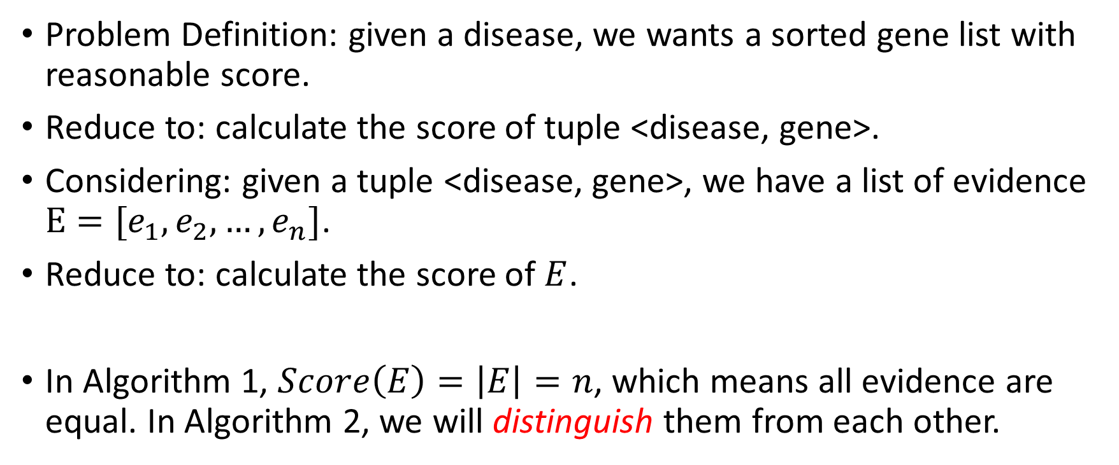
Re-analyze the Problem
Problem Definition: given a disease, we wants a sorted gene list with reasonable score.
Reduce to: calculate the score of tuple <disease, gene>.
Considering: given a tuple <disease, gene>, we have a list of evidence $E=[e_{1},e_{2},…,e_{n}]$.
Reduce to: calculate the score of $E$.
In Algorithm 1, $Score\left(E\right)=\left|E\right|=n$, which means all evidence are equal. In Algorithm 2, we will distinguish them from each other.

Slide 16
Distinguish Evidence
Evidence contains:
Gene & disease
Paper information: author, citing, date, etc.
We can distinguish evidence by scoring:
The quality of the paper
The fame of the author

Slide 17
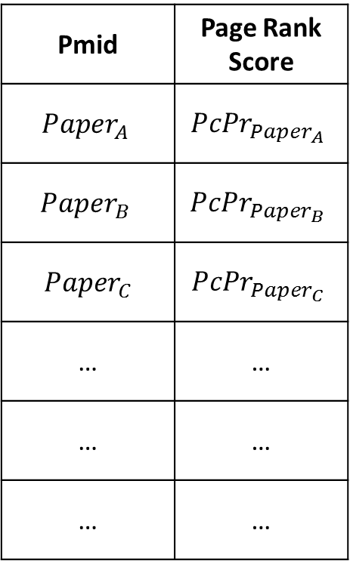






Quality of Paper
Pmid | Page Rank Score
$$Paper_{A}$$ | $$PcPr_{Paper_{A}}$$
$$Paper_{B}$$ | $$PcPr_{Paper_{B}}$$
$$Paper_{C}$$ | $$PcPr_{Paper_{C}}$$
… | …
… | …
… | …
Page rank of paper citation graph
$$Paper_{A}$$
$$Paper_{B}$$
$$Paper_{C}$$
$$Paper_{D}$$
$$Paper_{M}$$
$$Paper_{E}$$

Slide 18



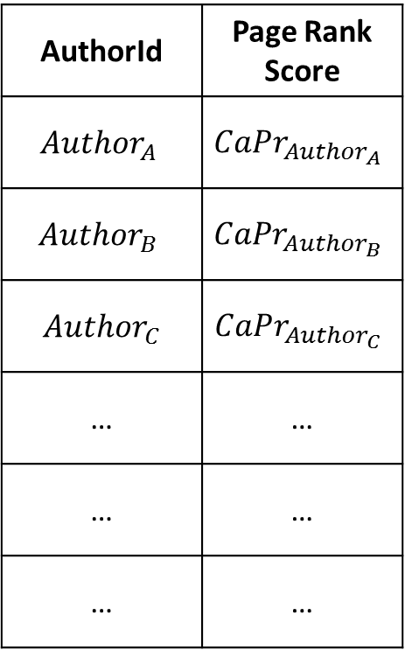





Fame of Author (1)
AuthorId | Page Rank Score
$$Author_{A}$$ | $$CaPr_{Author_{A}}$$
$$Author_{B}$$ | $$CaPr_{Author_{B}}$$
$$Author_{C}$$ | $$CaPr_{Author_{C}}$$
… | …
… | …
… | …
Page rank of co-author graph
$$Author_{A}$$
$$Author_{B}$$
10
3
$$Author_{D}$$
2
30
5
$$Author_{C}$$
15
$$Author_{E}$$
20
2
$$Author_{D}$$
50
$$Author_{F}$$
$$Author_{G}$$

Slide 19
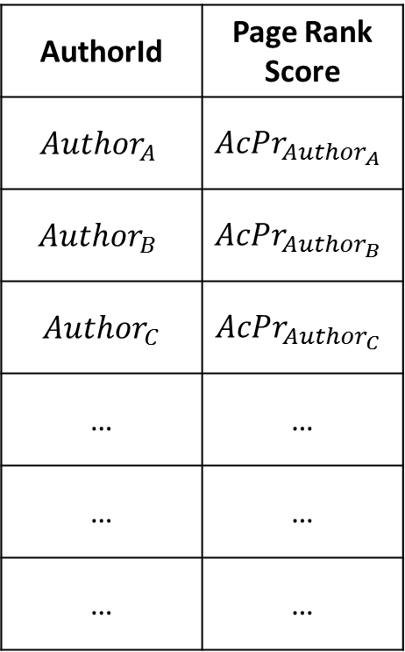
Fame of Author (2)
AuthorId | Page Rank Score
$$Author_{A}$$ | $$AcPr_{Author_{A}}$$
$$Author_{B}$$ | $$AcPr_{Author_{B}}$$
$$Author_{C}$$ | $$AcPr_{Author_{C}}$$
… | …
… | …
… | …
Page rank of author citation graph
$$Author_{A}$$
$$Author_{B}$$
10
3
$$Author_{D}$$
2
30
$$Author_{C}$$
15
$$Author_{E}$$
20
5
2
$$Author_{D}$$
50
$$Author_{F}$$
$$Author_{G}$$

Slide 20
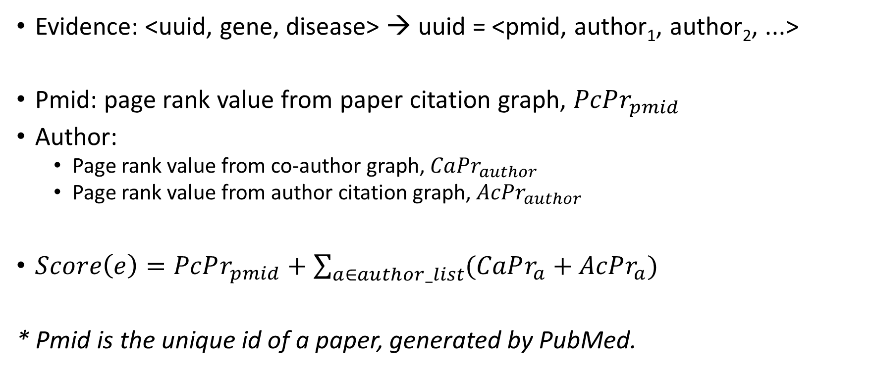
Score of an Evidence
Evidence: <uuid, gene, disease> → uuid = <pmid, author₁, author₂, ...>
Pmid: page rank value from paper citation graph, $PcPr_{pmid}$
Author:
Page rank value from co-author graph, $CaPr_{author}$
Page rank value from author citation graph, $AcPr_{author}$
$Score\left(e\right)=PcPr_{pmid}+\sum_{a∈author_list}{(CaPr_{a}+AcPr_{a})}$
* Pmid is the unique id of a paper, generated by PubMed.

Slide 21

Score of Evidence List
Given a tuple <disease, gene>, the evidence list is $E=[e_{1}, e_{2}, e_{3}, …]$
Define score of evidence list as: $S\left(E\right)=\sum_{e∈E}{Score(e)}$

Slide 22



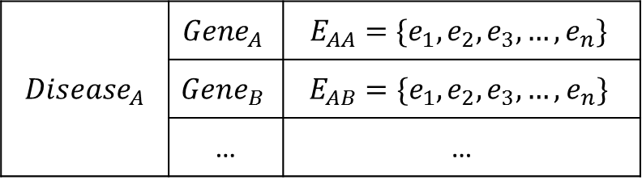









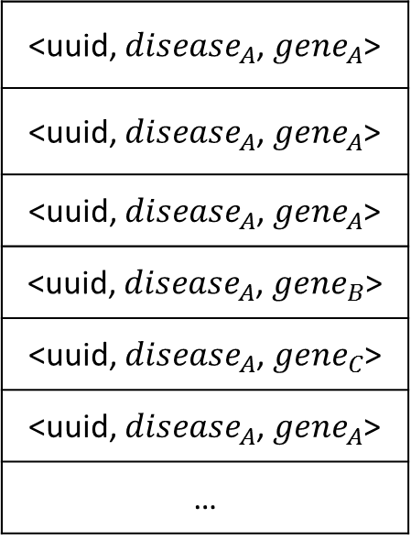


Score of Evidence List (Graphical)
$$PcPr_{pmid_{1}}$$
$$AcPr_{author_{1}}$$
$$pmid_{1}$$
$$author_{1}$$
$$CaPr_{author_{1}}$$
Evidences related to $Disease_{A}$
$$Σ→Score(e_{1})$$
$$author_{2}$$
$$AcPr_{author_{2}}$$
$$CaPr_{author_{2}}$$
$$author_{3}$$
<uuid, $disease_{A}$, $gene_{A}$>
<uuid, $disease_{A}$, $gene_{A}$>
<uuid, $disease_{A}$, $gene_{A}$>
<uuid, $disease_{A}$, $gene_{B}$>
<uuid, $disease_{A}$, $gene_{C}$>
<uuid, $disease_{A}$, $gene_{A}$>
…
$$AcPr_{author_{3}}$$
$$Disease_{A}$$ | $$Gene_{A}$$ | $$E_{AA}=\{e_{1},e_{2},e_{3},…,e_{n}\}$$
 | $$Gene_{B}$$ | $$E_{AB}=\{e_{1},e_{2},e_{3},…,e_{n}\}$$
 | … | …
$$CaPr_{author_{3}}$$
reduce
Formula
For $Disease_{A}$ and $Gene_{A}$:
$$S(E_{AA})=\sum_{e_{i}∈E_{AA}}{Score(e_{i})}$$
Notes:
A bunch of evidence

Slide 23
Ranking Algorithm
Rank via Score of the evidence list
Score of the evidence list = sum of the score of each evidence
Question: are all these evidence equal and independent?

Slide 24
Algorithm 3 – Publication Type
Import weight for publication type

Slide 25

Re-analyze Algorithm 2
In algorithm 2: $S(E_{AA})=\sum_{e_{i}∈E_{AA}}{Score(e_{i})}$
In this formula, it treats all evidence as equal evidence. Is that true?

Slide 26
Evidence Equality
In certain scenario, evidence are NOT equal.
Publication Types:
Clinical Trials
Vivo Test
Vitro Test
Others
Facing practical problem, you may want to assign different weight to different publication types.

Slide 27

Modified Score Formula
Formula: $S(E_{AA})=\sum_{e_{i}∈E_{AA}}{w\left(e_{i}\right)×Score(e_{i})}$
Function $w$ will assign a weight according to the publication type of $e_{i}$

Slide 28
Type Recognition (Weak Point)
Clinical Trial(%):
Can be recognized via PubMed element.
The other three (Vivo Test, Vitro Test, Others) cannot be recognized easily.
Possible method: keyword-based method

Slide 29
Algorithm 4 – Evidence Relation
(TODO) Import the relation among evidence to adjust score

Slide 30
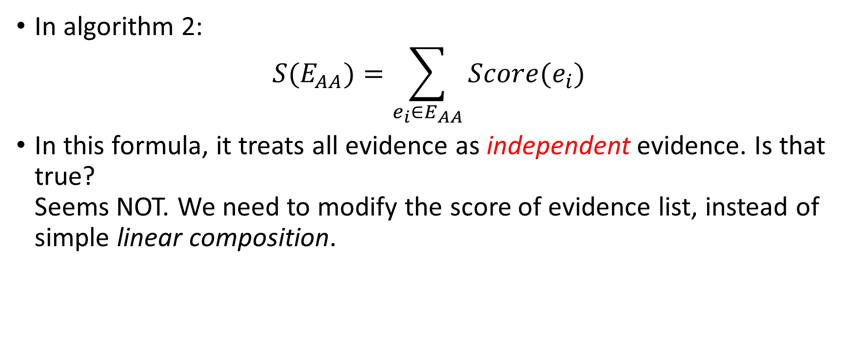
Re-analyze Algorithm 2
In algorithm 2: $S(E_{AA})=\sum_{e_{i}∈E_{AA}}{Score(e_{i})}$
In this formula, it treats all evidence as independent evidence. Is that true? Seems NOT. We need to modify the score of evidence list, instead of simple linear composition.

Slide 31
Evidence Repetition by same Author
Description: one author keeps saying the same tuple <disease, gene>
Modification: the evidence from this author should be grouped and the paper citing page rank of these evidence may be suppressed.

Slide 32
Strong Group of Authors
Description: a group of authors always appear together.
Modification: in one paper, such authors should be grouped and their co-author page rank may be suppressed.

Slide 33
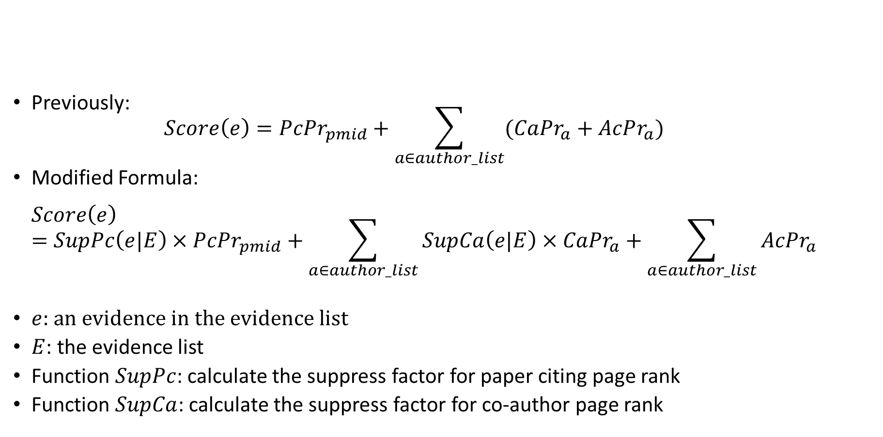
Modification of Evidence Score
Previously: $Score\left(e\right)=PcPr_{pmid}+\sum_{a∈author_list}{(CaPr_{a}+AcPr_{a})}$
Modified Formula: $Score\left(e\right)=SupPc\left(e|E\right)×PcPr_{pmid}+\sum_{a∈author_list}{SupCa\left(e|E\right)×CaPr_{a}}+\sum_{a∈author_list}{AcPr_{a}}$
$e$: an evidence in the evidence list
$E$: the evidence list
Function $SupPc$: calculate the suppress factor for paper citing page rank
Function $SupCa$: calculate the suppress factor for co-author page rank

Slide 34
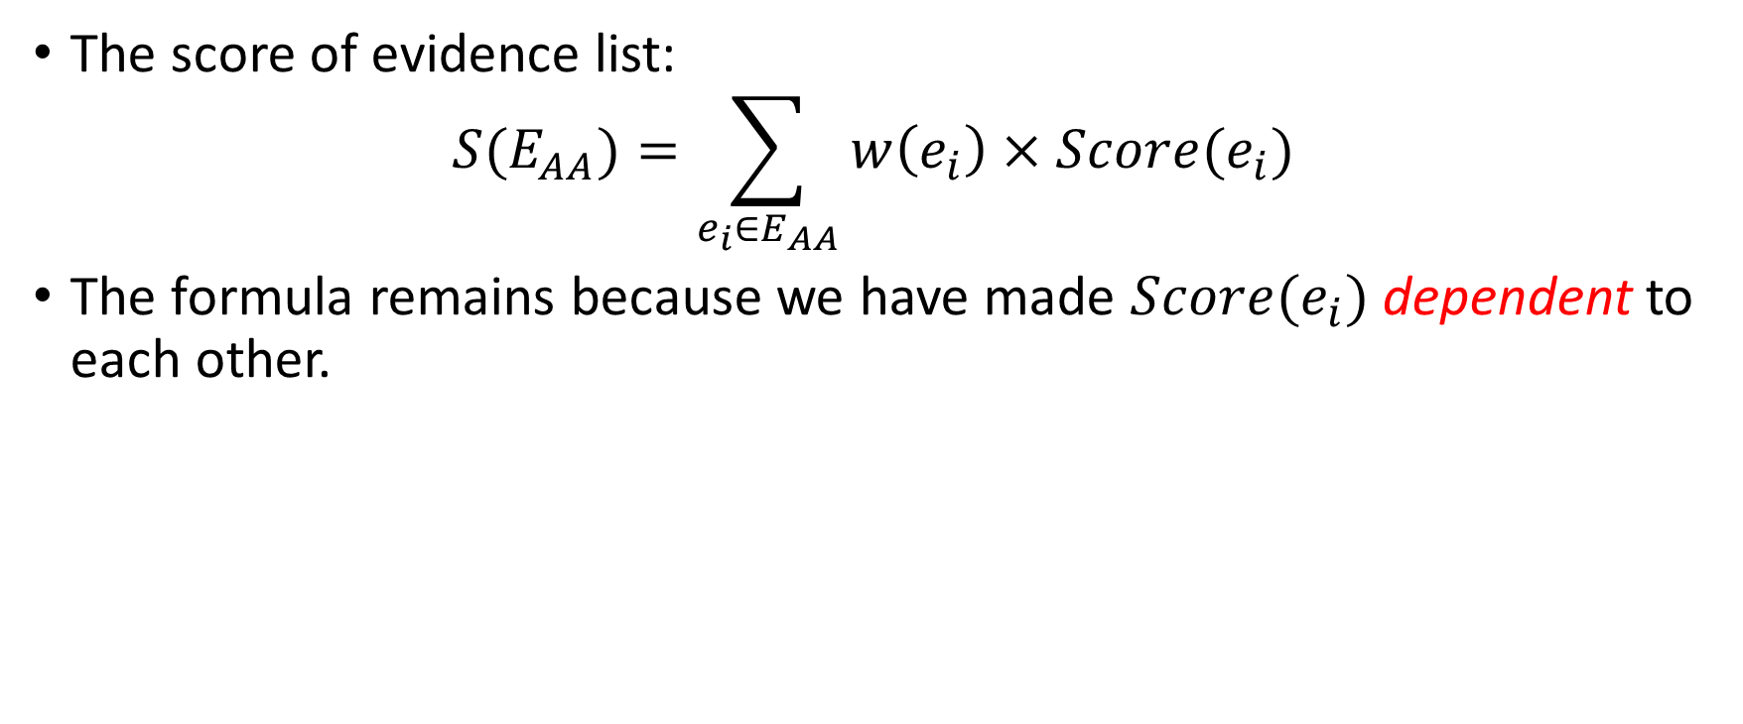
Score of Evidence List
The score of evidence list: $S(E_{AA})=\sum_{e_{i}∈E_{AA}}{w\left(e_{i}\right)×Score(e_{i})}$
The formula remains because we have made $Score(e_{i})$ dependent to each other.

Slide 35
Algorithm 5 – Rank Aggregation

Slide 36
Intuition
Consider Paper Citation graph and Co-author graph separately.
Combine the two rank list together

Slide 37
Evaluation(1)
Disease |  | Total Number Of Genes in Ground True | Top10 | Top20 | Top50 | Top100
Acute Kidney Injury | Paper Citation | 61 | 4 | 7 | 8 | 12
 | Co-author | 61 | 2 | 2 | 7 | 8
 | Combine | 61 | 3 | 7 | 8 | 12
Cardiovascular Diseases | Paper Citation | 41 | 2 | 2 | 5 | 12
 | Co-author | 41 | 2 | 2 | 6 | 11
 | Combine | 41 | 2 | 2 | 5 | 12
Kidney Failure, Chronic | Paper Citation | 43 | 1 | 2 | 6 | 11
 | Co-author | 43 | 1 | 1 | 6 | 8
 | Combine | 43 | 1 | 2 | 6 | 8
Kidney Neoplasms | Paper Citation | 20 | 1 | 1 | 2 | 5
 | Co-author | 20 | 0 | 0 | 3 | 4
 | Combine | 20 | 1 | 1 | 2 | 5

Slide 38
Evaluation(2)
Disease |  | Total Number Of Genes in Ground True | Top10 | Top20 | Top50 | Top100
Lung Carcinoma | Paper Citation | 180 | 2 | 3 | 5 | 12
 | Co-author | 180 | 3 | 3 | 5 | 13
 | Combine | 180 | 2 | 3 | 5 | 12

Slide 39
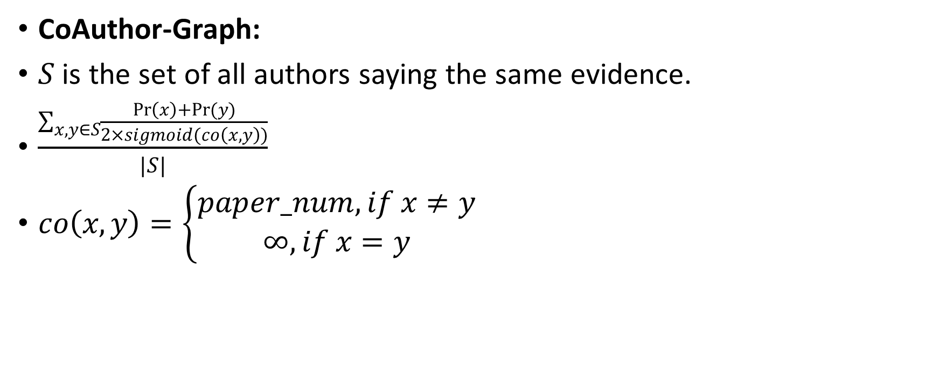
CoAuthor-Graph:
$S$ is the set of all authors saying the same evidence.
$\frac{\sum_{x,y∈S}{\frac{\operatorname{Pr}\left(x\right)+Pr(y)}{2×sigmoid(co\left(x,y\right))}}}{|S|}$
$co\left(x,y\right)=\left\{\begin{aligned}paper_num, if x≠y \\ ∞,if x=y\end{aligned}\right.$

Slide 40

Paper Citing Graph:
$\frac{\sum_{x,y∈S}{\frac{α×\operatorname{Pr}\left(x\right)+β×Pr(y)}{α}}}{|S|}, if\left\{\begin{aligned}x→y, then α=0.5, β=1 \\ y→x,then α=1, β=0.5\end{aligned}\right.$

Slide 41
That’s All!
Thanks!

