Slide 1
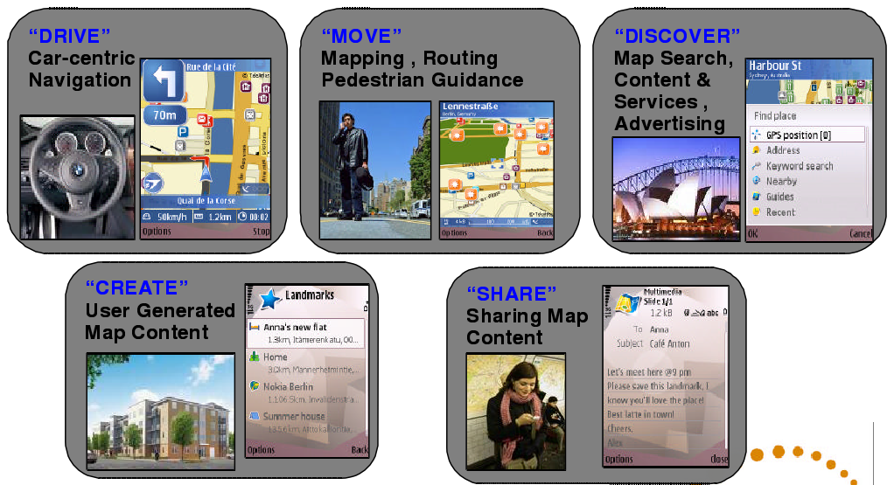
LOCATION-BASED SERVICE
From http://en.wikipedia.org

Slide 2

Outlines
Introduction
Basic Components of LBS
Services It Provides
Applications
How Does It Work

Slide 3
Introduction
Several definitions of location-based service:
  LBS is an information service accessible with mobile devices through the mobile network and utilizing the ability to make use of the location of the mobile device.
  LBS is a wireless-IP service that uses geographic information to serve a mobile user. Any application Service that exploits the position of a mobile terminal.

Slide 4
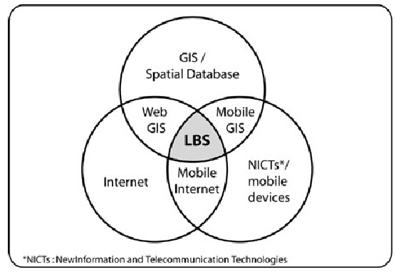
Introduction
LBS as an intersection of three technologies:
    Figure 1

Slide 5
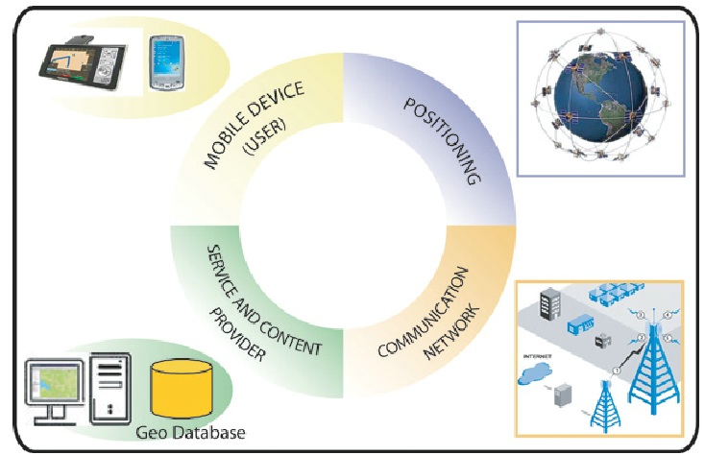
Basic Components of LBS
User, Communication Network, Positioning, Service Provider and Content Provider.
      Figure 2

Slide 6
Services It provides
Services :
  Push
    Mobile commerce, etc.
  Pull
    To identify a location of a person or object;
    and even location-based games, etc.
  hybrid
    Parcel tracking and vehicle tracking;
    Personalized weather services , etc.

Slide 7
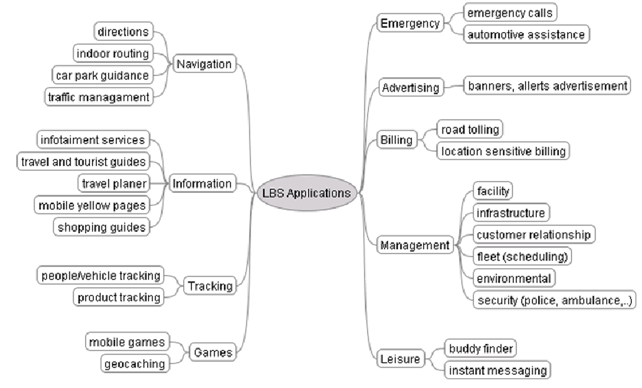
Applications——categories

Slide 8
Applications——examples
(Details to supplement)

Slide 9
How does it work?
Mobile positioning
Services request processing (details to supplement)
Mobile devices (details to supplement)
Mobile networks (details to supplement)
Architectural requirements (details to supplement)
Service types–OpenLS (details to supplement)
Data provider (details to supplement)

Slide 10
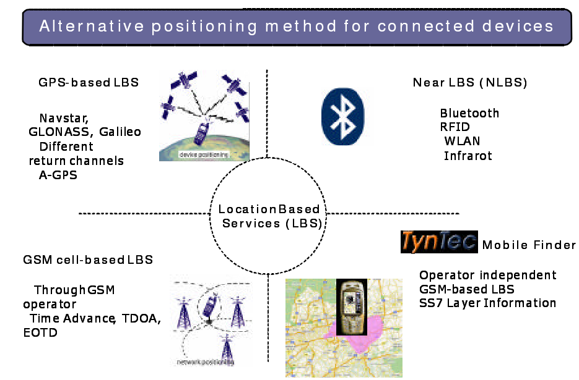
Locating Methods

Slide 11
Locating Methods
Methods:
  Control Plane Locating
    Gets the location based on the radio signal delay of the closest cell-phone towers;
    Gets the location based on GPS or A-GPS.
  GSM Locating
    Finding the location of a mobile device in relation to its cell site, Which based on multilateration.
  Others
    Near LBS, such as using Bluetooth, WLAN, infrared, etc.,
    Operator independent location service, which based on access into the deep level telecoms network;
    Local Positioning Systems, especially for indoor use.

Slide 12
Locating Methods
GPS. (Details to supplement)

Slide 13
Locating Methods
A-GPS (Details to supplement)

Slide 14
Locating Methods
Multilateration (Details to supplement)

Slide 15
Other parts
(details to supplement)

Slide 16
Thanks

