Slide 1
Labeling Document with Timestamps: Learning from their Time Expressions
Author: Nathanael Chambers
Presenter: Sun Wei
Publish: Proceedings of the 50th Annual Meeting of the Association for Computational Linguistics

Slide 2
Roadmap
Introduction
Background
Previous Work
Content
General Idea
Timestamp Classifier
Models with Time Expressions
Feature-based Method
Learning Time Constraints
Experiment Result

Slide 3
Roadmap
Introduction
Background
Previous Work
Content
General Idea
Timestamp Classifier
Models with Time Expressions
Feature-based Method
Learning Time Constraints
Experiment Result

Slide 4
Background
Relatively New Task in NLP Community:
Automatic Document Dating
The temporal reasoning community has long depended on document timestamps to ground relative time expressions and events.
Useful in information retrieval (IR) and management communities

Slide 5
Previous Work
Unigram language models for specific time and scored articles with log-likelihood ratio score (like topic classification)
NLP Community: bag-of-word approaches to classification (similar to the above)
Find a match from training doc for a test doc and assign its timestamp.

Slide 6
Roadmap
Introduction
Background
Previous Work
Content
General Idea
Timestamp Classifier
Models with Time Expressions
Feature-based Method
Learning Time Constraints
Experiment Result

Slide 7
General Idea
Timestamp Classifier
Normalized log-likelihood ratio (Topic-classification-like)
Discriminative Model (Topic-classification-like)
Models with Time Expression
Learning Time Constraints
Constraint Types
Constraint Learner
Joint Classifier

Slide 8
Roadmap
Introduction
Background
Previous Work
Content
General Idea
Timestamp Classifier
Models with Time Expressions
Feature-based Method
Learning Time Constraints
Experiment Result

Slide 9
Timestamp Classifier (1)
Previous Method: normalized log-likelihood ratio(NLLR)
Require: a language model for each year & entire corpus LM weights tokens by the ratio of their probability in a specific year to their probability over the entire corpus.

Slide 10
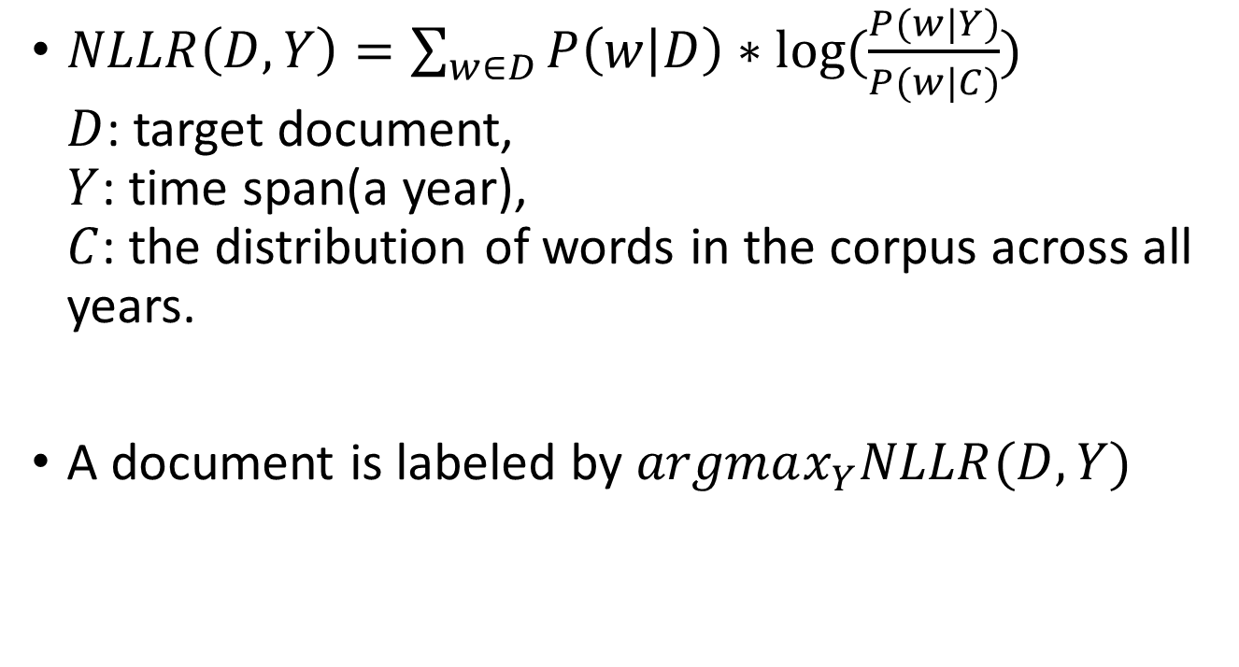
Timestamp Classifier (2)
$NLLR\left(D,Y\right)=\sum_{w∈D}{P\left(w | D\right)∗log(\frac{P(w|Y)}{P(w|C)})}$ $D$: target document, $Y$: time span(a year), $C$: the distribution of words in the corpus across all years.
A document is labeled by $argmax_{Y}NLLR(D, Y)$

Slide 11
Timestamp Classifier (3)
Filtering Techniques:
Word Classes: include only nouns, verbs, and adjectives as labeled by a POS tagger.
TF-IDF filter: include only the top-ranked items by tf-idf score
Discriminative Models
Max Entropy Model
Result:
MaxEnt model vastly outperforms these NLLR models
Notes:
It is easy to imagine the reason of better performance. The new model also includes new features.

Slide 12
Roadmap
Introduction
Background
Previous Work
Content
General Idea
Timestamp Classifier
Models with Time Expressions
Feature-based Method
Learning Time Constraints
Experiment Result

Slide 13
Motivation
Their tickets will entitle them to a preview of…the new Hayden Planetarium, which does not officially open until Feb. 2000.
Timestamp: before, Feb. 2000
Function: eliminate all years after 2000, which is not integrated from previous model
Notes:
“Present Tense” & “until” indicates that the article is written before 2000.

Slide 14
Two Ways to Learn & Reason about this information
Feature-based Method: add richer time-based features
Separate Learner: build separate learners that can assign probabilities to entire ranges of dates.

Slide 15
Roadmap
Introduction
Background
Previous Work
Content
General Idea
Timestamp Classifier
Models with Time Expressions
Feature-based Method
Learning Time Constraints
Experiment Result

Slide 16
Time Feature (1)
Typed Dependency:
Governors of year mentions and the relation between them.
Example: Torre, who watched the Kansas City Royals beat the Yankees, 13-6, on Friday for the first time since 1997.
The Resulting Feature: “since pobj 1997”

Slide 17
Time Feature (2)
Typed Dependency POS
The Resulting Feature: “PP pobj 1997”

Slide 18
Time Feature (3)
Verb Tense
Using VB* tag
Value: past, present, future, undetermined.

Slide 19
Time Feature (4)
Verb Path
Dependency path from the nearest verb to the year expression.
Example: “expected prep in pobj 2002”

Slide 20
Time Feature (5)
Named Entity (Person, Organization, Location)
People and places are often discussed during specific time periods, particularly in news genre.

Slide 21
Roadmap
Introduction
Background
Previous Work
Content
General Idea
Timestamp Classifier
Models with Time Expressions
Feature-based Method
Learning Time Constraints
Experiment Result

Slide 22
Goal & Difference
Goal: automatically learn temporal constraints on the document’s timestamps.
Difference from feature-based method: predicts a range of year instead of a single year.

Slide 23
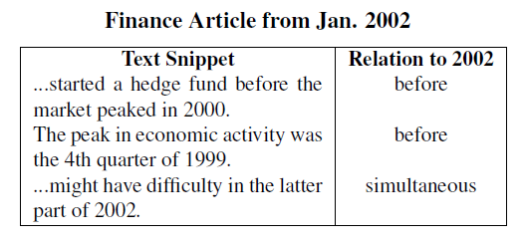
Example & Motivation
Year Mention: “not since 2009”
Inference: the mentioned year 2009 must occur before the year of doc creation.

Slide 24
Learning Time Constraints (1)
Types: before, after, same
Constraint Learner
Model: A Max Entropy Classifier
Features: Typed Dep., Verb Tense, Verb Path, Decade, Bag of Words, n-gram, n-gram POS
To be continued…

Slide 25
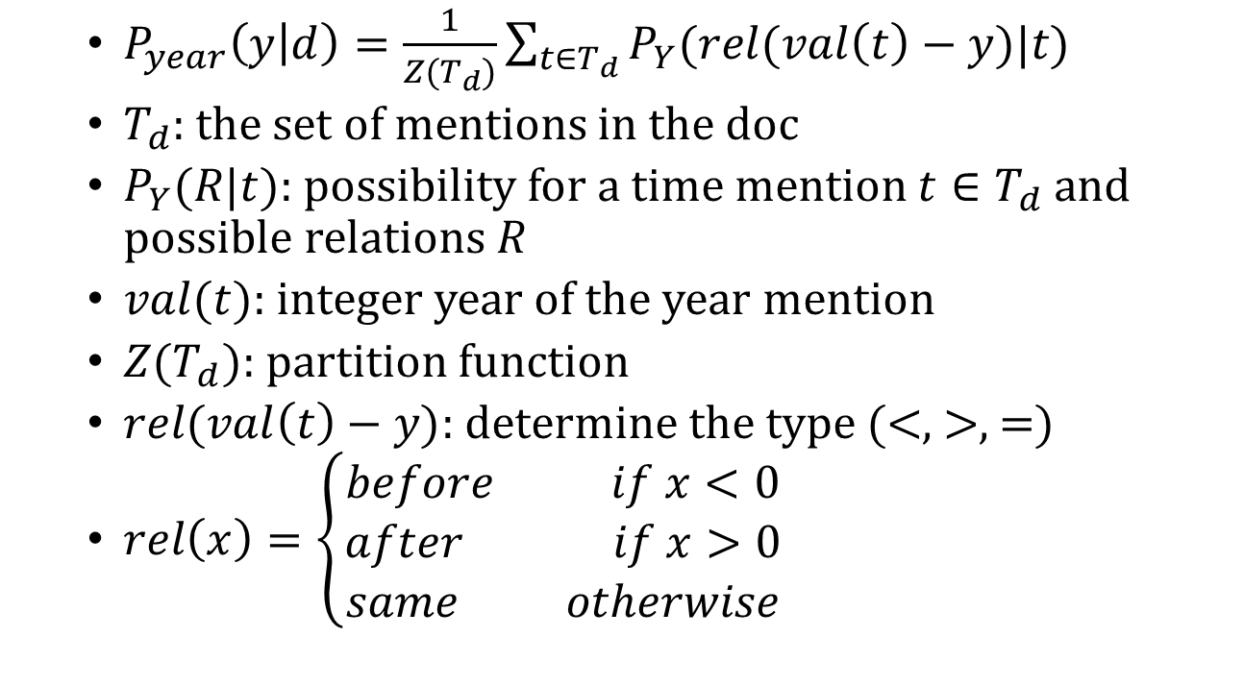
Learning Time Constraints (2)
$P_{year}\left(y | d\right)=\frac{1}{Z(T_{d})}\sum_{t∈T_{d}}{P_{Y}(rel(val\left(t\right)−y)|t)}$
$T_{d}$: the set of mentions in the doc
$P_{Y}(R|t)$: possibility for a time mention $t∈T_{d}$ and possible relations $R$
$val(t)$: integer year of the year mention
$Z(T_{d})$: partition function
$rel(val\left(t\right)−y)$: determine the type (<, >, =)
$rel\left(x\right)=\left\{\begin{aligned}before if x<0 \\ after if x>0 \\ same otherwise\end{aligned}\right.$

Slide 26
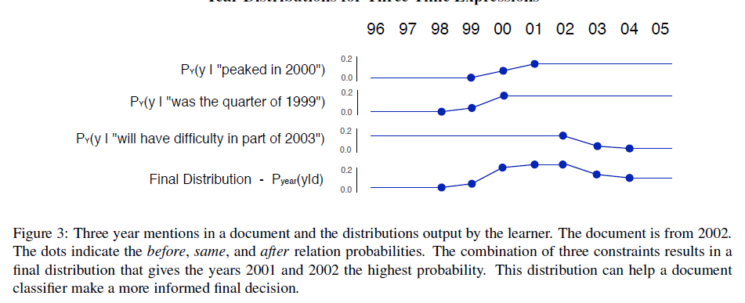

Learning Time Constraints (3)

Slide 27
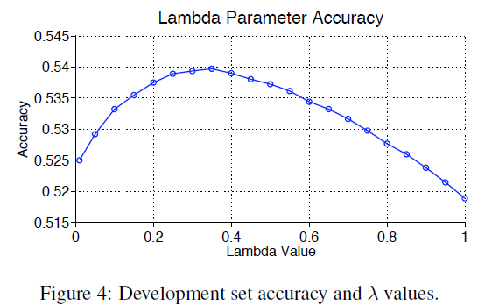

Learning Time Constraints (4)
Joint Classifier $P\left(y | d\right)=λP_{doc}\left(y | d\right)+\left(1−λ\right)P_{year}(y|d)$

Slide 28
Roadmap
Introduction
Background
Previous Work
Content
General Idea
Timestamp Classifier
Models with Time Expressions
Feature-based Method
Learning Time Constraints
Experiment Result

Slide 29
Datasets
The New York Times section of the Gigaword Corpus

Slide 30
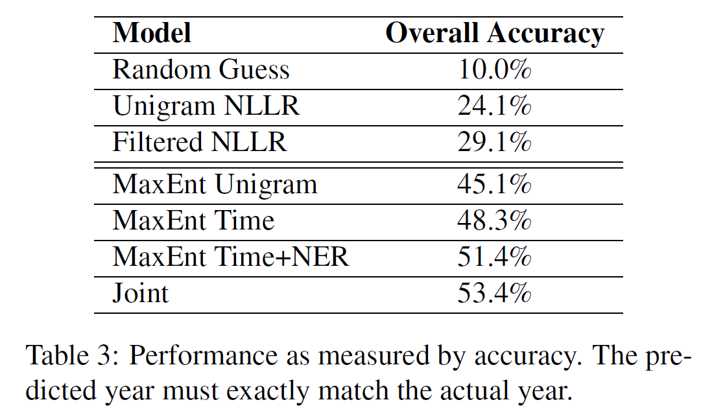
Accuracy of Mentioned Method

Slide 31
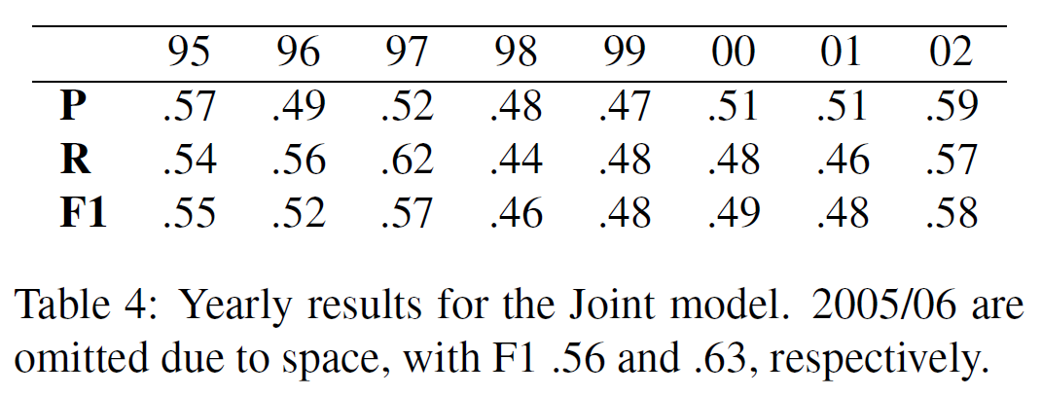
Yearly Result for Joint Model

Slide 32
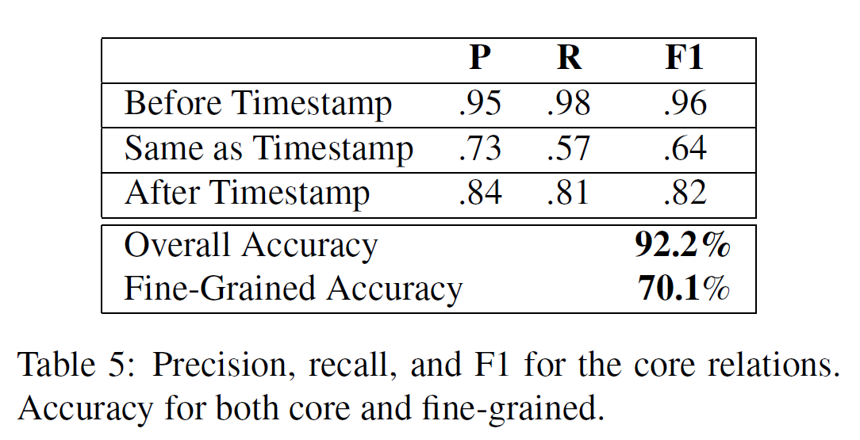
Accuracy of Core Relation

Slide 33
Summary
Main Contribution
Discriminative model – 54% improvements (Max Entropy Model)
A new set of features for document dating – 14% improvements
Weakness
Precision is still not that high.

Slide 34
Thank!

Slide 35
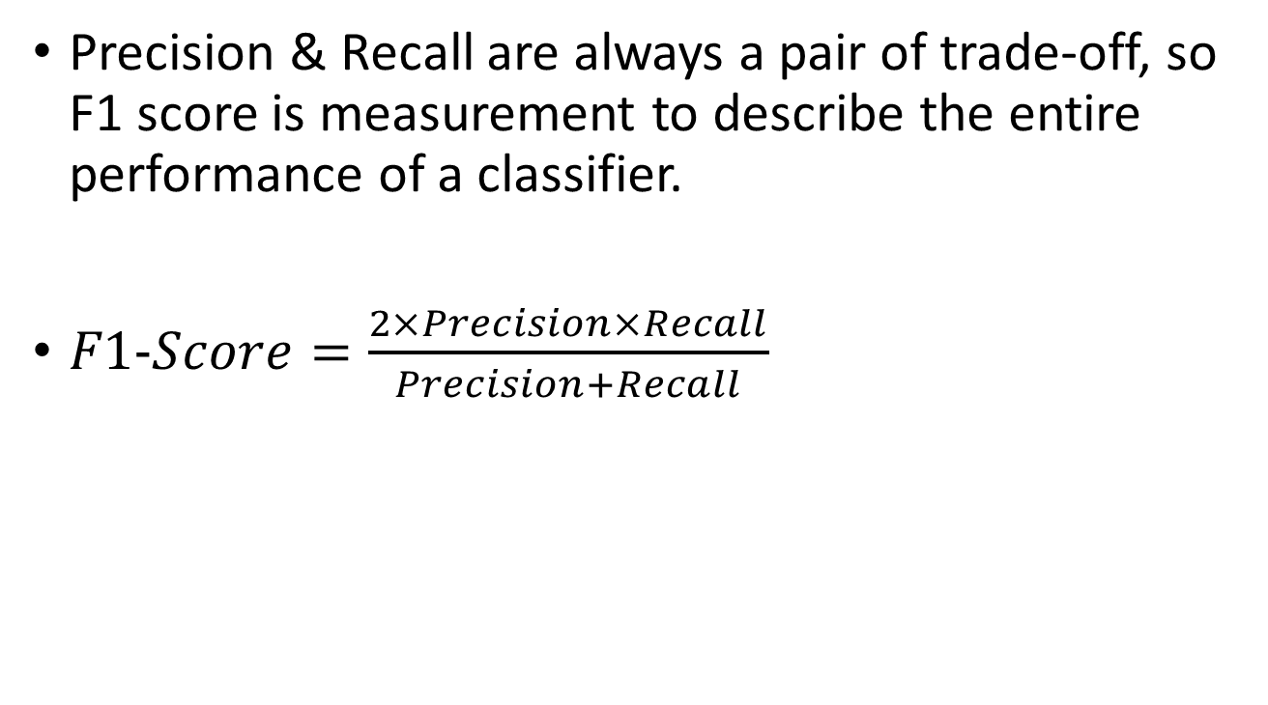
F1 Score
Precision & Recall are always a pair of trade-off, so F1 score is measurement to describe the entire performance of a classifier.
$F1−Score=\frac{2×Precision×Recall}{Precision+Recall}$

