Slide 1
WhereStore: Location-based Data Storage for Mobile Devices Interacting with the Cloud
Patrick Stuedi, Iqbal Mohomed, Doug Terry
Microsoft Research
MCS’10
Notes:
Mobile Cloud Computing & Services

Slide 2
Contents
1/16
Motivation
WhereStore: Key Idea and Challenges
Feasibility Study
System Architecture
Conclusion

Slide 3
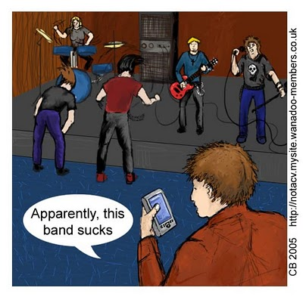
Smartphones are ubiquitous
Motivation
2/16
17% market share
225’000 applications on AppStore with over 5 billion downloads
Notes:
[juˈbɪkwɪtəs]
1. <正>普遍存在的;似乎无处不在的；十分普遍的

Slide 4



Mobile/Cloud applications
Motivation
3/16
Applications use cloud for storage and computation
Problems:
  High network latency
  Temporary network disconnections
Possible Solution: Caching
  What data should we cache?
computing
data sharing
storage
queries
3G/Wifi

Slide 5
Location-based application usage
Motivation
4/16
Finding: applications and application data are used in a location-based manner [Measuring serendipity: connecting people, locations and interests in a mobile 3G network, IMC’09]
Examples:
Browsing the web for ingredients needed for a given recipe
  Useful in a grocery shop after work
  Not useful when at work
Schedule for the work day
  Useful while on the way to work
  Not useful when driving home after work
Traffic news
  Good know about traffic in certain regions before a user gets there
  Useless once a user is in traffic
Notes:
Serendipity [ˌsɛrənˈdɪpɪti]
1. 意外发现珍奇事物的才能; 意外新发现2. 巧事；机缘凑巧3. 缘分天注定

Slide 6
WhereStore: Key Idea and Challenges
5/16
Key idea:
  Use a user’s location history to determine his future locations
  Pre-fetch and cache data for future locations of the user
Challenges
  Predicting future locations
  When to cache?
Opportunities
  Use storage space of phone efficiently

Slide 7
Feasibility Study
6/16
How much data for a certain geographical region do some of today’s web applications store?
If we cache content, how fast will it be outdated?
Experiments with popular web applications: YouTube, Flickr

Slide 8
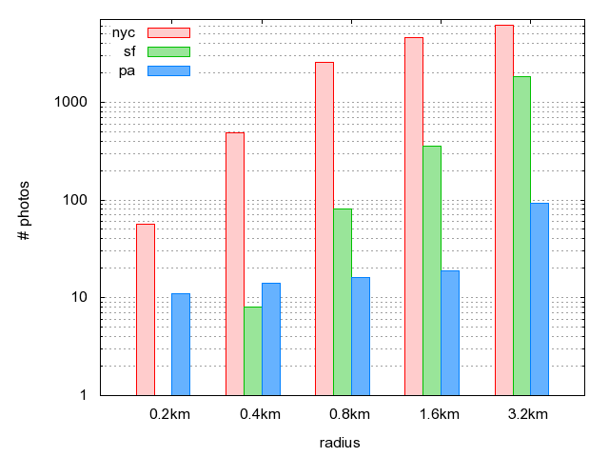
Flickr: photos for a region of size x
Study
7/16
Notes:
New York City: Manhattan
San Francisco
Palo Alto
Note that the vertical axis on the graphs is log-scale
the results shown in these queries are for a specific query (“travel“)
difficult for an application to cache query results for a large geographic region
an application might feasibly cache only those results for places a user is likely to visit
Multiple queries…
a circle of radius 3.2km at the center of the city yielded 6127 photographs and 516 videos matching our query
for smaller regions, the amount of data returned from queries tagged with geographic locations is much smaller, and can conceivably be cached on a smartphone (57 photographs on Flickr and 49 videos on YouTube in the case of Manhattan).

Slide 9
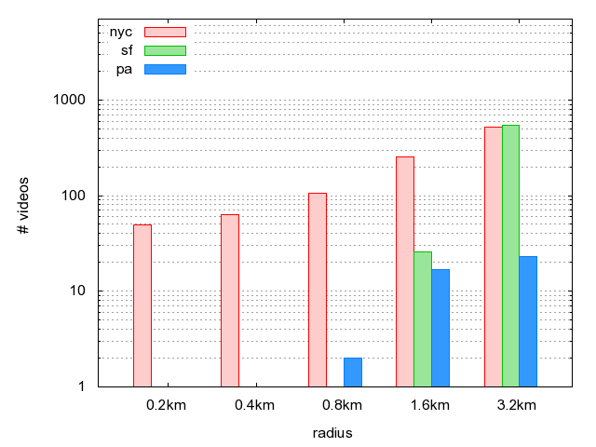
Youtube: videos for a region of size x
Study
8/16

Slide 10
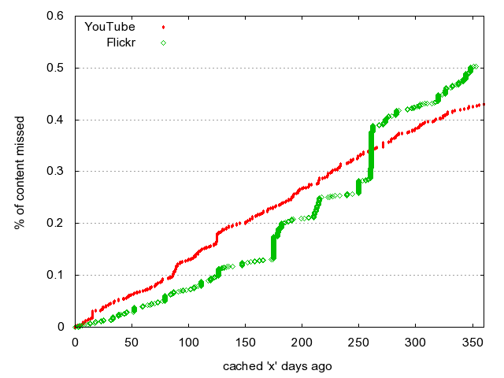
Staleness of data
Study
9/16
Notes:
query term is “travel” and the geographic region used is a circle of radius 300 meters at the center of Manhattan
the percentage of results missing from a cache constructed some number of days in the past
This suggests that results cached during an infrequent synchronization operation
(syncing to a PC once in a while), can remain useful for a significant time duration.
How to sync? This is the feasibility study…

Slide 11
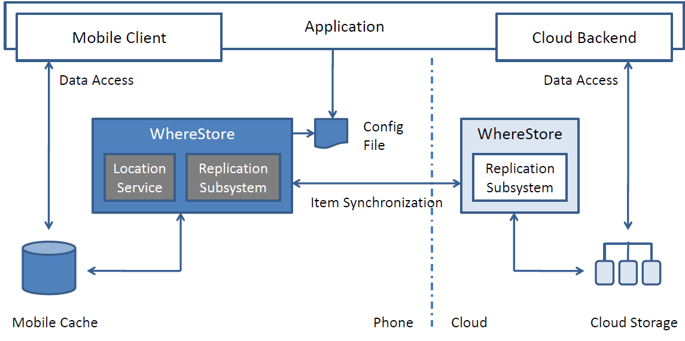
System Architecture
10/16
Notes:
A significant opportunity for caching and prefetching content

Slide 12
Cimbiosys
System Architecture
11/16
Cimbiosys: A platform for content-based partial replication, NSDI’09
Portable devices have limited resources for storage and bandwidth
It’s essential to take advantage of proximity and selected replication of content
It permits each device to define its own content-based filtering criteria and to share updates with any other device.
Filtered Replication: A filter is a predicate over the metadata of the items in the collection.
  For instance, a filter can select all JPEG pictures, or all pictures whose geo-tag is inside a certain geographical region.
Notes:
[prɔkˈsimiti]
n.1. 接近, 附近

Slide 13
Synchronizing with the cloud using Cimbiosys
System Architecture
12/16
groups.include(“new york”) AND groups.include(“reviews”)
groups : set<string>
priority: int
Filter
new york
Partial Replication
Platform
Synchronization
Partial Replication
Platform
reviews
Data
Data
Phone
Cloud

Slide 14
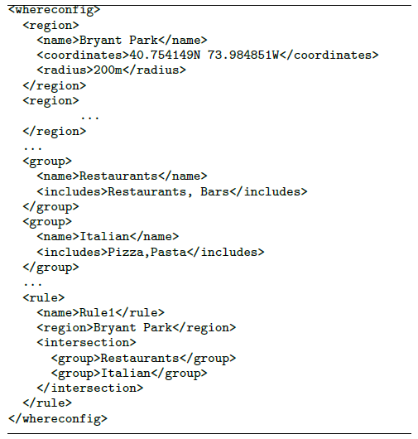
How WhereStore creates the filter
System Architecture
13/16
Location Prediction
Config
File
Filter

Slide 15

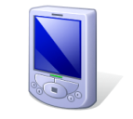
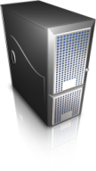
StarTrack
System Architecture
14/16
StarTrack: A Framework for Enabling Track-Based Applications, MobiSys’09
StarTrack Next Generation: A Scalable Infrastructure for Track-Based Applications, OSDI’10
StarTrack:
  Framework and infrastructure for managing user’s track data
  Track: Time-ordered sequence of location readings
StarTrack API:
  Operations on tracks: store, manipulate, compare, query, …
Application
API
StarTrack Server
StarTrack Client
Location Manager
Track Database

Slide 16
Location Prediction
System Architecture
15/16
WhereStore uses the location data to produce a transition graph
  Nodes in the graph are frequent places the user has visited
  Edges between nodes are weighted depending on the frequency of trips between a start and an endpoint
For any current location, the predicted future location is given by the transition graph
shopping
home
gym
work
bar

Slide 17
Conclusion
16/16
WhereStore: Location-based cache for mobile applications interacting with the cloud
  Pre-fetch and cache data for future locations of the user
System built on top of Cimbiosys (partial replication platform) and StarTrack (location track management)

