Slide 1
Probabilistic Knowledge Management on the Web
Haixun Wang
MSRA DB Group

Slide 2
Background
Dream of the Semantic Web: develop one ontology in one language covering everything that exists …
Reality: there are several ontologies in several languages covering partly overlapping subdomains; bits and pieces of facts and human knowledge scattered on the web
Problems: integration (structural heterogeneity, semantic heterogeneity, inconsistency and redundancy)

Slide 3
Three Demos
ProBase Browser http://msradb002/TaxonomyBrowser/
ProBase Web Table http://msradb010/WikiStatement
ProBase for Search http://msradb003/Search

Slide 4
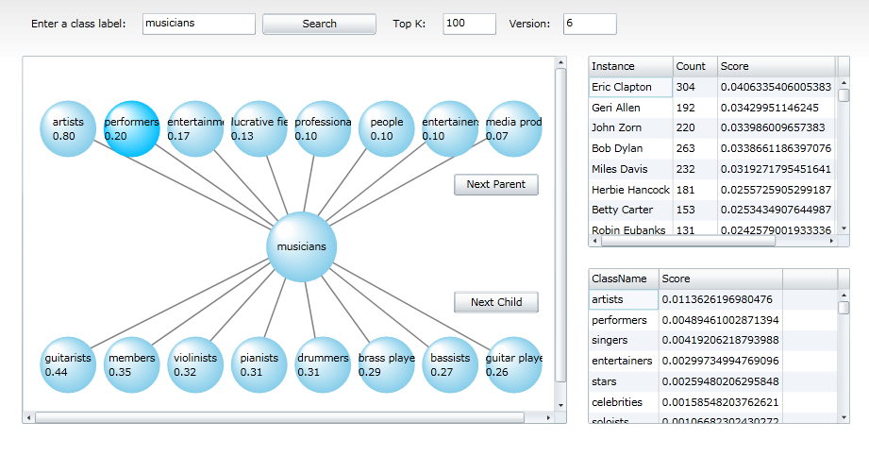

Slide 5
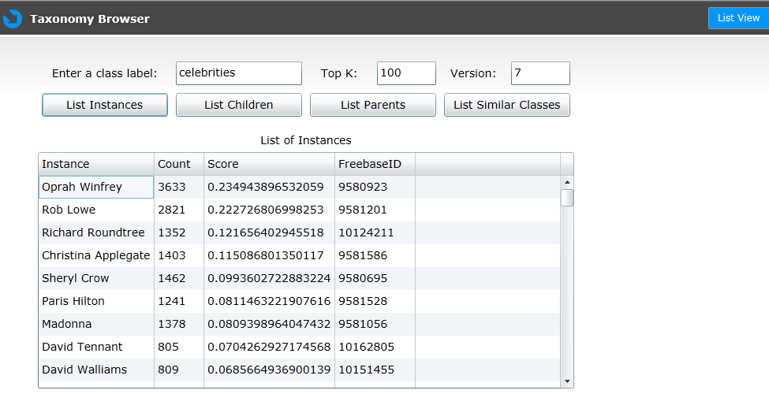

Slide 6
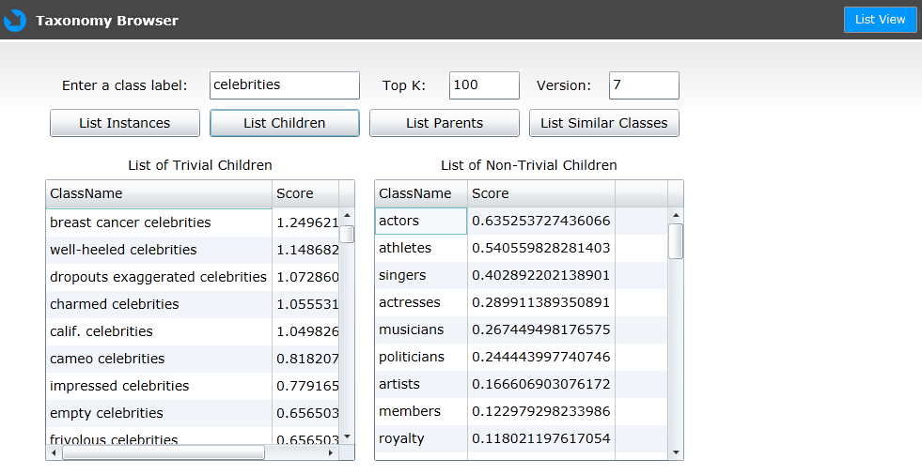

Slide 7
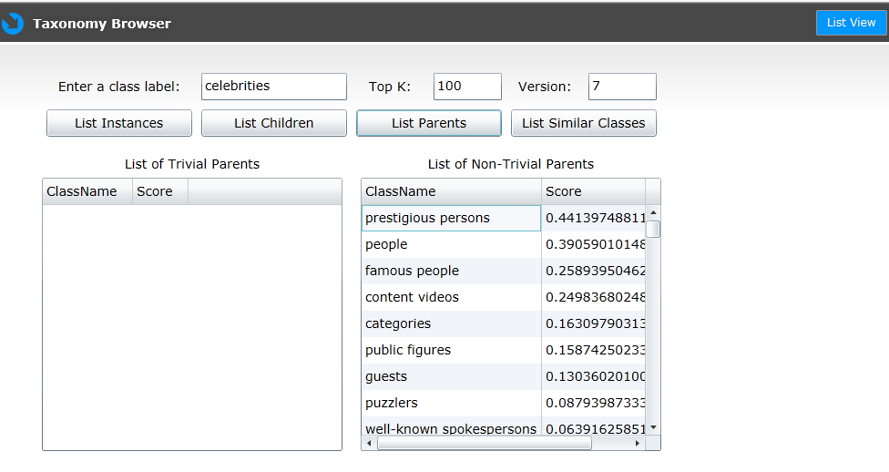

Slide 8
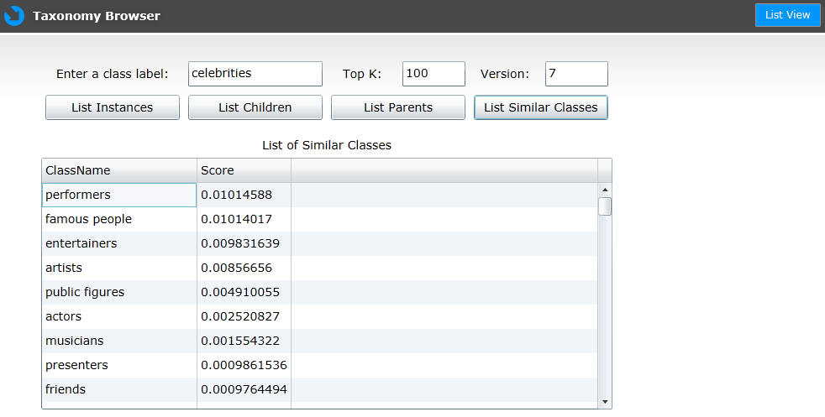

Slide 9
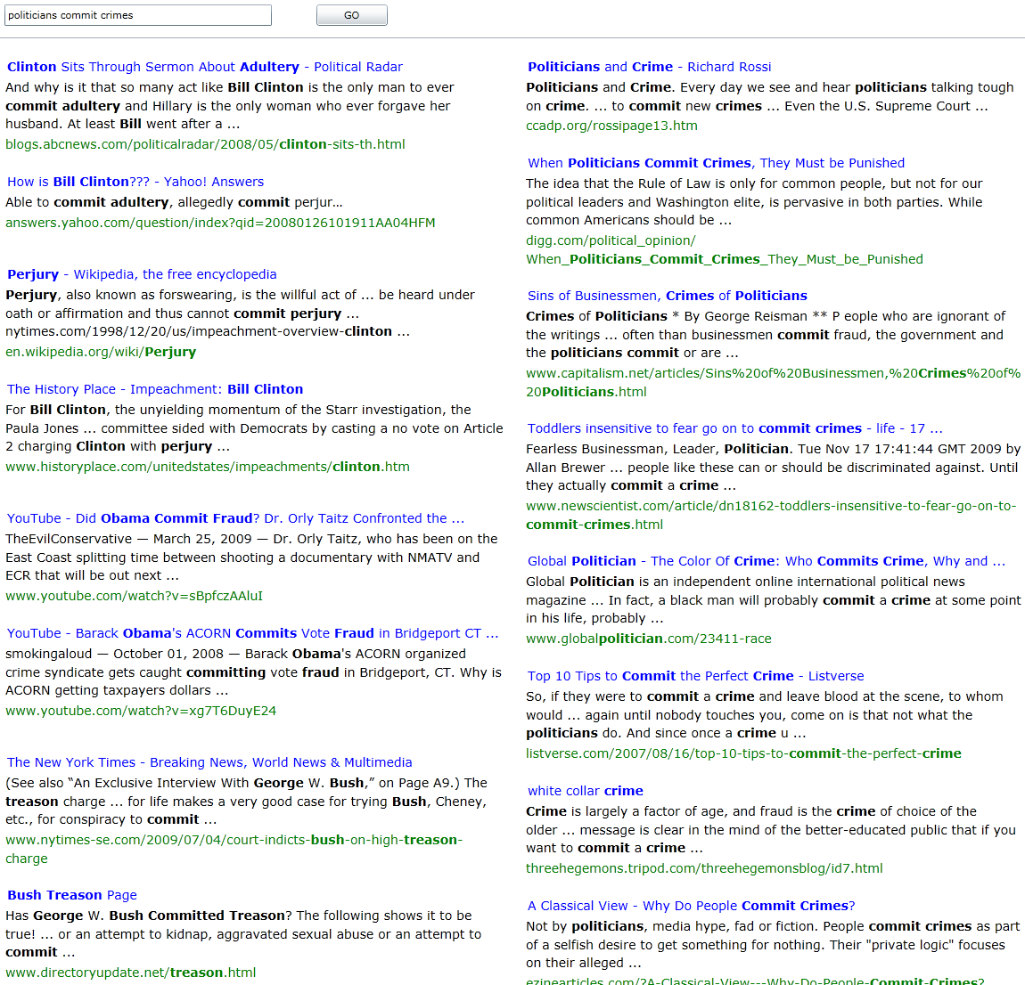
politicians commit crimes

Slide 10
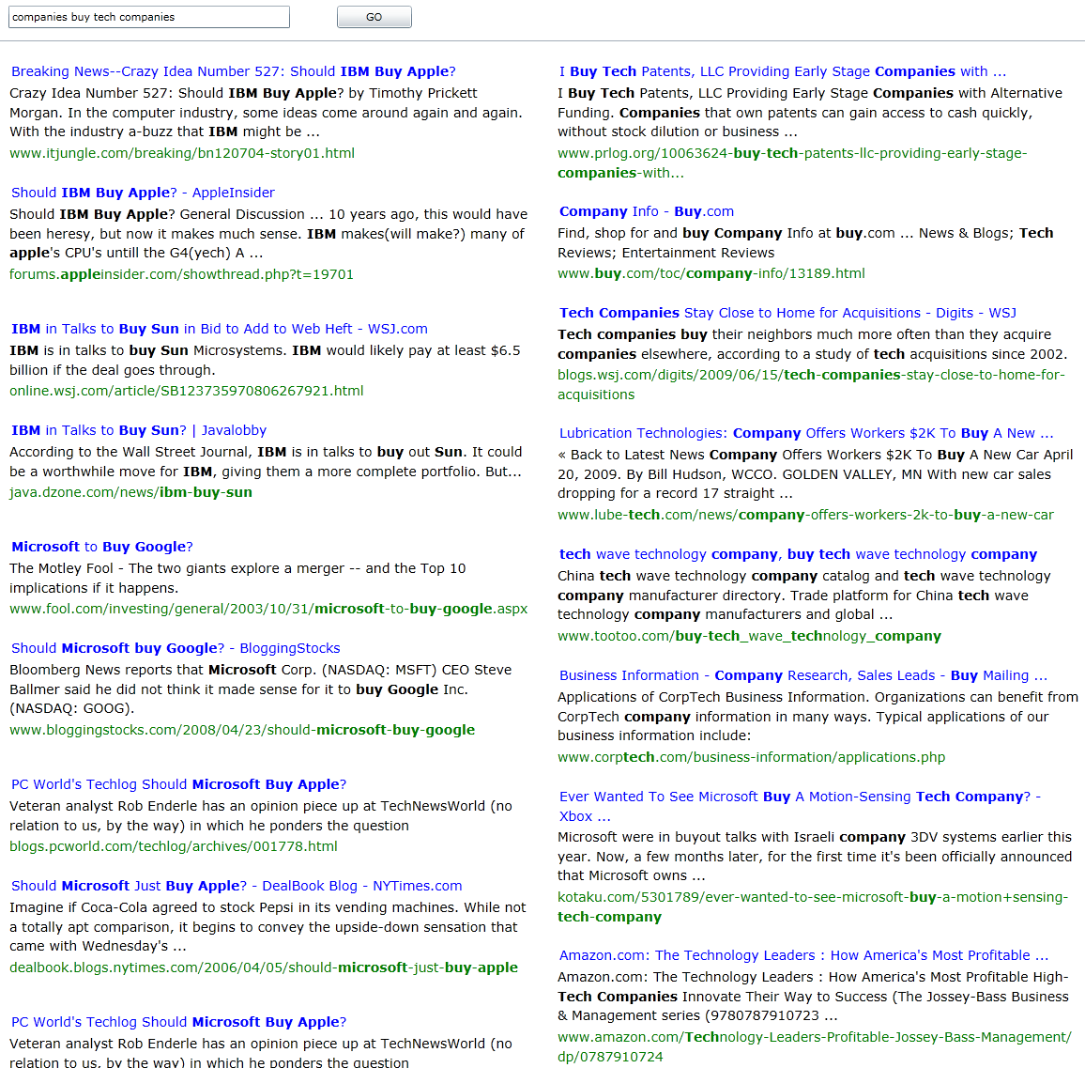
companies buy tech companies

Slide 11
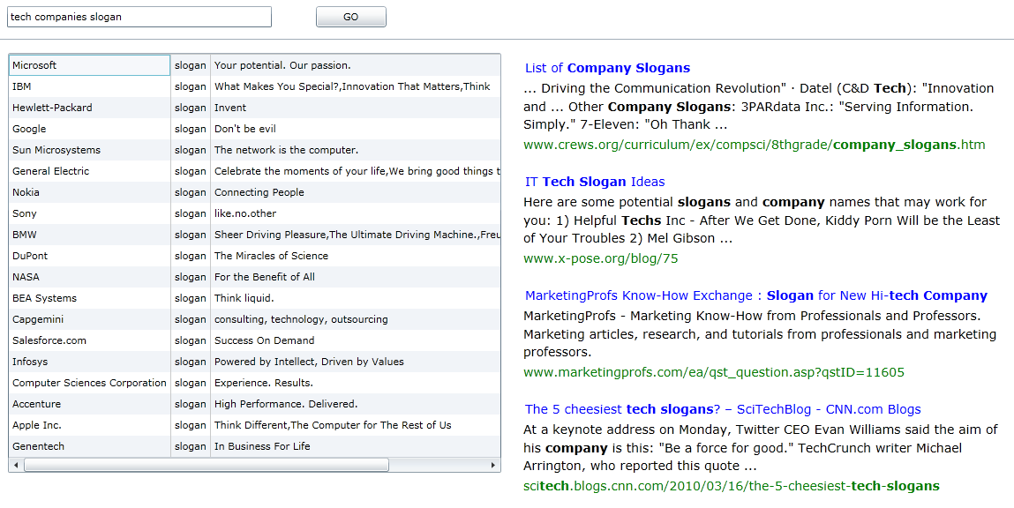
tech companies slogan

Slide 12
ProBase Internals

Slide 13

Freebase
A Shared Database of Structured General Human Knowledge

Slide 14

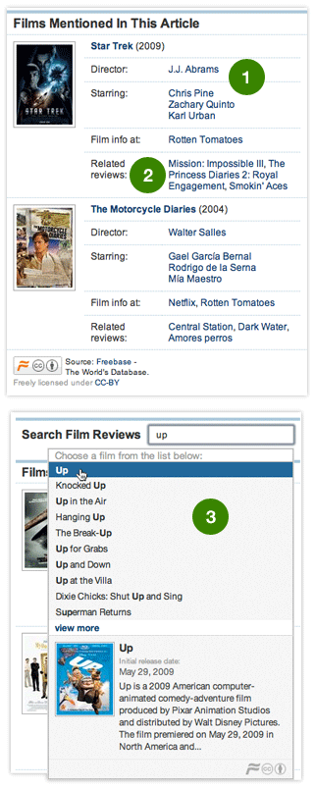
Who is using Freebase?

Slide 15
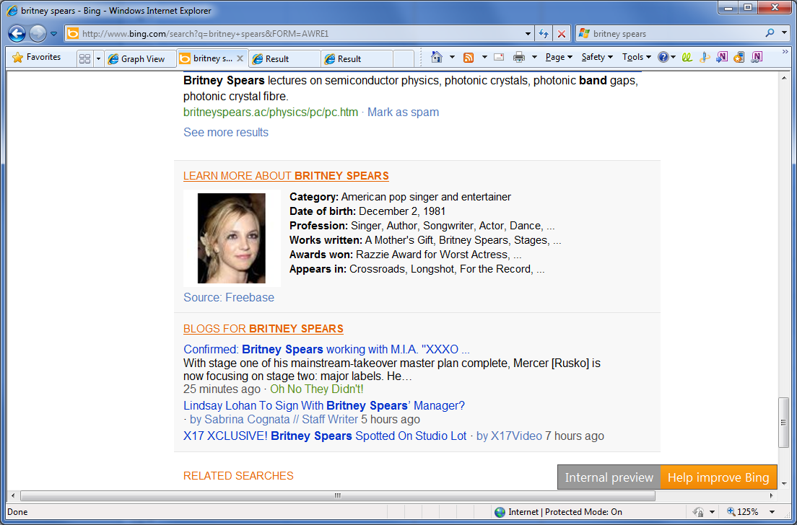

Who is using Freebase?

Slide 16
What’s in Freebase?
# of classes: 1,424
# of instances: 16,682,512
Notes:
tracks” means “songs”, so it lies under the “music” domain;
“isbns” is a list of ISBN numbers mapping to their corresponding books (“books” is the actual category for “books”);
“releases” is the release information about songs, especially for albums, so it also lies under the “music” domain.

Slide 17
ProBase
# of instances: : 16,423,710
# of classes: 2,026,806
# of class-subclass pairs: 2,052,912
extracted using SUCH-AS like patterns only from
HF Web Chunk snapshot (4/10/2010) with 1.68 billion documents

Slide 18
Probase vs. Freebase
Correctness is a probability.
Live with dirty data.
Dirty data is very useful.
Knowledge is black and white.
Clean up everything.
Dirty data is unusable.

Slide 19
Scoring the data
Data is noisy to begin with
We need to learn to live with noisy data
Seamless data integration
Web/Freebase/People/Location/Publications/…
Different data sources have different credibility
Potential support for reasoning

Slide 20
Scoring the data
Correctness: whether a claim (e.g., there is a company called Apple) is true or not
Popularity: e.g., Is Apple a top-3 company, or a top-5, top-10 company?
Ambiguity: e.g., does the word Apple, without any context, represent Apple the company?

Slide 21
Scoring the data
Correctness/Popularity: the probability that a claim is true Is there a company called Apple? is the same type of question as Is Apple a top-3 company, or a top-5, top-10 company?
Ambiguity: e.g., how likely is the word Apple, without any context, represent Apple the company?

Slide 22
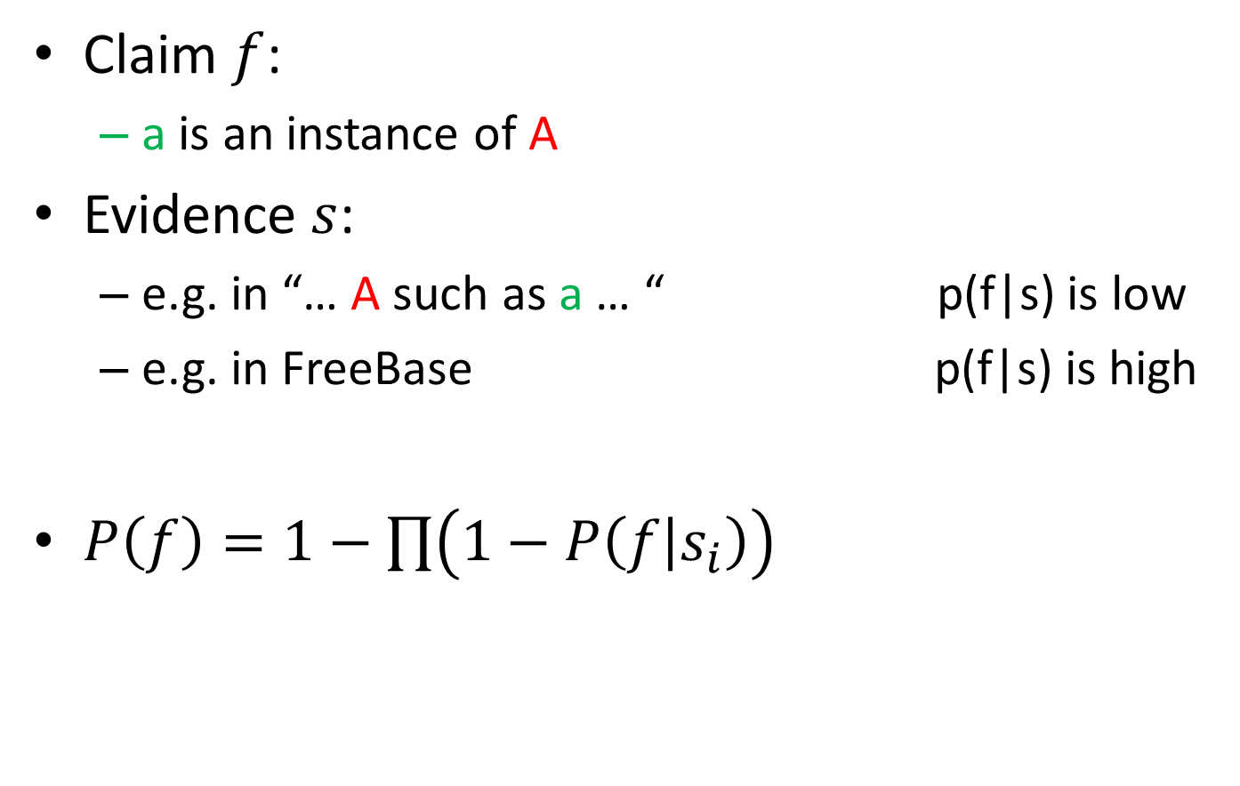
Correctness
Claim $f$:
a is an instance of A
Evidence $s$:
e.g. in “… A such as a … “ p(f|s) is low
e.g. in FreeBase p(f|s) is high
$P\left(f\right)=1−\prod{\left(1−P\left(f | s_{i}\right)\right)}$

Slide 23
Ambiguity
TFIDF
Document is class, Instance is term
But unlike the term-document scenario, classes form class-subclass relations
Microsoft appears in a lot of subclasses of “companies” like “big companies” and “tech companies”. TFIDF will reduce Microsoft’s ranking.
Ranking based on hierarchy
Generalize TFIDF score based on taxonomy
TF is the frequency of an instance within a class and all of its descendant subclasses.
IDF is the inverse of the number of other classes containing the instance, except the class and all of its descendant subclasses.

Slide 24
Probase vs. Freebase
2,026,806
classes
1,424
classes

Slide 25
Why we need so many classes/subclasses?
animals -> livestock -> sheep …
animals -> reptiles -> snakes …
plants -> trees -> …
artists -> musicians -> guitarists …
places -> restaurants -> fast foods …
foods -> vegetables -> cabbages …
machines -> computers -> laptops …
novels -> mysteries -> ghosts …
sports -> footballs …
celebrities -> athletes -> gymnasts …
Because these are the concepts in the mind of a human being.

Slide 26
Classes/Instances in Search
Bing search log (Sep 07-Jun 09) 538,154,049 distinct queries (freq≥5)
ProBase (ver 0.7) 2,026,806 distinct classes 4,414,931 distinct instances

Slide 27
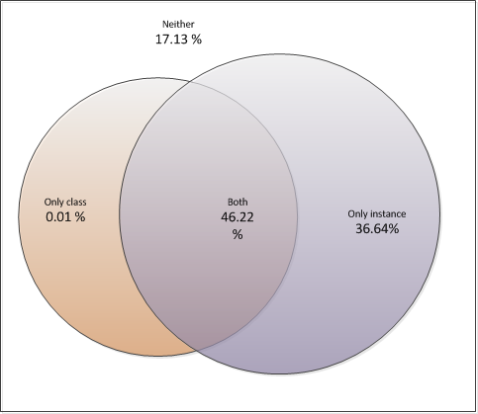

Classes/Instances in Search
# of distinct queries
query frequency
Notes:
Contain instance and class:
46.22% distinct queries, frequency 39.70%
Contain only instance:
36.64% distinct queries, frequency 45.43%
Contain neither:
17.13 % distinct queries, frequency 14.84%
Contain an exact class:
0.01 % distinct queries, frequency 0.02 %

Slide 28
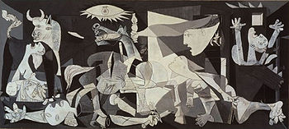
What are the tasks?
artist
painter
Born
Died
…
Movement
Picasso
1881
1973
…
Cubism
art
created by
painting
Guernica
Year
Type
…
1937
Oil on Canvas
…

Slide 29
Data Sources for Hierarchy Construction
SUCH-AS-like patterns in Web documents
tables in wiki and Web documents
many others … e.g., FreeBase

Slide 30
Data Sources
Patterns for single statements
NP such as {NP, NP, ..., (and|or)} NP
such NP as {NP,}* {(or|and)} NP
NP {, NP}* {,} or other NP
NP {, NP}* {,} and other NP
NP {,} including {NP ,}* {or | and} NP
NP {,} especially {NP,}* {or|and} NP
Examples:
Good: “rich countries such as USA and Japan …”
Tough: “animals other than cats such as dogs …”
Hopeless: “At Berklee, I was playing with cats such as Jeff Berlin, Mike Stern, Bill Frisell, and Neil Stubenhaus.”

Slide 31
Hierarchy Construction
Facts
A class may have multiple senses and a “noise sense”
A class usually has a dominant sense (the most frequent sense, e.g., “plants” for “living things that grow in the earth”).
Goal
Extract instances for each (dominant) sense
Observation
“such as” naturally groups instances according to their senses
Common: “plants such as trees and grass”
Common: “plants such as steam turbines, pumps, and boilers”
Not common: “plants such as trees and steam turbines”

Slide 32
Hierarchy Construction
Merging overlapping groups
“C such as X1, X2, …” and “C such as Y1, Y2, …”
“X1, X2, …” and “Y1, Y2, …” have certain overlap
then merge “X1, X2, …” and “Y1, Y2, …” under C
Missing links
the group with the largest instance frequency usually represents the dominant sense of the class label
the merging may not be complete (e.g., a group Turing, Church under mathematicians somehow does not merge with the larger group containing instances like Leibniz and Hilbert)
use supervised learning for further merging

Slide 33
Hierarchy Construction by Supervised Learning
Instances belonging to the same group usually share similarities
in lexical form
mathematicians: Leibniz, Hilbert, Turing, …
plants: tree, grass, herb, …
in semantic form
Instances belong to other same/similar classes
Supervised learning
features:
# of terms contained in the instance
# of terms with first char capitalized
contain numbers
other classes
Positive example set:
Top instances within the largest group (by TFIDF ranking score)
Negative example set:
Calculate distances of other instances outside the largest group from those within the positive example set, based on the selected features
Pick those instances with largest distance as negative examples
For each group other than the largest group, if most of its members are marked as positive, then merge this group into the largest group

Slide 34
Data Sources for Hierarchy Construction
SUCH-AS-like patterns in Web documents
tables in wiki and Web documents
many others …

Slide 35
Statements from Tables
Header? No
most cells of a row or column appear in an instance/attribute/class set?
statement: header and its corresponding row/column
Header? Yes
statements, attributes, values
Microsoft Partners | Founded | Founders | Headquarters
Companies
Equant | 2006
EMC | …
Accenture | 1913
Avanade | 2000
Ascentium | 2001
Notes:
We need representative companies

Slide 36
Attributes
Picasso
Born
Died
…
Movement
1881
1973
…
Cubism
Given a class, find its attributes
Candidate seed attributes:
“What is the [attribute] of [instance]?”
“Where”, “When”, “Who” are also considered

Slide 37
Attributes
Picasso
Born
Died
…
Movement
1881
1973
…
Cubism
Seed attributes for each class:
Add each instance’s weight to its candidate attribute
Rank all the candidate attributes according to their weight, select top ones as seed attributes of the class
From seed attributes to other attributes:
Search the web
Find similar patterns
Rank the attributes
Notes:
Assume we have a class with its seed instances and seed attributes.
First, get a noisy pool of candidate attributes from query logs (like all the n-grams occur with one of the seed instances)
For each attribute of the class(including seed), get its patterns from query logs and make a vector for the attribute.
For example, for class “company” and attribute “headquarters”, a query “where is the headquarters of Microsoft” leads to a pattern “[where is the](prefix) [of](infix) [](postfix)”.
Each element of the vector is the frequency of one pattern.
Merge all the vectors of seed attributes into one reference vector for each class.
For each candidate attribute, count the distance between reference vector and its own vector. Select the nearest ones at last as attributes for the class.

Slide 38
Relationships
Picasso
created by
Guernica
Extract instance pairs that satisfy certain relationship
E.g. relation: a painter creates a painting
Instance pair: (Guernica, Picasso)
Input:
Web corpus (366 million web pages)
Large set of relationships, each represented by a (e₁, e₂) pair
Taxonomy: classes/instances
Output:
More instance pairs belonging to each relation

Slide 39
Challenges
Picasso
created by
Guernica
Must handle millions of relations simultaneously
Not enough seed pairs
Pattern based approach, extract high-quality patterns, then use them extract several seed pairs
Term based approach, extract discriminative terms, then extract more pairs Terms are more general and more efficient
Must avoid generating massive amount of candidates
massive relations * massive candidates = infeasible

Slide 40
Overview
Picasso
Web pages:
Page 1: You can view the upcoming Toy Story 3 trailer here! Page 2: View company contact information for Pretty Woman on IMDbPro
……
created by
Guernica
Relations
(spider-man, director, Sam Raimi)
(Microsoft, headquarter, Redmond)
(telephone, invented, Bell)
……
Patterns
(The director of, is, .)
(The headquarter of, is, .)
(, is invented by, .)
……
Seed pairs
(Natural Born Killers ,Oliver Stone) (Army of Darkness, Sam Raimi)
(Toy Story, John Lasseter)
(Microsoft, Redmond)
(IBM, Armonk)
(Google, Mountain View)
(telephone, Bell)
(polygraph machine, Mackenzie )
(dry cleaning, Baptiste)
……
Taxonomy
Movies: Toy Story, Matrix,…
Companies: Microsoft, IBM,…
Directors: Stone, Lasseter,..
……
Classes
R1: (movies, directors)
R2: (companies, locations)
R3: (products, persons)
……
More pairs
(Titanic,Cameron)
…
Terms
(director, directed, movie,…)
(location, located, headquarter,…)
(inventor, inverted,…)
……
Phase 1
Phase 2

Slide 41
App
politicians commit crimes
Application Support

Slide 42
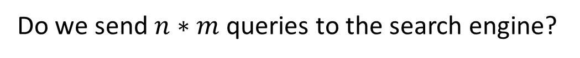
politicians commit crimes
Politicians
Crimes
Bill Clinton
George Bush
Barack Obama
…
murder
treason
adultery
…
Do we send $n∗m$ queries to the search engine?

Slide 43
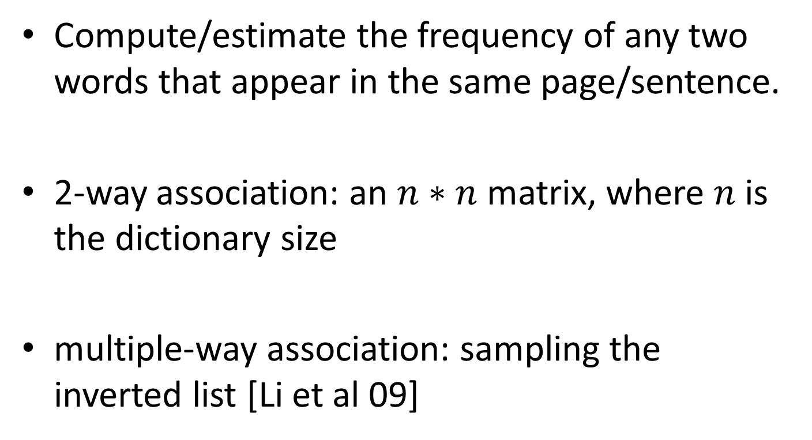
2-way and multi-way word association
Compute/estimate the frequency of any two words that appear in the same page/sentence.
2-way association: an $n∗n$ matrix, where $n$is the dictionary size
multiple-way association: sampling the inverted list [Li et al 09]

Slide 44
Method
For any top-K politicians, find pairs (politician, crime) that has top associations
For any top-K crimes, find pairs (politician, crime) that has top associations

Slide 45
Thanks!

