Slide 1
Probase: Understanding Data on the Web
Haixun Wang
Microsoft Research Asia

Slide 2
What’s our Goal?
injecting common sense into computing

Slide 3
Bill Gates
28 Oct 1955
American

Slide 4
… animals other than cats such as dogs …
animals
cats
Correct!
isA
isA
dogs
dogs
Notes:
The set of APIs can have far reaching meanings. Till this day, computation power is built upon the notion of “Intel Inside”. Today we are going to add a human touch to cold logic, and we will call it “Common Sense Inside” or even “Probase Inside”.

Slide 5
… household pets other than animals such as reptiles, aquarium fish …
household pets
animals
Correct!
isA
isA
reptiles
reptiles
Notes:
The set of APIs can have far reaching meanings. Till this day, computation power is built upon the notion of “Intel Inside”. Today we are going to add a human touch to cold logic, and we will call it “Common Sense Inside” or even “Probase Inside”.

Slide 6
Progress on Two Fronts
System
accumulating and serving knowledge
Applications
making smart use of knowledge

Slide 7
Trinity: Distributed Graph DB with Full Transaction Support

Slide 8
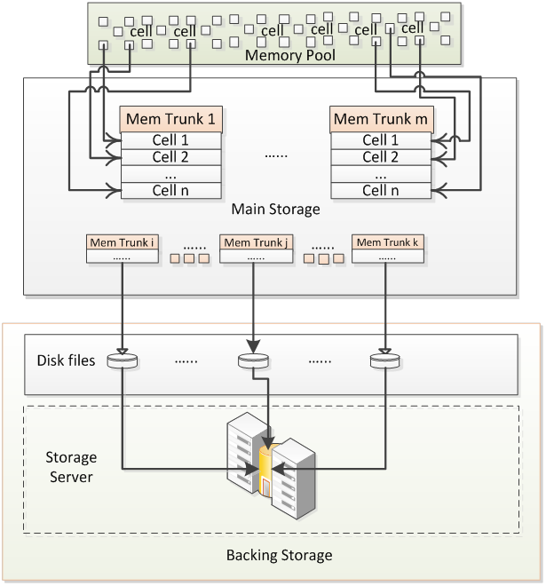
Trinity: Memory Cloud/Cell

Slide 9
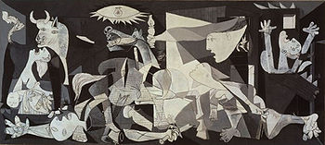
Knowledge Base
artist
painter
Born
Died
…
Movement
Picasso
1881
1973
…
Cubism
art
created by
painting
Guernica
Year
Type
…
1937
Oil on Canvas
…

Slide 10
Probase: Freebase: Cyc:
2 K concepts built by community effort
2.7 M concepts automatically harnessed
120 K concepts 25 years human labor
Probase has a logic foundation that supports evidential reasoning.

Slide 11
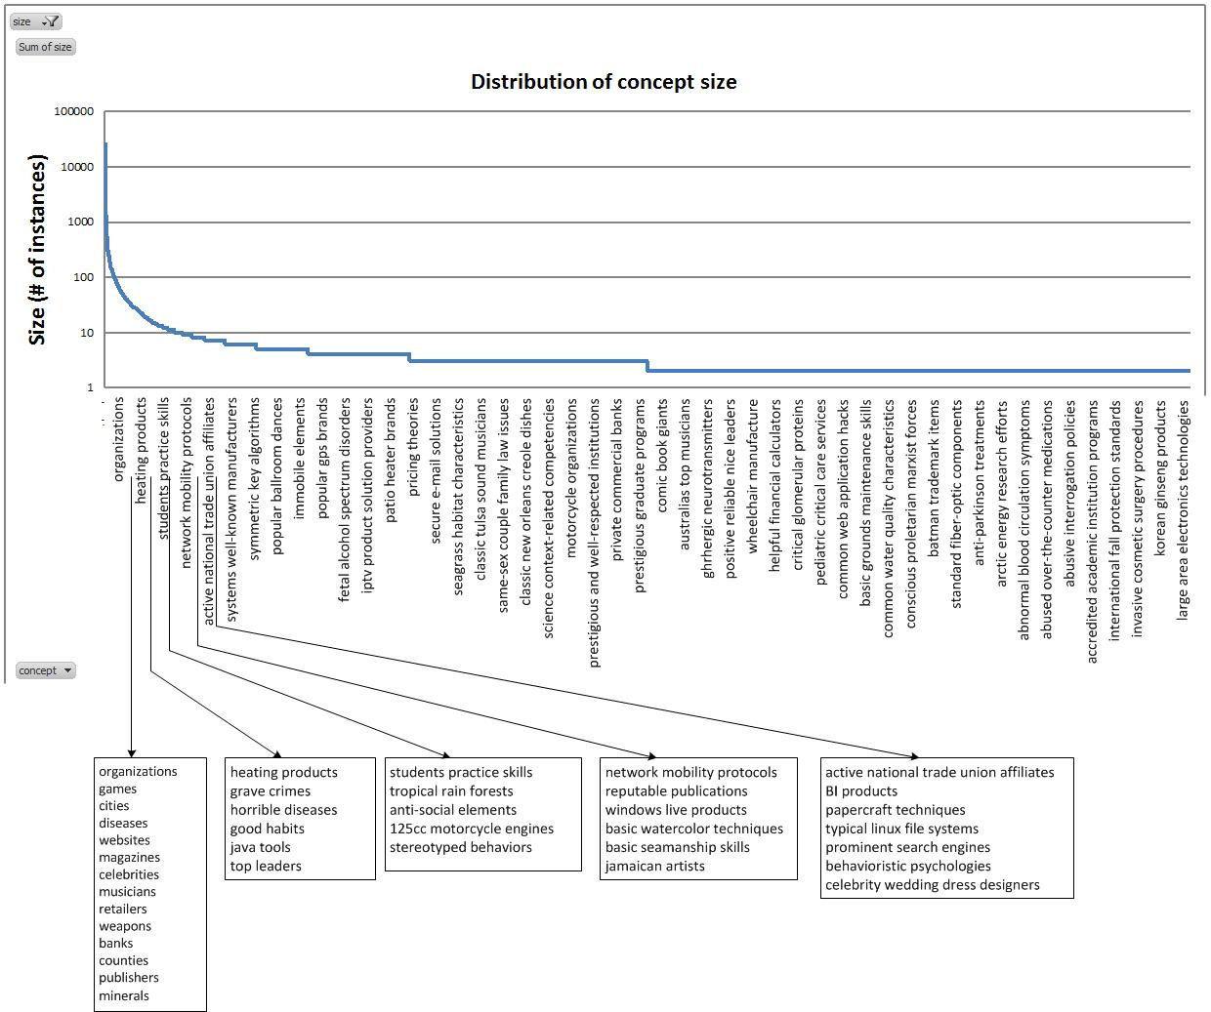
Nodes: 2.7 million concepts (size distribution)
Basic watercolor techniques
2.7 million concepts
countries
Celebrity wedding dress designers

Slide 12
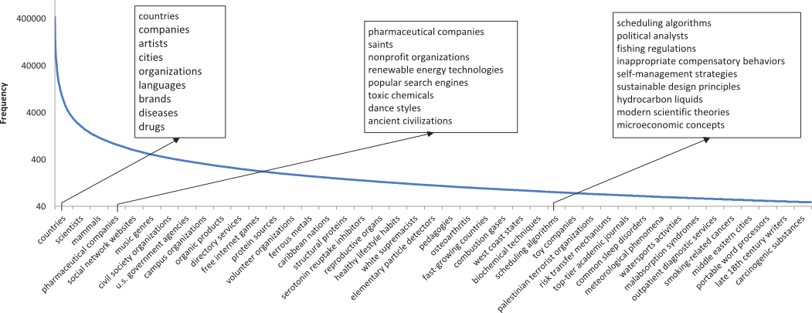
Nodes: 2.7 million concepts (frequency distribution)

Slide 13
Concepts are the glue that holds our mental world together.
Gregory L. Murphy, NYU

Slide 14
Edges: relationships
isA (backbone of the taxonomy)
similarity (derived relationship)
part-whole (to be incorporated)

Slide 15
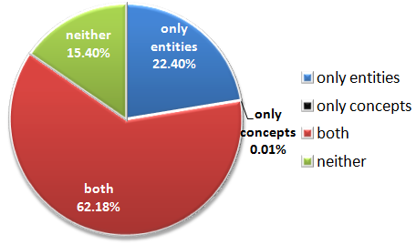
Classes/Instances in Search
Concepts 0.02% only? Two reasons:
Concept modifiers are often interpreted as instances, e.g., San Diego biotech companies.
Search engines do not handle concepts very well, and users stopped trying.

Slide 16
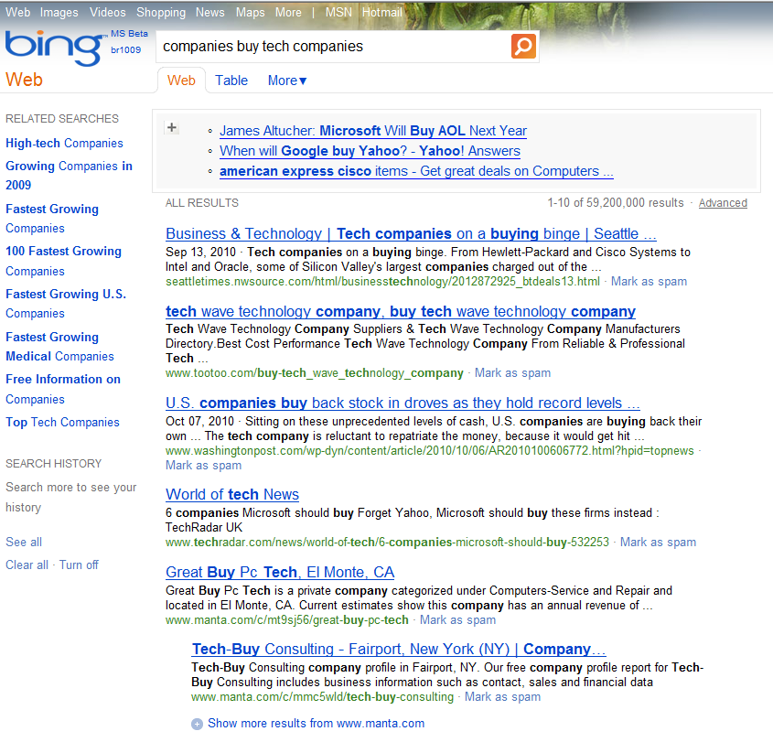
Click to expand

Slide 17
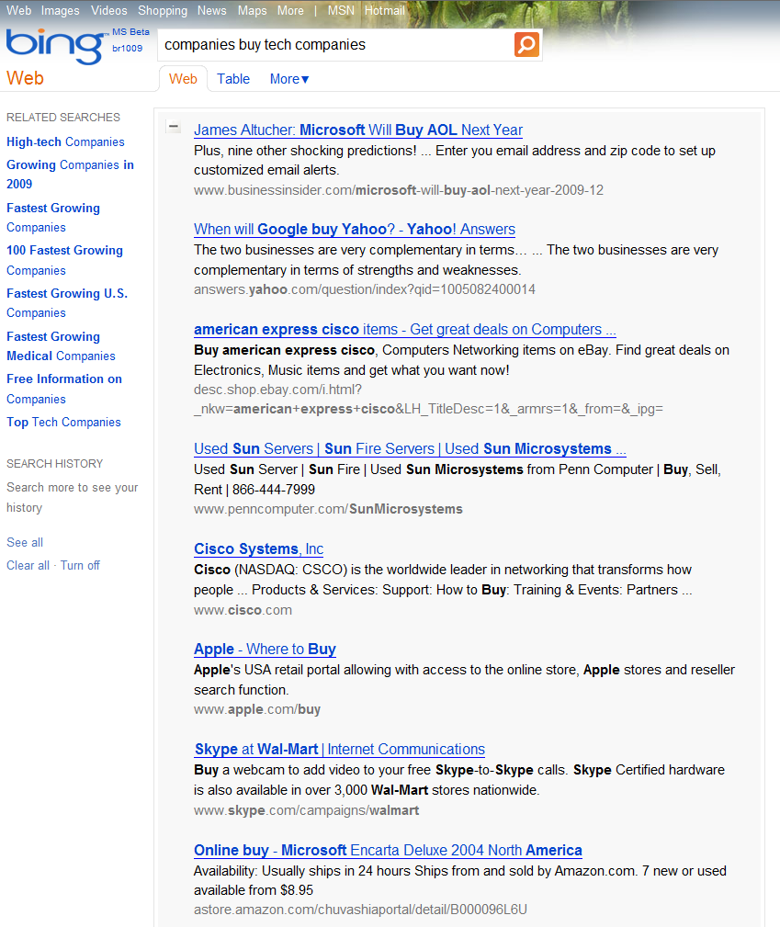

Slide 18
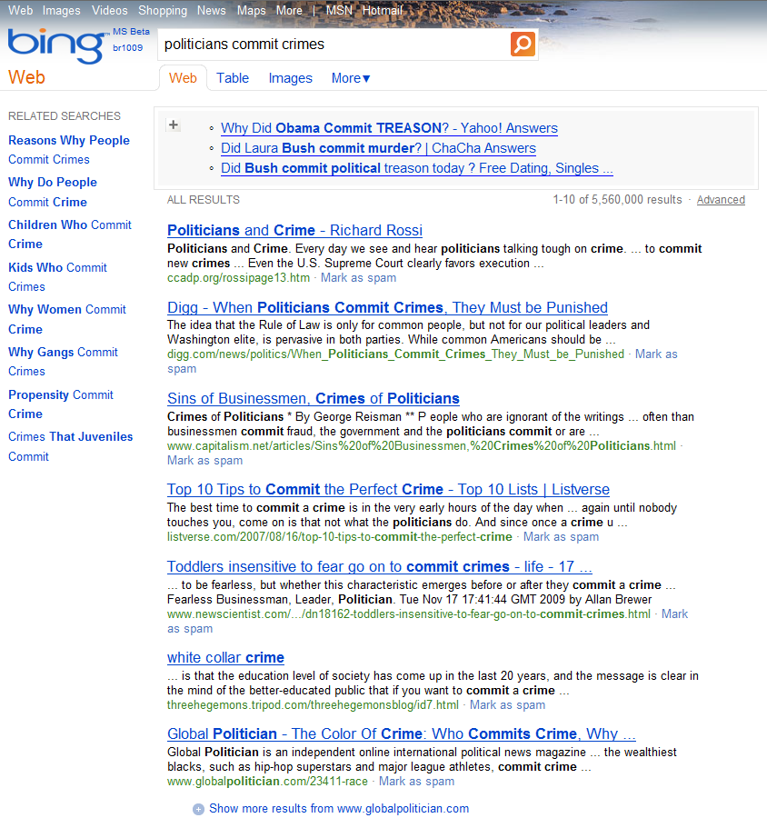

Slide 19
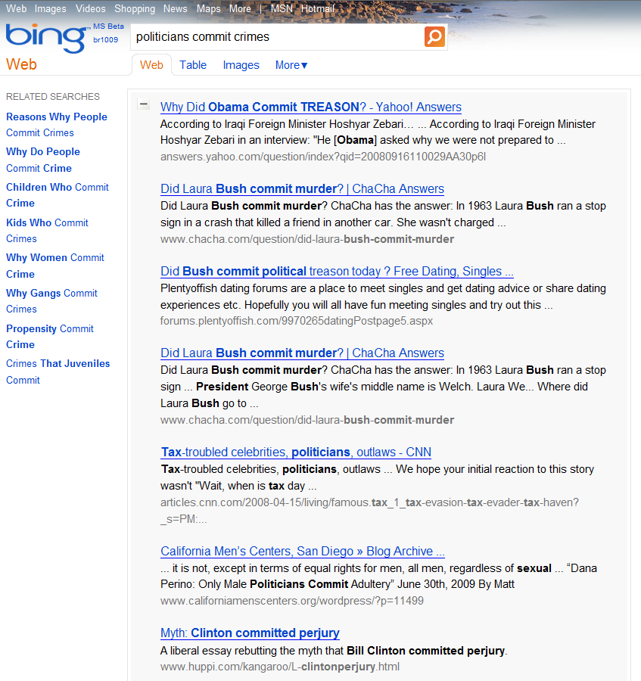

Slide 20
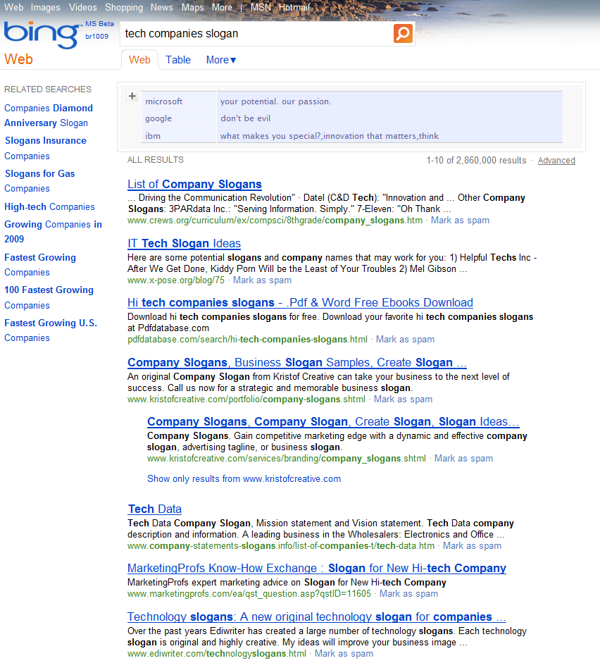

Slide 21
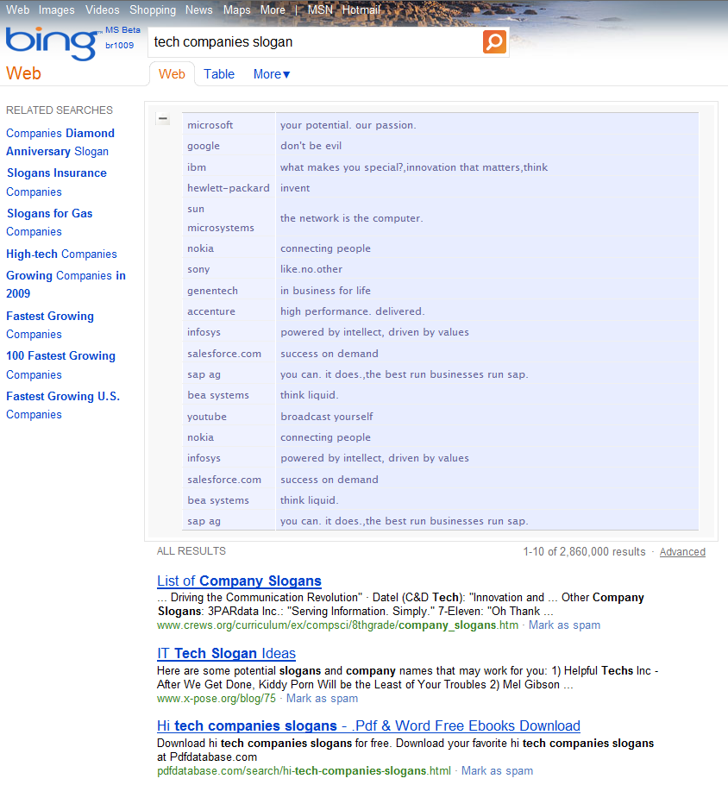

Slide 22
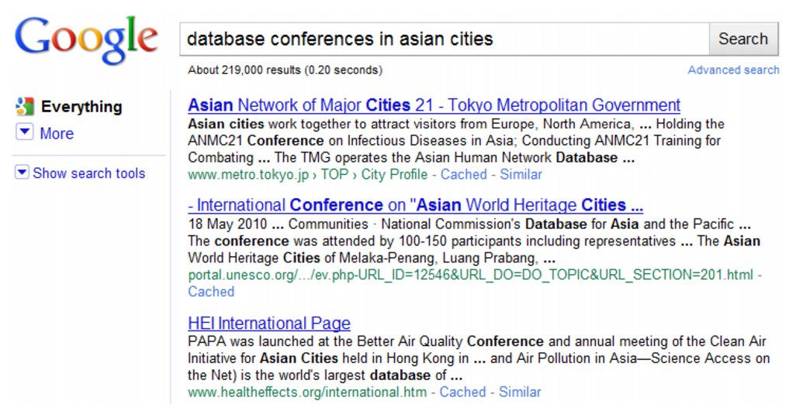

Slide 23
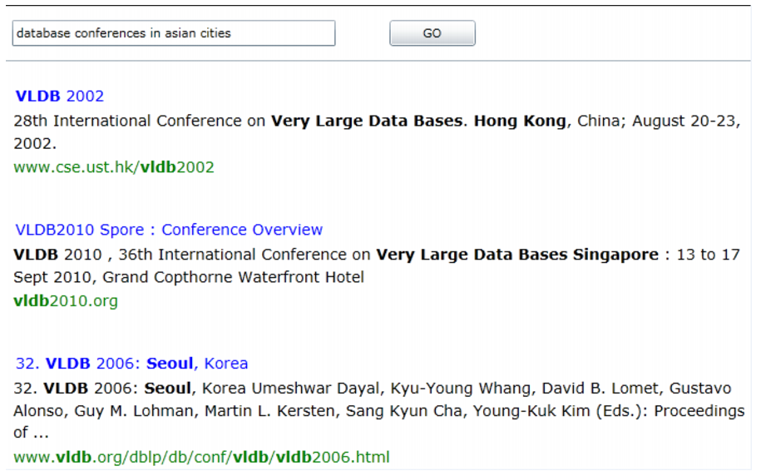

Slide 24
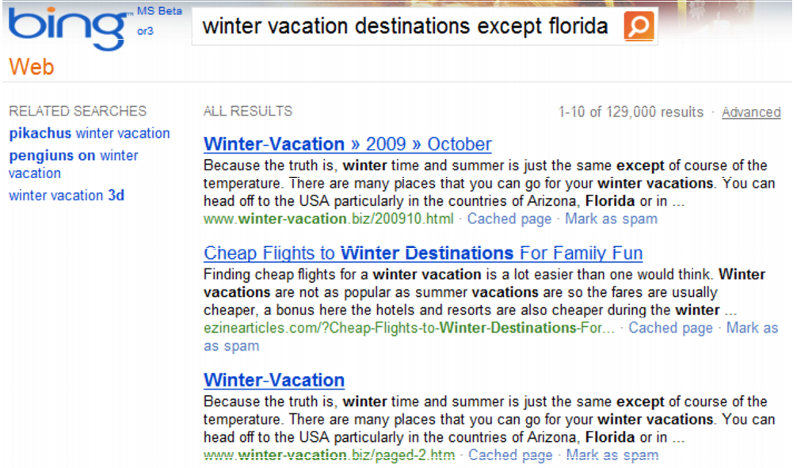

Slide 25
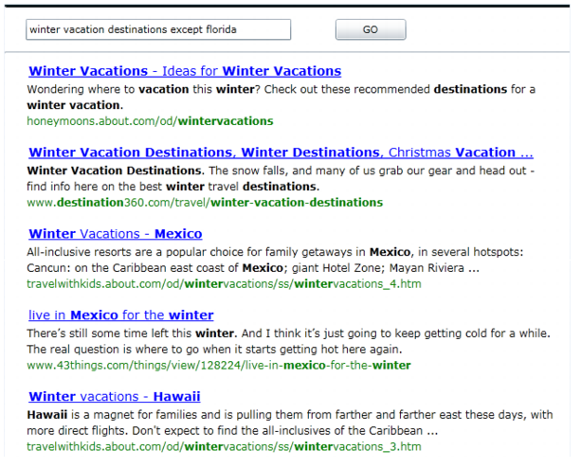

Slide 26
Are good results in our top 10 returned by Bing or Google? (up to their top 1000)

Slide 27
Probase vs. Freebase
Correctness is a probability.
Live with dirty data.
Dirty data is very useful.
Knowledge is black and white.
Clean up everything.
Dirty data is unusable.

Slide 28
How to handle noisy data?
Score the data!

Slide 29
Score the data
Consensus: e.g., is there a company called Apple?
Popularity: e.g., is Apple a top-3 company, or a top-5, or a top-10 company?
Ambiguity: e.g., does the word Apple, sans any context, represent Apple the company?
Similarity: e.g., how likely is an actor also a celebrity?
Freshness: e.g., Pluto as a dwarf planet is a claim more fresh than Pluto as a planet.

Slide 30
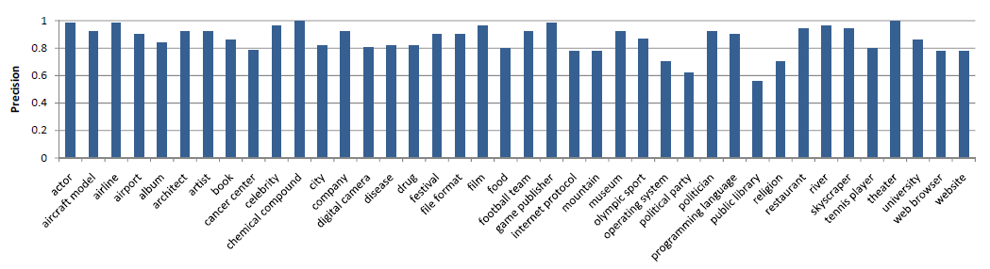
Quality

Slide 31
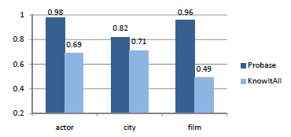
Compare with Probase

Slide 32
Consensus / Popularity
Is there a company called Apple? is the same type of question as Is Apple a top-3 company, or a top-5, top-10 company?

Slide 33
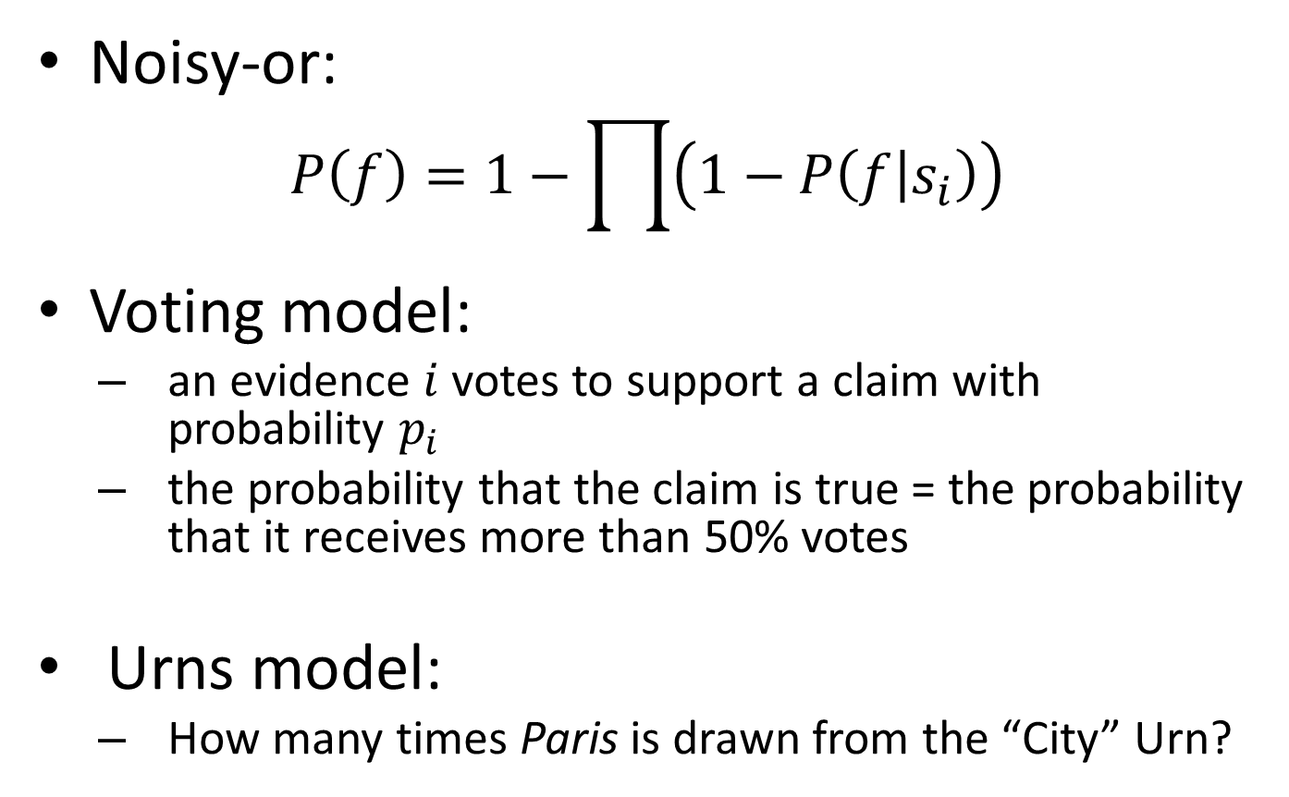
Consensus/Popularity
Noisy-or:
$$P\left(f\right)=1−\prod{\left(1−P\left(f | s_{i}\right)\right)}$$
Voting model:
an evidence $i$ votes to support a claim with probability $p_{i}$
the probability that the claim is true = the probability that it receives more than 50% votes
Urns model:
How many times Paris is drawn from the “City” Urn?
Notes:
Claim $f$:
a is an instance of A
Evidence $s$:
e.g. in “… A such as a … “ p(f|s) is low
e.g. in FreeBase p(f|s) is high

Slide 34
Negative Evidence
E.g. Two claims:
China is a company 100 evidences
MyCrazyStartup is a company 10 evidences
Negative evidences
treat each occurrence of China as a negative evidence unless it’s about “China is a company”
treat the fact that Company and Countries have low similarity (overlap) as a negative evidence

Slide 35
Ambiguous Identity
Apple is a company
Apple is a fruit
Tiger is a vertebrate
Tiger is a mammal
There are two apples but just one tiger. How do we know?
Notes:
TFIDF
Document is class, Instance is term
But unlike the term-document scenario, classes form class-subclass relations
Microsoft appears in a lot of subclasses of “companies” like “big companies” and “tech companies”. TFIDF will reduce Microsoft’s ranking.
Ranking based on hierarchy
Generalize TFIDF score based on taxonomy
TF is the frequency of an instance within a class and all of its descendant subclasses.
IDF is the inverse of the number of other classes containing the instance, except the class and all of its descendant subclasses.

Slide 36
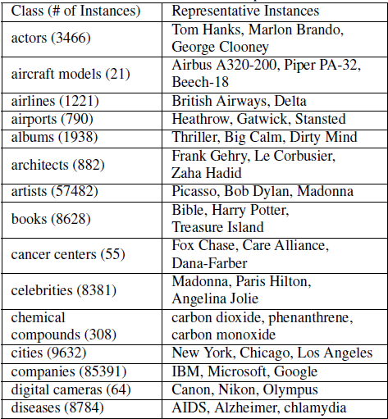
Important Instances

Slide 37
What are the tasks?
artist
painter
Born
Died
…
Movement
Picasso
1881
1973
…
Cubism
art
created by
painting
Year
Type
…
Guernica
1937
Oil on Canvas
…

Slide 38
Data Sources for Taxonomy Construction
Hearst’s patterns in HF data (1.68B docs)
HTML tables in Wikipedia
HTML tables in HF data
Freebase data
Many more can be added in the future

Slide 39
Hearst’s Patterns
Patterns for single statements
NP such as {NP, NP, ..., (and|or)} NP
such NP as {NP,}* {(or|and)} NP
NP {, NP}* {,} or other NP
NP {, NP}* {,} and other NP
NP {,} including {NP ,}* {or | and} NP
NP {,} especially {NP,}* {or|and} NP

Slide 40
Examples
Easy: “rich countries such as USA and Japan …”
Tough: “animals other than cats such as dogs …”
Almost hopeless: “At Berklee, I was playing with cats such as Jeff Berlin, Mike Stern, Bill Frisell, and Neil Stubenhaus.”

Slide 41
Taxonomy Construction
Each evidence is an edge
Put edges together into a graph
Problem: if two edges has end nodes of the same label, should we merge them?

Slide 42
Example
Example:
plants such as trees and grass
plants such as steam turbines, pumps, and boilers
Fortunately it’s extremely rare to see
“plants such as trees and steam turbines”
“such as” naturally groups instances by their senses
Notes:
Facts
A class may have multiple senses and a “noise sense”
A class usually has a dominant sense (the most frequent sense, e.g., “plants” for “living things that grow in the earth”).
Goal
Extract instances for each (dominant) sense

Slide 43
Hierarchy Construction
Merging overlapping groups
“C such as X1, X2, …” and “C such as Y1, Y2, …”
“X1, X2, …” and “Y1, Y2, …” have certain overlap
then merge “X1, X2, …” and “Y1, Y2, …” under C
Missing links
the group with the largest instance frequency usually represents the dominant sense of the class label
the merging may not be complete (e.g., a group Turing, Church under mathematicians somehow does not merge with the larger group containing instances like Leibniz and Hilbert)
use supervised learning for further merging

Slide 44
Hierarchy Construction by Supervised Learning
Instances belonging to the same group usually share similarities
in lexical form
mathematicians: Leibniz, Hilbert, Turing, …
plants: tree, grass, herb, …
in semantic form
Instances belong to other same/similar classes
Supervised learning
features:
# of terms contained in the instance
# of terms with first char capitalized
contain numbers
other classes
Positive example set:
Top instances within the largest group (by TFIDF ranking score)
Negative example set:
Calculate distances of other instances outside the largest group from those within the positive example set, based on the selected features
Pick those instances with largest distance as negative examples
For each group other than the largest group, if most of its members are marked as positive, then merge this group into the largest group

Slide 45
Attributes
Picasso
Born
Died
…
Movement
1881
1973
…
Cubism
Given a class, find its attributes
Candidate seed attributes:
“What is the [attribute] of [instance]?”
“Where”, “When”, “Who” are also considered

Slide 46
Reasoning
After building a coherent set of beliefs, reasoning can then follow.
Rules are uncertain/probabilistic as well.

Slide 47
Expanding Concepts
cities tech companies
basic watercolor techniques
learn swimming
buy books on Amazon
(low order concepts)
noun phrases
noun phrases +
verb +
prepositional phrases
(high order concepts)

Slide 48
Expanding Relationships
Relationships among concepts (noun phrases)
locatedIn, friendOf, createdBy, etc
relationship between apple and Newton
Relationships among high order concepts
causal relationships
tasks and subtasks

Slide 49
Find questions for answers
For each claim, find all possible of questions that the claim can be used to answer.
<China, population, 1.3 billion>
Q: How many people are there in China?
For a set of claims of the same class, find possible aggregate questions.
<China, population, 1.3 billion>, <India, population, 1 billion>, …
Q: What’s the most populous nation?

Slide 50
Thanks!

