Slide 1
Selectional Preference
Xu Dong

Slide 2
Outline
Introduction and motivation
Class-based approaches
Similarity based approaches
Discriminative approaches
Models based on LDA
Summary

Slide 3
Introduction and Motivation
Selectional preference can be defined as the semantic restrictions the predicate imposes on its arguments.
For example, a verb like drink, typically prefers animate subjects and drinkable objects.

Slide 4
Introduction and Motivation
It is obvious that selectional preference and word sense disambiguation are closely linked.
For example, burgundy can be interpreted as either a color or a beverage, but only the latter sense is available in the context of Mary drank burgundy.

Slide 5
Introduction and Motivation
It can also be used to improve statistical dependency parse.
Propositional phrase (PP) attachment is one of the hardest problems in English dependency parsing.
(1) John hit the ball with the bat.
(2) John hit the ball with the red stripe.

Slide 6
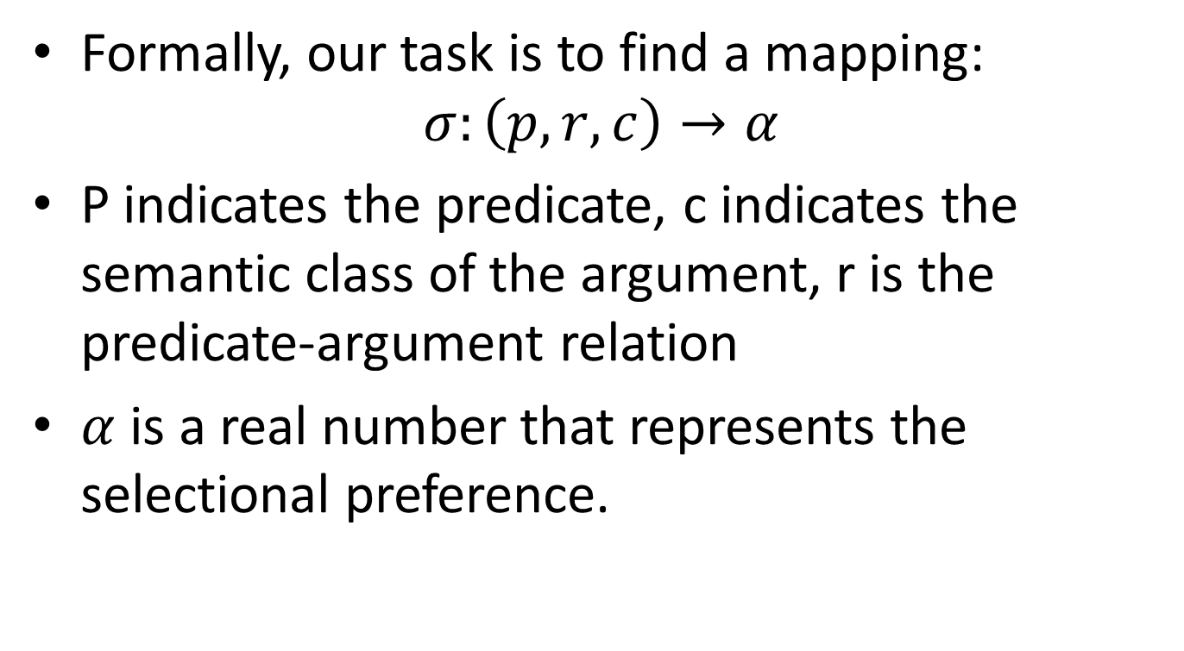
Introduction and Motivation
Formally, our task is to find a mapping:
$$σ:\left(p, r, c\right)→α$$
P indicates the predicate, c indicates the semantic class of the argument, r is the predicate-argument relation
$α$ is a real number that represents the selectional preference.

Slide 7
Class-based approaches
The most studied of the four
Make use of a pre-define set of classes, such as WordNet
Focus on the model proposed by Resnik in 1996

Slide 8
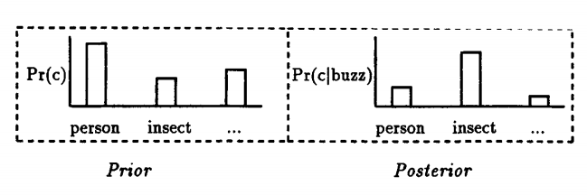
Class-based approaches
The prior probability for (person) tends to be significantly higher than the prior probability for (insect)
Once the identity of the predicate is taken into account, the probabilities can change -- if the verb is buzz, then the probability for (insect) can be expected to be higher than its prior, and (person) will likely be lower

Slide 9
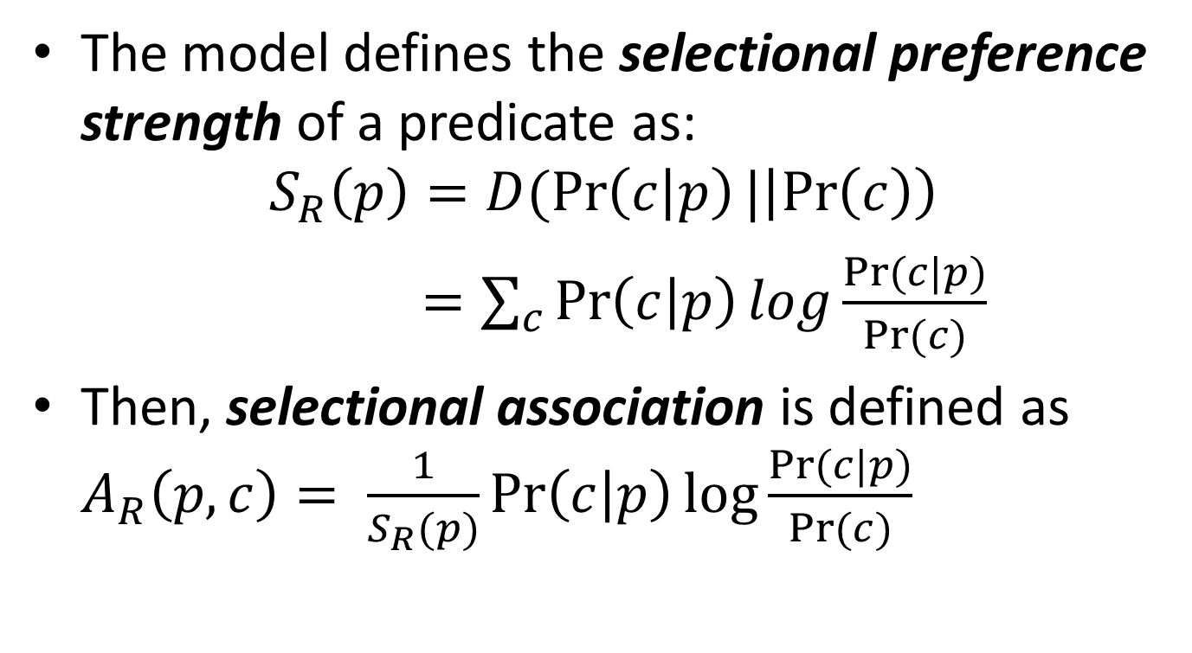
Class-based approaches
The model defines the selectional preference strength of a predicate as:
$$S_{R}\left(p\right)=D(\operatorname{Pr}\left(c | p\right)|\left|\operatorname{Pr}\left(c\right)\right)$$
$=\sum_{c}{\operatorname{Pr}\left(c | p\right)log\frac{Pr⁡(c|p)}{Pr⁡(c)}}$
Then, selectional association is defined as $A_{R}\left(p,c\right)= \frac{1}{S_{R}(p)}\operatorname{Pr}\left(c | p\right)log\frac{Pr⁡(c|p)}{Pr⁡(c)}$

Slide 10
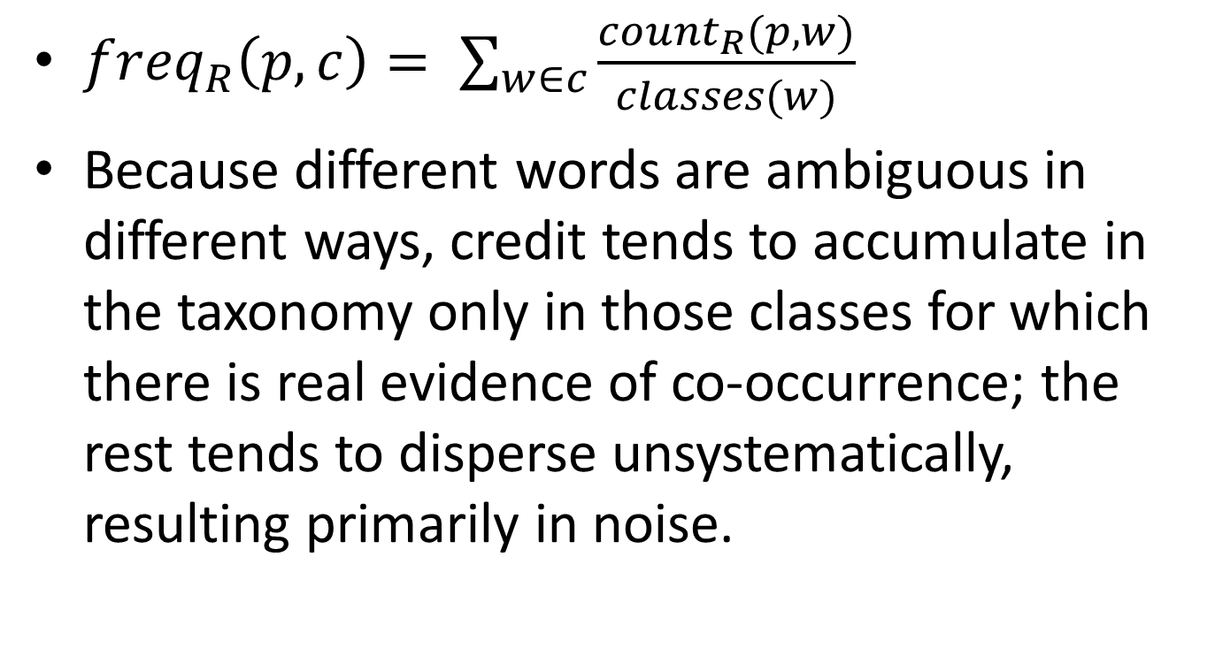
Class-based approaches
${freq}_{R}\left(p,c\right)= \sum_{w∈c}{\frac{{count}_{R}(p,w)}{classes(w)}}$
Because different words are ambiguous in different ways, credit tends to accumulate in the taxonomy only in those classes for which there is real evidence of co-occurrence; the rest tends to disperse unsystematically, resulting primarily in noise.

Slide 11
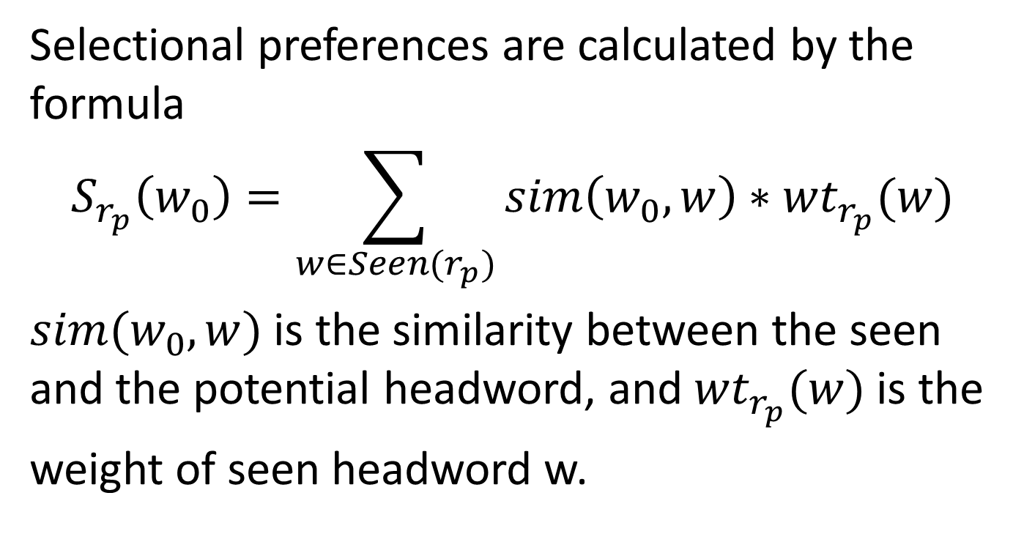
Similarity-based approaches
Selectional preferences are calculated by the formula
$$S_{r_{p}}\left(w_{0}\right)=\sum_{w∈Seen(r_{p})}{sim\left(w_{0}, w\right)∗{wt}_{r_{p}}(w)}$$
$sim(w_{0}, w)$is the similarity between the seen and the potential headword, and ${wt}_{r_{p}}(w)$is the
weight of seen headword w.

Slide 12
Discriminative approaches
Construct negative examples
Make use of many features in addition to co-occurrence frequencies
Train a SVM classifier

Slide 13
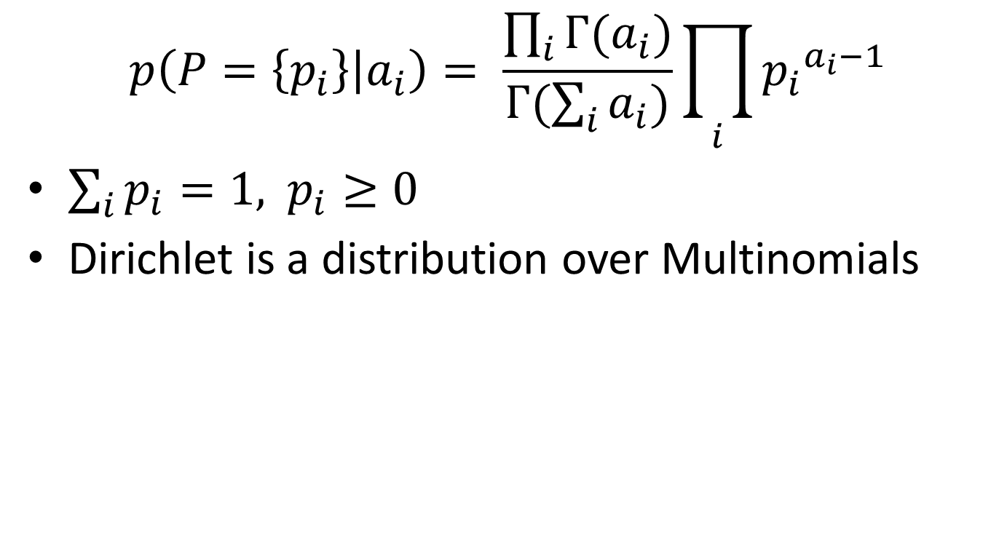
Dirichlet Distribution
$$p\left(P=\left\{p_{i}\right\} | a_{i}\right)= \frac{\prod_{i}{Г(a_{i}})}{Г(\sum_{i}{a_{i}})}\prod_{i}{{p_{i}}^{a_{i}−1}}$$
$\sum_{i}{p_{i}=1, }$ $p_{i}≥0$
Dirichlet is a distribution over Multinomials

Slide 14
Latent Dirichlet Allocation
Suppose you have the following set of sentences:
I like to eat broccoli and bananas.
I ate a banana and spinach smoothie for breakfast.
Chinchillas and kittens are cute.
My sister adopted a kitten yesterday.
Look at this cute hamster munching on a piece of broccoli.
What is latent Dirichlet allocation? It’s a way of automatically discovering topics that these sentences contain. For example, given these sentences and asked for 2 topics, LDA might produce something like
Sentences 1 and 2: 100% Topic A
Sentences 3 and 4: 100% Topic B
Sentence 5: 60% Topic A, 40% Topic B
Topic A: 30% broccoli, 15% bananas, 10% breakfast, 10% munching, … (at which point, you could interpret topic A to be about food)
Topic B: 20% chinchillas, 20% kittens, 20% cute, 15% hamster, … (at which point, you could interpret topic B to be about cute animals)

Slide 15
Latent Dirichlet Allocation
Latent Dirichlet allocation (LDA) is a generative probabilistic model of a corpus. The basic idea is that documents are represented as random mixtures over latent topics, where each topic is characterized by a distribution over words.

Slide 16
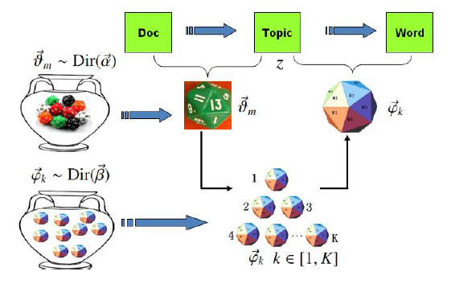
Latent Dirichlet Allocation

Slide 17
Models based-on LDA
LDA was introduced to models set of documents in terms of topics that they share in varying proportion.
The analogical move from modeling document-term co-occurrences to modeling predicate-argument co-occurrences is intuitive.

Slide 18
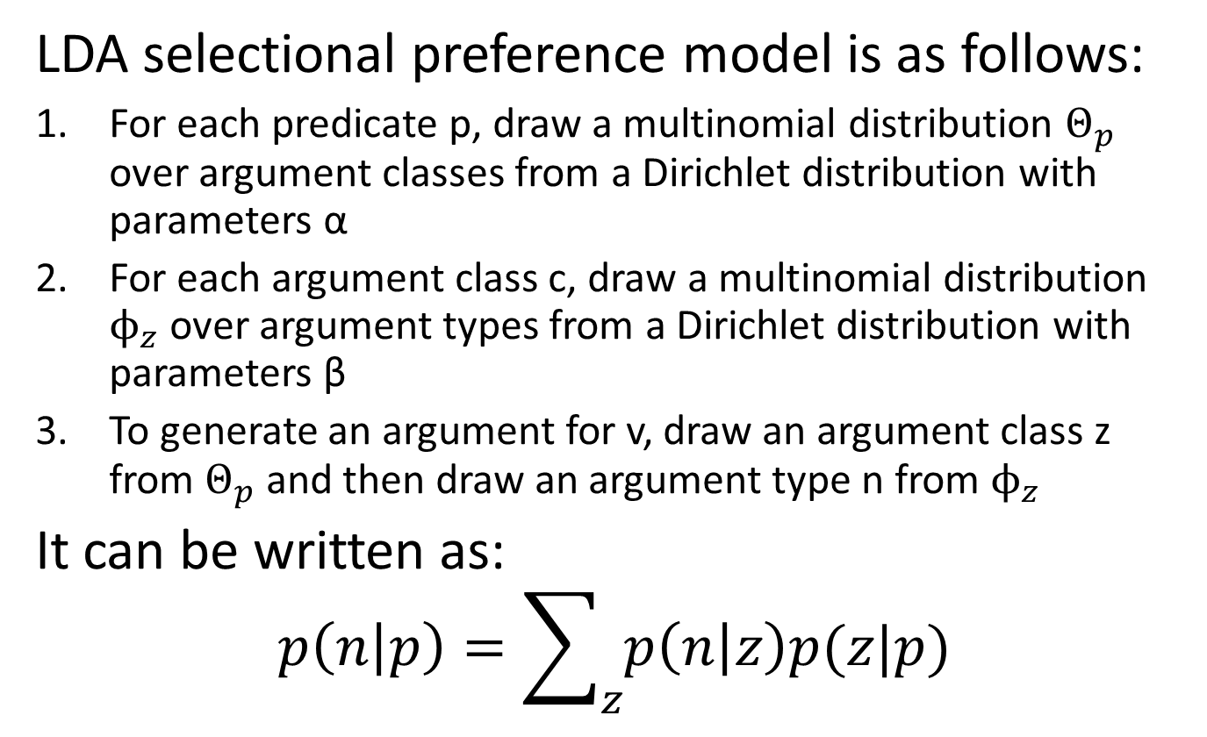
Models based-on LDA
LDA selectional preference model is as follows:
For each predicate p, draw a multinomial distribution $Θ_{p}$ over argument classes from a Dirichlet distribution with parameters α
For each argument class c, draw a multinomial distribution $ϕ_{z}$ over argument types from a Dirichlet distribution with parameters β
To generate an argument for v, draw an argument class z from $Θ_{p}$ and then draw an argument type n from $ϕ_{z}$
It can be written as:
$$p\left(n | p\right)=\sum_{z}{p\left(n | z\right)p(z|p)}$$

Slide 19
Summary
Class-based model
LDA selectional preference models
Handle sparse data well
Automatically induce semantic classes and predicate distributions over those classes
Because predicates simply do not select strongly enough to make a significant difference. Selectional preferences may provide some evidence, but most likely only as a complement to other sources of information

Slide 20
Thank you
Notes:
End

