Slide 1
Semantic Text Similarity
Kangqi Luo
2013-09-25

Slide 2
Agenda
Overview
Algorithm
Vector space model
Derivation from word-word similarity
Evaluation
Summary

Slide 3
Overview
Notes:
幻灯片过渡，可以选择屏幕先暗下来，再慢慢变亮，显示这个页面
修改字体，以及下面加一条灰色（从左到右颜色深浅变化）的分割线，下面再加一个象征性的图

Slide 4
Overview
What to do
Input: two natural language plain texts.
Output: a score representing the semantic similarity between these two texts.
“The manager fired that employee.”
“The worker is terminated from work by his boss.”
“iMac” “Apple computer” v.s. “Fuji apple” “Apple computer”

Slide 5


Overview
Why to do
Reverse dictionary
Semantic search
Question recommendation
Grading short answer questions
A scientific study of human minds.
Do you mean “Psychology”?
User
Server + Dictionary
Notes:
用图片展示一步步的想法（类似数据流图，每个节点用图片代替）

Slide 6
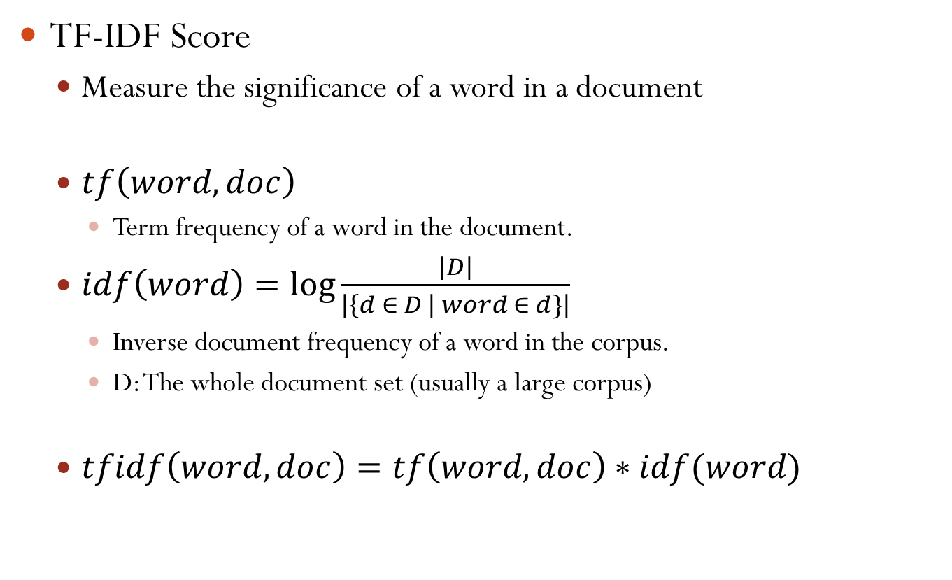
Preliminary
TF-IDF Score
Measure the significance of a word in a document
$tf\left(word, doc\right)$
Term frequency of a word in the document.
$idf\left(word\right)=\log{\frac{\left|D\right|}{\left|\left\{d ∈ D \right| word ∈ d\}\right|}}$
Inverse document frequency of a word in the corpus.
D: The whole document set (usually a large corpus)
$tfidf\left(word,doc\right)=tf\left(word,doc\right)∗idf(word)$

Slide 7
Algorithms
Vector Space Model
Word-Word Similarity Derivation

Slide 8
Various Methods
Different understanding of semantic similarity
Sharing common/similar objects, actions, …
Sharing common attributes when describing them.
E.g., “tiger” and “cat” share common attributes like “have fur” “can vocalize” “belongs to animals” …
Sharing entities from similar topics.
E.g., “book” and “library”.
Similar structure (have a correct alignment between two sentence pairs)
Similarity or Relatedness
Synonymy/Antonymy/Hypernymy
Notes:
Different definitions may get different methods

Slide 9
Vector Space Model
Previous work: Bag-Of-Words
Each text is represented by a weighted vector of lexical items.
The common lexical item between two texts contributes to their similarity score.
Drawback
Data sparsity
Ignoring synonymy/polysemy between texts
Text | Vectors in n-gram vector space
 | (ny, new, york, times, ny times, …)
NY times | (1, 0, 0, 1, 1, …)
New York times | (0, 1, 1, 1, 0, …)

Slide 10
Explicit Semantic Analysis
Characteristics
Vector space model
Representing text as a weighted mixture of Wikipedia concepts
Explicit: Human can understand
“equipment”
Tool (3.0)
Camping (2.4)
Engineering vehicle (1.8)
Weapon (1.5)
……
Notes:
data augmentation

Slide 11

Explicit Semantic Analysis
Building Semantic Interpreter
Provide significant concepts for each word
Each Wikipedia article of one Wiki concept is the document
Apple_Fruit (5.00)
Apple_Inc (4.80)
Apple
Building weighted invert index
Concept_{a} (tfidf_{2a})
……
Word₂
… . . .
Word_{n}
……
Weighted invert index
Notes:
(Wikipedia Invert Index)

Slide 12
Explicit Semantic Analysis
Representation Using Semantic Interpreter
“Apple released the new iPhone”
tfidf_{apple}
tfidf_{release}
tfidf_{iphone}
Apple (Fruit)
Release
iPhone
Apple Inc.
Album
iPhone 4S
+
+ …… +
Apple Bank
……
Apple Inc.
Apple Inc.
……
Apple Inc.
……
iPhone
Release
Final weighted concept vector
……
Apple (Fruit)
……
Notes:
(Graph in ESA paper P2, right-down corner)
Compute cosine similarity between texts.

Slide 13
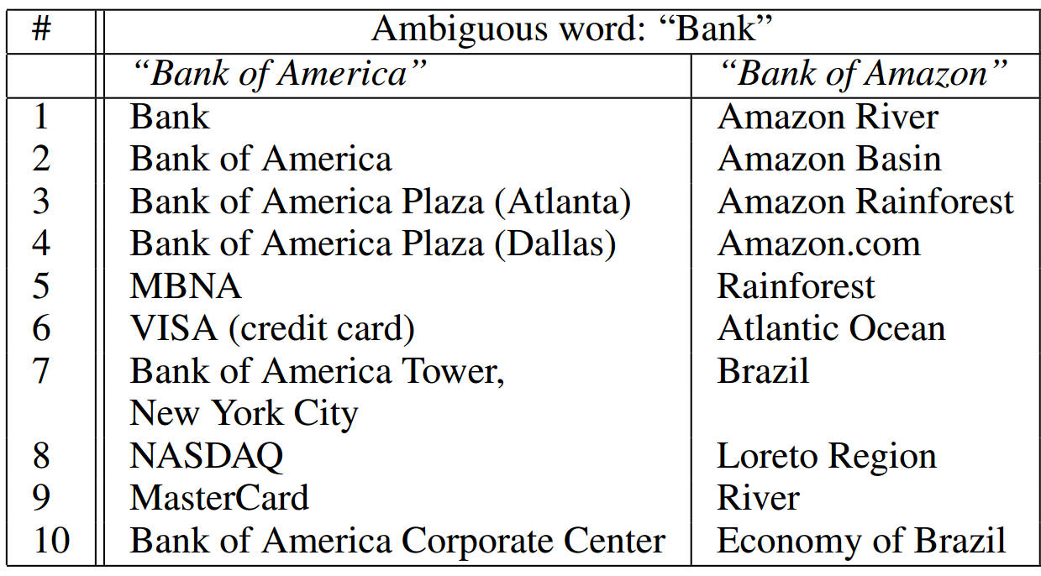
Explicit Semantic Analysis
ESA example for texts with ambiguous words
Context word helps disambiguate.
First Ten Concepts

Slide 14
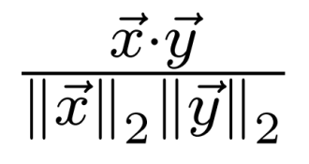
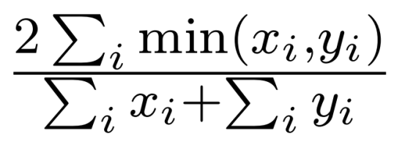
Explicit Semantic Analysis
Computing Similarity Between Texts
Just compute vector similarity
Cosine metric
Dice metric
Top-K filtering
Only retain the most top-k important elements in each vector
Notes:
Top-K retain metric

Slide 15
WordNet Random Walk
Characteristics
Vector space model
Mapping each word to a distribution of WordNet terms using a random walk expansion.
“I ate a salad and spaghetti.”
pasta (#5)
dish (#6)
eat (#9)
Random walk on WordNet
food (#12)
corrode (# >100)
……
Ranks of WordNet term distribution
Notes:
Once you get this vector representation, same similarity method also holds

Slide 16
WordNet Random Walk
Building the graph derived from WordNet
Leveraging inter-synset edges
E.g., hypernym edges between synsets.
salad
#n#1
hypernym
spaghetti
dish
#n#1
dish
#n#2
pasta
#n#1
spaghetti #n#1
hypernym
hypernym
hypernym
spaghetti
#n
dish
#v#1
food
#n#1
pasta
#n#2
spaghetti #n#2
hypernym
hypernym
Notes:
Spaghetti #n#1: The 1st noun sense of spaghetti in WordNet.
Hypernymy hyponymy ……
Only use noun/verb?

Slide 17
WordNet Random Walk
Initial Distribution Construction
Find words/phrases in WordNet as well as their POS-tags in the sentence
Compute the tfidf score for these word/phrases in the current sentence
“I ate some salad and spaghetti.”
→ “eat #v”, tfidf_{eat}
“salad #n”, tfidf_{salad}
“spaghetti #n”, tfidf_{spaghetti}

Slide 18
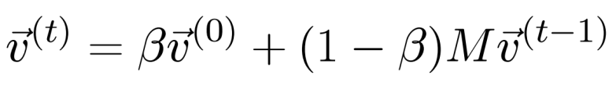
WordNet Random Walk
Computing the Stationary Distribution
Probability of random walk: equally distribution
Walking till probability distribution converges
salad
#n#1
1
spaghetti
dish
#n#1
1/3
dish
#n#2
1/2
pasta
#n#1
spaghetti #n#1
1
1/3
1
1/2
1/2
1/2
1/3
spaghetti
#n
dish
#v#1
food
#n#1
pasta
#n#2
spaghetti #n#2
1/2
1/2
1
1/2
1/2
Notes:
\beta: Like the returning node in PageRank
M: transition matrix

Slide 19
Derivation From Word Similarity
Intuition
Computing word similarity between every word pairs from two texts.
Using an alignment algorithm to integrate word similarities into a uniform similarity score.
“The manager fired that employee .”
“The worker is terminated from work by his boss .”

Slide 20
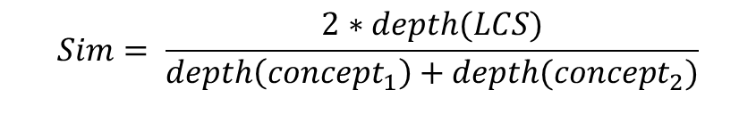
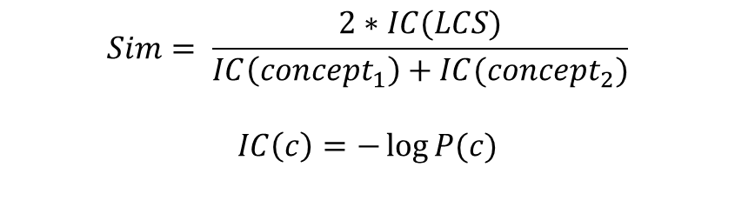
Word-Word Similarity
Knowledge-based methods
WordNet random walk
Find the least common subsumer in WordNet
Leverage depth or information content.
entity
$$Sim= \frac{2∗depth(LCS)}{depth\left(concept_{1}\right)+depth(concept_{2})}$$
$$Sim= \frac{2∗IC(LCS)}{IC\left(concept_{1}\right)+IC(concept_{2})}$$
$$IC\left(c\right)=−\log{P(c)}$$
professional
faculty member
medical man
professor
doctor
Notes:
And: Dependency (Mohler’2011), Intermediate Word(Islam’08) Graph!!

Slide 21
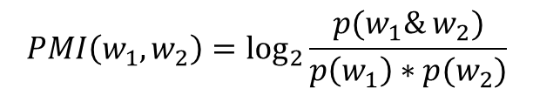

Word-Word Similarity
Corpus-based methods
Pointwise Mutual Information
PMI: The more co-occurrence, the more similar.
SOC-PMI: Neighboring words as bridges.
Explicit semantic analysis
Corpus is needed to calculate tfidf score
Word | Prob. of Occur
Apple | 0.01
iPhone | 0.005
Apple & iPhone | 0.001
$$PMI\left(w_{1},w_{2}\right)=\log_{2}{\frac{p(w_{1}\& w_{2})}{p\left(w_{1}\right)∗p(w_{2})}}$$
IT Company
Software
$$PMI\left(Apple, iPhone\right)=4.322>0$$
Google
Neighboring words
Microsoft
Larry Page
……
Relatedness
Notes:
Appendix

Slide 22
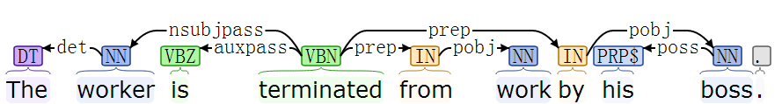
Word-Word Similarity
Feature-based methods
Extract context features for each word in the text, then weight each feature by using a logistic regression classifier.
Feature contains:
Lexical matching
POS matching
Role matching
Dependency sub-text similarity
subtext for “by”: “by his boss”.
Notes:
Abstract (Where is example?)

Slide 23
Alignment
Find the optimal alignment between texts based on similarity score between words.
Optimal bipartite graph matching
Hungarian algorithm
Normalize the matching score
The worker is terminated from work by his boss
The manager fired that employee
manager
worker
fire
terminate
employee
work
#NULL#
boss
Notes:
Weighted normalization

Slide 24
Evaluation

Slide 25
Dataset
Word Similarity: WordSimilarity-353 collection
353 word pairs with their similarity score by 13 annotators.
Short Text Similarity: Microsoft Research Paraphrase Corpus(MSRpar)
4076 training pairs and 1725 test pairs.
One score for each pair: 0 / 1
Word1 | Word2 | Ave. Score | #1 | #2 | … | #13
money | cash | 9.15 | 10 | 9.5 | 9.5 | 10
tiger | cat | 7.35 | 9 | 7 | 8 | 7
book | library | 7.46 | 8 | 9 | 8 | 9
smart | stupid | 5.81 | 3 | 7 | 9 | 0
Mars | water | 2.94 | 2 | 1 | 3 | 2
Text1 & Text 2 | Score
Amrozi accused his brother, whom he called "the witness", of deliberately distorting his evidence. | 1 (Similar)
Referring to him as only "the witness", Amrozi accused his brother of deliberately distorting his evidence.
Notes:
Different annotator has different ideas (not all people treat antonym as Dissimilar, but not all treat as similar)

Slide 26
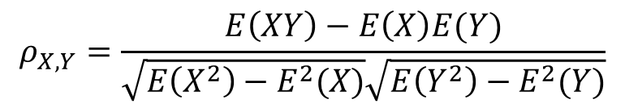
Evaluation Metric
Pearson Correlation
1
Similarity Score
Human judge
1
0
$$ρ_{X,Y}=\frac{E\left(XY\right)−E\left(X\right)E(Y)}{\sqrt{E\left(X^{2}\right)−E^{2}(X)}\sqrt{E\left(Y^{2}\right)−E^{2}(Y)}}$$

Slide 27
Summary
Various understanding brings different methods
Vector space model
Map text to a global view (Wiki Concept / WordNet node)
Topic view
Word-Word similarity derivation
Decompose and combine (alignment)
Structure view
Improvements
Incorporate word sense information
Aggregate more features to build a robust framework
Notes:
ESA/RW是把text映射到另一个维度，避免了稀疏性，是站在topic的角度看（相近topic的句子，具有相近的similarity）
WW-Derivation: 侧重于句子的结构，如果两个句子结构更加类似，句子的各个成分可以互相匹配，从而导致整个句子具有高的相似性
Sense information: 对于W-W的类型，如果事先知道sense，可以很方便的用wordnet处理，而不用纠结使用哪个sense

Slide 28
Reference
ESA
Computing Semantic Relatedness using Wikipedia-based Explicit Semantic Analysis
Random Walk
Random Walks for Text Semantic Similarity
Word-Word Similarity
Semantic Similarity in a Taxonomy: An Information-Based Measure and its Application to Problems of Ambiguity in Natural Language
Semantic Text Similarity Using Corpus-Based Word Similarity and String Similarity
Corpus-based and Knowledge-based Measures of Text Semantic Similarity
Alignment
Learning to Grade Short Answer Questions using Semantic Similarity Measures and Dependency Graph Alignments
UNT: A Supervised Synergistic Approach to Semantic Text Similarity

Slide 29
Thanks For Listening!
Q & A

