Slide 1
Self-supervised Tasks for Dialogue Context Modeling（II）
Qi Jia

Slide 2
Recap
DialogBERT: Discourse-Aware Response Generation via Learning to Recover and Rank Utterances
Learning an Effective Context-Response Matching Model with Self-Supervised Tasks for Retrieval-based Dialogues

Slide 3
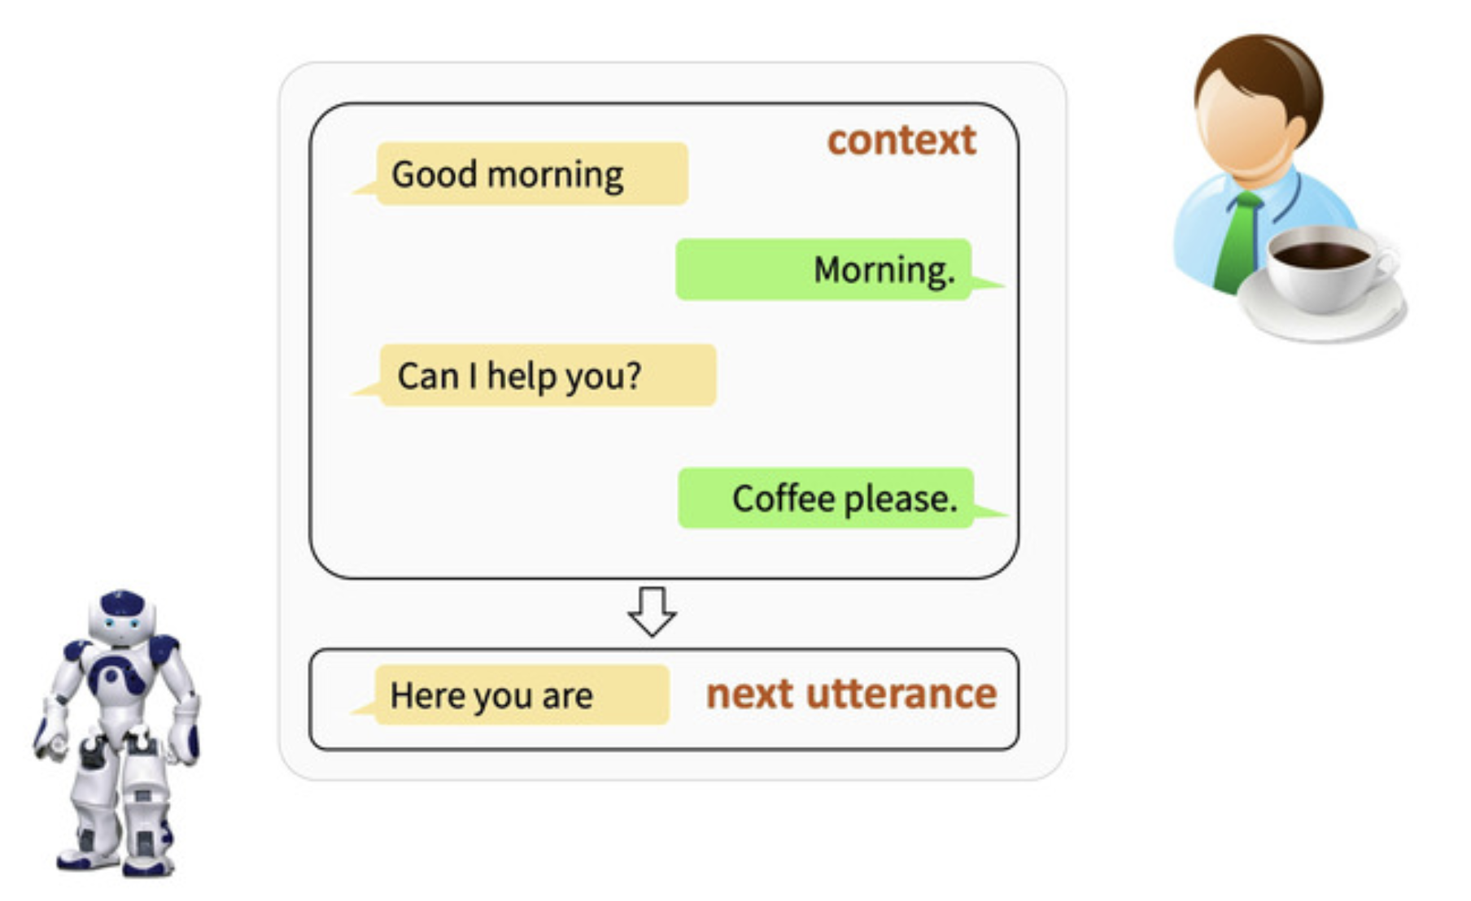
Open-Domain Dialogue Generation

Slide 4
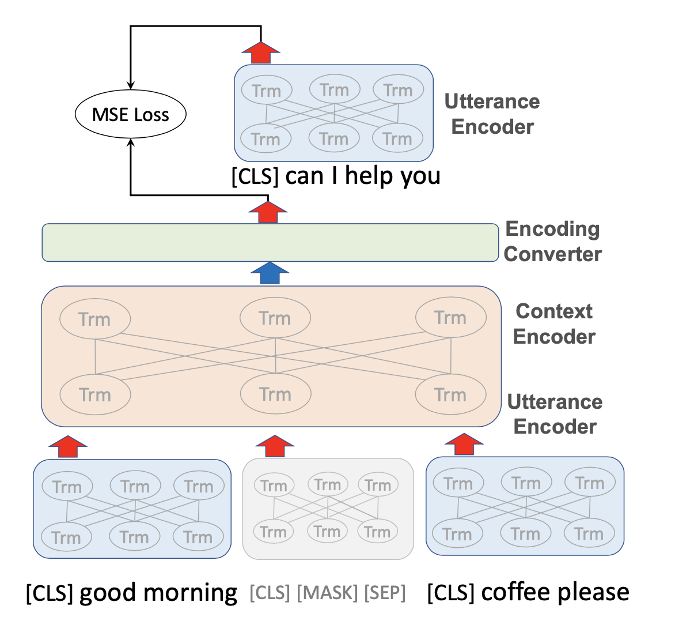
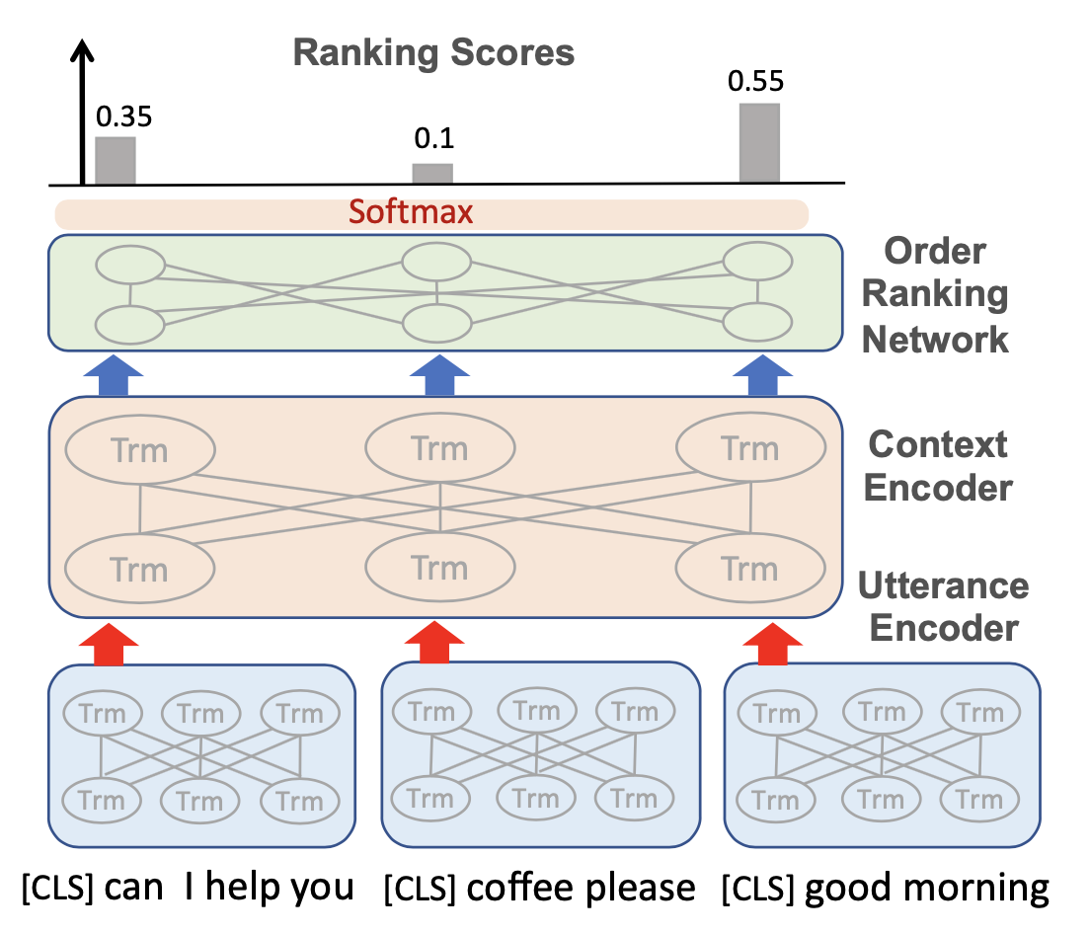
Self-supervised Tasks
DialogBERT -- a BERT extension for neural response generation
Hierarchical Transformer Encoder
Masked Utterance Regression
Distributed Utterance Order Ranking

Slide 5
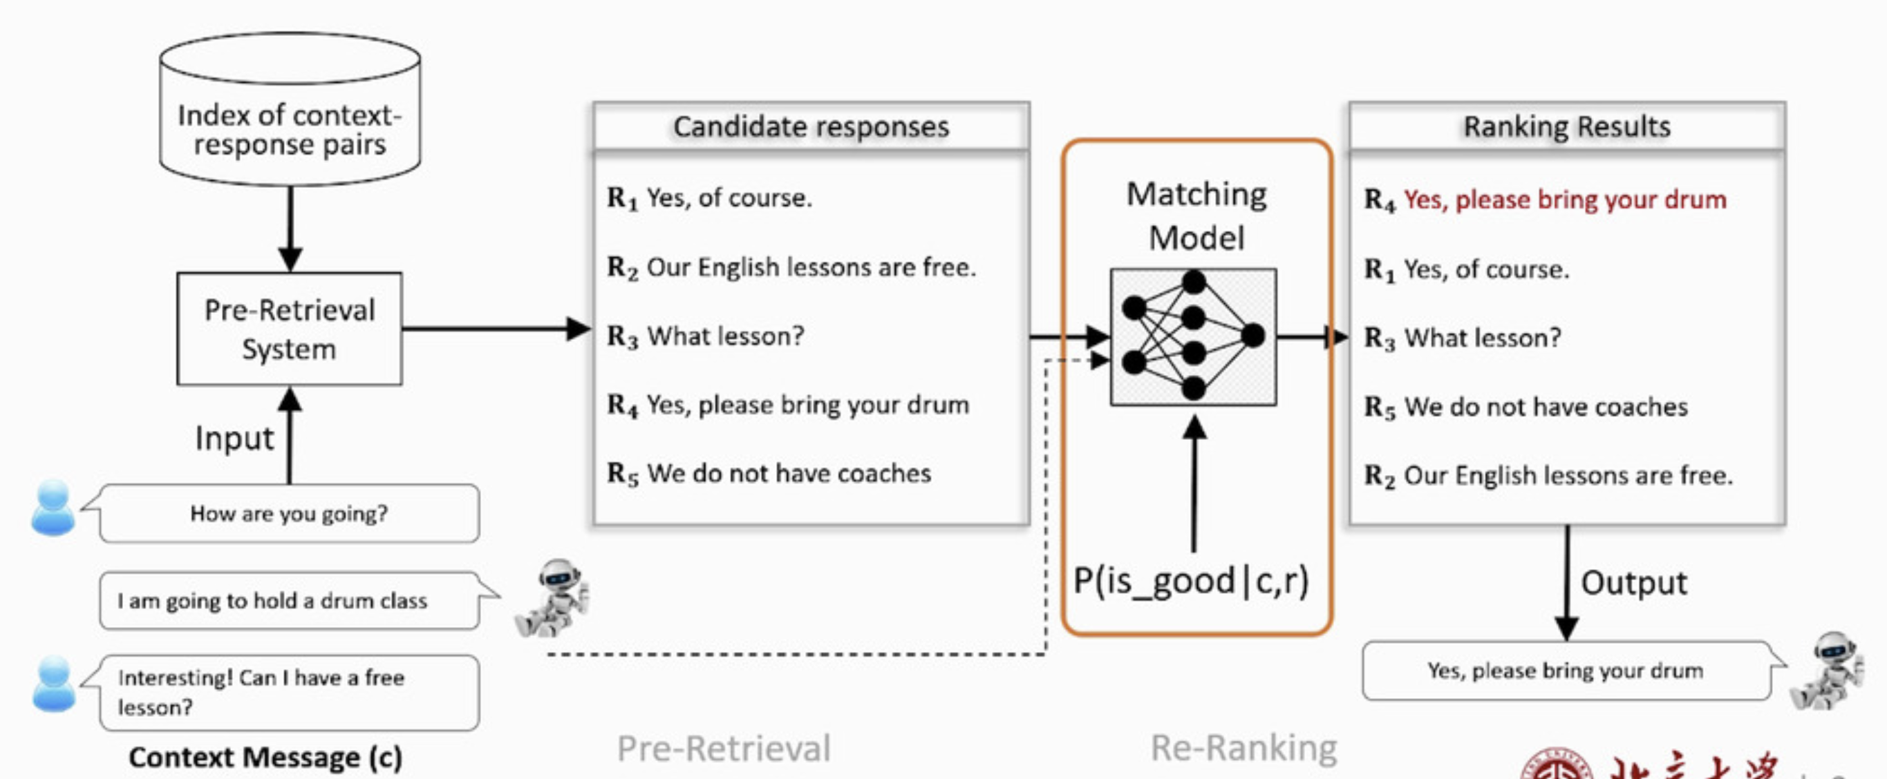
Retrieval-based Dialogue Systems
Notes:
Context-Response Matching Models
Better task-related representation
Better generalization ability

Slide 6
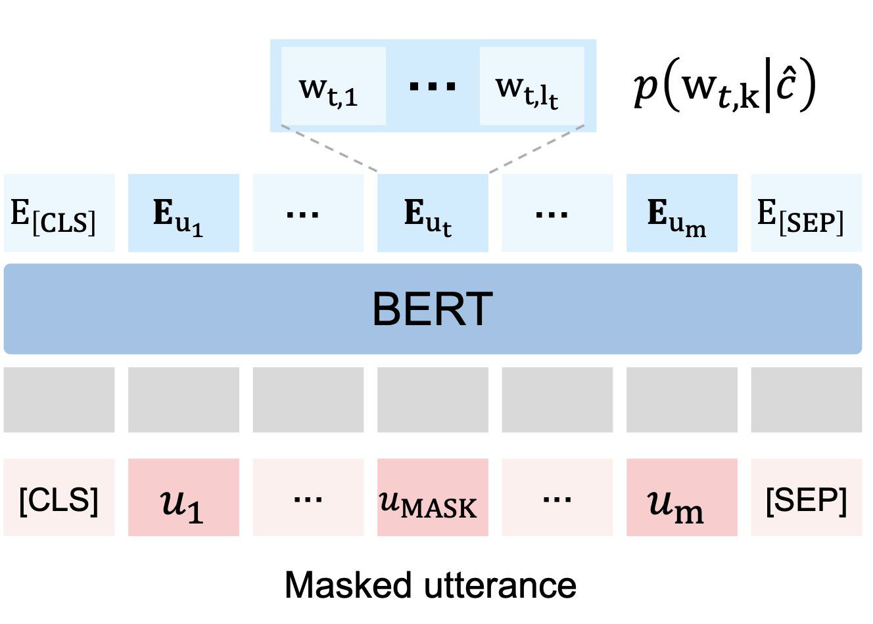
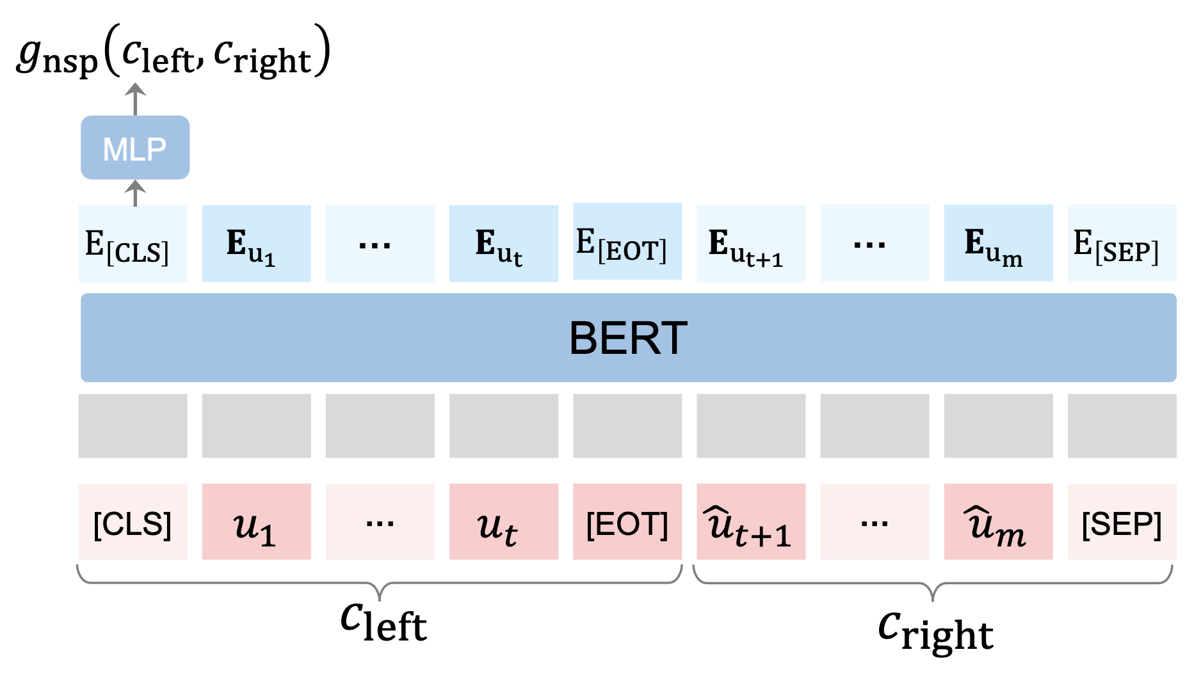
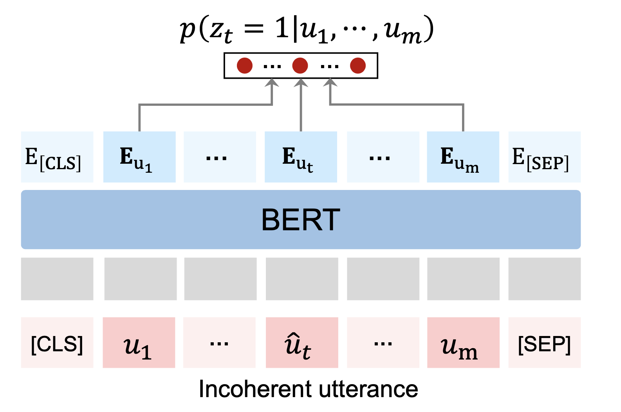
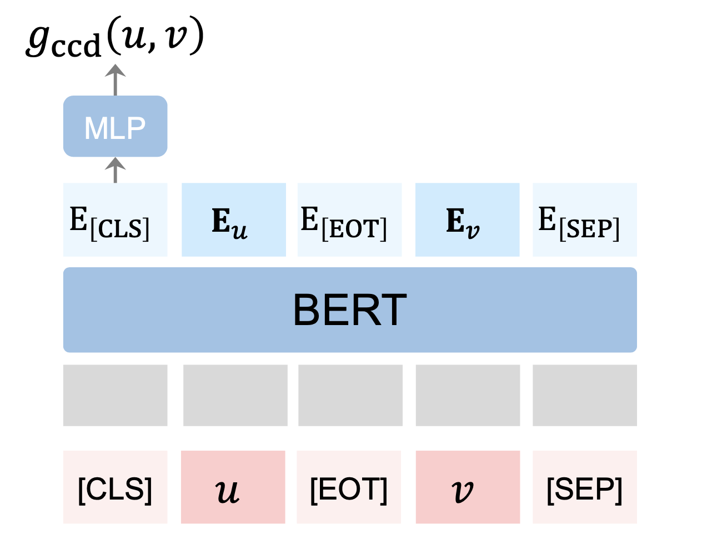
Self-supervised Tasks
Next-session Prediction
Utterance Restoration
Incoherence Detection
Consistency Discrimination

Slide 7
Contents
Pre-trained Language Model: ELECTRA
An Adversarial Experiment:
Are language models for response selection
trained properly?
Self-supervised Tasks: Utterance Manipulation Strategies (UMS)

Slide 8
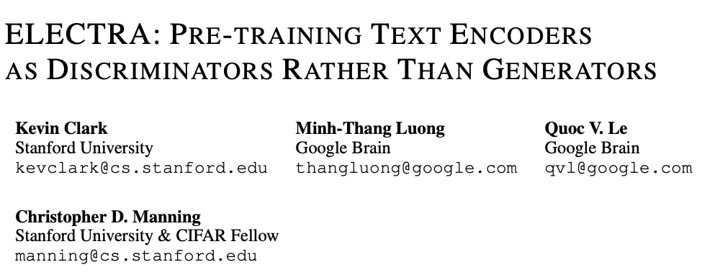

Slide 9
Background
pre-training with more compute
better downstream accuracies
For pre-training methods:
compute efficiency + absolute downstream performance
Replaced Token Detection v.s. MLM
Notes:
It has become a commonsense that
So, the author proposed that for fair comparison among pretraining methods, the same model size, data, and compute.
In other words, a better pre-training method should achieve better compute efficiency and higher absolute performance on down stream tasks.
This model focus on improving the masked language modeling.

Slide 10
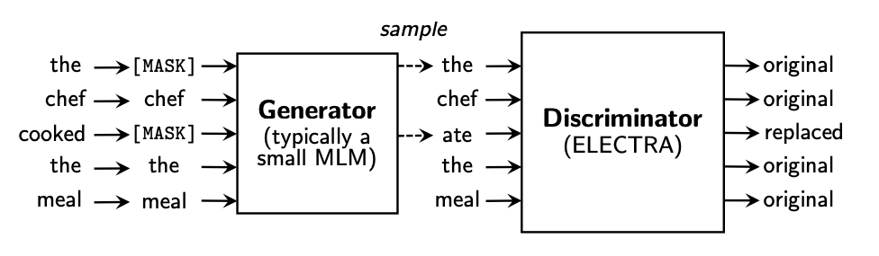
Replaced Token Detection
Notes:
MLM first select a random set of positions (integers between 1 and n) to mask out
The tokens in the selected positions are replaced with a [MASK] token:
The generator then learns to predict the original identities of the masked-out tokens
The discriminator is trained to distinguish tokens in the data from tokens that have been replaced by generator samples.

Slide 11
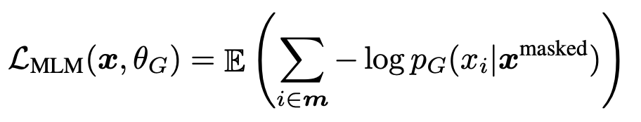
Replaced Token Detection
Trained with the maximum-likelihood
Notes:
The generator is trained to perform masked language modeling (MLM)

Slide 12
Replaced Token Detection
Trained with the binary cross-entropy loss
Notes:
The discriminator is trained to distinguish tokens in the data from tokens that have been replaced by generator samples.

Slide 13

Replaced Token Detection
Notes:
minimize the combined loss
We don’t back-propagate the discriminator loss through the generator

Slide 14
Replaced Token Detection

Slide 15
Advantages I: [MASK]
Solves the mismatch of the [MASK] tokens in BERT
Notes:
solves a mismatch in BERT (although not in XLNet) where the network sees artificial [MASK] tokens during pre-training but not when being fine-tuned on downstream tasks.

Slide 16
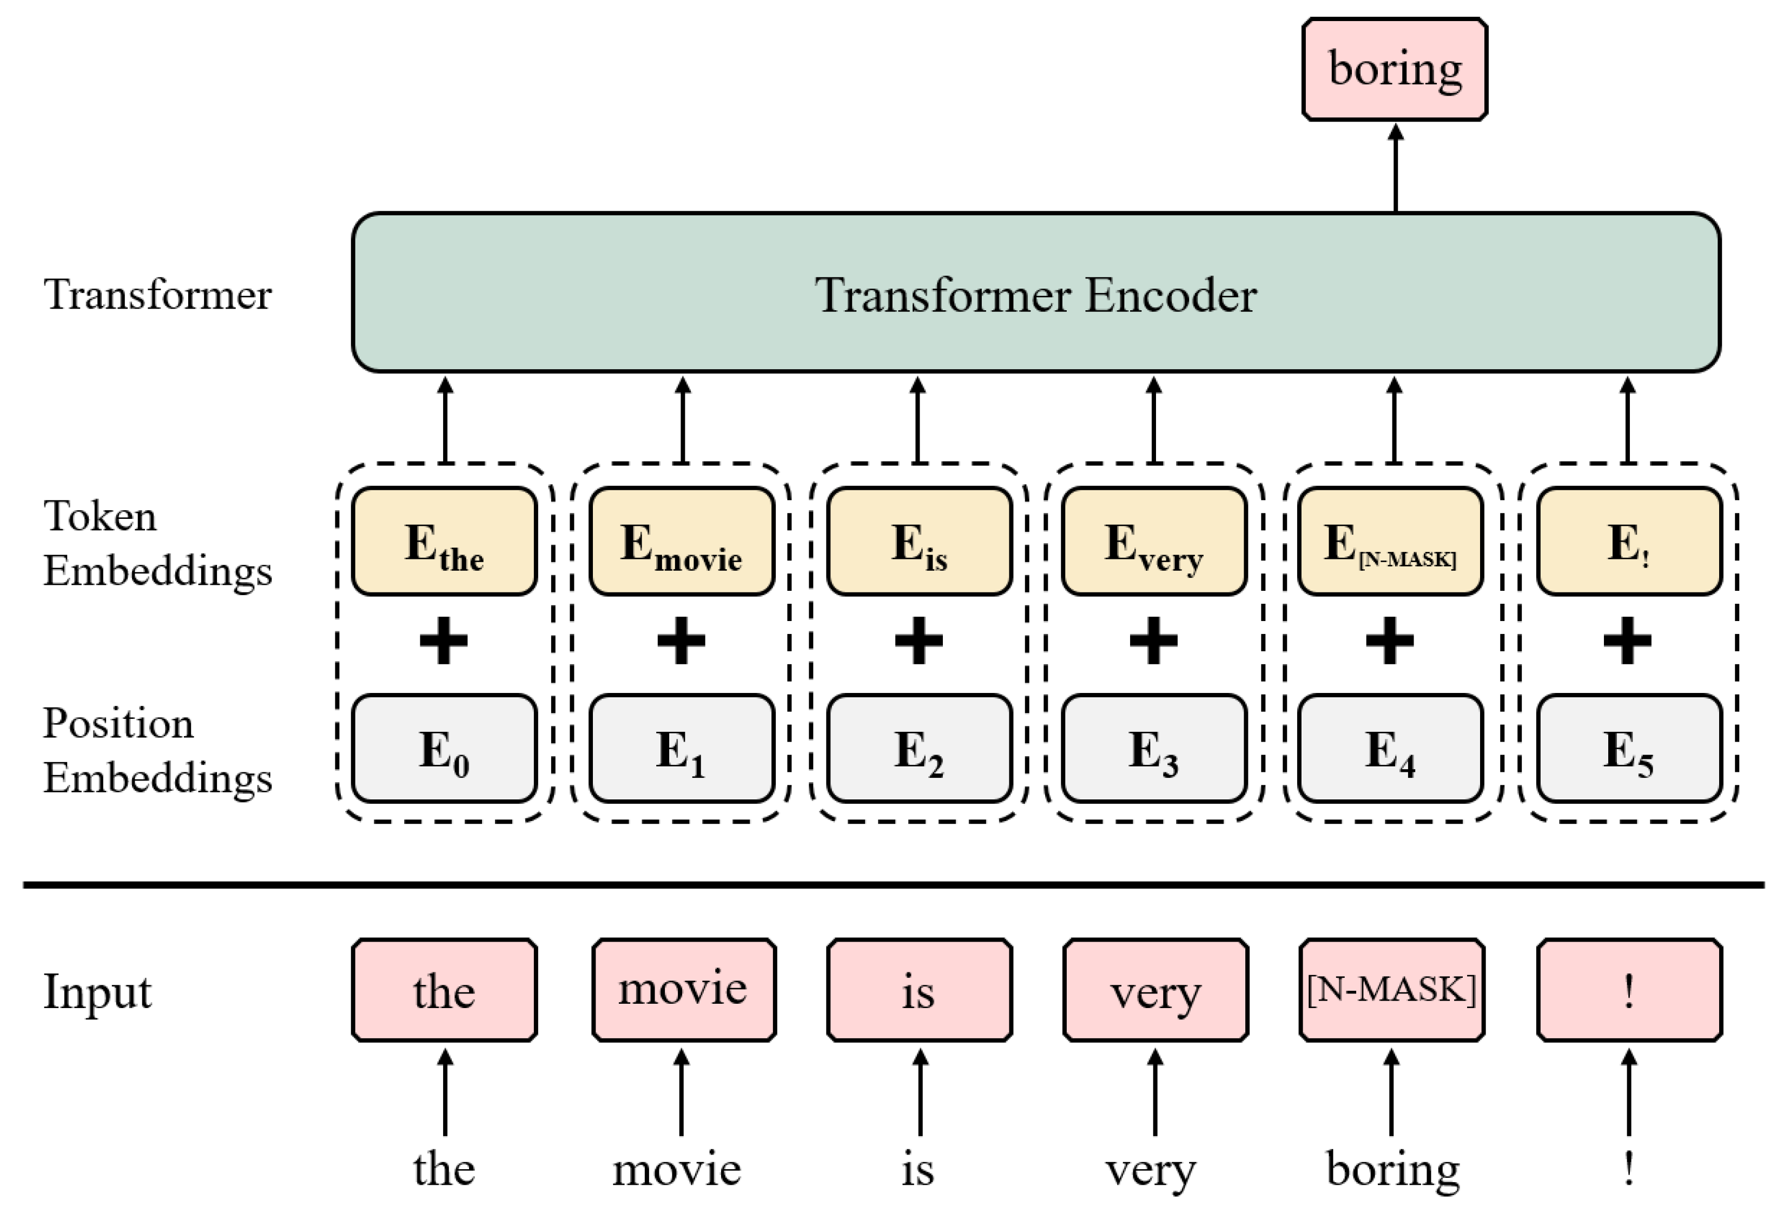
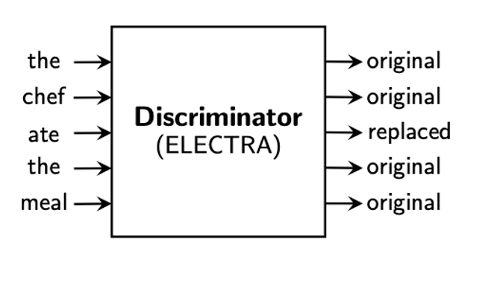
Advantages II: Efficiency Gains
MLM learns from the 15% of the tokens per example
RTD learns from all input tokens
Notes:
model learns from all input tokens instead of just the small masked-out subset, making it more computationally efficient.

Slide 17
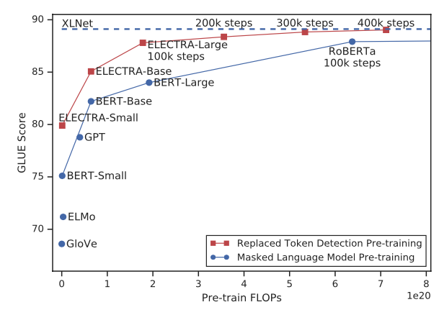
Results
Replaced token detection pre-training consistently outperforms masked language model pre-training given the same compute budget.
Notes:
FLOP:floating point operations per second
X axis: compute resources needed for pretraining
Y axis: the gleu score

Slide 18
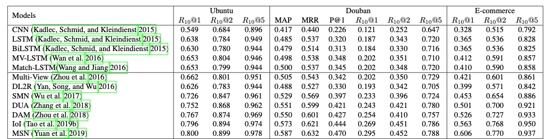
Results on Response Selection

Slide 19

Do response selection models based on pre-trained language models really know what’s next?

Slide 20
Adversarial Experiment
Train the models using the original training set
Evaluate them on the adversarial test set
Randomly extract an utterance from the dialog context
Replace it with one of negative responses among candidates
Notes:
Intuitively, we can come up with a simple adversarial experiment.

Slide 21
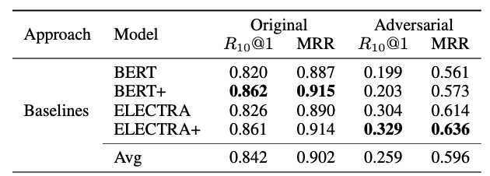

Adversarial Experiment
Adversarial experimental results on Ubuntu Corpus.
Notes:
The performances drop dramatically on the adversarial test set

Slide 22
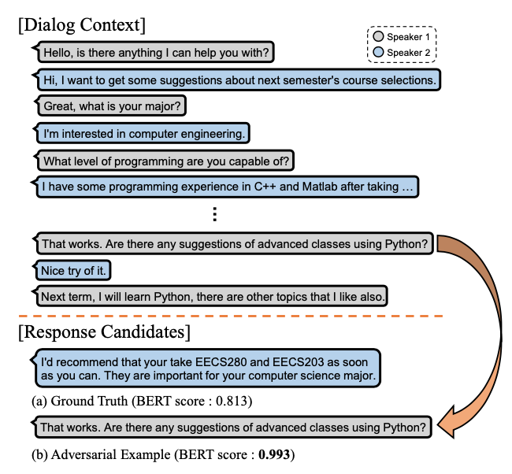
Adversarial Experiment
Notes:
A student is asking for suggestions on course selections for the next semester
The results show that the model tends to give a higher probability score to a response that is more semantically related to the dialog context rather than consistent response.

Slide 23
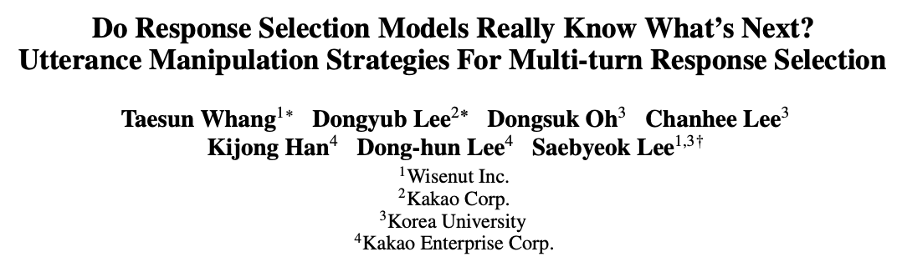

Slide 24
Approach
Utterance Manipulation Strategies (UMS)
Self-supervised learning methods
Utterance Insertion
Utterance Deletion
Utterance Search
Multi-task learning framework
Loss = response selection loss + UMS losses
Notes:
These tasks are jointly trained with the response selection model during the fine-tuning period.

Slide 25
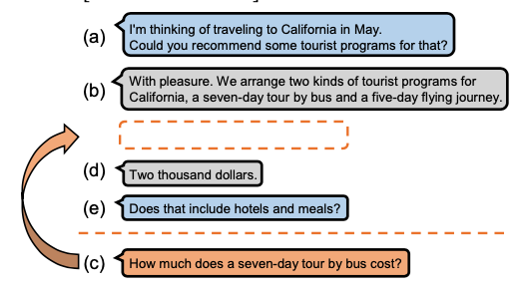
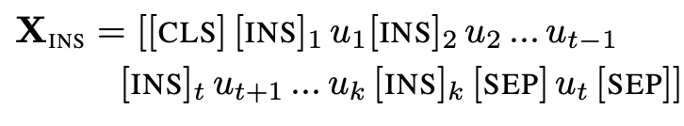
Self-supervised Tasks: Utterance Insertion
Find where the selected utterance should be inserted
Notes:
Add the special token [INS]
[INS] tokens are positioned before each utterance and after the last utterance
U_t is the target utterance
[INS]_t is the target insertion token

Slide 26
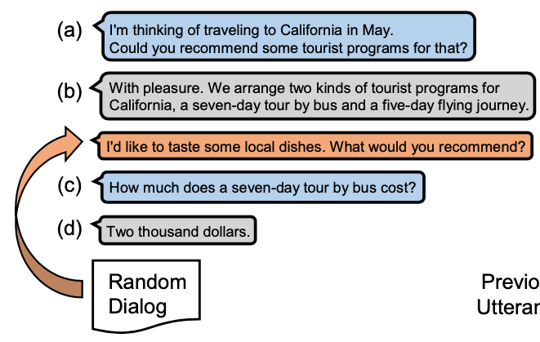
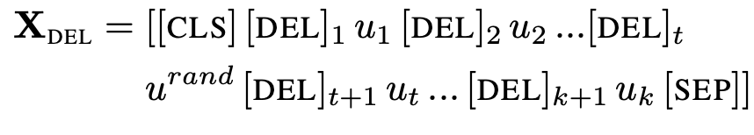
Self-supervised Tasks: Utterance Deletion
Find an unrelated utterance to the dialog.
Sampled from the random dialog.
Notes:
[DEL] tokens are positioned before each utterance
U_rand is the utterance form the random dialog
[DEL]_t is the target deletion token.

Slide 27
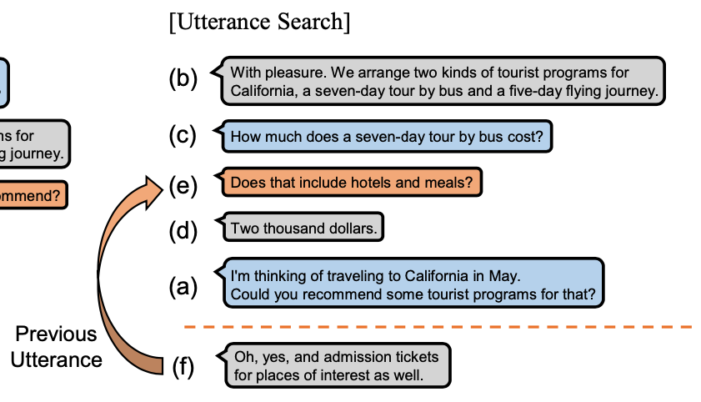
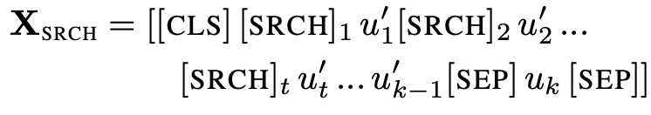
Self-supervised Tasks: Utterance Search
Find the previous utterance of the last utterance from the jumbled utterances.
Shuffle the utterances except for the last utterance.
Notes:
learn temporal dependencies between semantically similar utterances
we shuffle utterances except for the last utterance and insert [SRCH] tokens before each shuffled utterance
U_t’ is the previous utterance of the last utterance u_k
[SRCH]_t is the target search token

Slide 28
UMS losses
Binary cross-entropy loss on each target tokens for all auxiliary tasks.

Slide 29
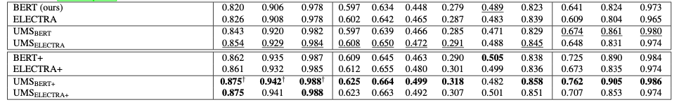
Results

Slide 30
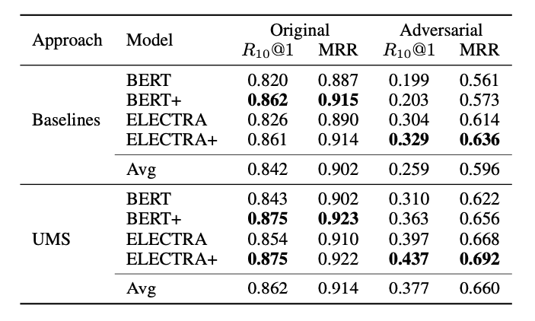
Adversarial Experiment
58.3%
38.6%
48.5%
25.4%
Adversarial experimental results on Ubuntu Corpus.
Notes:
It drops more than 10% less than the baselines

Slide 31
Crucial problems in applying language models to response selection:
Domain adaptation based on an additional training on a target corpus is extremely time-consuming and computationally costly.
Formulating response selection as a dialog–response binary classification task is insufficient to represent intra- and inter-utterance interactions as the dialog context is formed by concatenating all utterances.
The models tend to select the optimal response depending on how semantically similar it is to a given dialog.
Notes:
recap

