Slide 1
Commonsense Resources and Application
Roy

Slide 2
Outline
Introduction
Commonsense resources
Commonsense application
Conclusion
Notes:
My talk will be divided into 4 parts. First, I will briefly talk about why do we care about commonsense knowledge providing that current deep pretrained language models have already reached or surpassed human performance on a variety of NLP tasks, including sentiment analysis, natural language inference and question answering. Then I will introduce some widely used commonsense resources and the different characteristics of them. Next, I give some examples of how researchers and practitioners typically integrate these commonsense knowledge into deep neural models. In the end, I will draw my conclusion based on the above content.

Slide 3
Outline
Introduction
Commonsense resources
Commonsense application
Conclusion

Slide 4
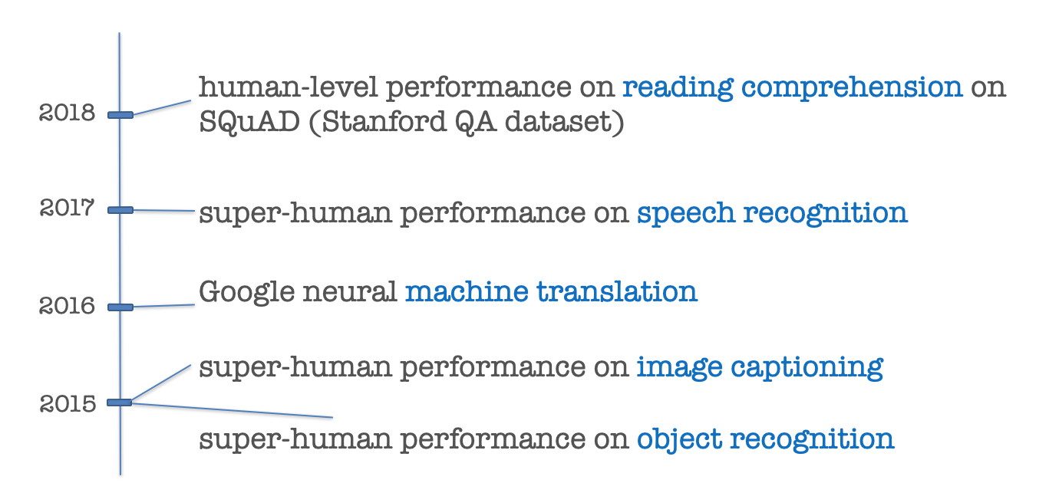
Mission Accomplished?
Notes:
As we can see from this timeline, almost in every year, we can witness deep neural models ranking higher than human performance on datasets and leaderboards in both computer vision, natural language processing and speech recognition. These rocketing performance of intelligent system mainly benefits from two aspects: one is the ever-growing scale of task-specific datasets, and the other one is the emergence of various advanced neural model architecture, such as Transformers. Combining these two, a lot of tasks seem to have been completely solved. However, recent work on adversarial example generation and model probing have unveiled that these data-driven deep models are indeed vulnerable and do not possess commonsense knowledge required to correctly solve the tasks.

Slide 5
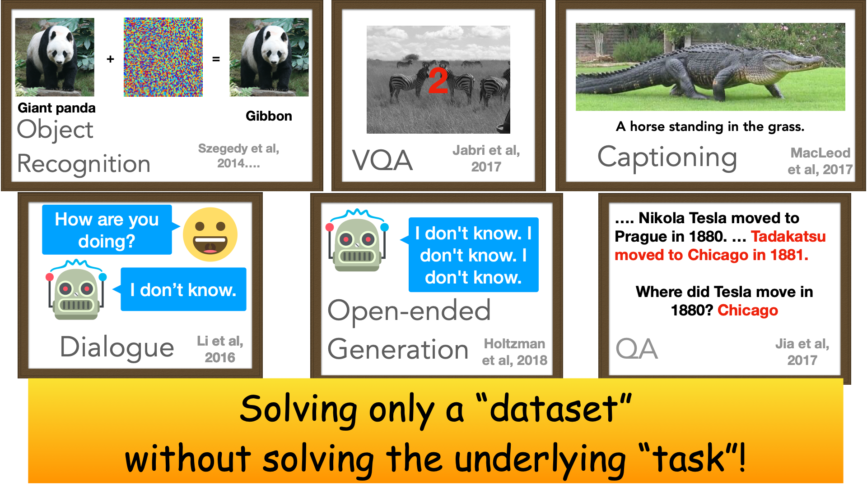
Yes we need
Notes:
In one word, these models are solving only a dataset without solving the underlying tasks.
Strong deep learning models for object recognition misclassify objects when random noise is applied.
In the task of visual question answering, often times the models just revert to priors that are in the dataset without doing reasoning.
Captioning models are often generic and very similar to the dataset that they were trained on.
Dialogue models are often blind and this issue gets worse if we want to generate a longer document. Even though recent work has improved this, there are still major shortcomings.
Last, question answering models are easily fooled with distractor sentences. Interestingly enough, all of these failure modes are seen with state of the art systems that do seemingly well on existing metrics and datasets.
And the impact of these failure modes isn’t just on accuracy, it’s been shown that when models make mistakes they tend to repeat unwanted social biases.

Slide 6
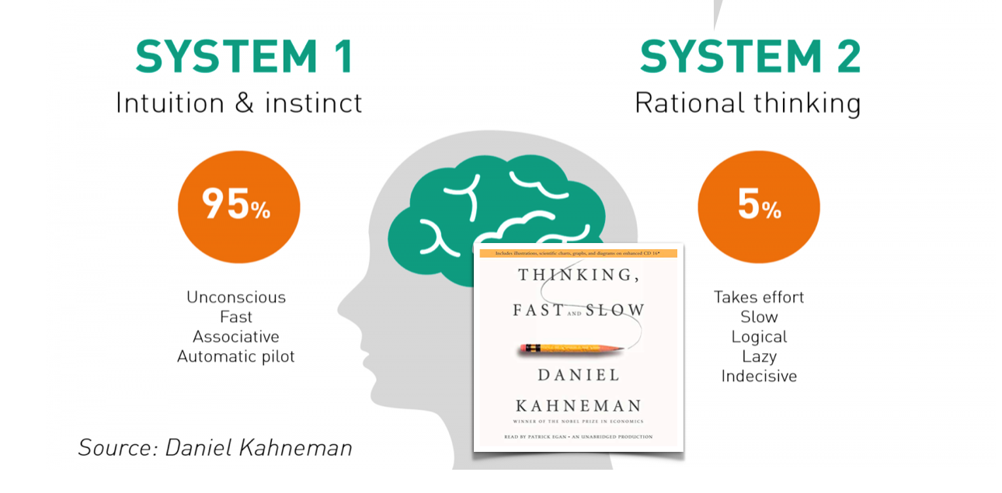
Neural Models Differ from How Human Think
Neural models trained on task-specific dataset are solving a “dataset” rather than solving the underlying “task” often by relying on spurious patterns.
Even trivial perturbations and noises that are easily distinguishable by human can make neural models perform poorly.
Neural nets may be good at system 2, but they are weak at system 1.
Notes:
In Daniel Kahneman‘s book THINKING FASK AND SLOW, he claimed that we human have two systems: system 1 and system 2. In system 1, we behave fast and unconsciously by intuition and instinct. In system 2, more complicated compositional and relational reasoning happen in a slow and indecisive manner. Current deep neural models may be good at system 2, but they are still relatively weak at system 1.

Slide 7
Outline
Introduction
Commonsense resources
Commonsense application
Conclusion

Slide 8
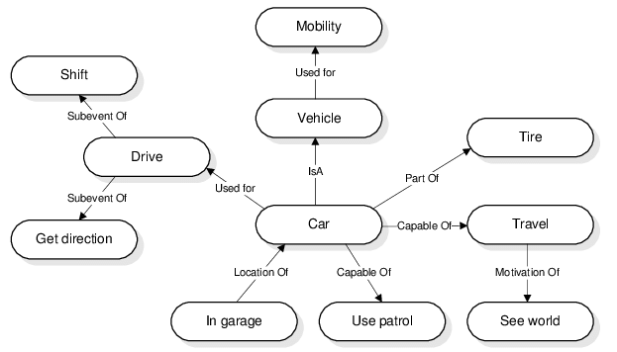
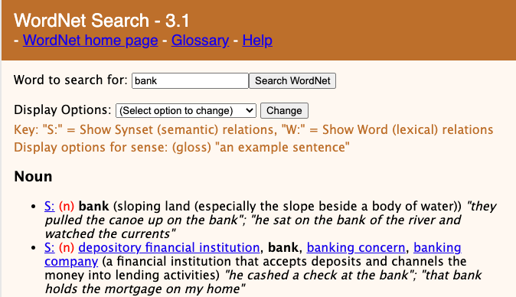
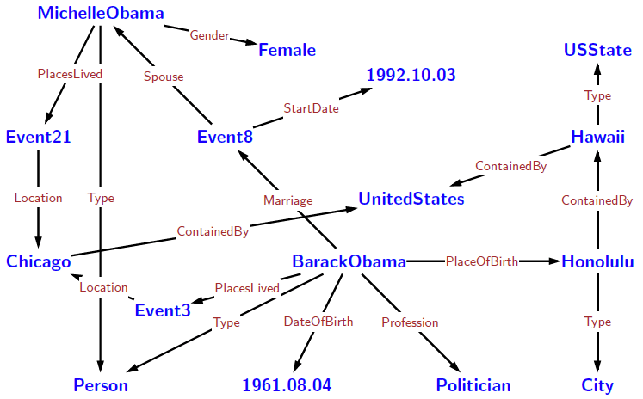
Types of Knowledge Base
Linguistic/Lexical knowledge base
Factual/Encyclopedic knowledge base
Commonsense knowledge base(social, physical, temporal, numerical)
Quiz: what are the knowledge types of the three examples?
Answer: C A B
Notes:
Though we mainly focus on commonsense knowledge today, there are indeed different types of knowledge. The first type if called linguistic or lexical knowledge, which is language-dependent. For now most lexical knowledge bases are about English since English is the dominant language in the world. The second type of knowledge is called factual or encyclopedic knowledge, which stored language-agnostic facts about entities in the world that we are living in. The third type of knowledge is commonsense knowledge, which describe knowledge about concepts and events that generally hold true in everywhere on earth.

Slide 9
Commonsense Resources
Desiderata for an ideal commonsense resource:
Large scale
Broad coverage
High quality
User-friendly interface
The larger, the better
The broader, the better
The more precise, the better
The easier to use, the better
Notes:
There are several desiderata for an ideal commonsense resource. The first one is large scale: we would like the resource to possess as much commonsense knowledge as possible. The second one is broad coverage: it means that we expect the resource to have various types of commonsense knowledge that are useful for different real-world scenarios. The third one is high quality, which means that the knowledge should be of high confidence and typicality in order to faithfully reflect our real world. The last one maybe be largely ignored but is also quite important: user-friendly interface.

Slide 10
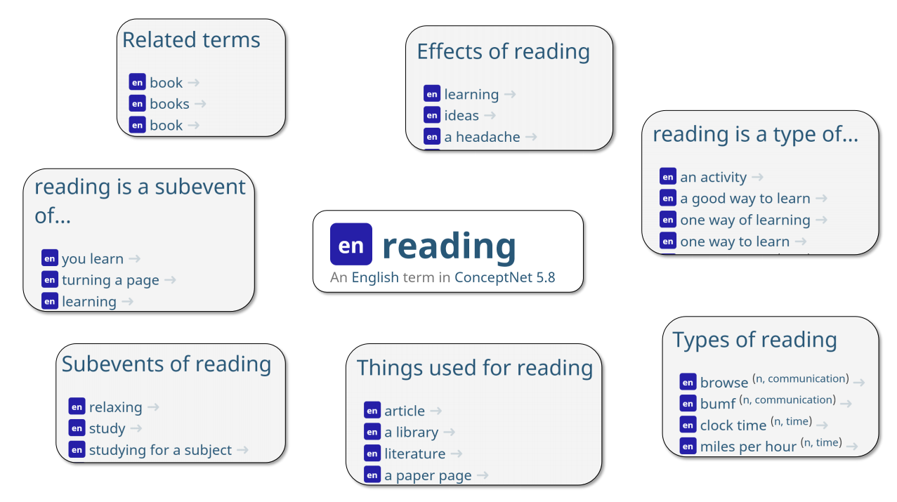
ConceptNet
Notes:
Let’s first meet ConceptNet. ConceptNet might be one of the most famous commonsense knowledge graph in the community. Here is a sample concept to illustrate how ConceptNet store and represent commonsense knowledge. “reading’ is an English term in ConceptNet 5.8, and there are several predefined relations as edges connecting “reading” to other concepts. These predefined relations cover various ontological, physical and lexical knowledge.

Slide 11
ConceptNet
About general commonsense knowledge between daily concepts in natural language
21 million edges and over 8 million nodes(1.5 million in English)
Over 86 languages
Knowledge acquisition: compiled from various sources
Knowledge covered:
Open Mind Commonsense assertions
Wikipedia/Wikitionary semantic knowledge
WordNet, Cyc ontological knowledge
Notes:
So in summary, ConceptNet is about ….

Slide 12
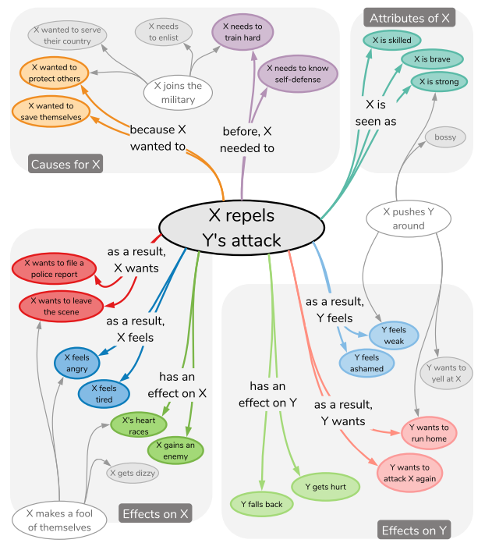
ATOMIC
Notes:
Now let’s move on to ATOMIC. ATOMIC is an atlas of if-then commonsense inferential knowledge. Each node in ATOMIC is a short phrase of English event prompt that describe a context-independent activity, event or mental state. Different from ConceptNet, ATOMIC distill its social commonsense knowledge using 9 predefined relations upon the arguments involved in the concept. In the example in this figure, there are 6 out 9 types of relations that provide knowledge about the subject person X and 3 types of relations that provide knowledge about arguments excluding PersonX.

Slide 13
ATOMIC
About inferential/causal knowledge of daily events in natural language
300,000 event nodes to date
880,000 if-then knowledge triples
Knowledge acquisition: crowdsourcing through Amazon Mechanical Turk
Knowledge covered:
Inferential knowledge about likely events that precede and follow
Abstraction on Person involved in events
Notes:
In summary, ATOMIC is about …

Slide 14
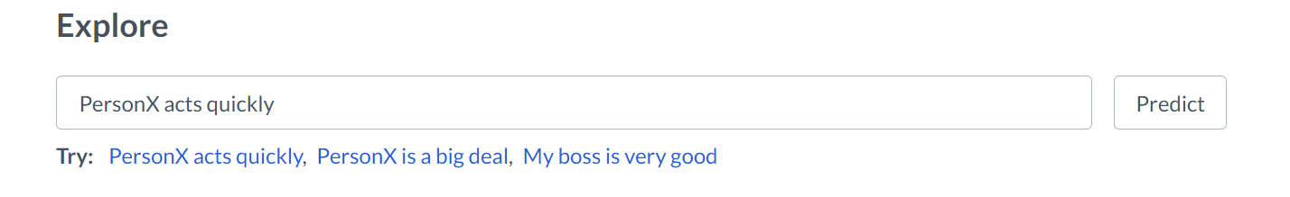
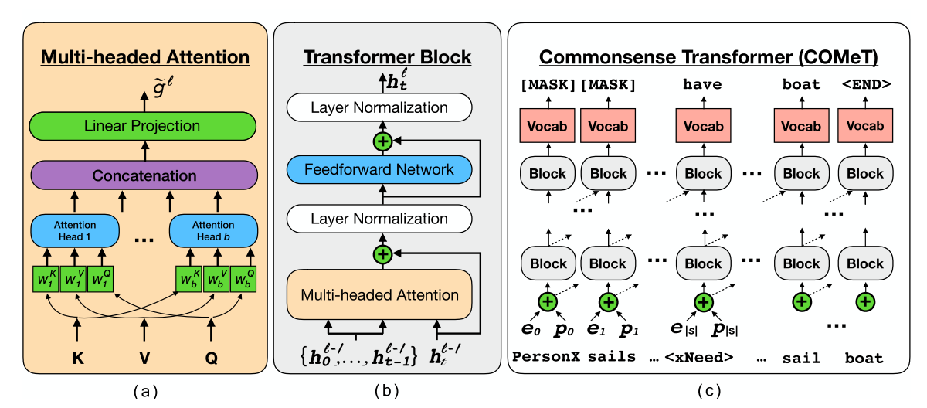
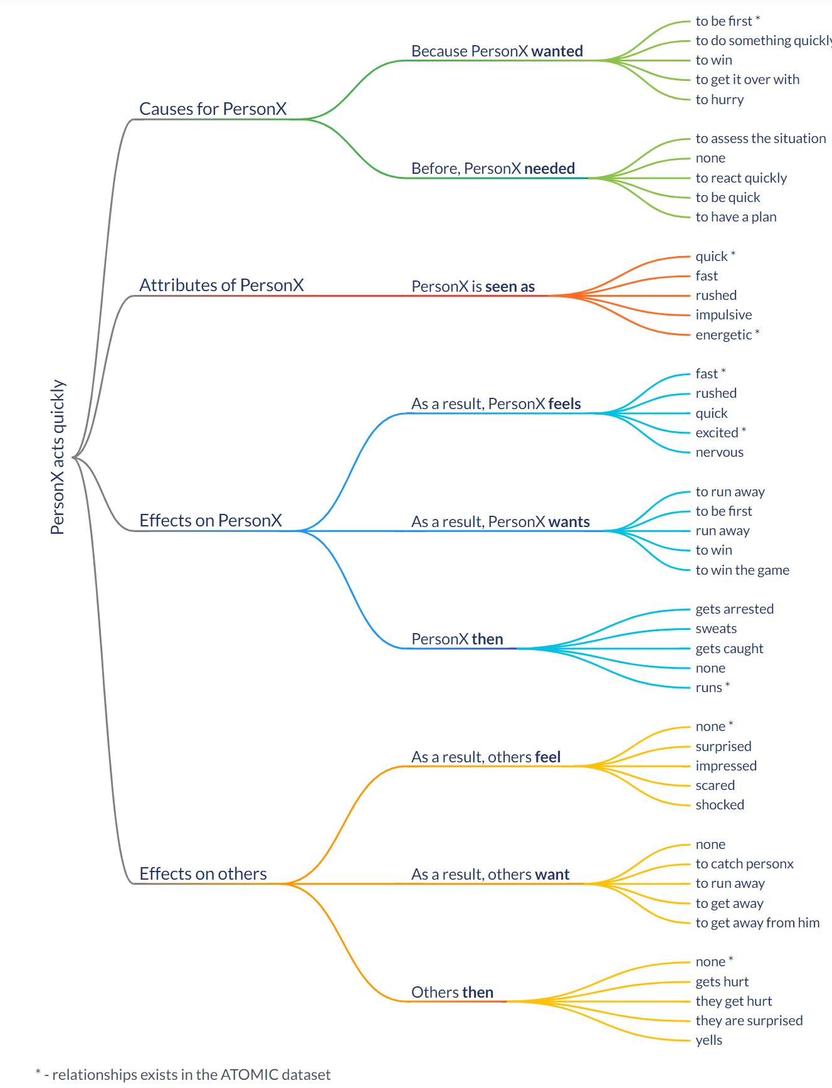
COMET
Notes:
Different from the previous two symbolic commonsense knowledge graph, COMET is a neural commonsense knowledge base. It is based on pretraind PGT-2 model and is then fine-tuned on different existing commonsense knowledge graph like ATOMIC and ConceptNet using language modeling objective.

Slide 15
COMET
A GPT-2 based neural commonsense knowledge base that generate inferential commonsense phrases conditioned on the input and specified relation type
Knowledge acquisition: generative pretraining on ATOMIC and ConceptNet.
Knowledge covered: dependent on the symbolic knowledge graph it is trained on.

Slide 16
More Commonsense KBs
ASER: large-scale, 14 discourse relations between events, in natural language form
Quasimodo: commonsense properties of events, structured key-value form
NELL: (subject, relation, object) triple form
OpenCyc: in Lisp-like logical form
…

Slide 17
Outline
Introduction
Commonsense resources
Application
Conclusion
Notes:
Next I will introduce some applications of symbolic knowledge graph in different natural language processing tasks.

Slide 18
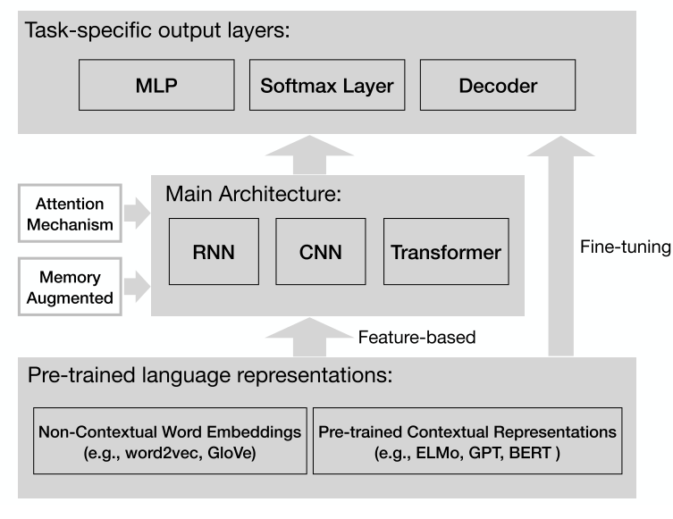
Neural Architecture for NLP
The prevalent paradigm for NLP tasks without external knowledge:
Notes:
So this is the prevalent paradigm for NLU tasks without external knowledge. The task-specific input is often first converted into non-contextualized static word embeddings using tools like word2vec and GloVE, or contextualized bidirectional representations using pretrained language models like ELMo, GPT and BERT. The encoded representations are then fed into following main architecture such as RNN, CNN and Transformer, which are optionally augmented with powerful attention or memory mechanism. Finally, task-specific output layers are placed on top of the main architectures. The whole model is then trained end-to-end by minimizing its training objective using back-propagation.

Slide 19
Knowledge Integration
Common ways of incorporating external commonsense knowledge:
Knowledge-enhanced representations (NLU tasks like MRC, QA, NLI, etc.)
Copy mechanism from symbolic knowledge(NLG tasks like Dialog generation)
…
Notes:
Given the presence of symbolic knowledge bases like ConceptNet, we can integrate useful knowledge into neural model to further improve downstream performance.

Slide 20

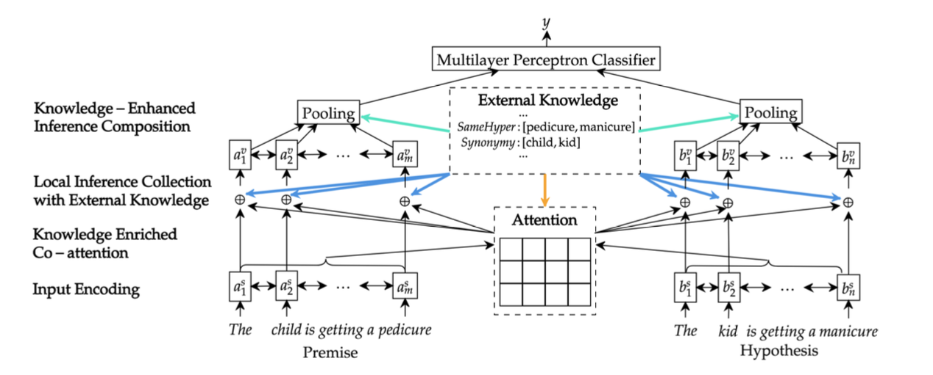
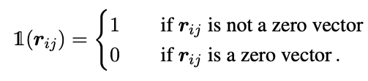
Knowledge Integration in NLU
Soft-alignment between word pairs by considering lexical relation described in WordNet:
Hypernym
Hyponym
Antonym
Co-hypernym
—— Neural natural language inference models enhanced with external knowledge (ACL2018)

Slide 21
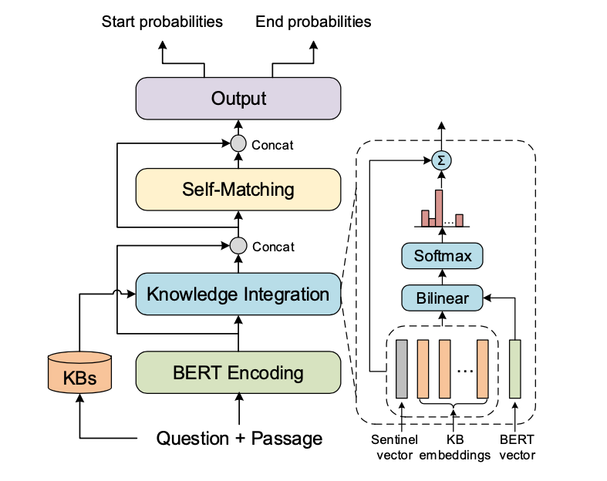
Knowledge Integration in NLU
Enrich contextual word representation with pretrained KG embeddings from WordNet and NELL using attention mechanism
—— Enhancing Pre-Trained Language Representations with Rich Knowledge for Machine Reading Comprehension (ACL2019)

Slide 22
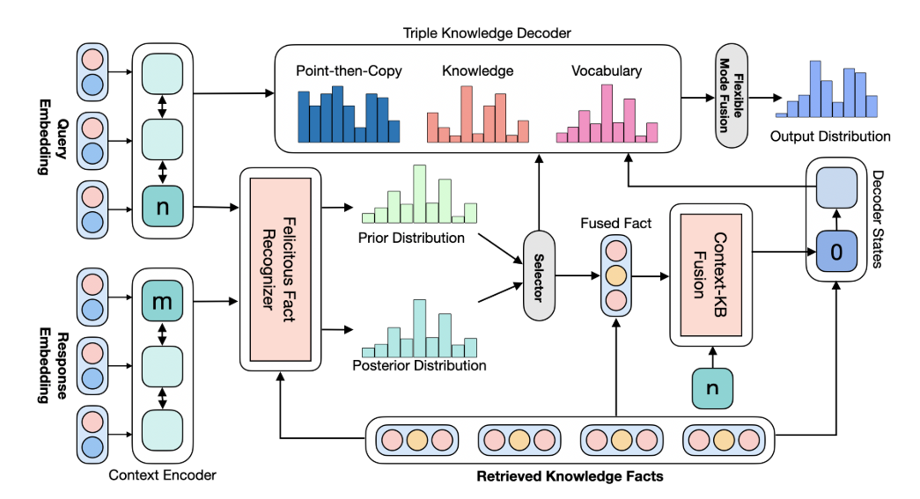
Knowledge Integration in NLG
Retrieve relevant triples from ConceptNet by fuzzy 1-gram matching and fuse the knowledge embedding with contextual embedding as input to the decoder
Dynamic entity word selection during each decoding step
—— Diverse and Informative Dialogue Generation with Context-Specific Commonsense Knowledge Awareness (ACL2020)

Slide 23
More to Explore on Knowledge Integration
More accurate knowledge embedding:
Exploiting multi-hop graph structure in KGs
More canonicalized and flexible knowledge representation:
Enabling compositional reasoning engine
More effective self-supervised pretraining using commonsense KBs:
Self-supervised pretraining on large scale raw text give rises to powerful LMs like BERT, GPT and RoBERTa, then can we draw inspiration from it and apply to knowledge-oriented pretraining?
Notes:
In addition to the previous use case I’ve introduced to you, there are more to explore on how to effectively integrate external knowledge into strong neural architectures.

Slide 24
Outline
Introduction
Commonsense resources
Commonsense application
Conclusion

Slide 25
Conclusion
Commonsense knowledge is heavily ignored in most current neural models in NLP community especially given the rise of large pretrained LMs.
Existing commonsense KBs, though providing useful knowledge, are still limited in diversity and coverage.
Ways of incorporating symbolic external knowledge remain an open research topic. Up to now, retrieve-then-integrate is the most popular strategy.

Slide 26
References
ATOMIC: https://homes.cs.washington.edu/~msap/atomic/
ConceptNet: https://homes.cs.washington.edu/~msap/atomic/
COMET: https://mosaickg.apps.allenai.org/comet_atomic/
ASER: https://hkust-knowcomp.github.io/ASER/
Quaimodo: https://www.mpi-inf.mpg.de/departments/databases-and-information-systems/research/yago-naga/commonsense/quasimodo/
NELL: http://rtw.ml.cmu.edu/rtw/
Paper list about knowledge in NLP: galaxy:/home/roy/commonsense/paper_list.bib

