Slide 1
Semantics and Algorithms for Data-dependent Grammars
Trevor Jim @ AT&T Labs-Research
Yitzhak Mandelbaum @ AT&T Labs-Research
David Walker @ Princeton University

Slide 2
Traditional parsers like YACC and its relatives were based around the LR fragment of context-free grammars.
They were powerful enough to express the syntax of many programming languages, and yet also gave linear-time performance.
How to deal with those languages without LR properties?

Slide 3
This paper is talking about a general solution to modern parsing problems ------ YAKKER.
It has some key features much different from traditional parsers. Let’s see through examples.

Slide 4


(1)Regular right sides

Slide 5
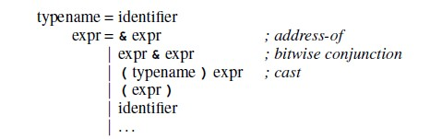
(2)Full context-free grammars
(a)&(b) may be int &x or x & y

Slide 6


(3)Attribute-directed parsing

Slide 7
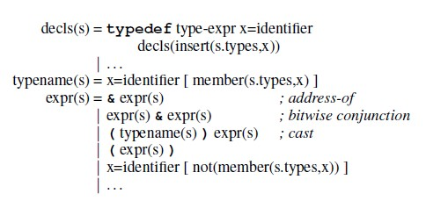
(4)Parameterized Nonterminals

Slide 8
(5)Scannerless parsing

Slide 9


(6)Blackbox parsers

Slide 10
(7)Compositionality
Our grammars are closed under union, concatenation, and Kleene closure.

Slide 11
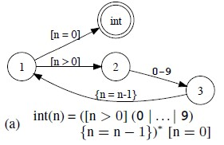
Data-dependent Automata

Slide 12
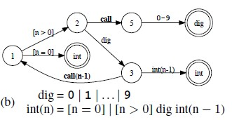
Data-dependent Automata
Using a stack

Slide 13
The Proof Idea
We will prove that data-dependent automata are powerful enough to parse the languages of data-dependent grammars.
We do so in two steps.
First, we identify sufficient conditions for a given transducer to parse the language of a given grammar.
Then, we present a translation from grammars to transducers that satisfies the conditions.

Slide 14
The Performance
In the case that a context-free grammar is specified, we retain the O(n^3) bound, given an efficient representation of tree sets.
In the case that the full features of our system are used, the algorithm is guaranteed to terminate on all inputs, if (a) all expressions within the grammar terminate, (b) the size of values in environments is bounded, (c) all blackboxes terminate, (d) the size of tree attributes is bounded and (e) tree sets have a finite representation.
In the case that one or more of the above conditions are violated, no guarantees can be made.

Slide 15
Use in PADS
PADS grammars are superficially similar to the grammars presented in this paper—they contain
regular expressions;
variable binding;
constraints;
parameterized definitions;
blackbox parsers.
And the difference:
PADS has limited backtracking, which causes closure under
union and concatenation to fail.

Slide 16
Thank you!

