Slide 1
Dead Code Detection in Scala Compiler Source
ADAPT Lab
Department of Computer Science & Engineering
Shanghai Jiao Tong University

Slide 2
Project Team Members
Professor:
Kenny Q. Zhu
Students:
Yu Shi
Changjiang Zhong
Yi Liu
Benxuan Zhang
Pei Lu

Slide 3
Outline
Introduction
Previous Attempts
Static detection: Linter
Dynamic detection: Scala debugger
Current Approach & Results
Scala Compiler Plugin
Type 1 Deadcode Detection
Type 2 Deadcode Detection
Conclusion

Slide 4
Introduction
Scala is a Java-like programming language which unifies object-oriented and functional programming.
Compilation Problem：
Compilation process of a Scala program is mush slower than a similar java program
Dead Code Detection:
Whether there is dead code in Scala compiler source for some certain set of programs as dead code may consume lots of compilation time

Slide 5
Why Scala compilation is slow?
Greater startup overhead, includes 25 phases.
appletekiMacBook-Air:~ apple$ scalac -Xshow-phases
phase name id description
---------- -- -----------
parser 1 parse source into ASTs, perform simple desugaring
namer 2 resolve names, attach symbols to named
treespackageobjects 3 load package objects
typer 4 the meat and potatoes: type the trees
……
icode 23 generate portable intermediate code
jvm 24 generate JVM bytecode
terminal 25 the last phase during a compilation run
Slow compilation speed, due to type inference, type checking , transformations on AST.
Notes:
Explain why we find dead code.

Slide 6
Why Scala compilation is slow?
Most time-consuming classes (visualVM)
Class name | Time(%)
scala.tools.nsc.transform.Transform | 36
scala.tools.nsc.symtab.classfile.Pickler | 1.1
scala.tools.nsc.transform.TailCalls | 0.8
scala.tools.nsc.typechecker.Analyzer | 31.4
scala.tools.nsc.backend.jvm.GenASM | 22.4
scala.tools.nsc.backend.icode.GenICode | 6.9
Total | 98.6
Notes:
Explain why we find dead code.

Slide 7
Why Scala compilation is slow?
The central data structure of the compiler is class scala.tools.nsc.ast.Trees. Trees are immutable structures, and need to be copied during transformation.
So we wish to find dead code in these related class for better performance.
Notes:
Explain why we find dead code.

Slide 8
Our Approaches
Types of Dead Code:
Type 1: The code which is never been executed
Type 2: The program executed assignment code but does nothing to results
Type 3: I/O relevant code in type 2 dead code
Main Contribution:
Writing a Scala compiler plugin adding a piece of “println” code to transform the AST.
Writing a Scala program to list all dead code in Scala compiler source

Slide 9
Previous Attempts
Static Analysis
Linter tool
Dynamic Analysis
Scala debugger

Slide 10
Static Detection Tool
Linter: is a Scala static analysis compiler plugin which adds compile-time checks for various possible bugs, inefficiencies, and style problems
But unfortunately, it doesn’t even warn the unused assignment as dead code which results from the special feature of scala.
Call for dynamic data flow analysis instead of static.

Slide 11

Static Detection Tools
We have found 16 such type 1 dead code fragments.
Useless assignment.
Identical Condition

Slide 12


Static Detection Tools
Identical cases
Useless condition

Slide 13
Dynamic Detection Tool
Trace program step-by-step using debugger integrated with Scala IDE
Hardwire code into the Scala IDE source

Slide 14
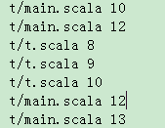
Type 1 Dead Code
Output format: path and line number
This file is generated by the modified Scala IDE, demonstrating executed traces.

Slide 15
Type 1 Dead Code
Then for each input, we will get a sequence of statements executed.
We compute the difference set between this and the whole source and we will get the type one dead code for this input.
Then we try many times and get the intersection which is the unexecuted codes.

Slide 16
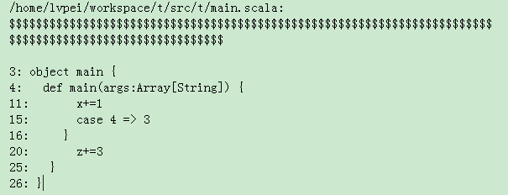
Type 1 Dead Code
Output format (deadcode.txt):

Slide 17
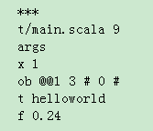

Type 2 Dead Code
We change the output format and add the variable information.
line 9
arguments
X = 1
ob = some state
t = helloworld
f = 0.24

Slide 18
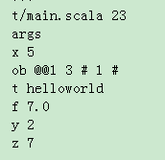
Type 2 Dead Code
For a class, see the value changed of variables ob. It means that we have changed some contents of classes.

Slide 19
Type 2 Dead Code
Then by comparing the values of variables between each steps, and combining with the AST tree, we keep a set for each variable in which instructions it was read and written.
Treat “if”, “while” as useful statement specifically, since “if” and “while” control the executed traces.

Slide 20
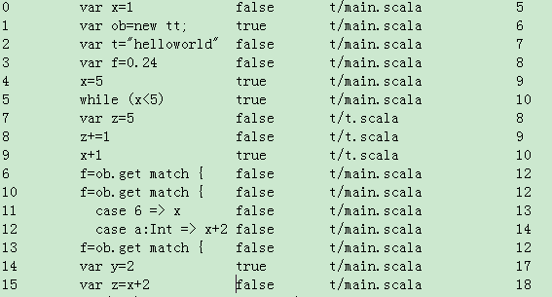
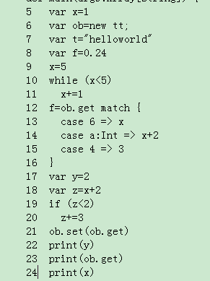
Type 2 Dead Code
Output whether an executed line is useful or useless.(false: useless; true: useful)

Slide 21
Limitation of Previous Approach
Stepping through in Scala debugger is extremely slow
Without complete view of the AST, parameter passing in function calls and attributes in objects are not handled properly
Not feasible!

Slide 22
Compiler plugin technology
Compiler plugin lets you modify the behavior of the compiler itself without needing to change the main Scala distribution
Two large categories with the current plugin support
You can add a phase to the compiler, thus adding extra checks or extra tree rewrites that apply after type checking has finished.
You can tell the compiler type-checking information about an annotation that is intended to be applied to types.

Slide 23

A simple plugin, beginning to end
Suppose you want to write a plugin that detects division by zero in obvious cases:
Your plugin could generate an error like this:
object Test {
val five = 5
val amount = five / 0
def main(args: Array[String]){
println(amount)
}
}
Test.scala:3: error: definitely division by zero
val amount = five / 0
^
one error found

Slide 24
A simple plugin, beginning to end
You need to write and compile the source of the plugin itself:
class DivByZero(val global: Global) extends Plugin {
import global._
val name = "divbyzero"
val description = "checks for division by zero"
val components = List[PluginComponent](Component)
private object Component extends PluginComponent {
val global: DivByZero.this.global.type = DivByZero.this.global
val runsAfter = "refchecks"
// Using the Scala Compiler 2.8.x the runsAfter should be written as below
// val runsAfter = List[String]("refchecks");
val phaseName = DivByZero.this.name
def newPhase(_prev: Phase) = new DivByZeroPhase(_prev)
class DivByZeroPhase(prev: Phase) extends StdPhase(prev) {
override def name = DivByZero.this.name
def apply(unit: CompilationUnit) {
for ( tree @ Apply(Select(rcvr, nme.DIV), List(Literal(Constant(0)))) <- unit.body;
if rcvr.tpe <:< definitions.IntClass.tpe)
{
unit.error(tree.pos, "definitely division by zero")
}
}
}
}
}
Notes:
The plugin is described by a top-level class that inherits from Plugin, takes a Global as a constructor parameter, and exports that parameter as a val named global.
The plugin must define one or more component objects that inherits from PluginComponent. In this case the sole component is the nested Component object. The components of a plugin are listed in the components field.
Each component must define newPhase method that creates the component's sole compiler phase. That phase will be inserted just after the specified compiler phase, in this case refchecks.
Each phase must define a method apply that does whatever you desire on the given compilation unit. Usually this involves examining the trees within the unit and doing some transformation on the tree.

Slide 25
Basic Idea of Our Plugin
Our Idea:
Transform the AST of Scala compiler source by adding “println” expression in front of every executable line
Three Main Problems:
1. How can we create the “println” expression and add it into the original AST?
2. How can we add “println” expression as complete as possible
3. How can we avoid adding expression at wrong places?
Notes:
Arguments of the “println” expression are file names and line numbers of these lines. For we want to track the behavior of Scala compiler, we use ant to build Scala compiler together with our plugin. The compiler built by our way not only has its original function but also can output the locations of every executed line.
Our plugin starts from the whole AST of a source file, each node of which denotes a construct occurring in the source code. We encounter three main problems:

Slide 26
Scala Compiler Plugin
1 object hello {
def main(args: Array[String]) {
val i = 1
4 if(i == 2)
5 print(“i is equal to 2.\n”)
6 else
7 print(“i is not equal to 2.\n”)
8 print(t)
}
10
11 def t = {
var re = 2
if(re == 2)
re = 3
15 else
16 re = 4
17 re
18 }
19 }
source-/Users/apple/Downloads/ExtendPlugin/src/print/hello.scala 2
source-/Users/apple/Downloads/ExtendPlugin/src/print/hello.scala 2
source-/Users/apple/Downloads/ExtendPlugin/src/print/hello.scala 1
source-/Users/apple/Downloads/ExtendPlugin/src/print/hello.scala 1
source-/Users/apple/Downloads/ExtendPlugin/src/print/hello.scala 3
source-/Users/apple/Downloads/ExtendPlugin/src/print/hello.scala 7
source-/Users/apple/Downloads/ExtendPlugin/src/print/hello.scala 4
source-/Users/apple/Downloads/ExtendPlugin/src/print/hello.scala 7
i is not equal to 2.
source-/Users/apple/Downloads/ExtendPlugin/src/print/hello.scala 4
source-/Users/apple/Downloads/ExtendPlugin/src/print/hello.scala 8
source-/Users/apple/Downloads/ExtendPlugin/src/print/hello.scala 8
source-/Users/apple/Downloads/ExtendPlugin/src/print/hello.scala 11
source-/Users/apple/Downloads/ExtendPlugin/src/print/hello.scala 11
source-/Users/apple/Downloads/ExtendPlugin/src/print/hello.scala 1
source-/Users/apple/Downloads/ExtendPlugin/src/print/hello.scala 1
source-/Users/apple/Downloads/ExtendPlugin/src/print/hello.scala 12
source-/Users/apple/Downloads/ExtendPlugin/src/print/hello.scala 14
source-/Users/apple/Downloads/ExtendPlugin/src/print/hello.scala 13
source-/Users/apple/Downloads/ExtendPlugin/src/print/hello.scala 14
source-/Users/apple/Downloads/ExtendPlugin/src/print/hello.scala 13
source-/Users/apple/Downloads/ExtendPlugin/src/print/hello.scala 17
3
Notes:
Okay, first, let’s go to see what our plugin does.
There is a toy scala program on the left. We compile it with our plugin, and run it. On the right is the output.
Except the two lines within expectations, there are a lot of strings composed of file paths and a number. File path is exactly the path to the program file. And I think it’s not difficult to find that numbers are lines of code that is executed, though they appear somewhat in disorder and some repeat strange. I will explain it later.
Now, image what if we build scala compiler with our plugin, and run the compiler to compile some programs.

Slide 27
Quiz
What if we build Scala compiler with our plugin and run it to compile some Scala program.

Slide 28
Scala Compiler Plugin
58 def helpTransform(tree : Tree, printList : List[Tree]) : Tree = {
59 var newtree =
60 tree match {
61 case p @ PackageDef(pid, stats) => {
62 if(//some files in source can not be applied to by plugin
91 )
92 {
93 val myPrint = generatePrintln(p.pos.focus.toString, p.pos.focus.line)
94 var x : List[Tree] = Nil
95 for(i <- p.stats) {
96 x = x ::: List(helpTransform(i, myPrint :: printList))
97 }
98 treeCopy.PackageDef(p, p.pid, x)
99 }
100 else {
101 println("Package Untransformed: " + unTransformed + p.name + " " + p.pos.focus)
102 unTransformed = unTransformed + 1
103 p
104 }
105 }
Notes:
As yi has explained the function of the plugin, I will directly go into some details about how our plugin is written.
AST of a scala program file is always a packagedef type tree. So once the plugin begin to work, the ast it encounters matches packagedef.
Look at here, an entrance to every file.

Slide 29
Scala Compiler Plugin
58 def helpTransform(tree : Tree, printList : List[Tree]) : Tree = {
59 var newtree =
60 tree match {
61 case p @ PackageDef(pid, stats) => {
62 if(//some files in source can not be applied to by plugin
91 )
92 {
93 val myPrint = generatePrintln(p.pos.focus.toString, p.pos.focus.line)
94 var x : List[Tree] = Nil
95 for(i <- p.stats) {
96 x = x ::: List(helpTransform(i, myPrint :: printList))
97 }
98 treeCopy.PackageDef(p, p.pid, x)
99 }
100 else {
101 println("Package Untransformed: " + unTransformed + p.name + " " + p.pos.focus)
102 unTransformed = unTransformed + 1
103 p
104 }
105 }
Notes:
“PackageDef” is the class type of the AST of every file of source code. It’s a example for how we add “println” expressions.Besides, our plugin skip some file in order to successfully build our Scala compiler.

Slide 30
Scala Compiler Plugin
58 def helpTransform(tree : Tree, printList : List[Tree]) : Tree = {
59 var newtree =
60 tree match {
61 case p @ PackageDef(pid, stats) => {
62 if(//some files in source can not be applied to by plugin
91 )
92 {
93 val myPrint = generatePrintln(p.pos.focus.toString, p.pos.focus.line)
94 var x : List[Tree] = Nil
95 for(i <- p.stats) {
96 x = x ::: List(helpTransform(i, myPrint :: printList))
97 }
98 treeCopy.PackageDef(p, p.pid, x)
99 }
100 else {
101 println("Package Untransformed: " + unTransformed + p.name + " " + p.pos.focus)
102 unTransformed = unTransformed + 1
103 p
104 }
105 }
Notes:
We can not add “println” expressions in front of all lines of code. We pass the locations of lines which can not be added to “println” expressions to its child nodes. So the traces output are complete.

Slide 31
Scala Compiler Plugin
We use ANT to build the Scala compiler:
scala/build.xml
<!-- Additional command line arguments for scalac. They are added to all build targets -->
<property name="scalac.args" value="-Xplugin:output.jar"/>
<property name="javac.args" value=""/>
Notes:
Use ant to build Scala compiler.

Slide 32
Testing data
Project Name | Description | Total # of Code Lines
scalastyle | Scalastyle examines your Scala code and indicates potential problems with it. | 8429
scala-dddbase | scala-dddbase-develop is a library used to develop application based on Domain Driven Design advocated by Eric Evans. | 2732
scala-stm | scala-stm is a lightweight software transactional memory for Scala, inspired by the STMs in Haskell and Clojure. | 12458
Scala-Algorithms | Java to Scala translations of around 50 algorithms from Robert Sedgewick and Kevin Wayne's website for their book Algorithms. | 4766
scala-chart | scala-chart is a scala library for creating and working with charts. | 2957
scala-cassandra | Implementation of a Scala wrapper over the DataStax Java Driver for Cassandra | 308
scala-parser-combinators | Scala Standard Parser Combinator Library | 1880
170 individual programs | Individual scala programs, mostly from scala reference books' code example, covering most basic syntaxes. | 4943

Slide 33
Type 1 Dead Code Detected
Scala compiler source
File path | Number of total lines | Number of total dead lines | Percentage of dead lines
scala/src/compiler | 72206 | 32704 | 0.536
scala/src/library | 35750 | 26237 | 0.763
scala/src/reflect | 31039 | 12340 | 0.460
type 1 dead code
traces

Slide 34
Top 5 Files with Type 1 Dead Dode
 | file path | total lines | total dead lines | percentage of dead lines
src/compiler | compiler/scala/tools/nsc/symtab/classfile/ICodeReader.scala | 959 | 959 | 100%
 | compiler/scala/tools/nsc/typechecker/Typers.scala | 4574 | 917 | 20.0%
 | compiler/scala/tools/nsc/backend/jvm/BCodeBodyBuilder.scala | 1020 | 708 | 69.4%
 | compiler/scala/tools/nsc/javac/JavaScanners.scala | 757 | 623 | 82.3%
 | compiler/scala/tools/nsc/typechecker/ContextErrors.scala | 1067 | 607 | 56.9%
src/library | library/scala/collection/parallel/ParIterableLike.scala | 967 | 967 | 100%
 | library/scala/collection/immutable/Vector.scala | 1028 | 586 | 57.0%
 | library/scala/collection/concurrent/TrieMap.scala | 872 | 582 | 66.7%
 | library/scala/collection/parallel/mutable/ParArray.scala | 575 | 575 | 100%
 | library/scala/collection/parallel/RemainsIterator.scala | 523 | 523 | 100%
src/reflect | reflect/scala/reflect/runtime/JavaMirrors.scala | 1034 | 1034 | 100%
 | reflect/scala/reflect/internal/Printers.scala | 1143 | 822 | 71.9%
 | reflect/scala/reflect/internal/ReificationSupport.scala | 966 | 707 | 73.2%
 | reflect/scala/reflect/internal/Types.scala | 3172 | 572 | 18.0%
 | reflect/scala/reflect/api/Trees.scala | 812 | 491 | 60.5%

Slide 35
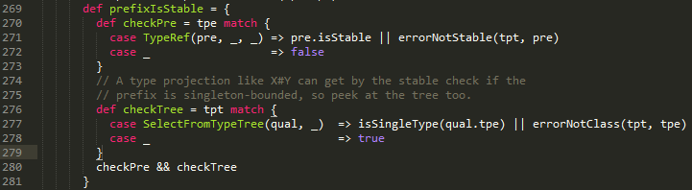
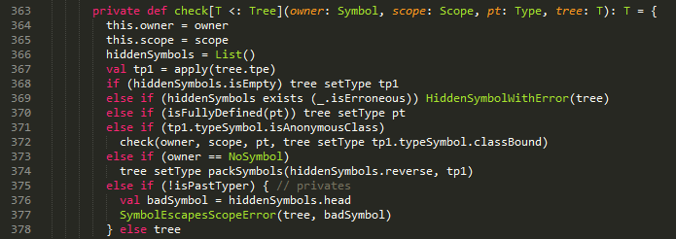
Type 1 Dead Code Examples
272,276,277,278 are dead code.
369-374, 376, 377 are dead code.

Slide 36
Type 1 Dead Code
Notes:
Dead code detected by different number of testing data.

Slide 37
Dynamic Data Flow
arg >>> f$
f$ >>> x
body >>> doubleValue$
doubleValue$ >>>
value >>> $times$
$times >>> value
value >>> Block867
Block867 >>> doubleValue
doubleValue >>> buffer
x buffer >>> $plus$
$plus >>> Block632
Block632 >>> temp
temp >>> g$
g$ >>> z
z >>> $plus$
$plus >>> g
g >>> Block637
Block637 >>> f
f >>> var2
var2 = f(arg)
def f(x : Int) : Int = {
val temp = {
val buffer = body.doubleValue()
buffer + x
}
g(temp)
}
def g(z : Int) : Int = z + 1

Slide 38
Naming ASTs for Data Flow
For ASTs participating in data flow, we want to give each of them an identifier/name to represent a corresponding node in data flow.
AST | Name
Apply(args, fun) | Name of “fun”
DefDef(mods, name, tparams, vparamss, tpt, rhs) | “name”
Block(stats, expr) | Block + AST ID
Return(expr) | Return + AST ID
ValDef(mods, name, tpt, rhs) | “name”
If(cond, thenp, elsep) | If + AST ID
Select(qualifier, selector) | “selector”
Match(selector, cases) | Match + AST ID
New(tpt) | New + AST ID
Try(block, catches, finalizer) | Try + AST ID

Slide 39
Search the Data Flow
odlval add >>> value
value >>> f3
f3 >>> b
value >>> Block864 Block864 >>> doubleValue doubleValue >>> buffer x buffer >>> $plus $plus >>> Block634 >>> temp
Something >>> t
Anything >>> b temp >>> t t >>> z z >>> $plus $plus >>> b g b c >>> d d Block634 >>> f1 f1 f2 >>> var2
Required:
f2 Block634 g c t
f2 Block634 g c temp
var2
f2 Block634 g b c
f2 g c x oldval add
f2 d Block634
f2 Block634 g c
f1 f2
f2 g c x Block364
f2 Block634 g c z
f2 g c x value
f2 g c x doubleValue
f2 Block634 g c $plus
f2 g c x buffer
f2 g c $plus
Dependents:
temp
$plus
oldval add
$plus
f1 f2
d Block634
doubleValue
Block864
t
x buffer
z
g b c
value
Dead Code

Slide 40
Data Flow in Tree Form
add
oldval
Something
value
value
temp
Block864
t
f3
doubleValue
z
Anything
$plus
x
buffer
c
$plus
g
b
Block634
d
Previous dependency
f1
f2
Latest dependency
var2

Slide 41
Scala Compiler Plugin
val temp: Int = {
val buffer: Int = {
Predef.this.print("body >>> doubleValue$ \n");
hello.this.body.doubleValue()
};
Predef.this.print("doubleValue >>> buffer \n");
{
val newvalue: Int = buffer.+({
Predef.this.print("x buffer >>> $plus$ \n");
x
});
Predef.this.print("$plus >>> Block632 \n");
newvalue
}
};
val temp = {
val buffer = body.doubleValue()
buffer + x
}

Slide 42
Order of Data Flow
def f(x : Int) : Int = {
. . .
Predef.this.print("g >>> Block637 \n");
Predef.this.print("Block637 >>> f \n");
g(temp)
}
def f(x : Int) : Int = {
. . .
g(temp)
}
def f(x : Int) : Int = {
. . .
g(temp)
Predef.this.print("g >>> Block637 \n");
Predef.this.print("Block637 >>> f \n");
}
def f(x : Int) : Int = {
. . .
g(temp)
}
def f(x : Int) : Int = {
. . .
val newvalue = g(temp)
Predef.this.print("g >>> Block637 \n");
Predef.this.print("Block637 >>> f \n”);
newvalue
}
def f(x : Int) : Int = {
. . .
g(temp)
}

Slide 43
“helpTransform” function
The recursive function used in tree transform
Takes 4 parameters
tree: the AST to transform
paramList and returnList: Lists of “println” passed from higher ancestor ASTs.
parSymbol: owner symbol used for newly created values.
def paramList : List[Tree], returnList : List[Tree], parSymbol : Tree = NoSymbol) : Tree

Slide 44
Order of Data Flow
def helpTransform(tree : Tree, paramList : List[Tree], returnList : List[Tree], parSymbol : Tree = NoSymbol) : Tree = {
var newtree =
tree match {
. . .
case d @ DefDef(mods, name, tparams, vparamss, tpt, rhs) => {
. . .
treeCopy.DefDef(d, mods, name, tparams, vparamss, tpt,
helpTransform(rhs, List(println(“d$ >>> parameters”)), println(“rhs >>> d”), d.symbol))
}
case b @ Block(stats, expr) => {
. . .
treeCopy.Block(b, newStats ::: paramList,
helpTransform(expr, Nil, println(“expr >>> Block”) ::: returnList, parSymbol)
case i @ Ident(name) => treeCopy.Block(i, paramList ::: returnList, i)
case l @ Literal(value) => treeCopy.Block(l, paramList ::: returnList, l)

Slide 45
Challenges
Insert new value to keep the order of data flow (see slide 19). This requires the transformation:
{
val newvalue = f(x)
newvalue
}
f(x)
Need creating ValDef ASTs, two approaches:
1. Create ValDefs before typer.
2. Create ValDefs after typer.

Slide 46
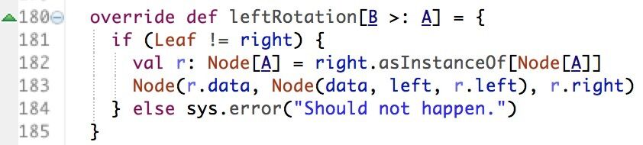
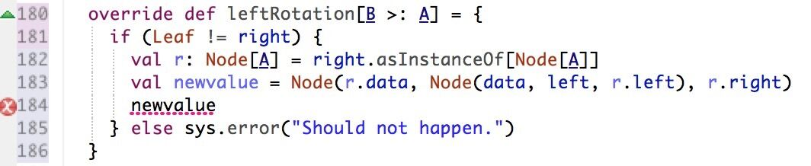
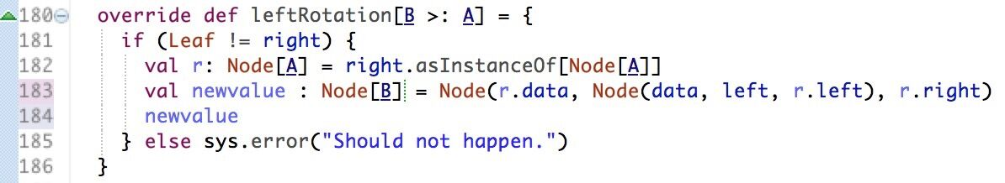
Challenges
Create ValDefs before typer:
Advantage: No need to deal with symbols.
Problem: Type mismatch.

Slide 47
Challenges
Create ValDefs after typer:
Advantage: Type mismatch can be avoided.
Problem: Difficult to get symbols right.
error: scala.reflect.internal.FatalError:
symbol value t#16922 does not exist in hello.g, which contains locals value newvalue#16940.
Method code: def g(): scala.Unit = {
val newvalue: scala#27.runtime#2827.BoxedUnit#4159 = {
hello.this.f({
{
hello.this.liftedTree1$1(t);
scala.runtime.BoxedUnit.UNIT

Slide 48
Challenges
Dilemma in tail-recursion
def f(i: Int): Int =
if (i == 0) i
else {
val newvalue = f(i - 1);
newvalue
}
def f(i: Int): Int =
if (i == 0) i
else f(i - 1);
The transformation makes the function no longer tail-recursion, the compiler can’t do optimization on it. This leads to stack overflow.
So although “println”s are plugged into tail-recursion functions, but without transformation above, their order of data flow violates our principle.

Slide 49
Preliminary Type 2 Results
Examples of useful dependencies discovered:
File Name | Useful data dependencies
Driver.scala | 10/49
ConsoleReporter.scala | 3/11
Typers.scala | 49/13065

Slide 50
Type 3 dead code
Based on Type 2 dead code.
Look into the dead data flow for name of IO operations in scala, such as print, println, Source, and other names in scala.io package.
Also look for basic io function names defined in Java, such as java.io.FileWriter, write and so on.

Slide 51
Conclusion
Compiler plugin is feasible avenue for source-level dynamic dead code detection
Type 1 dead code has been successfully detected in the scalac source
Caveats with Type 2 and 3:
Maintaining order of execution traces hard given tail-recursion and other complex features in Scala
Transforming original AST may cause symbol mismatches
Dataflow can be short and broken

Slide 52
Quiz
What kinds of dead code we find in our project?

Slide 53
Quiz
What do we do to deal with code that can not be inserted “println” expression?

