Slide 1
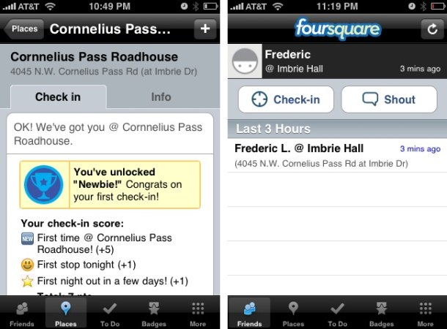
Foursquare
Founders:Dennis Crowley and Naveen Selvadurai

Slide 2

Outlines
Introduction
Avenues for profits
Platforms it runs on
Modes and Services it offers
Competitors and similar application on internet

Slide 3
Introduction
Foursquare is a location-based social networking website for mobile devices. It encourages users sharing their current locations with others. It is a merging of internet and mobile network.
ALL in one: LBS+ Commenting right now + Award mechanism’s SNS
Similar project ”LBS for cell” but has stopped such as Dodgeball.
About 7 years ago, internet companies has intended to build websites of “footprint” , but also failed and be changed into tour website.
it was shielded by RPC on 25th of May,2010.

Slide 4
Avenues for profits
Advertisements, specially, Games mechanism is adopted in advertisements
  For merchants who provide Shopping vouchers
  For sponsors, etc.
Traffic analysis, such as:
  the times of visiting certain venue for certain people or different peoples,
  shopping habits of customers , etc.

Slide 5
Platforms it runs on
It can be used in platforms of all mainstream intelligent cells. Such as:
  iphone
  Android
  WebOS
  Windows Mobile
  BlackBerry, etc.

Slide 6
Services it offers
Modes:
  50% is tools of recording geographical information
  20% is tools of sharing social communication
  30% is tools of games.
Specific services it provides
  Finding people (where he is, where he ever went,etc. )
  games
  Publishing advertisements
  Commenting right now
  Sharing and downloading materials such as music, movies ,etc.
  Traffic analysis, etc.

Slide 7
Competitors and similar application on internet or cells
Abroad(some has applied on cells):
  Google Buzz, http://www.google.com/buzz
  Gowalla, http://gowalla.com/
  MyTown, http://www.booyah.com/
  Yelp, http://www.yelp.com/
  Facebook, http://www.facebook.com/
Inland (some has applied on cells):
  Bedo, http://www.bedo.cn/
  Luutoo, http://luutoo.com/
  Sifang, http://sifang.com/
  Lifang, http://www.l99.com/home

