Slide 1

False Rumor Detection on Sina Weibo by Propagation Structures
Kenny Q. Zhu (朱其立)
Dept. of Computer Science & Engineering
Shanghai Jiao Tong University
kzhu@cs.sjtu.edu.cn
Joint work with Ke Wu and Song Yang
To appear at ICDE 2015, Korea

Slide 2
Overview
Introduction
Rumors vs. False Rumors
False Rumors Detection
Intuition
Problem Definition
Approach
Propagation Structures
Simplification of structure
Graph Kernel
Additional Features
Hybrid Kernel
Evaluation
Conclusion

Slide 3
Rumors vs. False Rumors
Rumor: A currently circulating unconfirmed or uncertain statement or report.
“US government works with aliens.”
“Hillary Clinton is running for president in 2016.”
False rumor: A rumor that turns out to be false. (A.k.a. misinformation, disinformation)
“Genetically modified foods cause cancer”
“slapping a mosquito feeding on you can kill you!”
“Magnifier and sweetener cause watermelon to explode…”

Slide 4
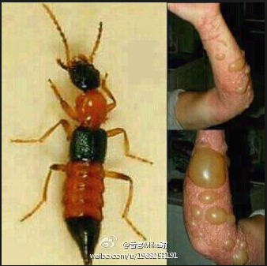
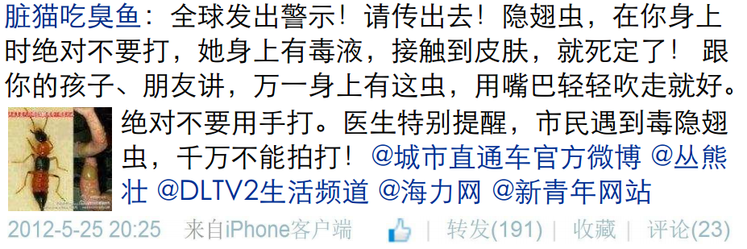
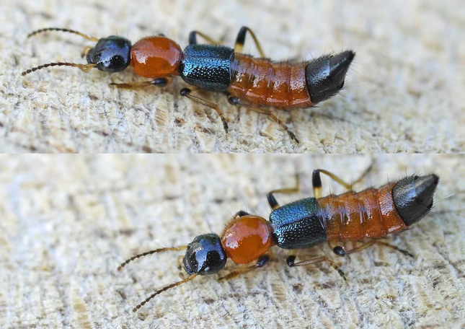
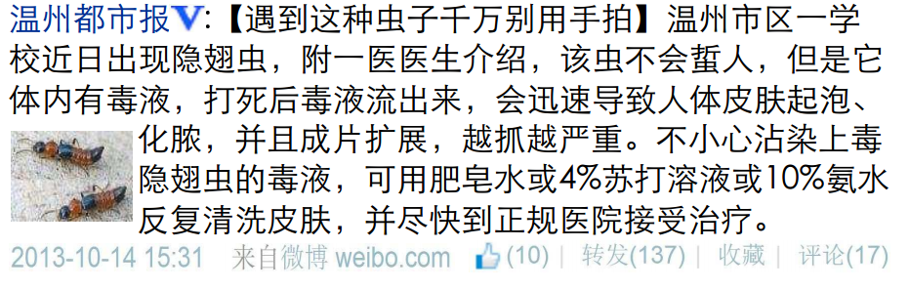
Detecting False Rumor is Hard…
Dirty Cat Eats Foul Fish: Global warning! Please repost! You should never crush a rove beetle if it lands on your skin. Rove beetles contain venom which kills people for sure if it contacts skin! Tell your children and friends that it’s better to just gently blow the rove beetle away if it lands on your skin. Doctors specially warn that if you come across a rove beetle, never smash it with hands! @AccessCity @CongXiongzhuang @DLTVLivingChannel @hiliziWebsite @NewYouthWeb
Wenzhou City News: [Don’t crush this beetle with hands when you see it] Rove beetles have been discovered in a school of Wenzhou. According to a doctor, rove beetle doesn’t bite human beings, but once the venom in its body comes in contact with human skin, it can quickly cause blistering and festering, spreading to other areas and getting worse if you scratch it. If you ever touch the venom of rove beetle, please clean the skin repeatedly with soap water, 4% baking soda solution or 10% ammonia, and seek help at a local hospital immediately.

Slide 5
Our Intuition – False Rumor

Slide 6
Our Intuition – Normal Message

Slide 7
Problem Definition
Input:
All of Weibo = Forest of message propagation trees W
A message thread = A propagation tree T
Each message text = One node of propagation tree m
Original message = Root of propagation tree Root(T)
Repost relationship = Father-child relationship
Each message m is associated with meta data:
<user, timestamp, client, images>
Binary Classification Problem:
Given T, return if Root(T) is a false rumor or not.

Slide 8
Propagation Tree
m1 (user1): When a rove beetle is on your skin, don’t crush it or your skin will fester.
m2 (user2): Really? I never saw it before! //@user1
m3 (user3): Thanks for the warning. //@user1
m4 (user4): That sounds awful! What is rove beetle? //@user2
m5 (user5): It’s true. I’ve been bitten once. //@user2

Slide 9
Enriched Propagation Trees
User types (Node label)
Opinion leaders (p) & normal users (n)
Meta-data of Messages (Edge label)
a is approval score of m_{j}
d is doubt score of m_{j}
s is sentiment score of m_{j}
θ(x) is time-decay function:

Slide 10
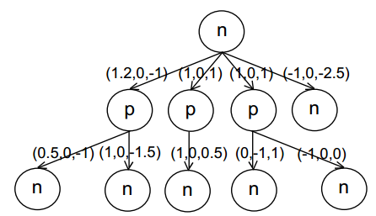
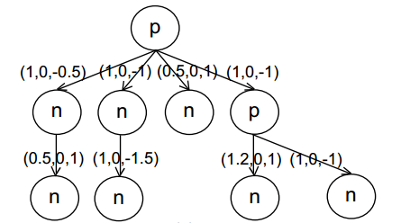
Enriched Propagation Trees
False rumor:
Normal message:

Slide 11
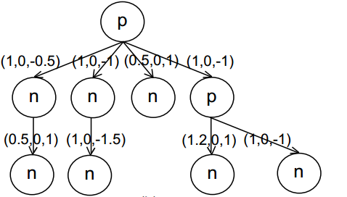
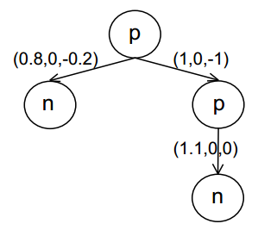
Simplification of Propagation Trees
Sina Weibo: 50 million active users
The propagation tree of a popular message extremely large
Simplify a tree by lumping adjacent normal user nodes together to form one super node

Slide 12
Graph Kernel
Idea: If two trees are similar, then they might be both false rumors or both normal messages
Similarity of two trees:
Tree kernel: subset tree, subtree
Graph kernel: random walk

Slide 13
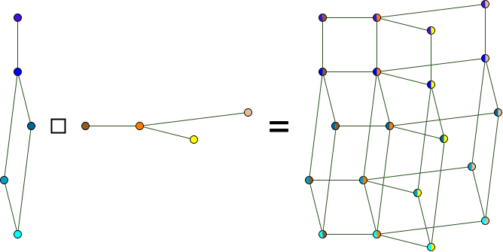


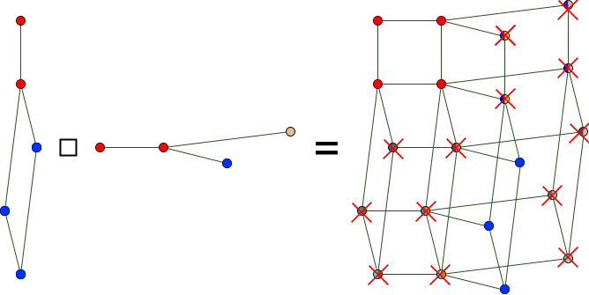
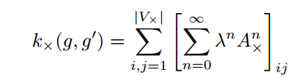
Graph Kernel
Basic idea:
If two men start random walking from the roots of two trees, what is the probability that they will walk the same path (same node type, similar edges)

Slide 14
Other Features
Extract 23 features from each message propagation tree to build a vector for Radial Basis Function(RBF) kernel.
Message based: has URL, client, time span, etc.
User based: is verified, gender, number of followers, etc.
Repost based: number of reposts, average sentiment, etc.

Slide 15
Topic Type Feature
Latent Dirichlet Allocation (LDA) model:
18-topic distribution for message m_{i}:
topic(m_{i}) = (s₁, s₂, …, s₁₈)
where s_{j} is the probability of m_{i} belonging to topic j.
Convert topic(m_{i}) into a binary vector by setting the k highest probability topics to 1 and the rest to 0.
Select k such that the sum of probabilities of top k topics > 0.5 while sum of probabilities of top k-1 topics < 0.5

Slide 16
Average Sentiment Feature
Average sentiment score
where NP_{i} is the number of positive words in m_{i}
NN_{i} is the number of negative words in m_{i}
|m_{i}| is the number of words in m_{i}
n is the total number of reposts for that message.

Slide 17
Repost Time Feature
Repost Time
where n is the total number of reposts
t_{i} is the time stamp of repost m_{i}
t_{o} is the time stamp of the original message.
The sooner the repost message, the stronger the response.

Slide 18
Hybrid Kernel
where T_{i} is the propagation tree of m_{i}
X_{i} is the feature vector of m_{i}
β is the weight controlling the different kernels.

Slide 19
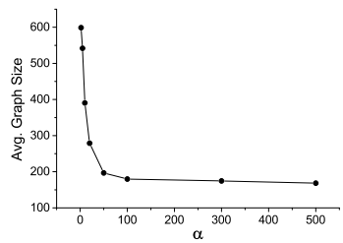
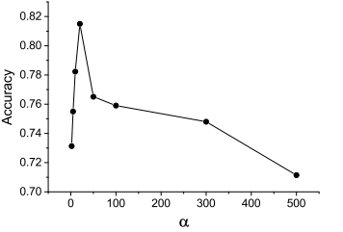
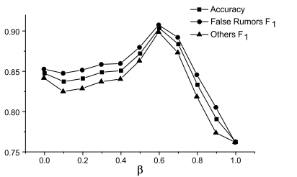
Evaluation
Dataset: 2601 false rumors and 2536 normal messages (500+500 as development set)
Training parameters: α = 20 and β = 0.6

Slide 20
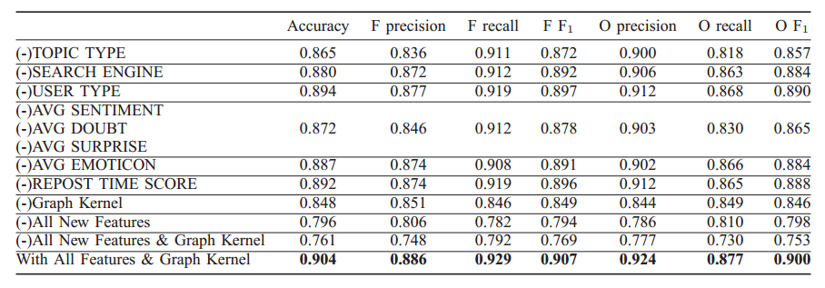
Evaluation
Feature selection:

Slide 21
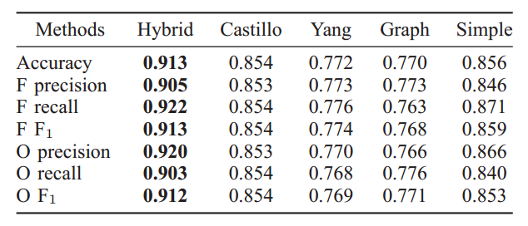
Evaluation
End-to-end comparison:
Two other false rumor detection algorithms: Castillo, 2011 and Yang, 2012
Baselines: using only Graph kernel, using simple graph features instead of graph kernel
3-fold cross validation

Slide 22
Evaluation
False rumor early detection:
Given a detection deadline, we assume all reposts and related information published after this deadline are invisible when testing the model of the classifier.
The sooner the deadline, the less data of reposts and hence the propagation structures can be used.
A deadline of 0 hours means that we will not use any repost data except the original messages themselves.

Slide 23
Conclusion
A graph-kernel based SVM classifier
Message propagation used as high-order feature
Combines other features from original messages, users and reposts
State-of-the-art classification accuracy: 0.913
Early detection accuracy of 0.88 after 24 hours

Slide 24
Thanks and Questions?

