Slide 1
Enabling Epsilon-Approximate Querying in Sensor Networks
Yu LIU, Jianzhong Li, Hong Gao, Xiaolin Fang
Paper from: VLDB09 (35th International Conference on Very Large Data Bases)

Slide 2

Outlines
Introduction
Conventional method
Conclusion to conventional method
EAQ scheme
Conclusion to EAQ scheme
Main contributions

Slide 3
Introduction
Data approximate is a popular means to support energy-efficient query processing.
Conventional data approximate methods require users to specify error bounds before hand and cannot reuse the previous acquired results.
In this paper, it mainly centers on how to acquire the approximate data from interesting area using certain way that doesn’t require specifying error bounds before hand and can reuse the previous acquired results.

Slide 4
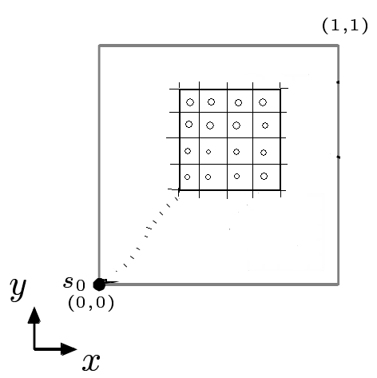
Conventional Method
Step one

Slide 5
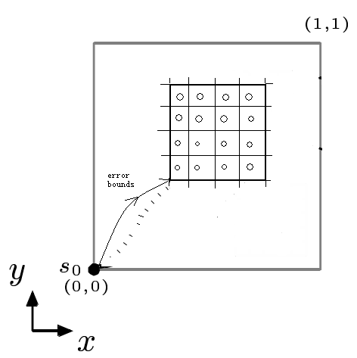
Conventional Method
Step two

Slide 6
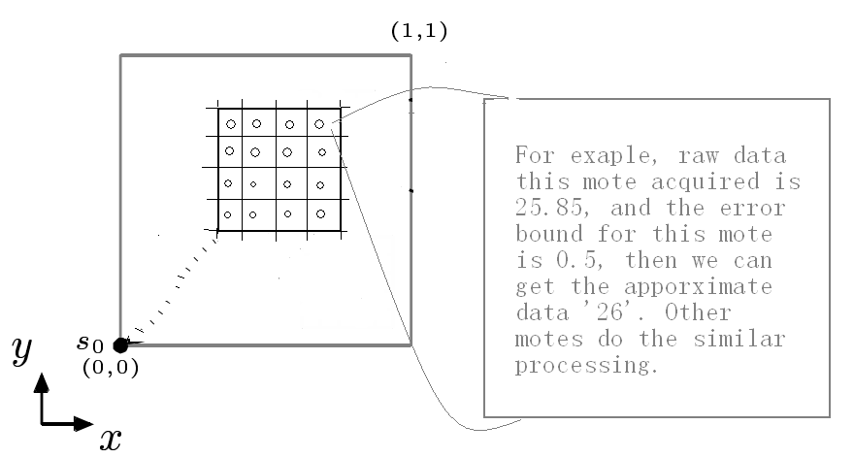
Conventional Method
Step three

Slide 7
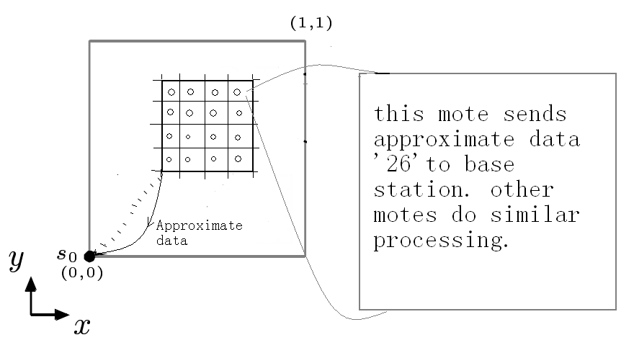
Conventional Method
Step four

Slide 8
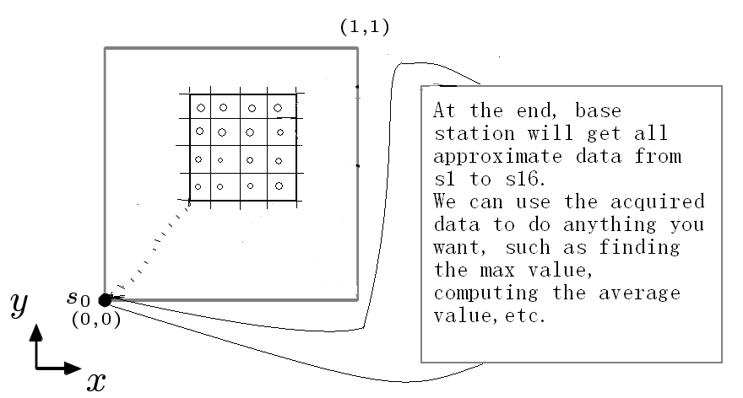
Conventional Method
Step five

Slide 9
Conclusion To Conventional Method
It requires specifying error bound before hand.
  If the error bound is too large, base station will get quite coarse data, which will heavily affect the subsequent works. In another word, the results of subsequent works are very easily to deviate the correct results.
  If the error bound is too small, it will consume a lot of energy that may have not been consumed. Given a extreme example, we specify the error bound as zero, then, we can imagine, in this circumstance, and easily understand the principle.
  If we are not satisfied with the previous results, then we require specifying a new error bounds again as same as before. Unfortunately, at that time, we just do the repetitive works while we cannot reuse the previous results.

Slide 10
Conclusion To Conventional Method
It requires sending each data (within certain sampling period and in our interesting area) to base station.
  If it succeeds in the first time, and the number of motes in our interesting area are somewhat big, we can imagine that sending each approximate data to base station is a rather energy-consuming task.
  If it don’t succeed in the first time, in another words, it succeeds after It tried many times on error bounds. Accordingly, it will consume about N times energy comparing to succeed only once, in here, N denotes the times of specifying error bounds until it succeeds.

Slide 11
EAQ Scheme
This paper proposes a novel uniform data access scheme underlying various queries in sensor networks, i.e., Epsilon Approximate Query (EAQ).
  It doesn’t require specify error bounds before hand;
  And it can incrementally ‘refine’ previously obtained approximate data to arbitrary accuracy or a just-sufficient level.

Slide 12
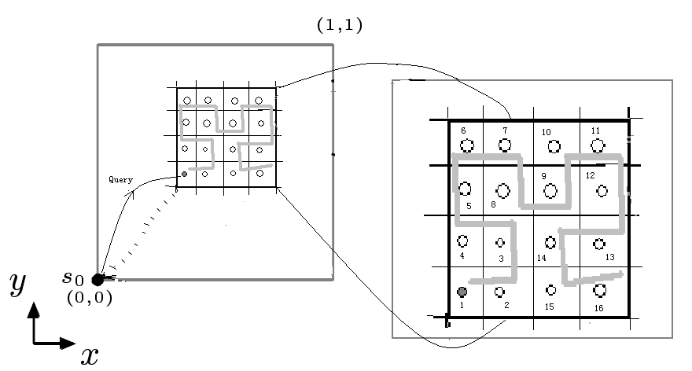
EAQ Scheme
Step one

Slide 13
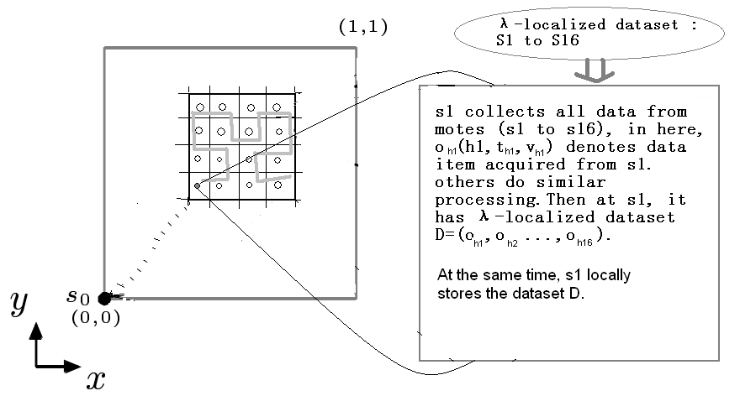
EAQ Scheme
Step two

Slide 14
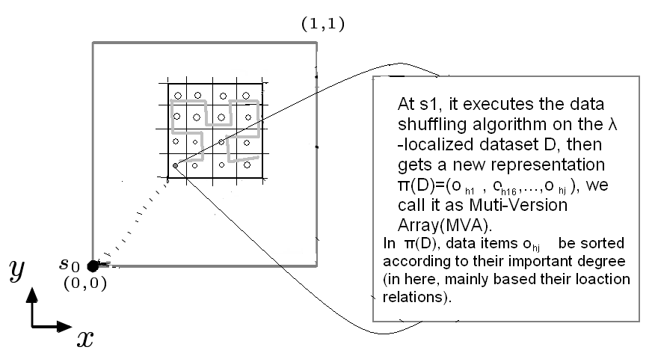
EAQ Scheme
Step three

Slide 15
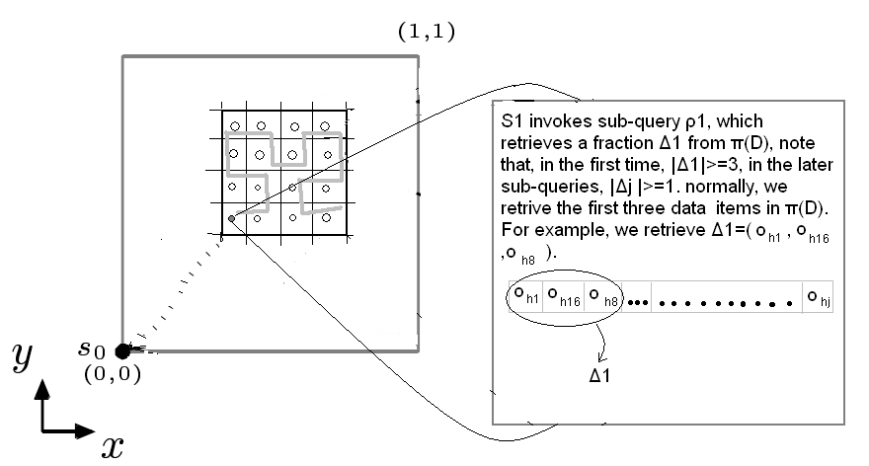
EAQ Scheme
Step four

Slide 16
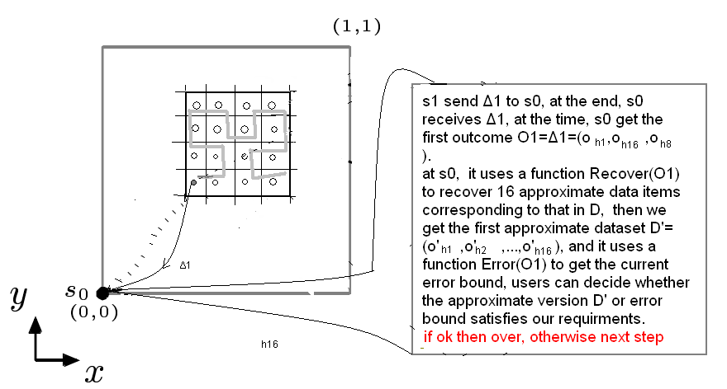
EAQ Scheme
Step five

Slide 17
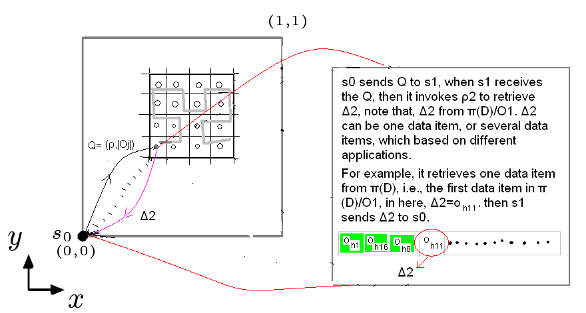
EAQ Scheme
Step six

Slide 18
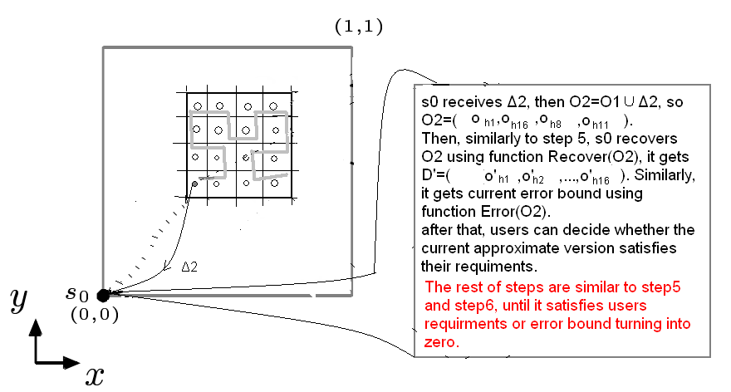
EAQ Scheme
Step seven

Slide 19
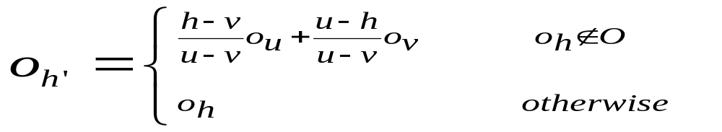
EAQ Scheme
Approximate data recovery
  Any subset O of D, |O|>=2, we can obtain D’, i.e., for all o_{h}∈D, can obtain o_{h’}∈D’ :
  (1)
  Example 1: assuming that D=(o1,o2,o3), o1=(1,2), o2=(2,1), o3=(3,3), in here, we omit the time stamp, in each data item, the first component denotes location stamp, the second component denotes value acquired from respective motes. Now assuming that we have acquired a subset O=(o1,o3) of D, and have known the location stamp h2=2 of o2, then we can use the formula (1) getting h2’=h2=2 and v2’=((h2-h3)*v1)/(h1-h3)+ ((h1-h2)*v3)/(h1-h3)=2.5, i.e., o2’=(2,2.5).

Slide 20
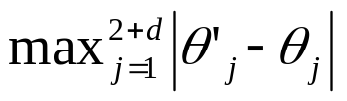
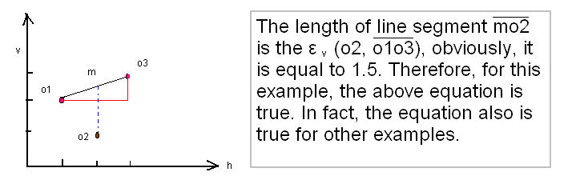
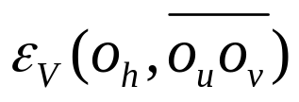
EAQ Scheme
Data shuffling algorithm
  Claim 1. Let o_{h}=(h,t_{h},v1_{h}, v2_{h} ,… , vd_{h} ) ∈D, o_{h’}=(h’,t_{h’},v1_{h’} ,v2_{h’} ,…,vd_{h’} ) ∈D’, ε_{h}=|| o’_{h} – o_{h} ||∞= . because h’=h, t_{h}≈ t’_{h}:
  (2)
  Using the same example as the previous page. So ε₂=||o2’-o2 ||= |v2’-v2|=|2.5-1|=1.5 .
  Goal of data shuffling algorithm is ordering the data items by descending order according to their sizes of .

Slide 21
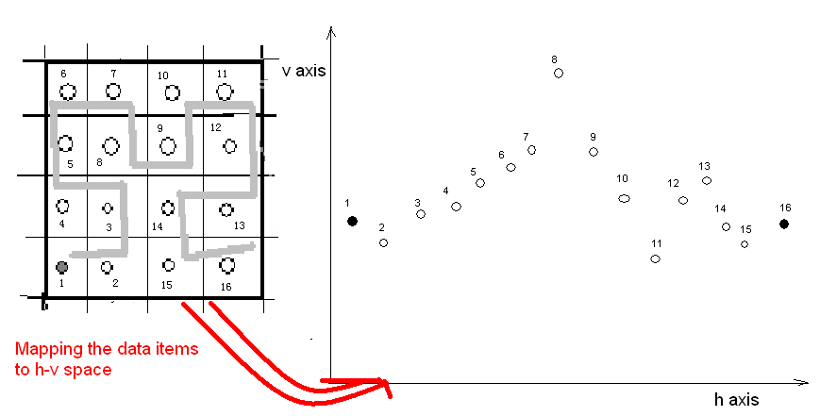
EAQ Scheme
Data shuffling algorithm (step one)

Slide 22
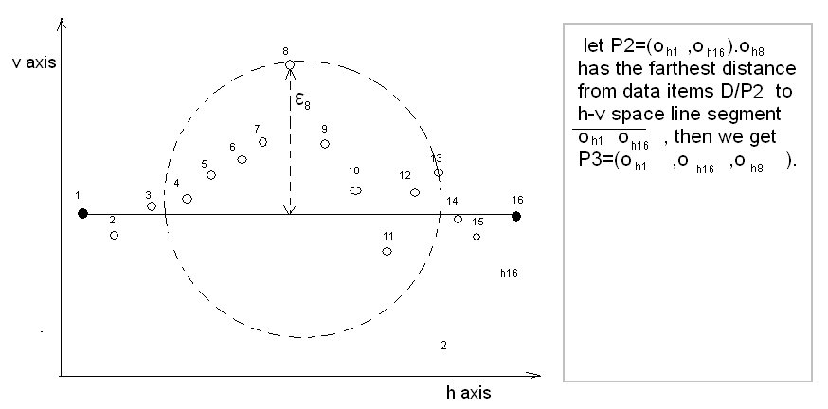
EAQ Scheme
Data shuffling algorithm (step two)

Slide 23
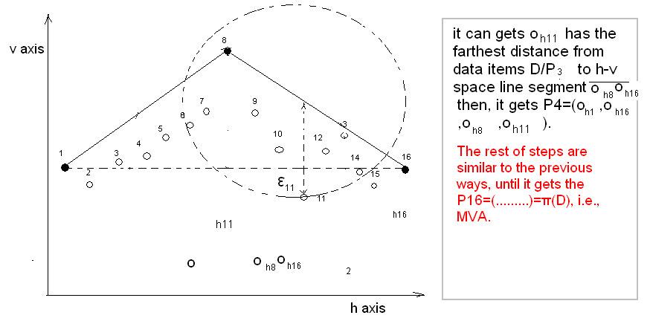
EAQ Scheme
Data shuffling algorithm (step three)

Slide 24
EAQ Scheme
Error bound
  Theorem 1. Suppose |π(D)|=k, given any prefix O of π(D)=(o₁, o₂,…, o_{k}), |O|=b (2=<b<k). Hold that O always yields approximate D’ (based on the formula 1) such that L∞(D’,D)<=||o’_{b+1}-o_{b+1}||∞.
  In another word, giving any prefix O=(oi,oj,ok,…) ofπ(D), |O|>=3, we always use the last item in O to compute the error bound. The value computed by this ways always is the current approximate version’s max error bound because, in MVA, we have ordered the sequence of data items according to their error bound by descending order.

Slide 25
Conclusion To EAQ Scheme
No prior error bound;
Refining approximate versions on Runtime;
Produce multi-versions of approximate data with L∞-norm error bounds;
From any prefix of MVA, it can recovers approximate versions of full dataset;
a just-sufficient level, saving energy.
Quick response time.
Broad applications in various query processing.

Slide 26
Main Contributions
A uniform data access scheme named EAQ .
A data shuffling algorithm, and a new representation to raw datasets.
Present the EAQ-based query processing examples such as spatial window query, multi-dimensional value range query, queries with QoS constraints.
Conduct experimental studies in a real sensor networks testbed, which center on the approximate error and the consumption of energy.

Slide 27
Thanks

