Slide 1
What? Why?
A tutorial on causal relation
ed

Slide 2
Outline
Motivation & Vision
Approaches
Sub sentences
Noun phrases
Related work
Conclusions

Slide 3
Why do we need this
Relatively enough concepts, relations and facts
isA
wasBornOnDate(wordnet_person_100007846,date)
<Westwood_Junction,_California> <isLocatedIn> <United_States> , hasGender(<Steve_Strachan>,<male>)
Next, we want the computers to reason
Inductive Logic Programming
A huge library of rules/axioms

Slide 4
Current Knowledge base
Take YAGO2 as an example
Schema
<hasChild> rdfs:domain <wordnet_person_100007846>
<isConnectedTo> rdfs:range <yagoGeoEntity>
Type
<Abraham_Lincoln> rdf:type <wikicategory_People_from_Coles_County,_Illinois>
<Abraham_Lincoln> rdf:type <wordnet_officeholder_110371450>
Taxonomy
<wikicategory_Novels_by_Caroline_B._Cooney> rdfs:subClassOf <wordnet_novel_106367879>

Slide 5
Current Knowledge base
Take YAGO2 as an example
Transitive type
<Abraham_Lincoln> rdf:type <wordnet_lawyer_110249950>
Facts
<Frank_Johnson_(rugby_league)> <hasGender> <male>
<Tony_Gibson> <created> <Ghetto_Blaster_(video_game)>
Literal Facts
<Jabłonowo,_Olecko_County> <hasLatitude> "54.15"^^<degrees> 54.15

Slide 6
What do we want
(Prerequisite) Prolog
human(kate).
friend(X,Y):-likes(X,Y),likes(Y,X).
Reasoning
More rules are desired (populate!)
Connect hasLung-Cancer and pollute
hasLung-Cancer(X) :- pollute(Y), live_in(Y,X)
Reading comprehension
Extract all facts and rules, turn every article to a Prolog program
Thus Understand this article

Slide 7
Approaches
Inductive Logic Programming
is-a(panther, carnivore)
eat(panther, zebra)
eat(panther, gazelle)
eat(zebra, grass)
is-a(zebra, herbivore)
eat(gazelle, grass)
is-a(gazelle, herbivore)
eat(A, zebra):- is-a(A, carnivore)
eat(A, grass):- is-a(A, herbivore)

Slide 8
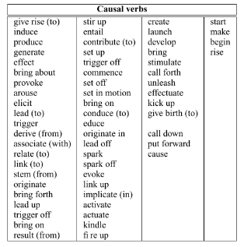
APPROACHES
Mining the rules
Between sub sentences
IF THEN,AFTER
How to process these sub sentences?
Between noun phrases
addison 's disease may cause vitiligo
untreated case can lead to death
How to convert?

Slide 9
Sub sentences
Ambiguity
Officer dies after shooting himself
Too specific
Navy punishes 2 officers because of lewd banner
No guarantee of correctness
I love math because I love the math teacher
If you dump your girlfriend, then you’ll be doomed
Notes:
Data driven… too casual

Slide 10
Intuitive methods
Extract relation
V(entityA, entityB) or V(entityA)
Even a type system (check Verb related conceptualization)
Given V, output corresponding argument concepts
Ride – vehicle, car…
Problems
Resolution
Generalizability

Slide 11
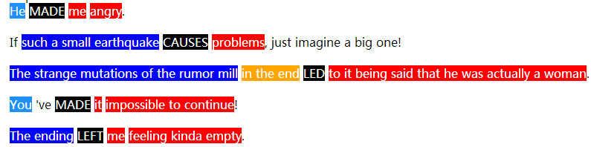
Sub sentences
Simple generalization may not suffice
APPLE - ?
FrameNet kicks in
Notes:
Lost the context

Slide 12
FrameNet
Concepts
Frame – a schematic representation of a situation involving various participants
Causation, Being_born
Frame Element - semantic roles
Actor, Cause, Effect
Lexical Unit – a word evoking frames

Slide 13
Semantic Role labeling
Input: sentences
Output: corresponding frames
…
<annotationSet ID="2" frameName="Rewards_and_punishments">
<layers>
<layer ID="201" name="Target">
<labels>
<label ID="20101" end="12" name="Target" start="5"/>
</labels>
</layer>
<layer ID="202" name="FE">
<labels>
<label ID="20201" end="23" name="Evaluee" start="14"/>
<label ID="20202" end="3" name="Agent" start="0"/>
</labels>
</layer>
</layers>
</annotationSet>
<annotationSet ID="3" frameName="Causation">
<layers>
<layer ID="301" name="Target">
<labels>
<label ID="30101" end="34" name="Target" start="25"/>
…

Slide 14
Semantic Role labeling
Example
Navy punishes 2 officers because of lewd banner
Frame
Leadership, Cardinal_numbers, Reward_and_punishments, Causation, Military
Use frame names as predicates, “frame name_frame element” as argument
punish(Navy, officers) →
Reward_and_punishment(Military_Force, Leadership_Leader)
Reward_and_punishment(Military_Force, Leadership_Leader, null, null, null…)

Slide 15
Semantic Role labeling
Moreover…
Causation frame → causal noun phrase pairs ☺
However…
1.2~1.6 sentence/second
Against 90 million lines of wiki dump file
2 years computation of our server

Slide 16
Causal Noun Phrases
<NP verb NP>
Extraction
GREP, using verbs of high confidence
Not enough
Classification
features are noun hierarchy(whether it is entity, phenomenon, abstraction, etc.) of head word and verb itself
[earthquake,generate,tsunami] is represented as (0,0,0,0,0,0,0,0,1,generate,0,0,0,0,0,1,0,0,0)
indicates earthquake is phenomenon and tsunami is event

Slide 17
Causal Noun Phrases
Then what?
NP -> Predicates
Preliminary ideas
Reversed use of FrameNet
Connect the NP to a specific Frame
Frame name, lexical unit, frame element…
Convert to predicate-argument representation

Slide 18
Causal Noun Phrases
Example
addison's disease may cause Vitiligo
Vitiligo -> skin disease-> hasDisease(P, vitiligo)
Or hasVitiligo(P)
Medical_conditions([ailment]vitiligo,[patient]null,[body part]null,…)
But more difficult with phrases
Link to death, loss of oxygen, etc.
Advice welcome ☺

Slide 19
Populating rules
E.g. Google acquires Android Inc. The acquisition will enhance Google’s competition in mobile phones.
acquire(X,Android) => compete-in(X,mobile phones)
acquire(X,Y) => compete-in(X,Z)
acquire(X,Y) ∧ specialized-in(Y,Z) => compete-in(X,Z)
Related work - Use deverbal noun as clues for causation, build a classifier to choose a relation instance as constraints
Precision and recall suffered

Slide 20
Conclusions
Processing sub sentences deserves a second thought
Turning NP to predicates is novel and challenging
Populating rules is still a mystery

Slide 21
Thanks!
And have a nice day :D

