Slide 1
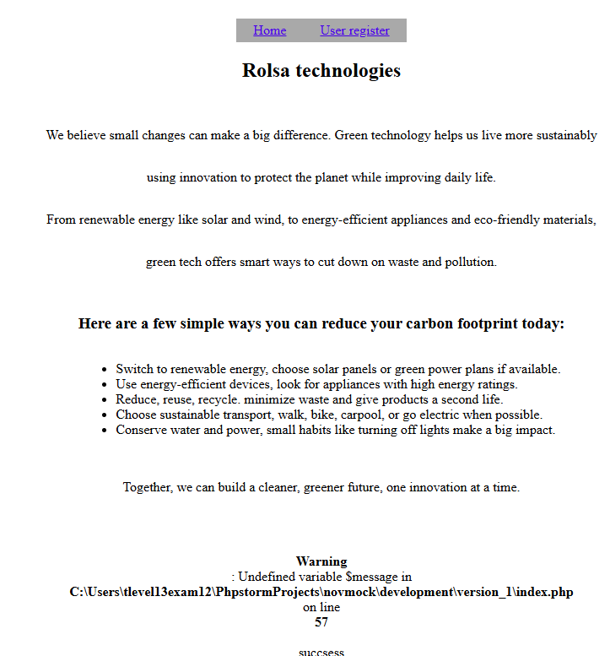

Page 1
Image 2
Image 1

Slide 2


Page 2
Image 1
Image 2

Slide 3
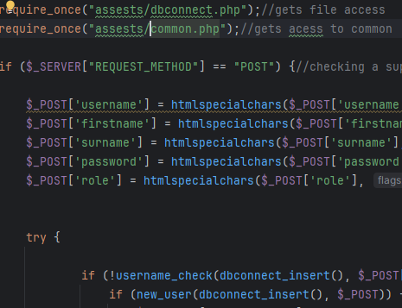
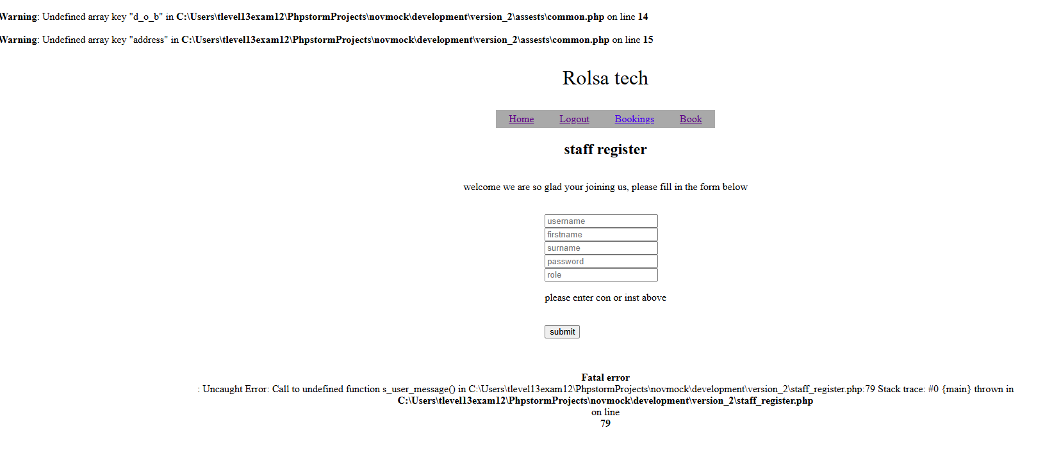
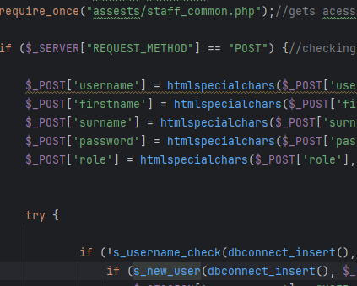
Page 3
Image 2
Image 1
Image 3

Slide 4


Page 4
Image 1
Image 2
Image 3

Slide 5

Page 5
Image 2
Image 1
Image 3

Slide 6



Page 6
Image 1
Image 2
Image 3

Slide 7
Page 7
Image 1
Image 2

Slide 8

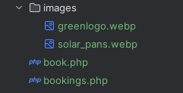
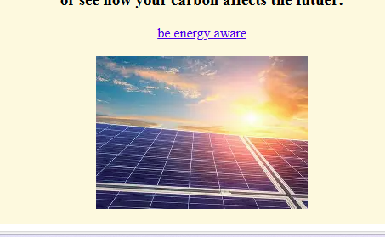
Page 8
Image 2
Image 1
Image 3

Slide 9


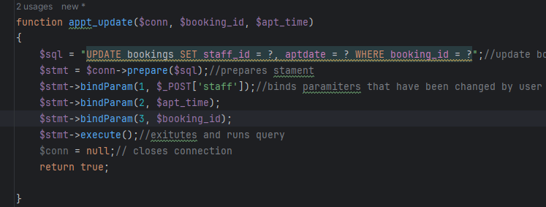
Page 9
Image 1
Image 2
Image 3

Slide 10

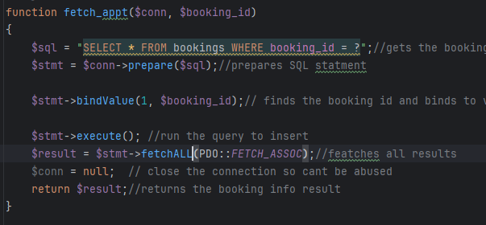
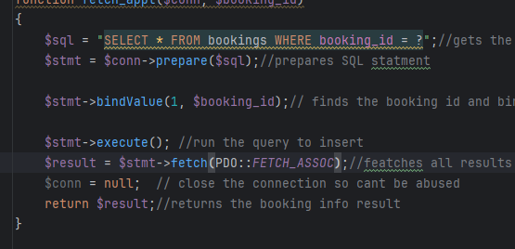
Page 9
Image 1
Image 2
Image 3

