Slide 1
How to make a data base

Slide 2
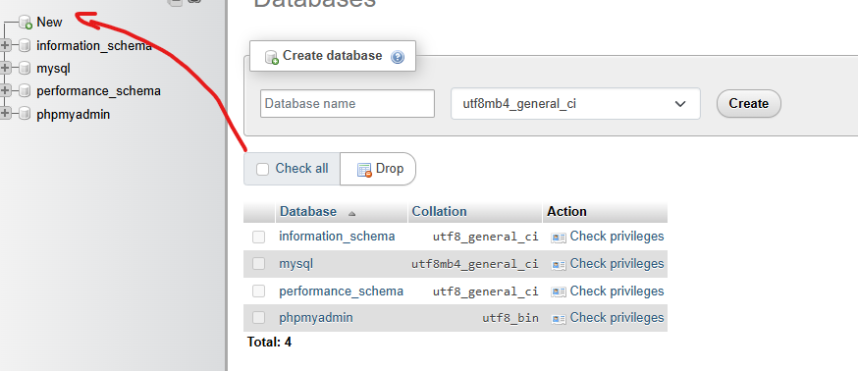
Open a new data base

Slide 3
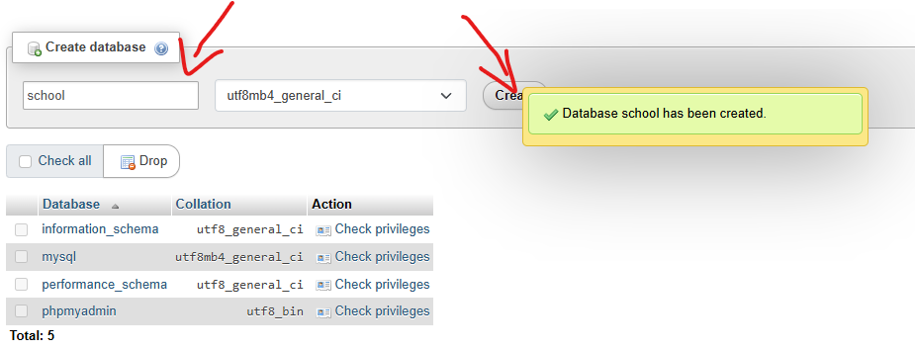
Name the data base and press create

Slide 4
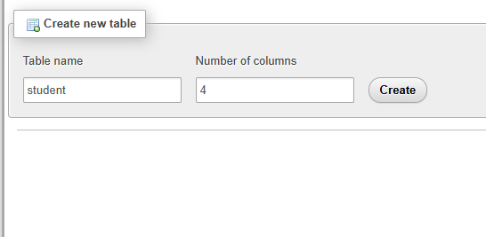
Name and create table

Slide 5
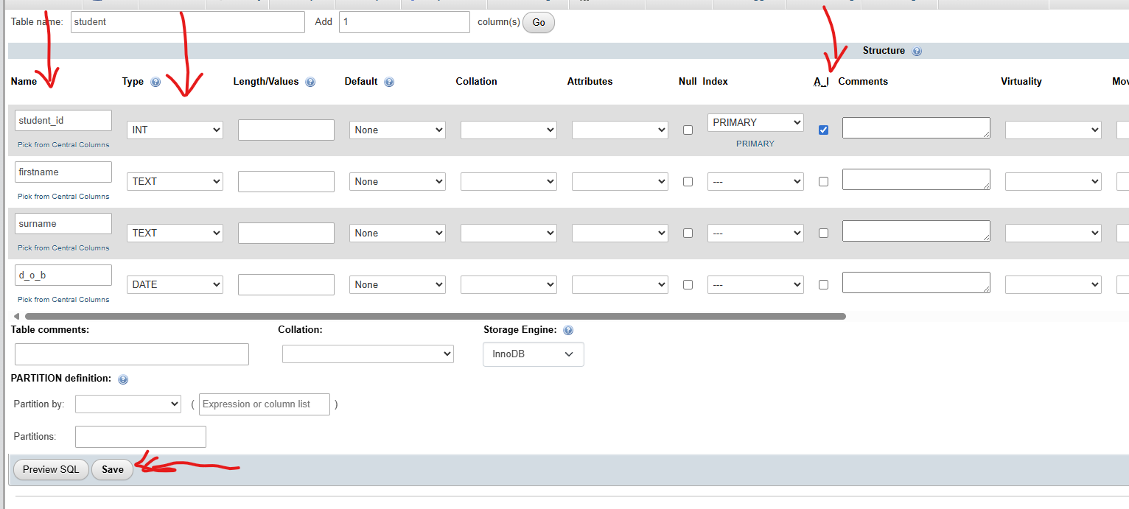
Name each record, select right datatype, and add the primary key, then save

Slide 6
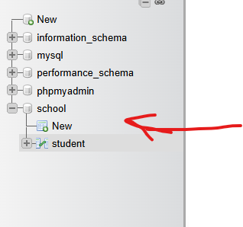
Add new and any other tables you need and your link table

Slide 7
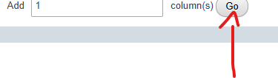
If you need to add a coloum in a table press here

Slide 8
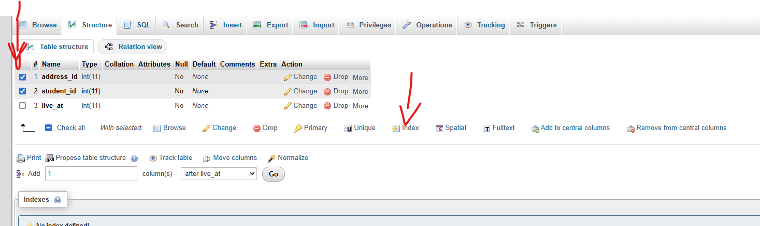
For you link table you want to create foreinge keys, fist click the items you want to be the keys, then press index

Slide 9
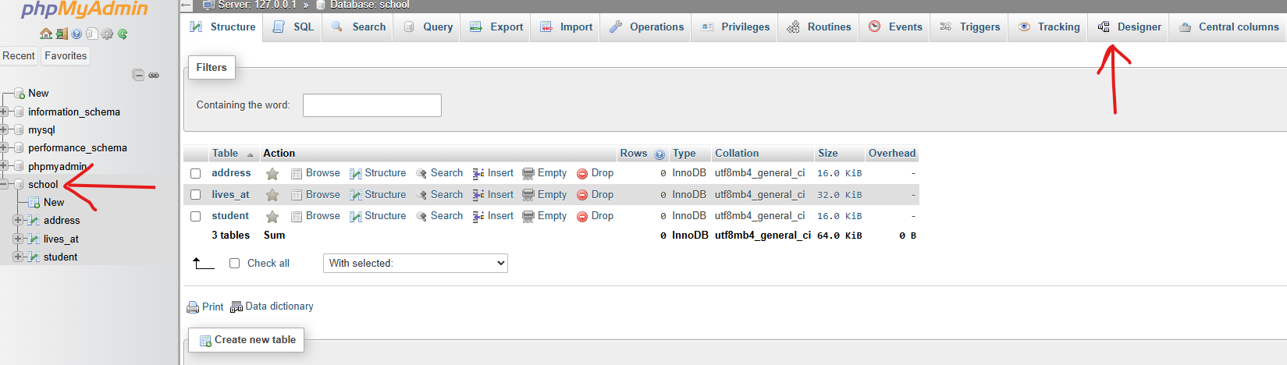
To link them go on the database and then press designer

