Slide 1
Input sanitisation
Why its needed and how to do it

Slide 2
Xss – Cross site scripting
Trusted websites infested with code
Usually javascript
Malicious intent

Slide 3
SQL Injection attack
Equifax told is about their attack 2017
Less secure webapp
SQL injection to access unauthorised data

Slide 4
filter_var()
Built in feature of PHP
Sub routine that is called, it cleans out input and RETURNS a clean value.
Make sure to capture the returned value

Slide 5
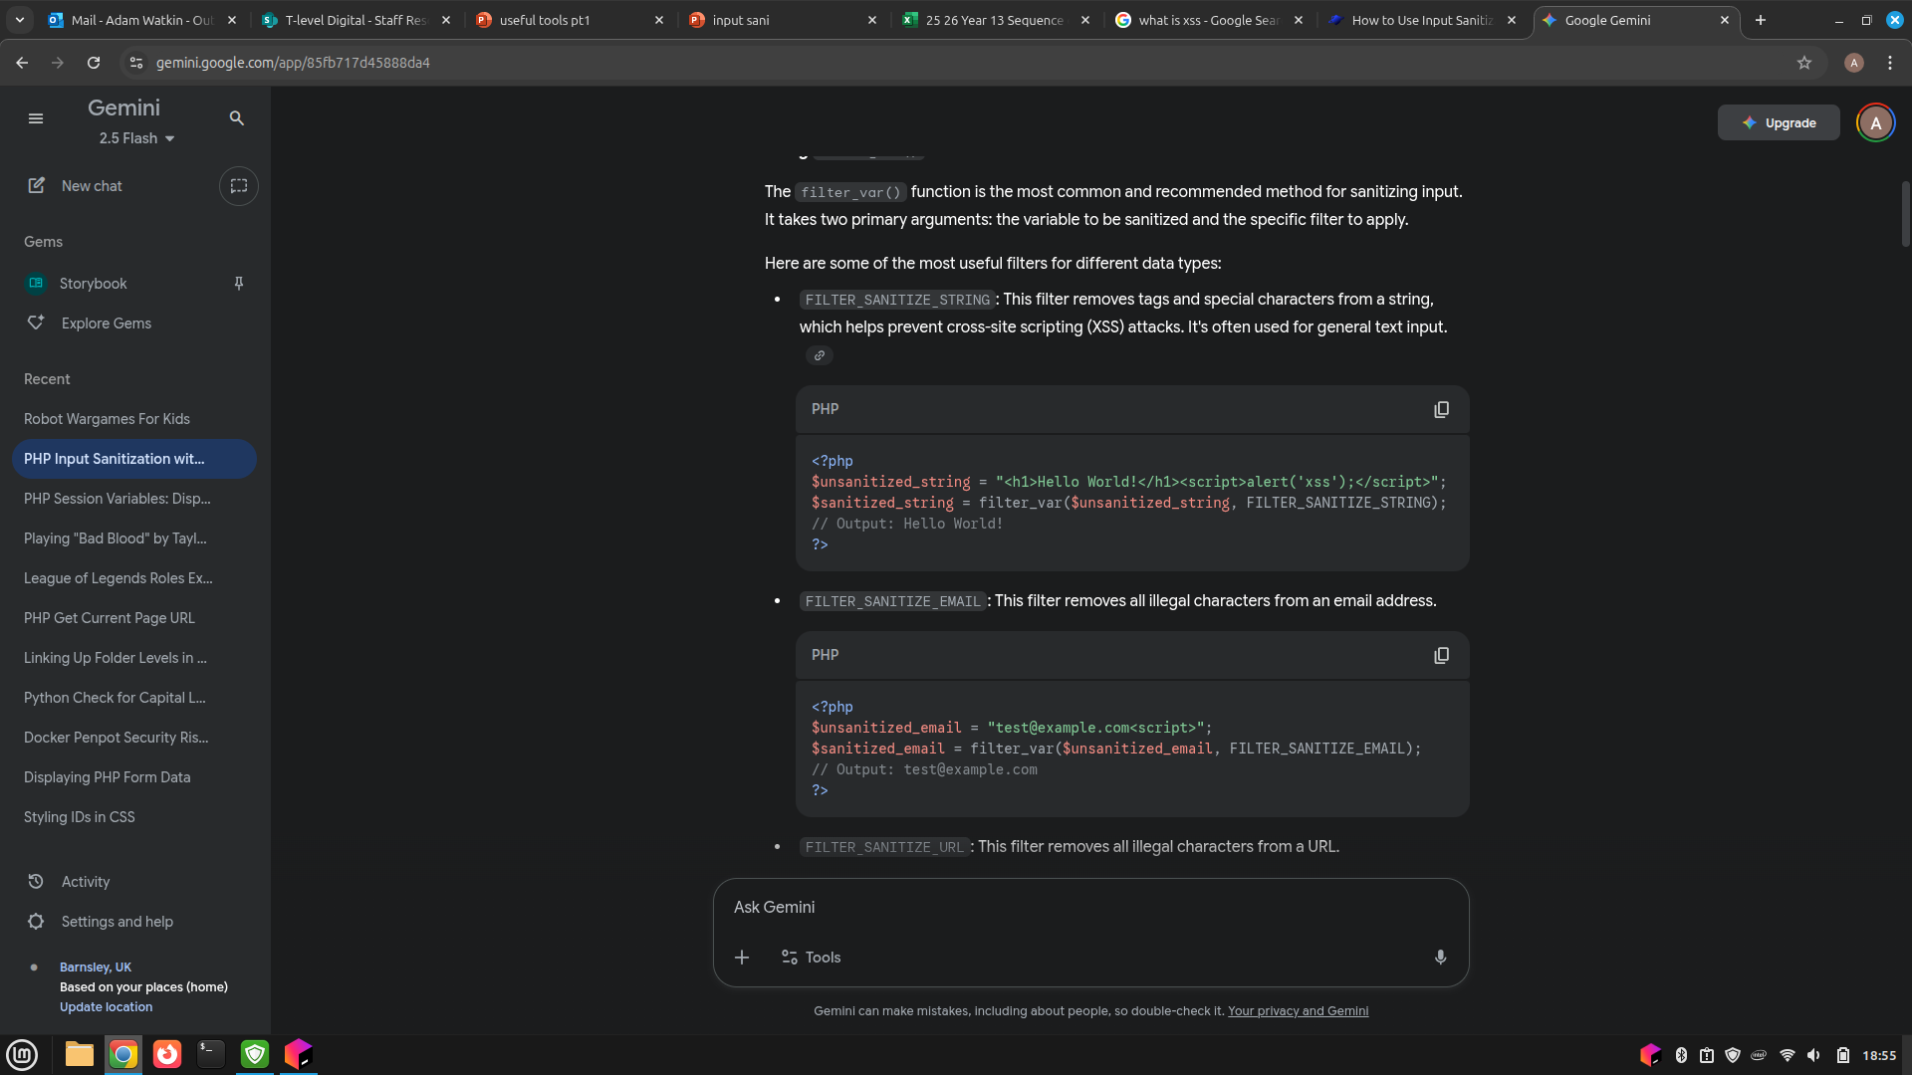
FILTER_SANITIZE_STRING

Slide 6
FILTER_SANITIZE_EMAIL

Slide 7
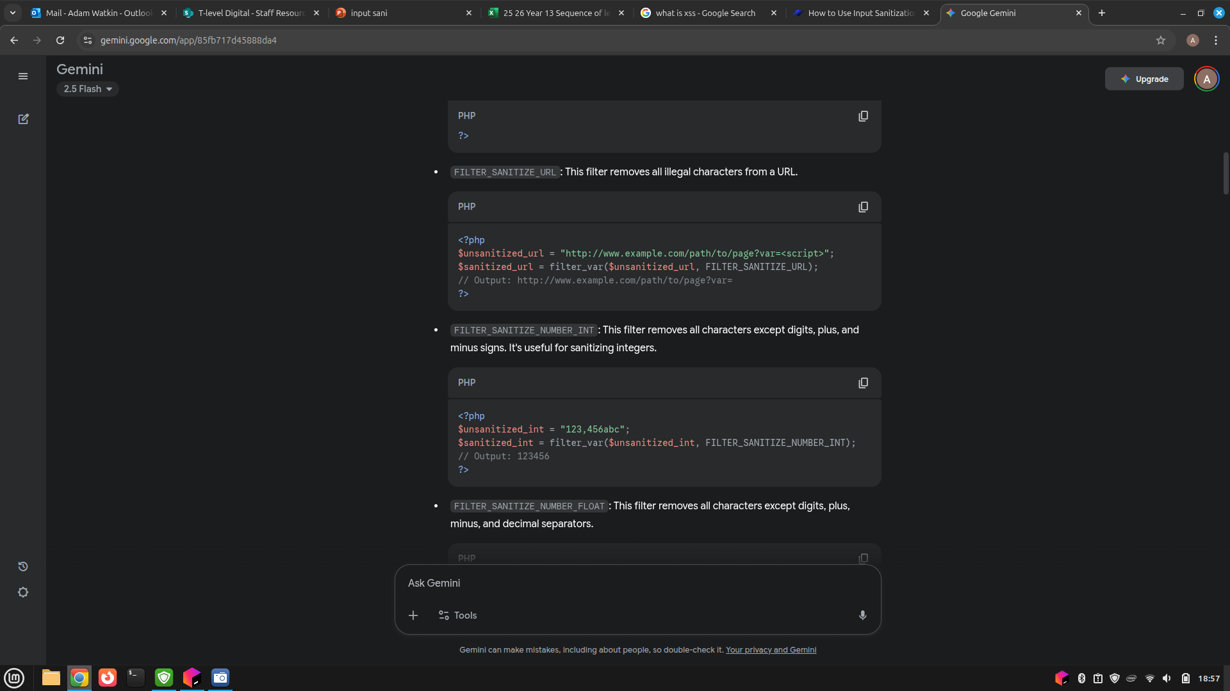
FILTER_SANITIZE_URL

Slide 8
FILTER_SANITIZE_NUMBER_INT

Slide 9
FILTER_SANITIZE_NUMBER_FLOAT
<?php
$unsanitized_float = "123.456,789";
$sanitized_float = filter_var($unsanitized_float, FILTER_SANITIZE_NUMBER_FLOAT, FILTER_FLAG_ALLOW_FRACTION); // Output: 123.456 ?>

Slide 10
Task: Make a mini site called "sani"
Set up directory called: sani
Create a form on the index page which takes in each of the types of input to sanitise
Sanitise each output the result with a suitable message

