Slide 1


The World of Artificial Intelligence
Welcome to the exciting world of AI! It's about building machines that can think and learn like humans, transforming industries from healthcare to entertainment.
by Advyth Vaman Akalankam

Slide 2

What is Artificial Intelligence?
Artificial Intelligence (AI) simulates human intelligence in machines. It focuses on enabling computers to perform tasks that typically require human intellect, such as recognizing images, understanding language, and making decisions.
1
Data Processing
AI learns from data, refining its models to make better decisions over time.
2
Reasoning
AI interprets information to make informed decisions, similar to how humans analyze situations.
3
Learning
AI models improve their abilities through continuous training with new data.
4
Self-Correction
AI models evolve by adjusting based on feedback, constantly refining their performance.

Slide 3
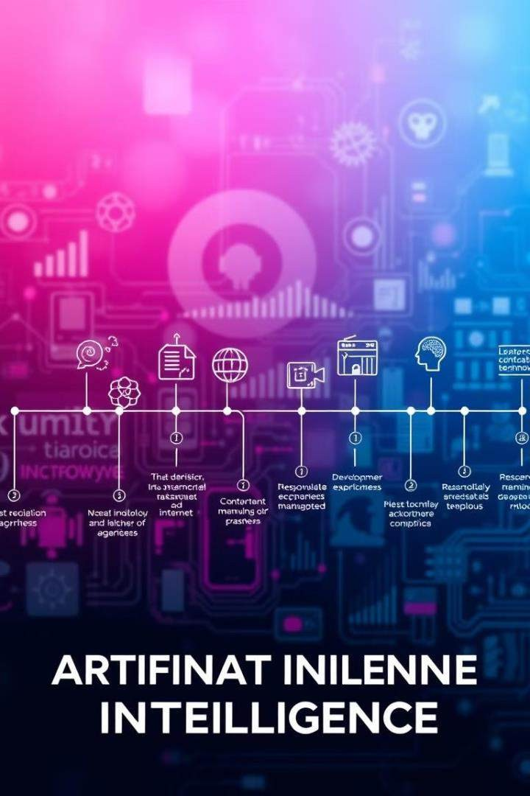
A Glimpse into AI's History
AI's journey has been marked by fascinating advancements and shifting approaches.
1
Symbolic AI
Early AI systems used rigid, rule-based processes, lacking flexibility.
2
Machine Learning Rise
The focus shifted from rigid rules to data-driven learning in the 1980s.
3
Deep Learning Revolution
Modern AI uses complex neural networks to analyze vast data and
learn intricate patterns, creating human-like outputs.

Slide 4

AI Applications: Shaping Our World
AI is already transforming our lives with applications across various domains.
Recommendation Systems
Used by platforms like Netflix and Amazon to suggest content and products based on your preferences.
Voice Assistants
Siri, Alexa, and Google Assistant use AI for speech recognition, answering questions, and automating tasks.
Autonomous Vehicles
Use computer vision and sensors to navigate roads, promising a future of safer and more efficient transportation.
Translation Services
Google Translate and other platforms use AI to enable language translation, breaking down communication barriers.

Slide 5

What are Chatbots?
Chatbots are programs designed to engage in conversations with users, simulating human interaction.
1
Functions
Chatbots can answer questions, book appointments, and guide users through various processes.
2
Benefits
They provide instant, interactive support without the need for human assistance, improving efficiency and accessibility.

Slide 6
Types of Chatbots
Chatbots fall into two categories based on their capabilities and approach to communication.
Rule-Based Chatbots
These chatbots operate on predefined rules, ideal for FAQs but limited in flexibility and input interpretation.
AI-Based Chatbots
Leveraging machine learning and NLP, AI-based chatbots enable more dynamic, natural interactions that can handle complex queries.

Slide 7

Chatbot Use Cases Across Industries
Chatbots are finding valuable applications across a wide range of industries, enhancing efficiency and user experiences.
Customer Service Reduces response time by handling common inquiries 24/7.
Healthcare Assists with appointment scheduling and symptom checking for immediate support.
Education Acts as a virtual tutor, answering student questions and providing personalized responses.

Slide 8
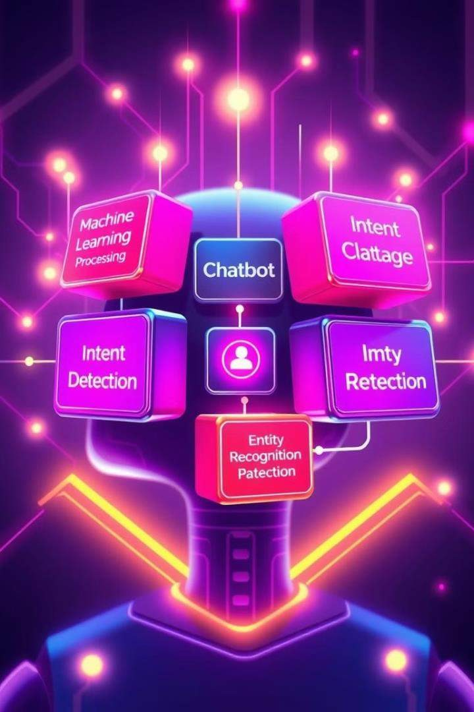


AI Technologies in Chatbots
The effectiveness of AI-based chatbots relies on powerful technologies that
enable them to understand and respond to human language.
Machine Learning
Enables chatbots to continuously learn from interactions, improving their accuracy and providing more nuanced responses.
Natural Language
Processing (NLP)
Allows chatbots to understand and process human language, enabling meaningful and natural replies.

Slide 9
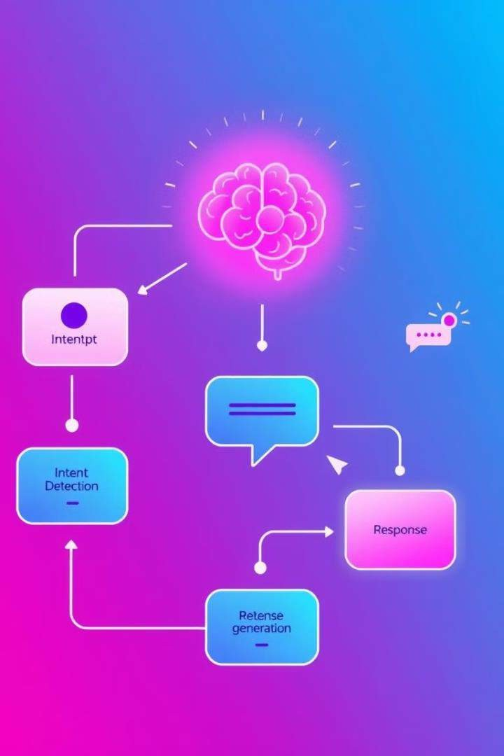

Core Components of an AI-Based Chatbot
Two key components work together to provide a customized experience for chatbot users.
Intent Detection
Identifies the user's goal or purpose, e.g., tracking an order
when asked, "Where is my package?"
Entity Recognition
Extracts specific details, like dates, locations, or product names, to tailor responses to the user's needs.

Slide 10
Large Language Models (LLMs)
Welcome to the exciting world of LLMs!

Slide 11

Why Use LLMs?
1
Automated Tasks
Generate code, write stories, and answer questions.
2
Enhanced Efficiency
Automate repetitive and time- consuming tasks.
3
Unlock Creativity
Explore new ideas and enhance creative output.
4
Personalized Experiences
Create tailored content and experiences for users.

Slide 12

What is a Large Language Model?
AI System
Processes and understands human language.
Vast Data Training
Learns from massive amounts of text data.
Predictive Capabilities
Predicts the next word or phrase in a sequence.

Slide 13
Understanding Neural Networks
Inspired by the brain
Interconnected Nodes
Learning Through Patterns
Adjust connections to improve performance.
Similar structure to biological neurons.
Process and transmit information.

Slide 14


Transformers: The Foundation of LLMs
Encoder
Processes input text into meaningful representations.
Decoder
Generates output text based on encoded representations.
Attention Mechanism
Focuses on relevant parts of the input.

Slide 15





Popular Large Language Models
GPT-3
Generative Pre-trained Transformer 3.
LLaMA
Large Language Model Meta AI.
Bard
Google's conversational AI.
BLOOM
BigScience Large Open-access Open-source Multilingual Language Model.

Slide 16
Using Large Language Models
Text Generation
Write stories, articles, and poems.
1
2
Translation
Translate text between different languages.
Code Generation
Create code in various programming languages.
3
4
Summarization
Condense large amounts of text into summaries.
Question Answering
Answer questions based on provided text.
5

Slide 17
Key Concepts
Temperature Controls the randomness of the generated text.
Tokens Basic units of text that LLMs process.
Seed A value used to initialize the random number generator.

Slide 18

Interesting Doubts about LLMs
1
Bias and Fairness
LLMs can reflect biases present in training data.
2
Ethical Considerations
Impact of LLMs on society and jobs.
3
Transparency and Explainability
Understanding how LLMs make decisions.
4
Future of LLMs
Potential for further advancements.

Slide 19

Open Source AI
Models: Efficiency Uncovered
Open-source AI models are democratizing access to powerful artificial intelligence capabilities. These models offer a cost-effective and adaptable alternative to proprietary systems, fostering innovation and collaboration in the field of AI.

Slide 20

Introduction to Open Source AI Models
1
Open-source philosophy
2
Diverse models
A wide range of open-source AI models exist, each specialized for different tasks, such as language generation, image recognition, and machine translation.
3
Benefits of open source
Open-source AI models offer flexibility, cost-effectiveness, and the opportunity to customize and extend existing models for specific applications.
Open source models promote transparency, community involvement, and rapid advancement by making code and training data publicly available.

Slide 21
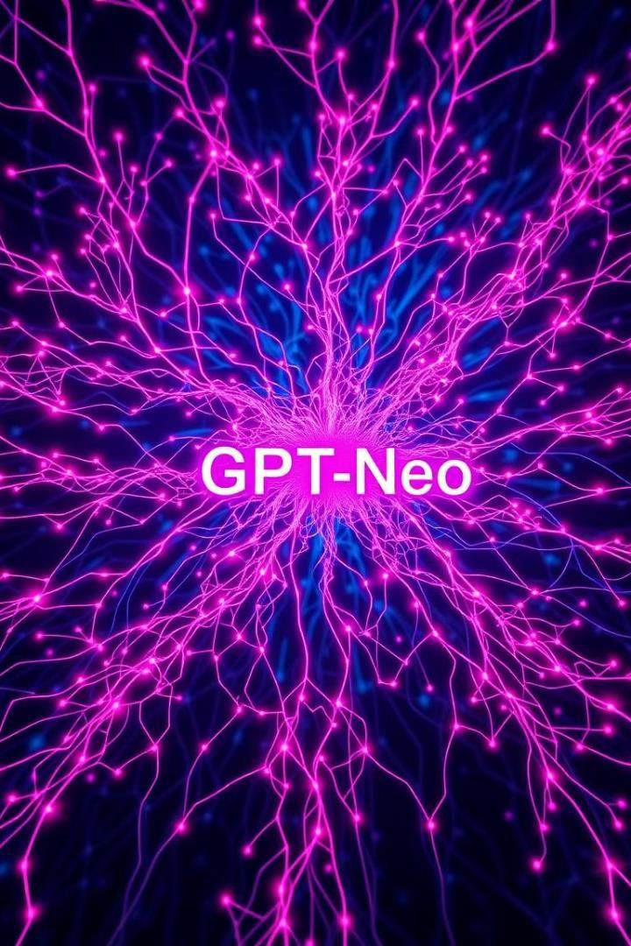
GPT-Neo: Capabilities and Performance
Language Generation
GPT-Neo excels at generating human-quality text, making it suitable for applications like creative writing, dialogue systems, and code completion.
Translation
Its ability to understand and translate languages opens up opportunities for multilingual applications and cross-cultural communication.
Efficiency
GPT-Neo achieves high performance with a balance of computational power and model size, making it efficient for resource-constrained environments.

Slide 22
LLaMA: Flexibility and Scalability
Modularity
LLaMA's modular design allows for easy integration with other systems and frameworks, making it versatile for a range of applications.
Scalability
LLaMA can be scaled to handle larger datasets and more complex tasks, ensuring it can adapt to evolving AI needs.
Efficiency
Its optimized architecture and training methods contribute to its efficiency, achieving high performance with relatively lower computational resources.

Slide 23

Comparison of Model Efficiency
Model | Performance | Resource Consumption
GPT-Neo | High | Medium
LLaMA | Very High | Low

Slide 24
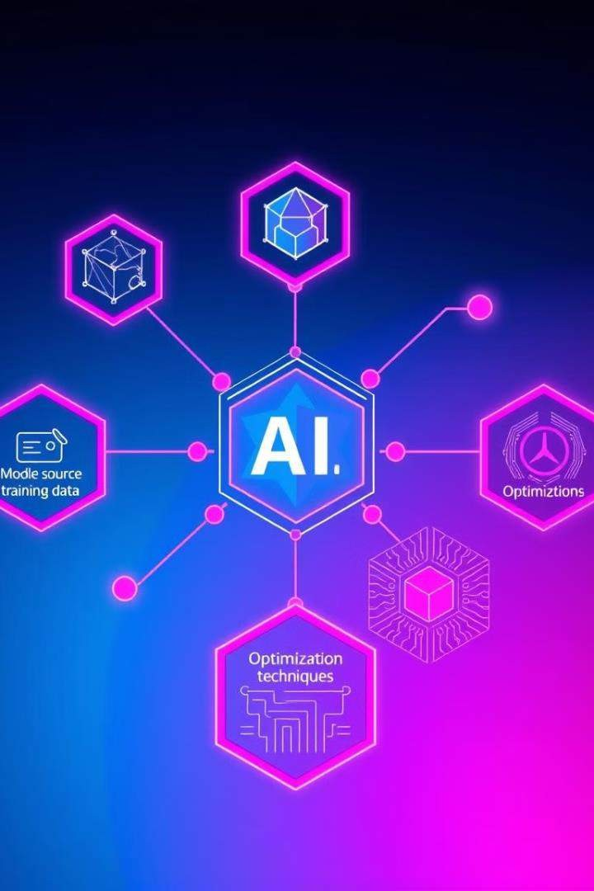
Factors Influencing Model Efficiency
1
Model Architecture
The design of the neural network significantly impacts performance and resource usage.
2
Training Data
The quality and quantity of training data play a crucial role in model accuracy and
efficiency.
3
Hardware Capabilities
Computational power and memory capacity influence the speed and feasibility of
model training and inference.
4
Optimization Techniques
Strategies for reducing model size, improving training speed, and optimizing inference efficiency enhance overall performance.

Slide 25
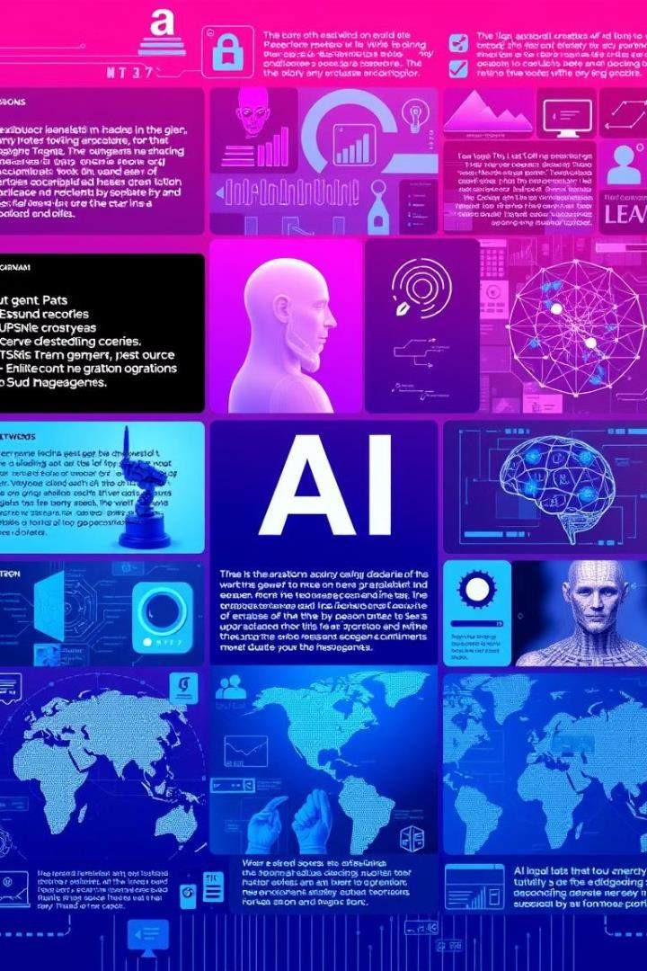




Real-World Applications of Open Source AI
Chatbots
Open-source AI models enable the development of intelligent chatbots for customer service, education, and entertainment.
Healthcare
These models assist with medical diagnosis, drug discovery, and personalized treatment plans, improving healthcare outcomes.
Language Translation
Open-source AI models facilitate cross- cultural communication by enabling accurate and efficient language translation.
Robotics
They empower robots with advanced cognitive abilities, enabling them to perform complex tasks, navigate environments, and interact with humans.

Slide 26

Conclusion and Future Outlook
Open-source AI models are rapidly evolving, driving innovation and expanding the frontiers of artificial intelligence. Their accessibility, adaptability, and collaborative nature are poised to revolutionize various industries and aspects of human life.

Slide 27

What is OLlama?
OLlama empowers you to run large language models (LLMs) directly on your computer, offering increased privacy and control over your data.
1
Advantages
OLlama provides enhanced privacy, reduced latency, and greater
control over data by running AI models locally.

