Slide 1
Legal and ethical concerns with scraping
Avinash Tulasi | PhD Scholar | Precog@IIITD

Slide 2
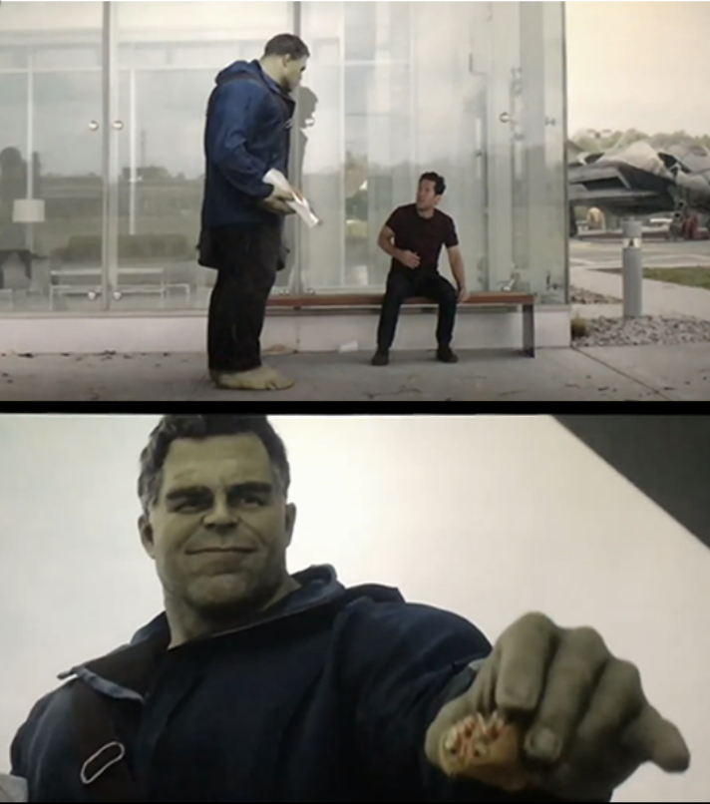
*TWITTER
*REDDIT
*ME
*KEY

Slide 3


VS

Slide 4
Concerns of a site owner

Slide 5
Concerns of a scraper

Slide 6
As an ethical scraper I will:
Use a public API If you have and avoid scraping all together.

Slide 7
As an ethical scraper I will:
always provide a User Agent string that makes my intentions clear and my contact.
import requests
url = 'SOME URL’
headers = {
'User-Agent': 'My User Agent 1.0’,
'From': 'youremail@domain.com' # This is another valid field
}
response = requests.get(url, headers=headers)

Slide 8
As an ethical scraper I will:
request data at a reasonable rate. I will strive to never be confused for a DDoS attack.

Slide 9
As an ethical scraper I will:
only save the data I absolutely need from your page. If all I need it OpenGraph meta-data, that’s all I’ll keep.

Slide 10
As an ethical scraper I will:
respect any content I do keep. I’ll never pass it off as my own.

Slide 11
As an ethical scraper I will:
look for ways to return value to you. Maybe I can drive some (real) traffic to your site or credit you in an article or post.

Slide 12
As an ethical scraper I will:
respond in a timely fashion to your outreach and work with you towards a resolution.

Slide 13
As an ethical scraper I will:
scrape for the purpose of creating new value from the data, not to duplicate it.

Slide 14
As an ethical site owner I will:
allow ethical scrapers to access my site as long as they are not a burden on my site’s performance.

Slide 15
As an ethical site owner I will:
respect transparent User Agent strings rather than blocking them and encouraging use of scrapers masked as human visitors.

Slide 16
As an ethical site owner I will:
reach out to the owner of the scraper (thanks to their ethical User Agent string) before blocking permanently. A temporary block is acceptable in the case of site performance or ethical concerns.

Slide 17
As an ethical site owner I will:
understand that scrapers are a reality of the open web.

Slide 18
As an ethical site owner I will:
consider public APIs to provide data as an alternative to scrapers.

