Slide 1


Slide 2
Create a repository
Create new repo in directory:
$ git init
Get from remote location (typically via HTTP or SSH)
$ git clone <url>
Specify the directory you want to store the repo in
$ git clone <url> <targetdir>

Slide 3
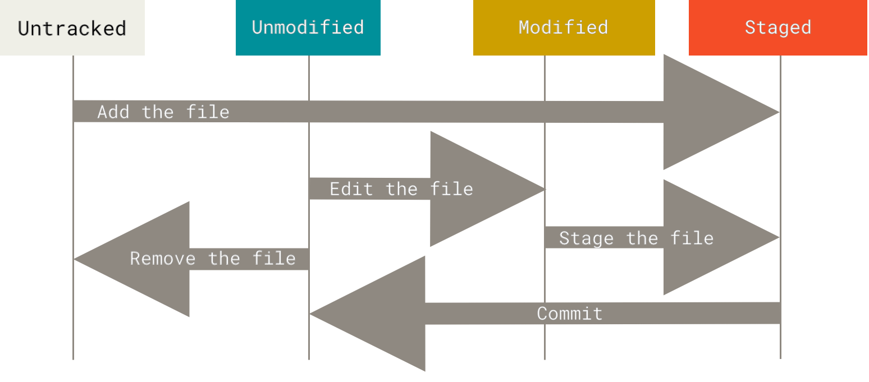
Lifecycle

