Slide 1
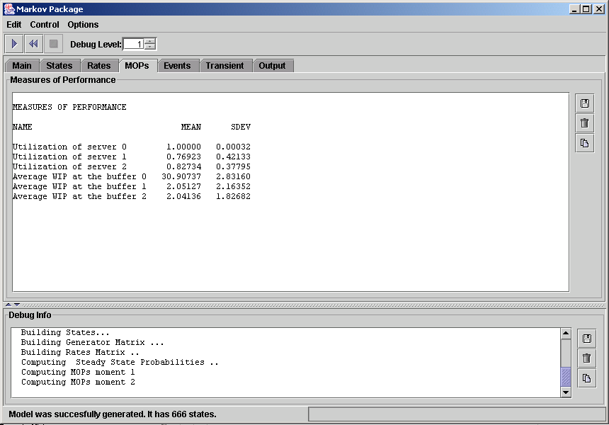
Notes:
screen2

Slide 2
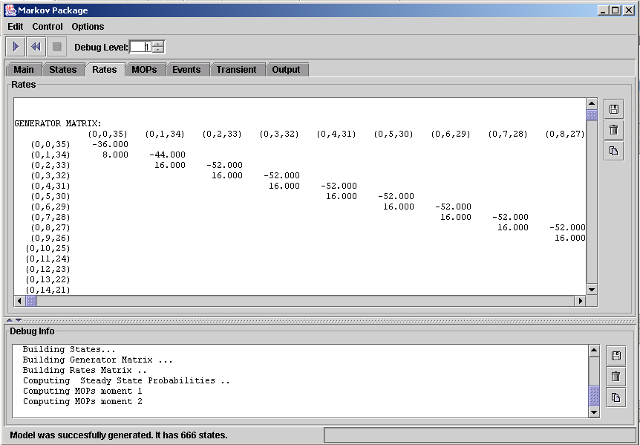
Notes:
screen1

