Slide 1
Introduction to Machine Learning with Python
Josue Martinez-Martinez
jmartinez718@email.uagm.edu

Slide 2
Machine Learning Background
Machine learning is the study of computer algorithms that improve automatically through experience.
Supervised Learning – is the task of learning a function that maps an input to an output based on example input-output pairs.

Slide 3
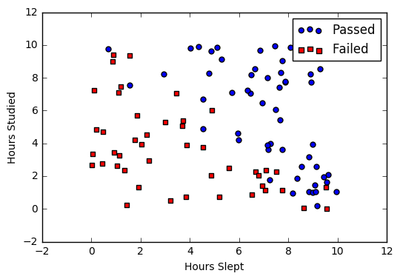
Logistic Regression
Logistic regression is a classification algorithm used to assign observations to a discrete set of classes.
Transforms its output to return a probability value which can then be mapped to two or more discrete classes.

Slide 4
Methodology
Model Training
Pre-Process Data
Training Data Set
Shuffle Data Set
Train Model
Predict Classifications
Validation Data Set
Evaluate Model
Validate Accuracy
Edit Parameters
Split Data
Test Model

Slide 5
Questions?

