Slide 1
Brief Overview
on Deployment Techniques
Focusing on deployment of Flask Applications

Slide 2
TABLE OF CONTENTS
01
03
02
04
What it is
Free credits
Ways to Deploy
Conclusion

Slide 3
01
Definition

Slide 4
What is
Deployment?
Software deployment includes all of the steps, processes, and activities that are required to make a software system or update available to its intended users.Developers deploy software updates, patches and new applications with a combination of manual and automated processes. Some of the most common activities of software deployment include software release, installation, testing, deployment, and performance monitoring.

Slide 5
Deployment Activities
Release
Installation
Activation
Deactivation
Uninstallation
Update
Built-in Update
Version Tracking
Making a version of software available to the public.
Establishing some form of command, shortcut, script or service for executing the software
Starting up the executable component of software for the first time
Shutting down any already-executing components of a system
Removal of a system that is no longer required
Replaces an earlier version of all or part of a software system with a newer release
Mechanisms for installing updates
Help the user find and install updates to software systems

Slide 6
02
Top 5 Methods to
deploy your Flask App!

Slide 7
TOP 5 TYPES OF DEPLOYMENT
ngrok
Heroku
Deployment
“Serverless”
Virtual Machines
Docker
Get it running on the go!
Easiest way out.
Based on Flask Applications
Pay for what you use!
Bigger your wallet better your cloud storage.
Could there be something better than this?

Slide 8
ngrok
PROS
CONS
Fast and easy
Handy for Demos
Working on webhooks
Stops when you close your laptop
Random Domains
Definitely doesn’t scale

Slide 9
Heroku
PROS
CONS
One app 24/7 for free
Zero server Management
Add-ons available for the ecosystem
Scaling is easy but gets pricey
Harder server customization
Some add-ons better than others

Slide 10
Serverless
PROS
CONS
Economical for small to medium loads
Good for spikey traffic
Zero server config
Relatively cheap technique
Can be tricky to troubleshoot.

Slide 11
Virtual Machines
PROS
CONS
Full Control
Scales as much as your wallet
Economical..if you’re careful enough.
More work for the devs.
There’s a lot more to learn and apply.
Harder to predict the ultimate costs.

Slide 12
Docker
PROS
CONS
Consistency across your team.
Eases the pain of debugging environments.
There can be a significant learning curve to migrating to Docker.
Has some gaps in documentation.

Slide 13
03
Free Credits for Everyone!

Slide 14
PROCESS TO EARN FREE CREDITS
Step 1
Step 2
Step 3
Step 4
Step 5
Step 6
Goto the website
https://education.github.com/pack
Sign in to your Github Account
Add your VIT E-mail ID.
Enter the ways you plan to use these credits
Submit your application
Get the free credits

Slide 15
04
Event Conclusion

Slide 16


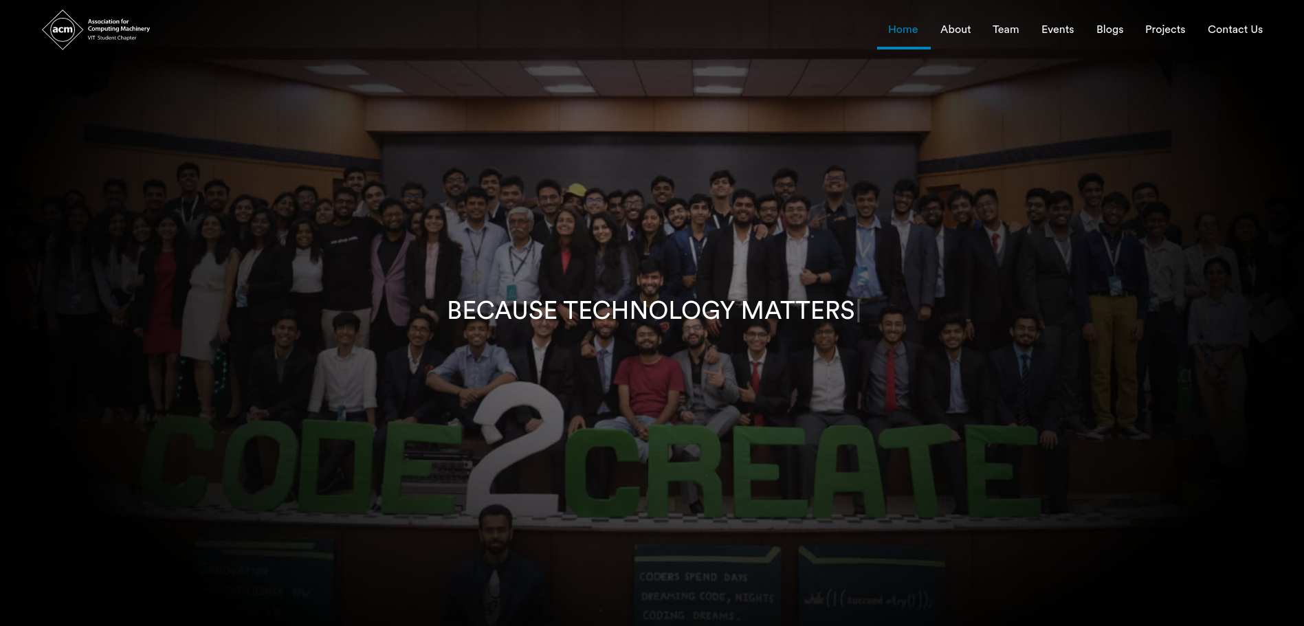

THANKS!
Association for
Computing Machinery
VIT Student Chapter
Do you have any questions?
outreach.acmvit@gmail.com
https://acmvit.in/

