Slide 1
CAPSTONE PROJECT · FINAL REPORT
Understanding and Predicting Father Absence in South Africa Using Machine Learning for Social Insight and Policy Support.
Presented by
Asnath Miandabu · 202306148
Lecturer: Dr. Ibidun Obagbuwa
Sol Plaatje University

Slide 2




BACKGROUND
Aim of the Study
The aim of this study is to explore the effects and causes of absent fathers, and develop an interpretable, data-driven machine learning framework to predict father absence in South African households. Utilizing demographic, socio-economic, health, and educational indicators, the framework will uncover key risk factors and generate actionable insights.
These insights will support social workers, educators, and policymakers in targeting at-risk households and strengthening family support systems.
Social workers
Educators
Policymakers
Understanding and Predicting Father Absence in South Africa Using Machine Learning for Social Insight and Policy Support

Slide 3



BACKGROUND
Business Domain
Domain
Client / User Group
Goal
Social Policy, Family Development, and Community Welfare.
Government agencies, social workers, NGOs, and educational policymakers.
Provide insights to improve social support and reduce father absence rates through evidence-based strategies.
Notes:
The project operates within the social policy and welfare domain, focusing on family stability. It provides a data-driven foundation for decision-makers to allocate resources more effectively.

Slide 4

BACKGROUND
Problem Statement
“According to News24, absent fathers in households are a growing concern in South Africa. Over 50% of children in the country are raised by single mothers, while their fathers are alive but either inconsistently contribute or do not contribute at all to the household or child welfare. If the issue of fatherlessness is not addressed, it can become a major contributing factor to dysfunctional communities and lead to various social issues.”
50%+
of children in South Africa are raised by single mothers
THE GAP
There is a gap in the use of data-driven insights and machine learning to identify the key factors that influence the likelihood of a household having a father figure. This research seeks to bridge that gap by leveraging data science to provide deeper insights into this pressing issue.

Slide 5

BACKGROUND
Literature Review
60%+
of children don’t live with their biological fathers
A cycle across generations
“According to the Human Sciences Research Council, most children in South Africa — over 60% — don’t live with their biological fathers. And 20% only have contact with their biological father twice a week. This isn’t to suggest that they don’t have other male figures in their lives, but it does point to an imbalance in the distribution of parental responsibilities.”
“Many men who are absent fathers had absent fathers themselves. Since they’ve never experienced the advantages of a present male figure, they don’t know what these advantages are — or how to pass them on.”
Source: Daily Maverick
Source: Daily Maverick
While the consequences of fatherlessness in South Africa have been explored in various studies, there is limited empirical data on the specific factors that contribute to this issue.

Slide 6

BACKGROUND
Relevant Research Studies
So many studies have been done on this issue. A study of absent fathers in Johannesburg, South Africa in 2013 stood out to me.
Key themes
Methodologies comparison
Four themes were provided in the research:
2013 STUDY
THIS RESEARCH
Gaps in literature
Fatherhood conception
Qualitative, exploratory-descriptive design. Targeted fathers aged 15–35 who were absent in the life of at least one of their children. Conducted in Alexandra, Doornkop, Thembisa and Devland with 15 participants each.
Data-driven insights and machine learning to find the major contributors to fatherlessness in the country, using a general household survey.
1
Previous research has fallen short of using machine learning. This research could contribute by using supervised classification to predict whether a household is managed by a father figure, “Yes” or “No”.
2
The cause
3
Fathers’ perception of the consequences of their absence
4
Recommendations to address the matter

Slide 7


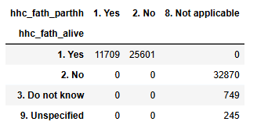

SCOPE & METHOD
In-Scope & Out-of-Scope
In scope
Out of scope
Analysis of demographic and socio-economic factors from national surveys.
Machine learning model to predict father presence (0 = No, 1 = Yes).
Development of dashboards for insight presentation (Panel, Tableau).
Analysis of deceased or unknown father cases.
Longitudinal tracking of individual households.
Father-status variables in the data

Slide 8



SCOPE & METHOD
Solution / Methodology
The methodology follows a structured data science pipeline. Key focus is on interpretability — understanding which variables most influence father presence.
1
Data acquisition
2
Data preprocessing
3
Exploratory Data Analysis
From DataFirst UCT (2023).
Cleaning, encoding, feature selection, and transformation.
Using Plotly visualizations.
4
Model development
5
Model evaluation
6
Reporting
Random Forest and other supervised classifiers.
Performance metrics (accuracy, precision, recall).
Interactive dashboard with policy-focused insights.
TOOLS

Slide 9
SCOPE & METHOD
Clear Project Deliverables
1
Data Acquisition
2024
household survey
The 2024 household survey data was manually collected from DataFirst (University of Cape Town) under rules and policies provided. This dataset serves as the primary source for analysis.
71,000+
rows
100+
columns

Slide 10



SCOPE & METHOD
Deliverable 2: Data Preprocessing
A clean dataset
The key challenge
Few duplicates, no missing values, and no inconsistencies.
2024 categorical data used text labels, whereas the 2023 dataset used coded labels in the format Code. Label.
Two formats
Mapping logic
Aligned data
ML-ready
2023 dataset: Code. Label
2024 dataset: Label
Match 2024 labels to 2023 codes. Labels not encoded were mapped manually using the dataset guide.
2024 data transformed into the format Code. Label.
Only the code values are extracted, converting categoricals to numbers for ML algorithms.
Ensures consistent, standardized categories across the data.
Helps identify unexpected or missing categories that need review.
Improves data quality for better analysis, reporting and machine learning.

Slide 11
SCOPE & METHOD
Clear Project Deliverables (cont.)
3
Exploratory Data Analysis
4
Machine learning models
Tools used
EDA was conducted to uncover patterns, trends, and key variables related to fatherlessness. Both statistical methods and visualizations were used to understand the relationships in the data.
A set of classification models that predict the presence of a father figure in a household: Random Forest, XGBoost and binomial logistic regression, built in R.
Plotly
interactive, customizable visualizations
Panel
interactive dashboards in Python
Tableau
flexible drag-and-drop visual analysis
5
Cause & impact analysis report
6–7
Final report & presentation
Python
EDA, visualization and user interface
Statistical analysis that identifies causes of fatherlessness and the impacts on households.
A comprehensive report with actionable insights, a prediction app, and policy recommendations for addressing fatherlessness, plus a presentation of findings to stakeholders, including community leaders and policymakers.
R
model training, testing and retraining
Plumber API
connects Python and R

Slide 12
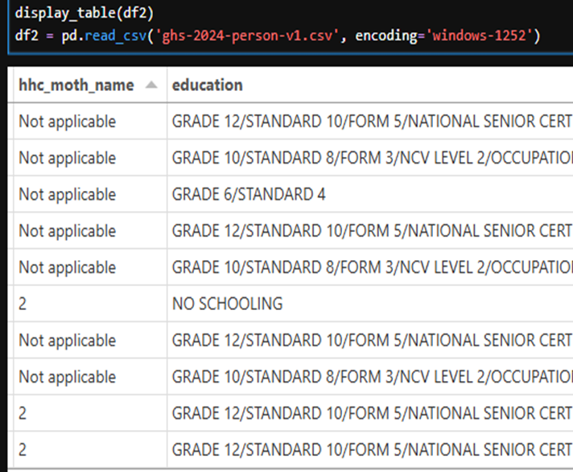
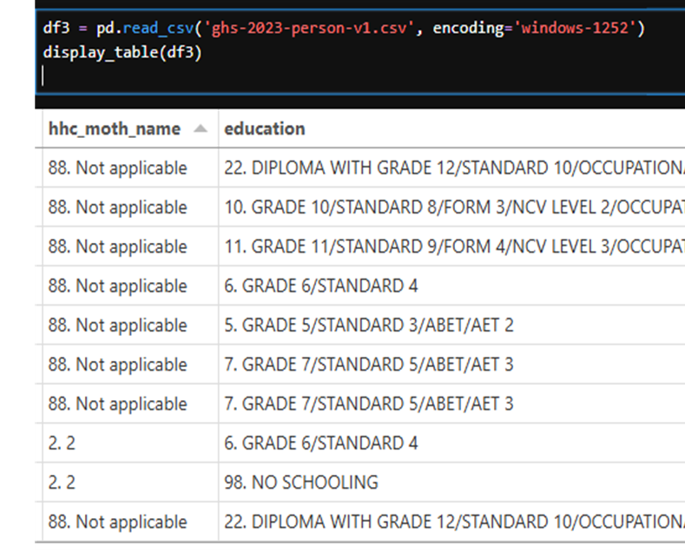
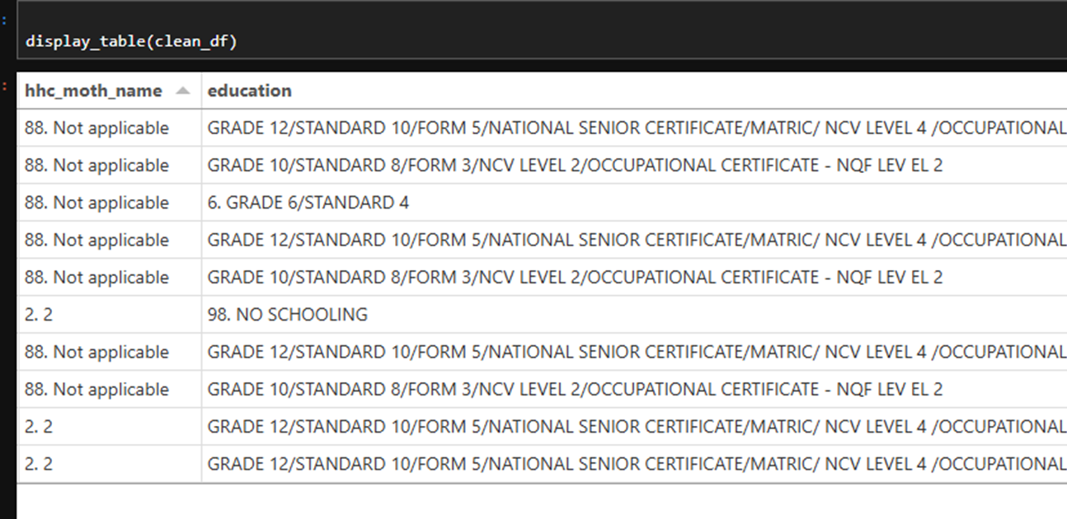
SCOPE & METHOD
Final Data & Features
2024 dataset: text labels (df2)
Mapped labels
2023 dataset: coded labels (df3)

Slide 13
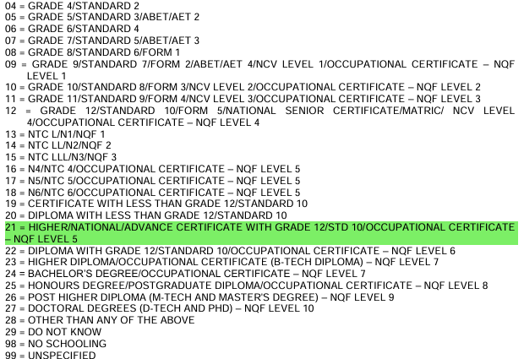
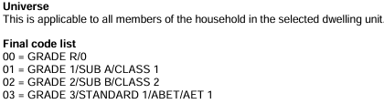
SCOPE & METHOD
Codebook Reference & Mapping Steps
Dataset guide: education codes
Mapping steps
1
Extract suffixes (None, Primary, Secondary, Tertiary) from df3.
2
Build mapping: suffix → full label (e.g., “Primary” → “2. Primary”).
3
Replace matching values in df2 with full labels.
4
Leave unmatched values as-is and flag for review.
Notes:
Ensures consistent, standardized categories across the data.
Helps identify unexpected or missing categories that need review.
Improves data quality for better analysis and reporting.
Steps:
- Extract suffixes (None, Primary, Secondary, Tertiary) from df3.
- Build mapping: suffix → full label (e.g., "Primary" → "2. Primary").
- Replace matching values in df2 with full labels.
- Leave unmatched values as-is, flag for review.

Slide 14
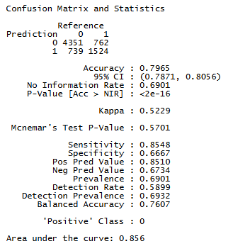
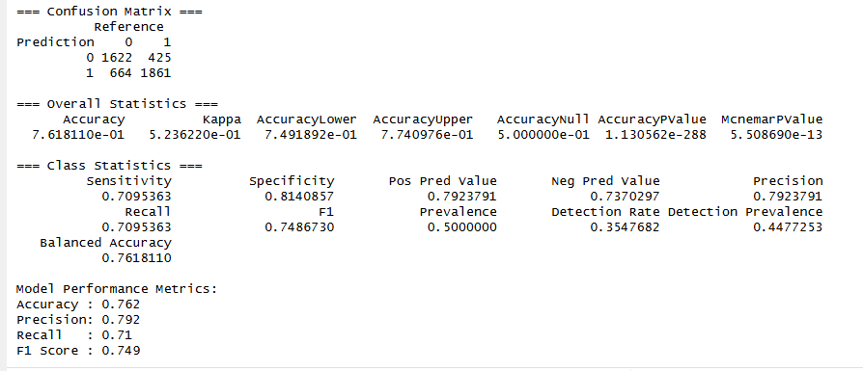

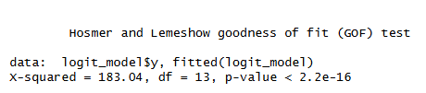
RESULTS
Models Evaluation on Balanced Dataset
Random Forest
Logistic regression (binomial)

Slide 15
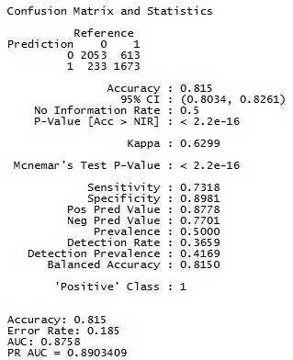
RESULTS
XGBoost Model Evaluation
81.5%
81.5%
accuracy
balanced accuracy
0.63
73%
Kappa: substantial agreement beyond chance
sensitivity for class 0 (father not present)
Balanced across both classes, and stronger on class 1 (father present, 90% precision) than class 0. Downsampling improved the model’s ability to generalize despite the original imbalance.
Notes:
Insights & Interpretation
The model performs very well overall, with strong accuracy and balanced performance across both classes.
The model performs better on class 1 (father present) than class 0.
Class 0 (father not in household) has lower sensitivity (73%), meaning more false negatives (i.e., father actually not present but predicted as present).
Class 1 (father present) is predicted with high precision (90%), indicating fewer false positives. This means the model correctly classifies 90% of class 1 (father present).
"The balanced accuracy of 81.5% shows that the XGBOOST model effectively distinguishes between both classes, despite the original imbalance in the dataset. This suggests that downsampling was successful in improving the model’s ability to generalize across class boundaries.“
Kappa = 0.6299 indicates substantial agreement beyond chance.
Accuracy alone can be misleading—especially when the dataset is imbalanced.
Kappa corrects for this by considering how often you'd expect agreement just by chance.
This is a good result, showing that the model isn't just "getting lucky.“
"The Kappa statistic of 0.6299 confirms that the model’s performance is not due to random guessing.
This result supports the conclusion that the Random Forest model has learned meaningful patterns in the data and generalizes well,
even in the context of class imbalance."
The OOB error rate of 18.5% is consistent with the test accuracy, supporting the model's reliability.
OOB is like cross-validation for Random Forests — this is a reliable estimate of generalization error.
That means the model misclassifies ~19 out of 100 observations on average.

Slide 16
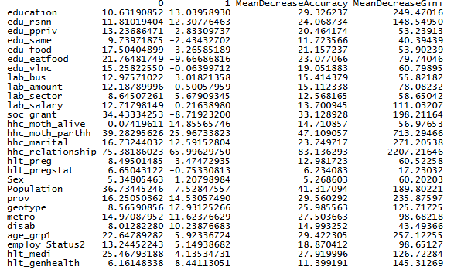
RESULTS
Most Important Predictors (by MeanDecreaseGini)
Strongest signal: family structure. hhc_relationship and hhc_moth_parthh lead; income, grants, employment and education-related variables also add predictive power.
Little or no importance: hhc_fath_alive (0 across the board) and undisab (≤ 0). Candidates for removal without hurting performance.
Notes:
You can interpret these as: Variables with higher values have more influence in partitioning the data and improving the prediction accuracy.
These are the strongest variables in predicting whether the father is part of the household.
The high importance of hhc_relationship and hhc_moth_parthh suggests that family structure is the most powerful signal in predicting father presence.
Socio-economic variables like income, grants, employment status, and education-related violence or absence also have predictive power.
Most important variables based on MeanDecreaseGini:
hhc_moth_parthh (704.69): Huge impact on purity of splits, confirming it’s a top feature.
Population (89.96): Strong contributor to node purity.
lab_amount (77.07): Likely labor or employment related.
prov (80.17): Also important for classification purity.
geotype (62.29): Geographic or environmental type is important.
Variables with low or no importance:
hhc_fath_alive (0 across the board): No importance in the model.
undisab (-0.4 and low values): Negative or very low importance — might not contribute meaningfully.
What does this mean practically?
The model relies most heavily on hhc_moth_parthh (some household or parental variable), Population, and prov for prediction.
Variables with higher MeanDecreaseAccuracy and MeanDecreaseGini are key drivers of the model’s performance.
Variables with zero or negative importance could potentially be removed from the model without harming, or even improving, performance.

Slide 17



RESULTS
Model Performance Summary
Criterion | Best model | Reason
Accuracy | XGBoost | Highest at 81.5%
AUC (ROC) | XGBoost | 0.8758 shows strongest class separation
Precision & specificity | XGBoost | Fewer false positives
Sensitivity (recall) | Random Forest | Captures positives effectively
Interpretability | Logistic Regression | Coefficients explain variable influence
XGBoost
Highest overall accuracy and AUC, the best performer for both classification and ranking positive cases.
Random Forest
Competitive, particularly strong in recall for the majority class but slightly lower specificity.
Logistic Regression
Interpretable, with significant insights into variable contributions but lower predictive performance than the tree-based models.
Recommendation: XGBoost is the preferred model for deployment and predictive accuracy. Logistic regression can complement it for interpretability, and Random Forest is a robust alternative with good sensitivity for the majority class.

Slide 18
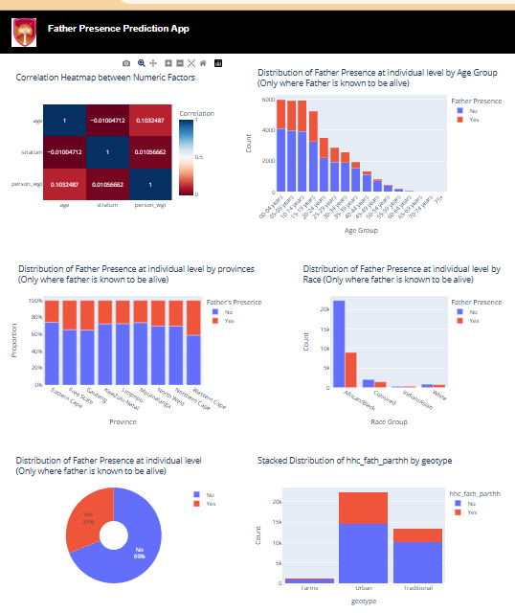
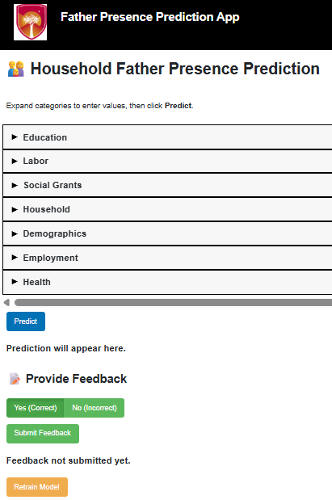
RESULTS
Interactive Dashboard & Prediction App
The interactive dashboard visualizes trends and relationships in the data used to predict father absence, focusing on how demographic, geographic, and socio-economic variables influence the likelihood of a father figure being present.
69%
live without a father figure
31%
live with one

Slide 19
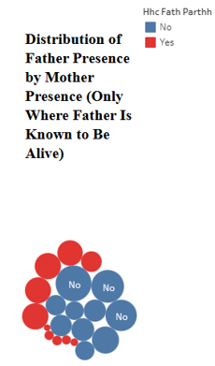
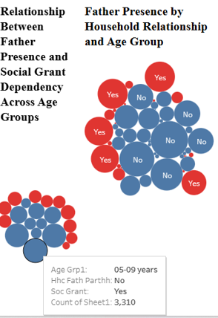
RESULTS
Dashboard Analysis
Correlation heatmap
Age group
Weak correlations among numeric variables such as age, stratum, and person weight confirm that multicollinearity is minimal, ensuring model reliability and interpretability.
Children aged 0–14 are most affected by father absence, while the presence rate decreases progressively with age.
Province
Race & geotype
Eastern Cape, KwaZulu-Natal, and Limpopo show the highest father absence; Western Cape is comparatively lower, suggesting socio-economic differences.
Race-based distribution reflects broader socio-economic inequalities. Urban areas show more variability, while traditional households show higher father absence.
These findings validate the dataset’s structure and variable selection, and provide actionable insights for social policy and targeted interventions.

Slide 20


WRAP-UP
Recommendations
Develop targeted support programs in high-risk regions identified by the model.
Encourage educational and employment initiatives for young men to reduce intergenerational father absence.
Use predictive insights to guide policy formulation and early intervention strategies.
Notes:
Recommendations aim to translate analytical findings into practical social actions. They emphasize prevention and empowerment rather than reactive policy measures.

Slide 21
WRAP-UP
Potential Risks and Mitigation Strategies
1
Data availability and quality
2
Missing values and data format
3
Data bias
MITIGATION
MITIGATION
MITIGATION
High-quality datasets from Stats SA or DataFirst. If the latest data is unavailable, I will manually create a questionnaire for SPU students, other colleges and schools in Kimberley to fill. Stats SA is a reliable source and has the latest General Household Survey.
Handle missing data effectively by removing them. Apply feature transformation and encode categorical features.
Balance the dataset using random under-sampling to handle data imbalance. Regularly retrain and use different models and methods with the updated dataset.
4
Privacy concerns
5
Feature and model selection
6
Time constraints
MITIGATION
MITIGATION
MITIGATION
Use label data encoding for data anonymization and follow ethical standards in handling household data.
The dataset has over 71,000 rows and over 100 columns, so it is difficult to know which features to select because only some are relevant to the topic. Suggestion: manual feature selection.
Adhere to the project timeline by breaking tasks into manageable milestones and conducting regular progress reviews. Allow buffer time for unforeseen delays.

Slide 22



WRAP-UP
Challenges
Label data & encoding
Handling label data and label encoding, which is important in model training and testing.
Class imbalance
Managing data imbalance of 60:30 through data undersampling.
Computational limits
Mitigated by data sampling and efficient feature engineering.

Slide 23
WRAP-UP
Project Plan (Timeline)
1
Data acquisition
5
Model development & evaluation
24 Feb 2025 – 05 Mar 2025
July 2025
2
Data preprocessing
6
Cause and impact analysis
05 Mar 2025 – 10 Apr 2025
July – August 2025
3
Exploratory Data Analysis (EDA)
7
Reporting & recommendations
01 May 2025 – June 2025
Aug 2025 – 05 Sept 2025
4
Feature engineering
8
Final review & delivery
June 2025
10 September 2025

Slide 24
WRAP-UP
Harvard Reference List
1
DataFirst UCT. (2023). General Household Survey 2023. Available at: https://www.datafirst.uct.ac.za/services/citations (Accessed: 02 March 2025).
2
News24. (2025). New study highlights the impact of fatherlessness in South Africa. News24. Available at: https://www.news24.com (Accessed: 03 March 2025).
3
Daily Maverick. (2023). South African society suffering profound absence of father. Available at: https://www.dailymaverick.co.za/opinionista/2023-06-14-its-fathers-day-but-south-african-society-suffering-profound-absence-of-father-figures/ (Accessed: 05 March 2025).
4
Mavungu Eddy, M., Thomson-de Boor, H. and Mphaka, K. (2013). SO WE ARE ATM FATHERS: A study of absent fathers in Johannesburg, South Africa. Johannesburg: Centre for Social Development in Africa, University of Johannesburg. Copyright: The authors, the Centre for Social Development in Africa, University of Johannesburg, and Sonke Gender Justice.

Slide 25
Thank you
Asnath Miandabu · Sol Plaatje University

