Slide 1

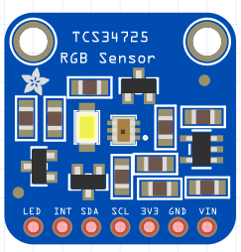
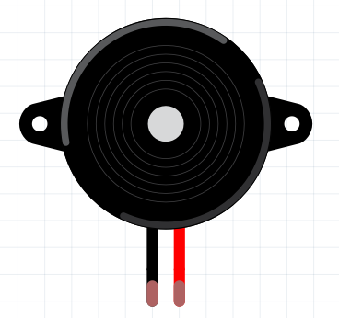
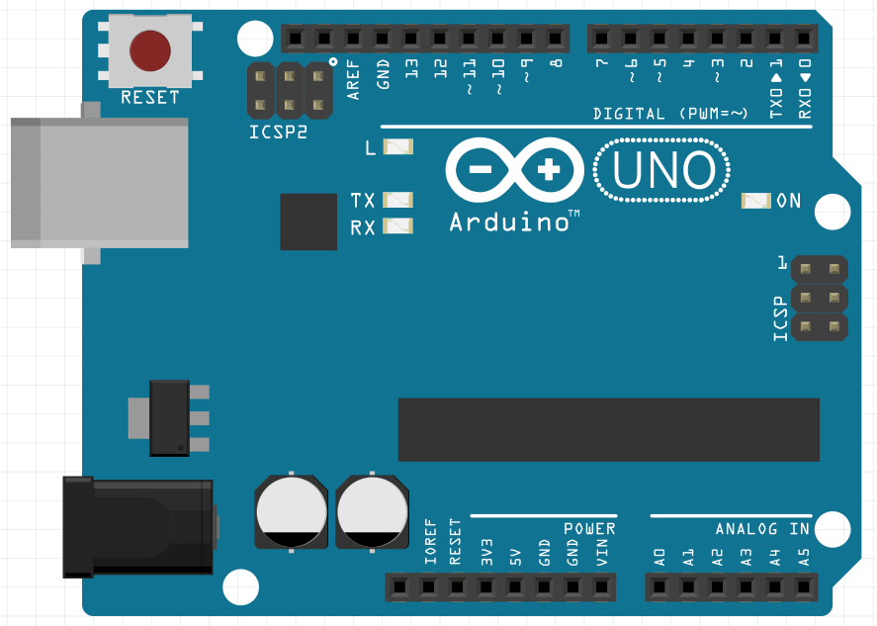
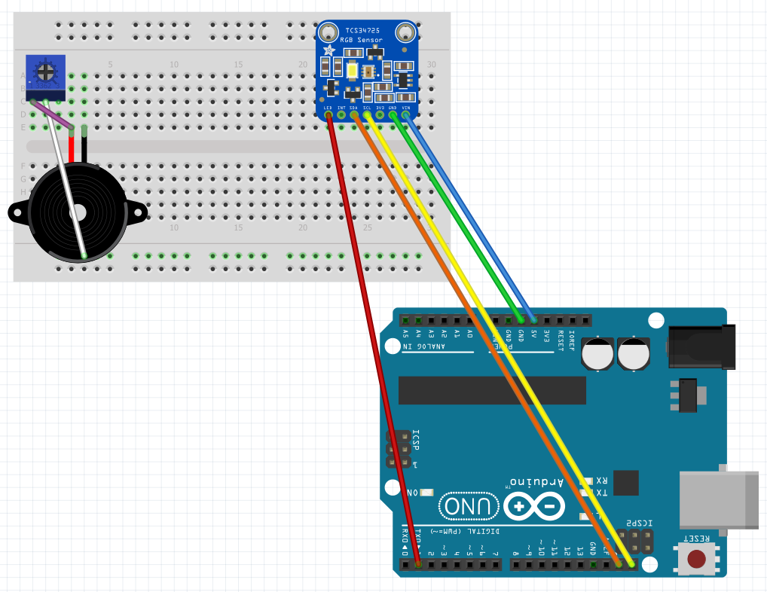
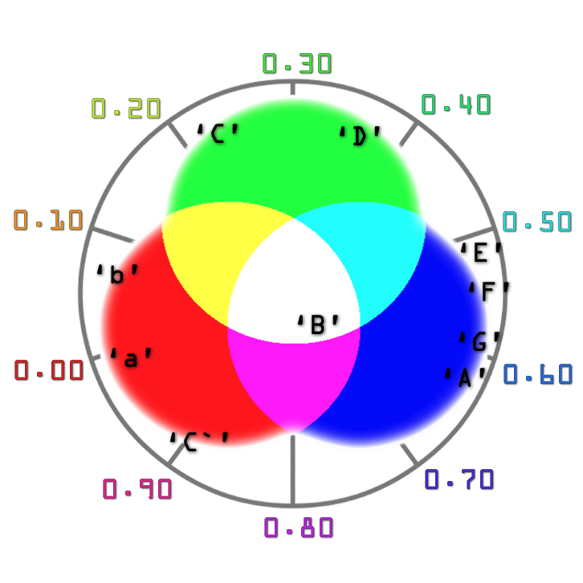
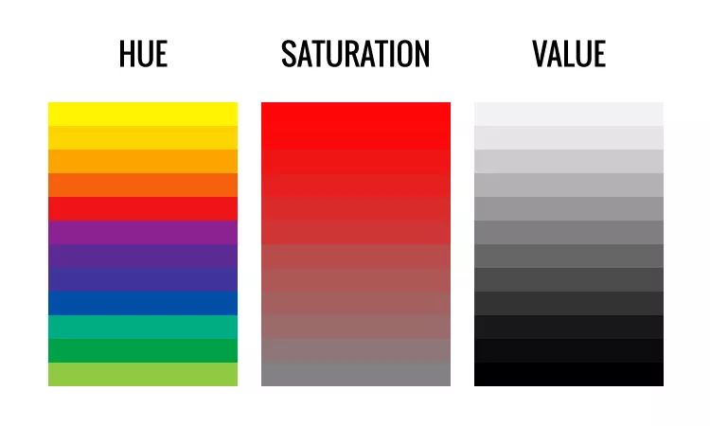


Project Name: Color Identifier
Matthew Higginbotham, Alex Mallett, Corey Manint, Frank Obioma, Pratchi Roy
McNeese State University – Department of Electrical Engineering and Computer Science
How does this work?
The Adafruit RGB Sensor has pins that interpret four different dimensions of color: red, green, blue, and clear. This model makes it difficult to make simple decisions based on major color categories, so a more intuitive method involving the use of only one variable was found. The formula listed below converts RGB data into HSV (hue-saturation-value) data. A pitch determination is made from the hue-value.
Based on this hue, the code will call a function that makes the Piezo Buzzer pulse at a certain frequency. We interpret this pulse as “pitch” or a certain note. The notes from A3-C5 are currently available.
Major Components and Diagram:
Limitations and Direction:
Fixed Number of Pitches/Colors: There are currently only 10 pitches available. This includes notes only in diatonic C Major - no chromatic notes. The coding only accounts for the hue registered from the RGB sensor. Accommodations will be made to accept a continuum of colors involving saturation and value. A larger number of pitches will also be available as a result
Non-intuitive way of playing: The RGB sensor is what allows colors to be determined, but it is currently bound to the bread board. Given the current set-up, a color has to be brought to the sensor rather than the sensor to the color. Placement of the sensor is a major part of how this project will be implemented in the future.
Sound Only Produced By Buzzer: Although pitch is currently being produced, it is fixed to the timbre produced by the buzzer. A MIDI controller and a speaker will be added, so that sounds similar to other instruments may be produced.
RGB Sensor:
“Sees” colors. Contains multiple photodiodes as well as an IR sensor and LED light to interpret colors. Compatible with 3.3V and 5V logic.
Piezo Buzzer:
Holds two small piezoelectric discs that resonate when a voltage is applied at a certain frequency. Makes the “boop” noise!
Arduino Uno
Arduino Uno:
A microcontroller that contains 14 digital pins and 6 analog pins. Allows for code to be implemented.
RGB to HSV Algorithm:
color Dimensions
H = Hue / color in degrees;
S = Saturation
V = Value
Conversion RGB → HSV
V = max = max(R, G, B);
min = min(R,G,B)
S = $\frac{\left(\text{max}\text{−}\text{min}\right)}{\text{max}}$; (if V = 0, S = 0)
Pitch Decisions and Diagram:
H = $\left\{\begin{aligned}\text{0+}\frac{\text{G}\text{ −}\text{B}}{\text{max}\text{−}\text{min}} \text{if} \text{max}\text{=}\text{R} \\ \text{2+}\frac{\text{B}\text{ −}\text{R}}{\text{max}\text{−}\text{min}} \text{if} \text{max}\text{=}\text{G} \\ \text{4+}\frac{\text{R}\text{ −}\text{G}}{\text{max}\text{−}\text{min}}\text{if} \text{max}\text{=}\text{B}\end{aligned}\right.$
COLOR | PITCH
RED | a
ORANGE | b
YELLOW | C
L. GREEN | D
D. GREEN | E
L. BLUE | F
D. BLUE | G
PURPLE | A
WHITE | B
MAGENTA | C

