Slide 1

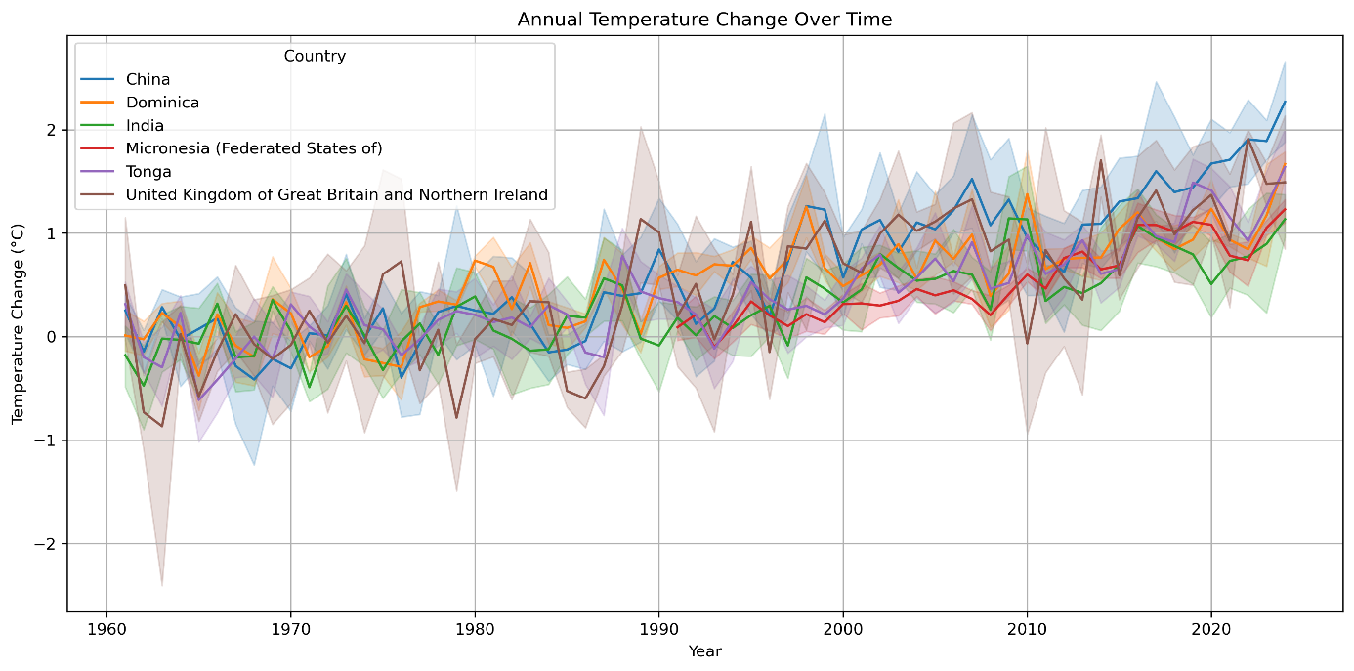
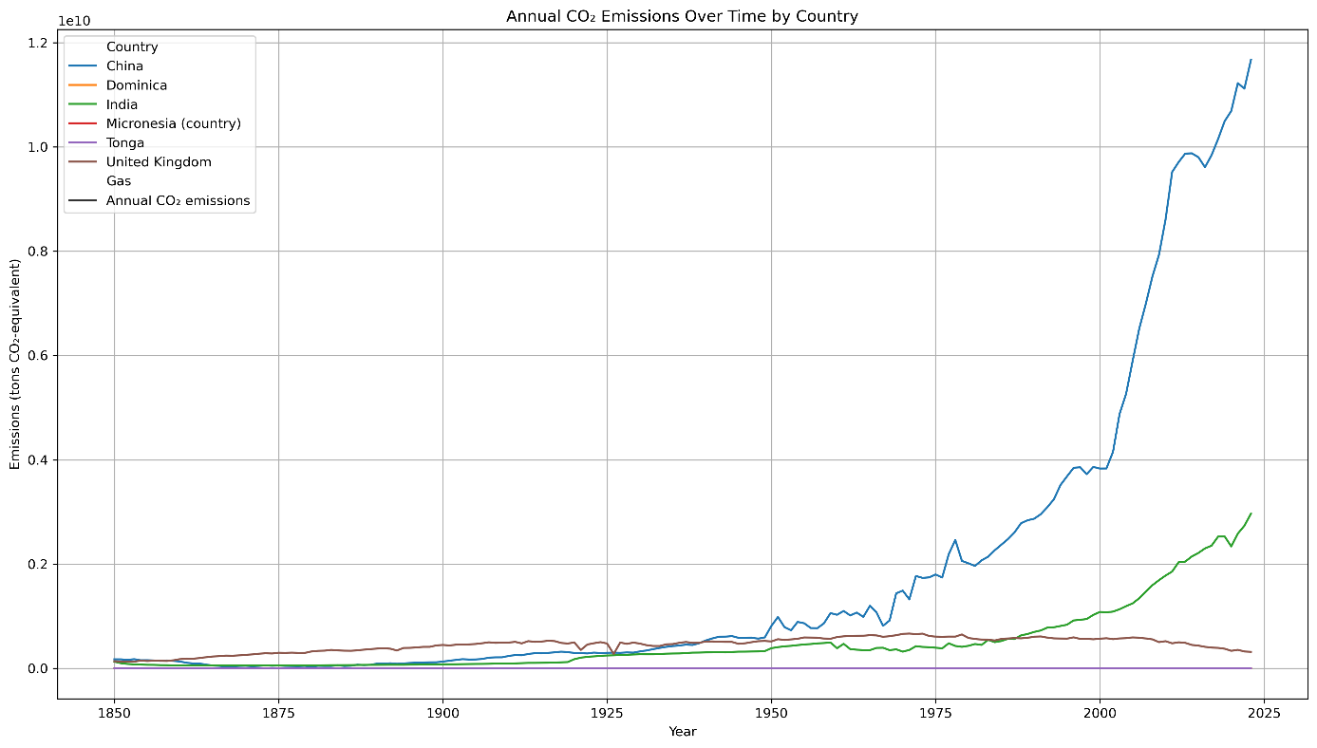
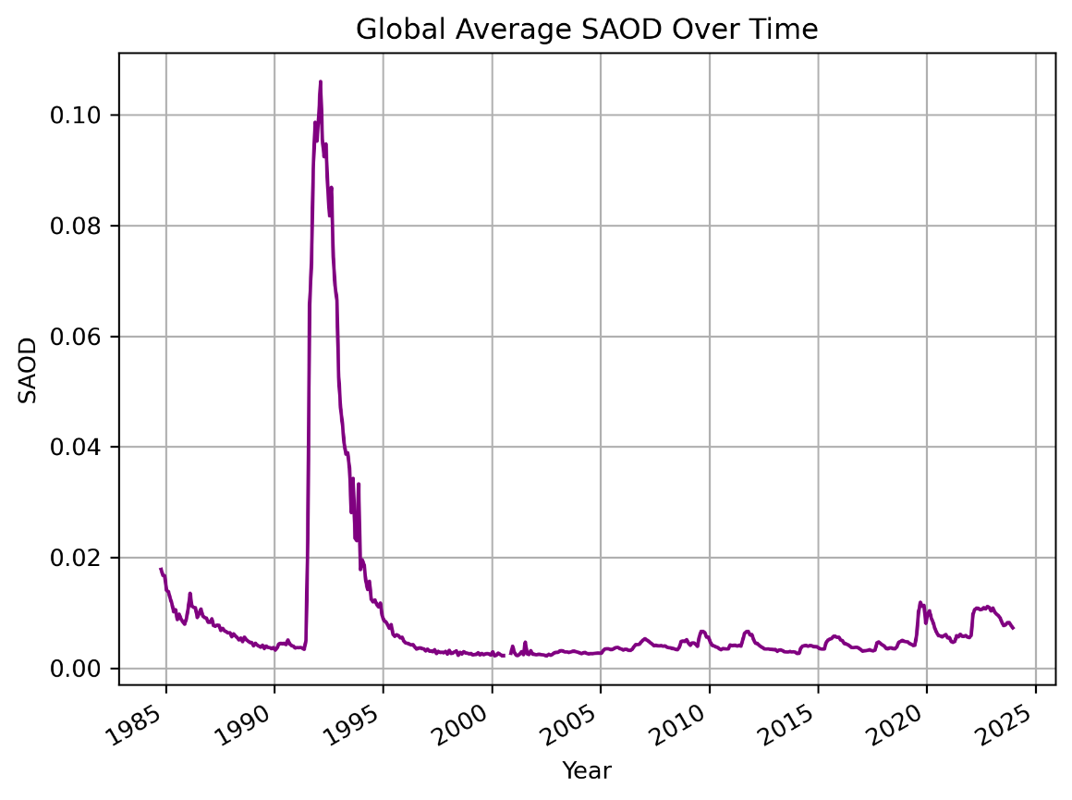
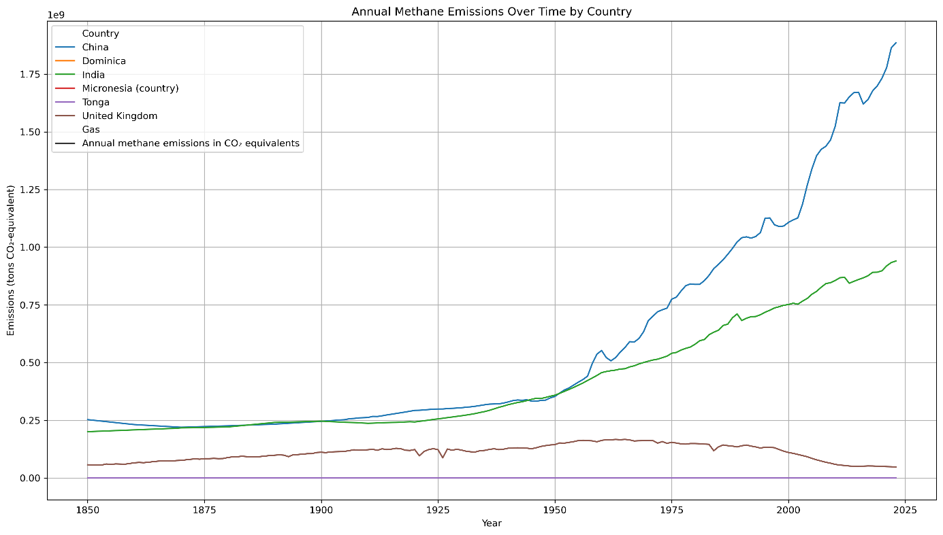
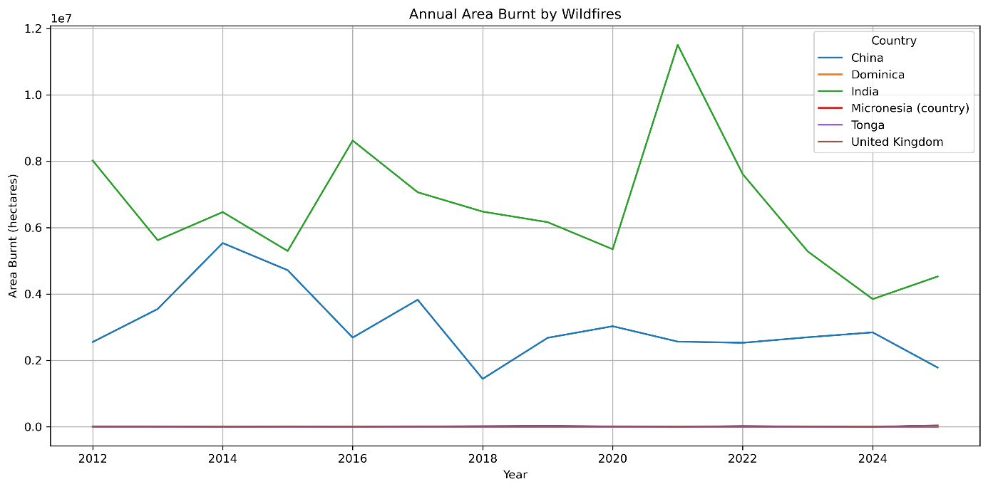
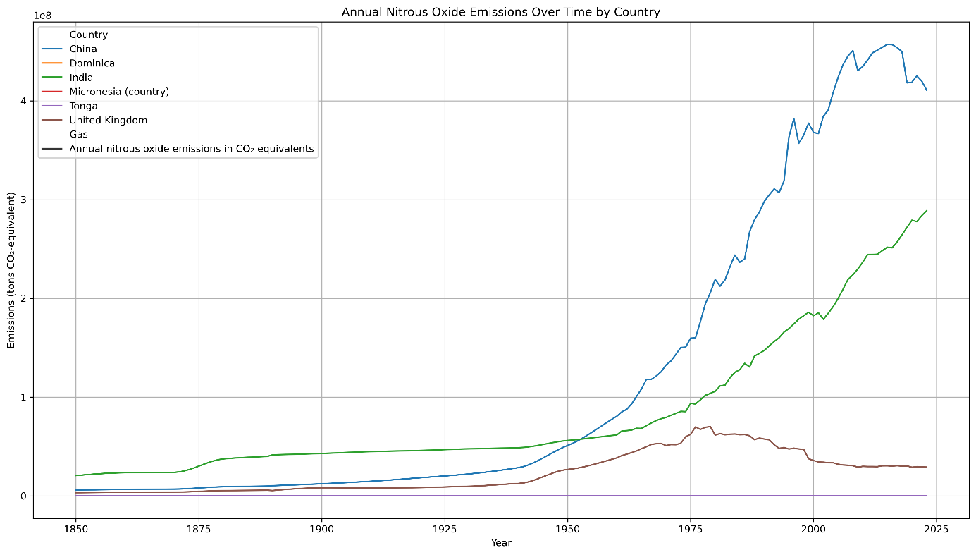
Global Warming: Human Influence Outweighs Natural Causes
Davin V Jobin & Emma Thomas
INTRODUCTION
TEMPERATURE CHANGE ACROSS COUNTRIES
Global warming is one of the most pressing challenges of the 21st century. But is it primarily caused by human activity? This study investigates the connection between human-generated greenhouse gas emissions and temperature changes over time using multi-country datasets including China, India, UK, Tonga, Dominica, and Micronesia. We also evaluate the potential role of natural factors such as volcanic activities.
OBJECTIVES
To examine trends in greenhouse gas (GHG) emissions and temperature over time.
To assess alternative causes such as volcanic activities.
To evaluate disproportionate climate impacts on low-emission countries.
CO₂ EMISSIONS
Figure 4: Annual Temperature Change (1960–2024)
All six countries show warming trends, with sharp rises in China and the UK post-2000. Increases in low-emission nations highlight the global impact. Shaded areas indicate variability.
VOLCANIC AEROSOLS
Figure 1: Annual CO₂ Emissions by Country (1850–2024)
China and India show steep increases in CO₂ emissions since the 1950s, with China now the dominant emitter. This sustained rise parallels industrial growth and aligns with observed global temperature increases, reinforcing the link between human activity and global warming
METHANE EMISSIONS
Figure 5: Global Average Stratospheric Aerosol Optical Depth (1985–2025)
A sharp peak in 1991–1993 marks the Mount Pinatubo eruption, causing temporary global cooling. Since then, SAOD levels remain low, indicating minimal volcanic cooling influence on recent warming trends.
WILDFIRE IMPACTS
Figure 2: Annual Methane Emissions by Country (1850–2024)
Sharp rise in emissions from China and India reflects growing human activity mainly due to agricultural expansion and livestock production which in turn intensifies warming due to methane’s potency.
NITROUS OXIDE EMISSIONS
Figure 6: Annual Area Burnt by Wildfires (2012–2025)
India and China show the largest wildfire impact, with significant spikes in burnt area. These trends suggest increasing fire risk driven by rising temperatures, prolonged dry seasons, and climate-related extremes.
CONCLUSION
All six countries show clear warming trends.
CO₂, methane, and N₂O emissions show strong upward trends since 1950, aligning with rising temperatures.
Natural factors like volcanic aerosols cause only short-term cooling and do not explain long-term warming.
Even low-emission nations are experiencing significant temperature increases.
The evidence strongly supports that global warming is primarily driven by human activity.
REFERENCES
Figure 3: Nitrous Oxide Emissions by Country (1850–2024)
China and India show steep rises post-1970, reflecting industrial and agricultural expansion. Emissions from the UK peaked earlier and have since declined. Nitrous oxide, though less discussed, is a potent greenhouse gas
https://ourworldindata.org/greenhouse-gas-emissions
https://www.fao.org/faostat/en/#data/ET
https://fmi.b2share.csc.fi/records/dfe14351fd8548bcaca3c2956b17f665
https://ourworldindata.org/grapher/annual-area-burnt-by-wildfires

