Slide 1
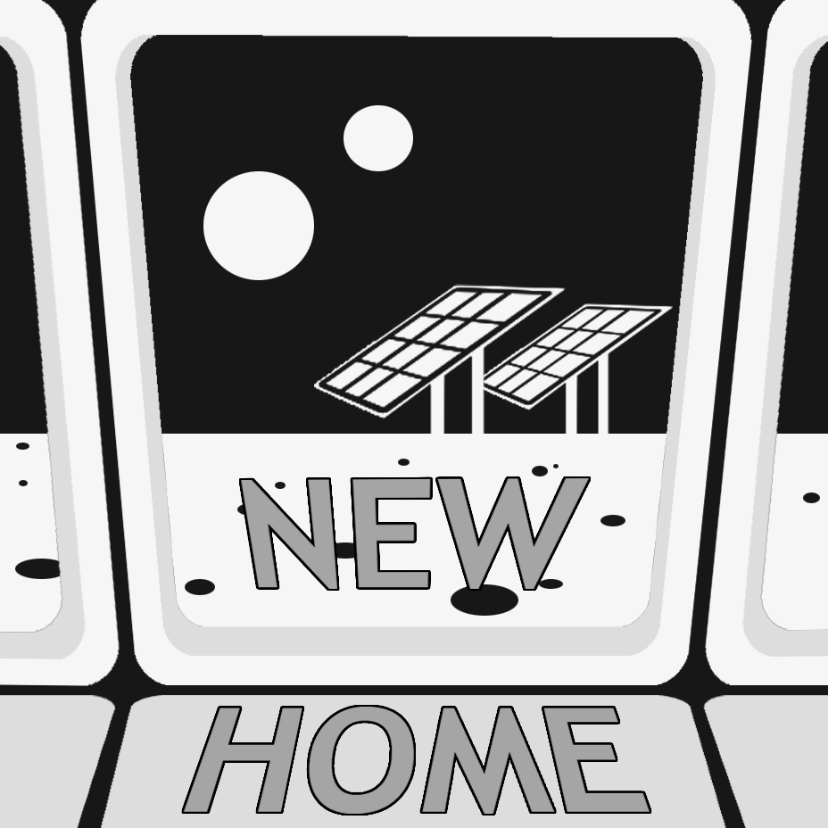
NEW HOME
Space colony simulator

Slide 2

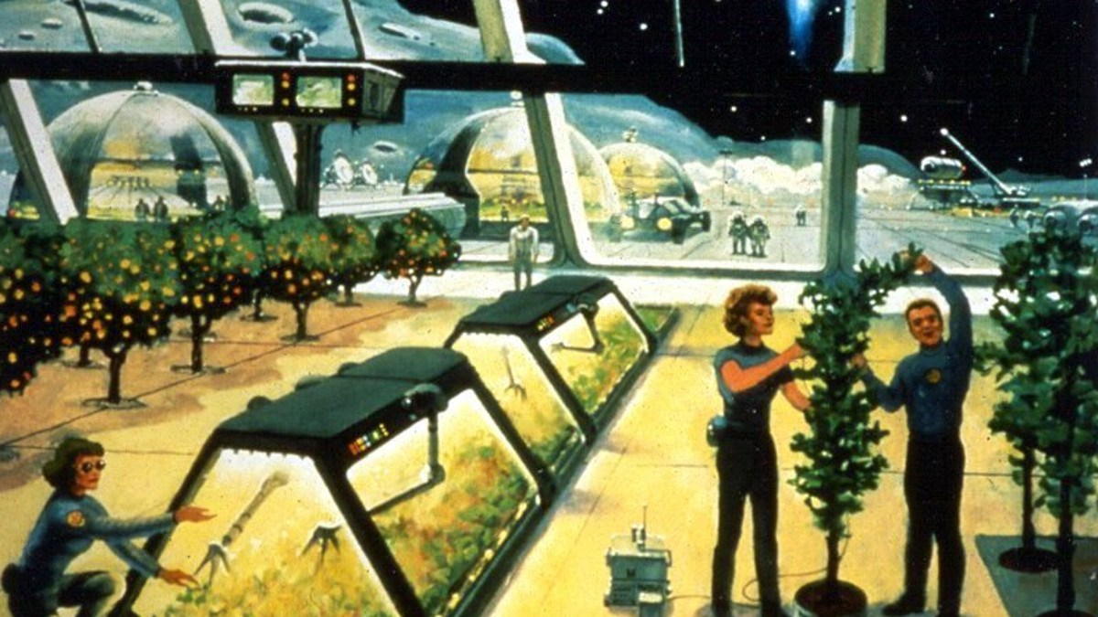
Main idea
We have developed a colony simulator, where you can check if the planet is survivable.

Slide 3

Planet conditions
Length of the day
Gravitation
Water
Сomposition of the atmosphere

Slide 4








Colony Modules
Air
supply
Electricity
supply
Water
supply
Greenhouse
Residential bay
Canteen
Gym

Slide 5
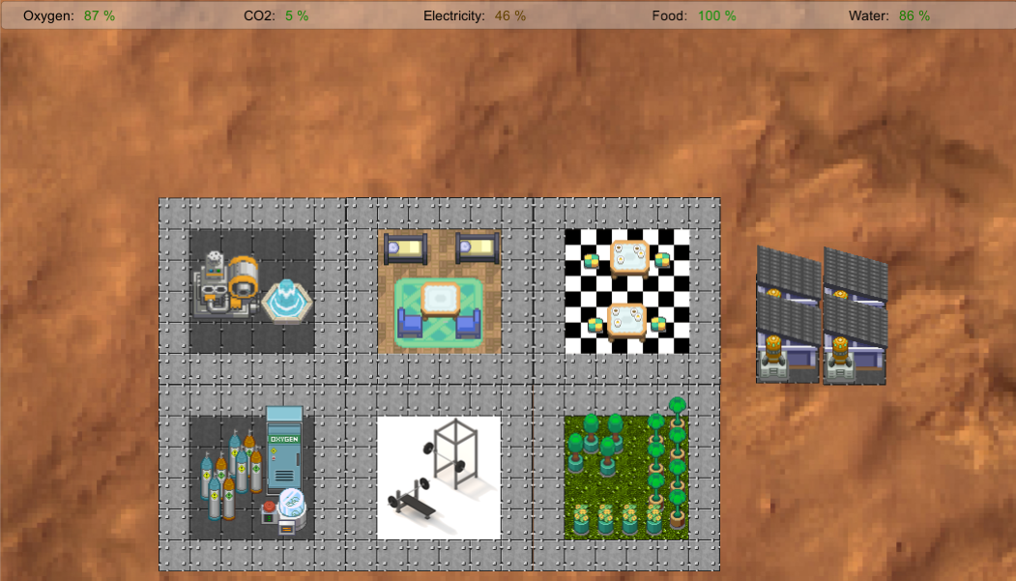
Look and Feel

Slide 6
TimeLine
Idea
Simulation
Release to Play Store
Hackathon
Game prototype
Regular Supplies from Earth
Crew skill system
Dynamic environment

Slide 7




Our team
Taras Lototsky
Developer / Artist
Mike Denisov
Developer
Margo Sadovets
Dmitriy Mina
Designer
Developer

Slide 8
Thank you for your attention!

Slide 9




Appendix 1
Canteen
Water pump
Residential bay
Electricity
Gym
Solar panels
Oxygen Generating System
Water
Food
Cold
Greenhouse
Oxygen
Temperature Control Bay
Nuclear power Generator
Hydrogen
Air
Solid Fuel Oxygen Generator
Pu-238
N+CH4
Heat
CO2
Solid fuel

