Slide 1
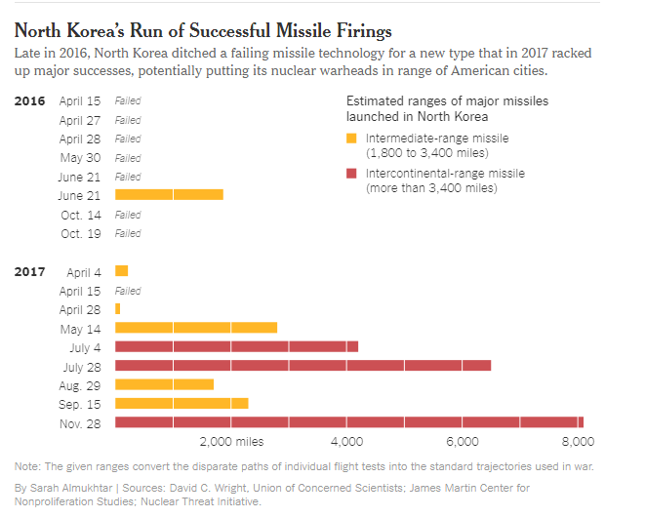

Slide 2


















Slide 3
ISP Data Pipes
NodeJS
NTM+
NTM
COM
DB
MySQL
Cluster
Accumulo
NRO GeoHUB
NGA RLE C2S
Neo4j
PostGre
AWS
Readers
Machine Learners
Modules
LWIP
Geohack
JS-DB
IVA
RandPR Supervisor
MathJS
JS-lab
Flex
OSSIM
CPU
GPU
BitCoin
Atomic
Totem
Engines
GDAL
OpenCV
Caffe
Jade
SMTP
DEBE
Matlab
NLP
Theano
ML-JS
Matlab-JS
RNN
Python
Client
JS
Workflow
Jade
ExtJS
Cesium
NodeRed
SQL
Reveal
Voxel
D3
TauFlow
C
jQuery
Plugins
Etc …
jointJS
MathJax

