Slide 1
ITAR Records as Potential Source for Patterns-of-Life Studies
1 Export - Import Lingo
2 What does “Defense Article” mean ?
3 Information inside an ITAR License
4 Who is barred from ITAR
5 ITAR Licenses - Hard to Counterfeit, Hard to Spoof
6 Intel / GEOINT value in ITAR Licenses

Slide 2
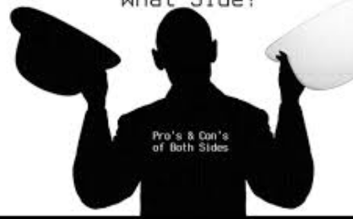


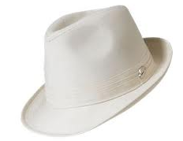
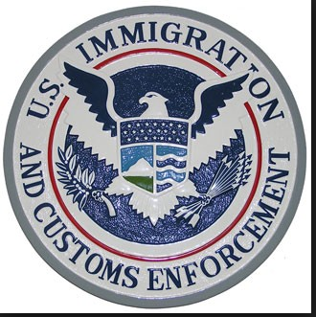


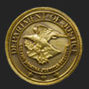
1 Export - Import Lingo
dual citizens
can be either
USP or Not USP
Brokers are barred but must register.
According to DoS their DDTC is the ultimate license adjudicator
Volume:
+ 9 K ITAR pipes service
170 actors in any year
+ 2500 $USD annual reg fee
+ 15 K actors in any year
+ 6 B $ USD yearly salaries
+ 100 persons at DoS DDTC (36 M $USD budget) review
50 K Licenses / YR
+ 100 B $USD / YR def articles in 2009 ( x2 every 5 yrs )
+ US dominate USML sales (50% of global traffic)
$
Defense Article:
Equipment, Service, Specs, Drawings
CLASSIFIED (DSP-85) or UNCLASSIFIED (DSP-5)
License
Export
License
Liability
CO
GC
PM
SE
CO
GC
PM
SE
Import
$
Registered
“US Person”
Registered
“Not US Person”
Broker
Broker / Foreign Agent
DoJ FARA / FCPA compliance
Eg. DMPI, FIG, DLA Piper, Dickens & Madson Canada, Invest Northen Ireland, Japan NTO, Netherlands BTC, Ketchum Inc, ASG

Slide 3
2 Defense Article: Equip, Services, Specs, Drawings
Fire arms Surface Vessel of War Ammo
Ground Vehicle A/C Related Military Training Equip
Personal Protection Military Electronics Fire Ctrl, Laser, Imaging, Guidance
Materials Toxicological Agents Spacecraft
Nuclear Weapons Gas Turbine Engines Submersible Vessels
Missile Tech
USML defined by CFR 122.x
This is the stuff we usually hunt for with photons

Slide 4
3 Info in ITAR License
Defense Article: Equip (PN, SN, $ Value, Qty, USML), Specs, Drawings, Services
Purchase Order, Contract #, Permit, Letter of Intent
POCs: US GOV , Corp Officer, End User
Mailing Addresses: Source, Destination
Financing Terms: FMS, FMF, Grant, Aid, …
Date
Contains everything we
need to reverse engineer a
network
License = Event = Packet = Pixel

Slide 5
4 Who cant play ITAR
Afghanistan Belarus Burma Cen. African Repub
China Cuba Cyprus Dem. Repub. of Congo
Eritrea Haiti Iran Iraq
Kyrgyzstan Lebanon Libya North Korea
Russia Somalia Sudan Syria
Venezuela Zimbabwe
The embargo list changes year-to-year.
Exceptions may apply
Pakistan has been on past embargo lists

Slide 6
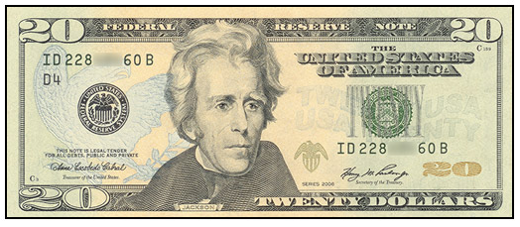
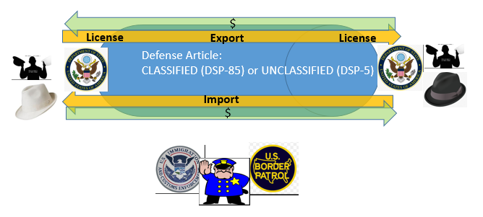
5 ITAR Licenses Hard to Counterfeit / Spoof
Self Policed
- Real money involved
- Thus suspicion on both sides
DoS + BP + ICE + DoJ Policed
Per Infraction Penalties
1M $USD, 10 yrs prison, disbar, loss of job
A license is NOT like social media
A license is NOT like a photon
License provide what two parties wish could remain confidential
… intrinsically “intel”
… intrinsically human activity

Slide 7
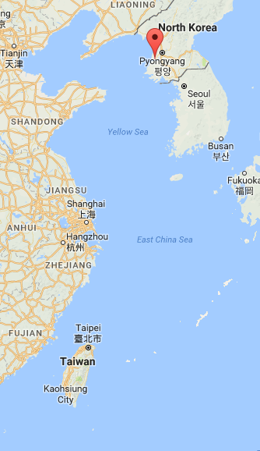
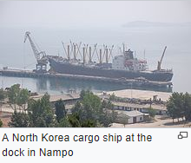
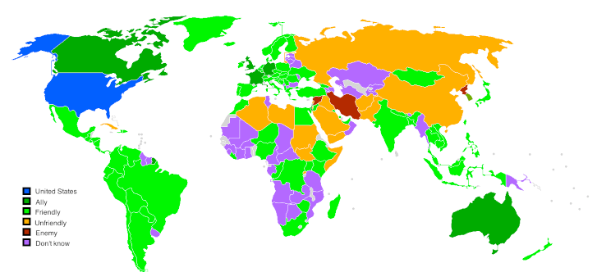
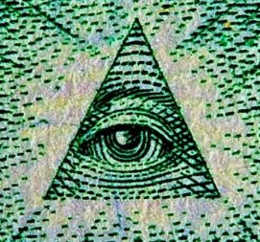
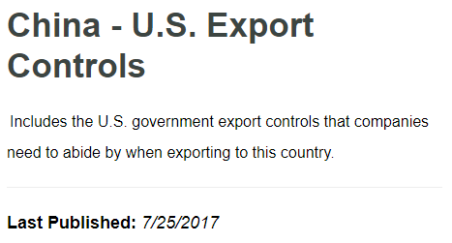
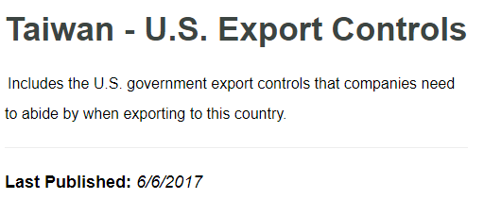

6 Intel value in ITAR Licenses
Boeing
Northrop
Lockheed
Raytheon
ITT
$ 80 B
USD last
5 YRS
BAH
ITAR Channel
Easy to monitor
Hard to spoof
Photon Assets
Hard to allocate
Easy to spoof
As of Feb 2017
Potential R/AA data products:
Flow of Military Budgets, Goods & Services,
Supply Chain Vulnerabilities / OOB , License vs. Actual $,
Predict Ship / Missile Launch based on Stockpiles

Slide 8
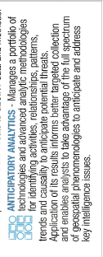

ITAR in R/AA mission ?

Slide 9
ITAR Resources

Slide 10
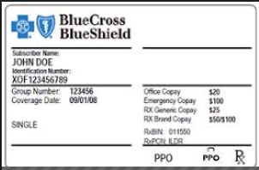

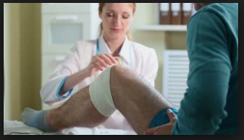
Wiki - Stakeholder
Legal: a third party who temporarily
holds money while its owner is
still being determined.
Corporate: an organization that
affects or can be affected by an
organizations actions.

Slide 11

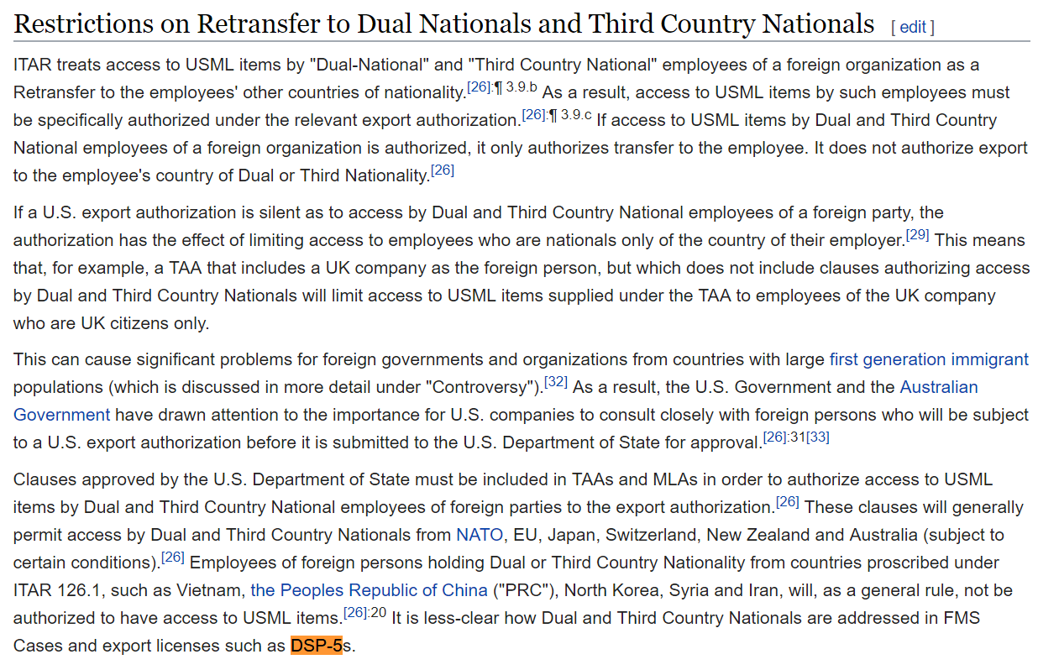

Slide 12

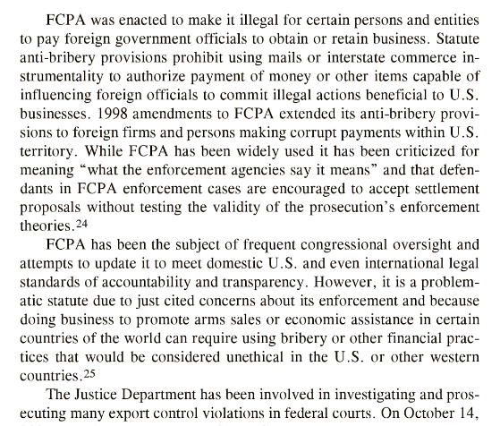
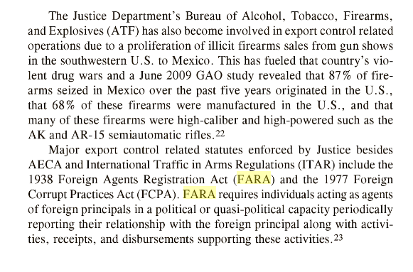

Slide 13

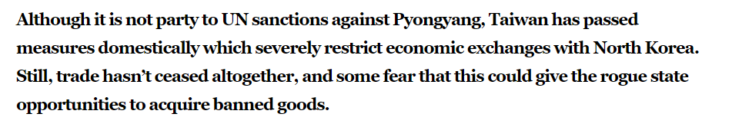
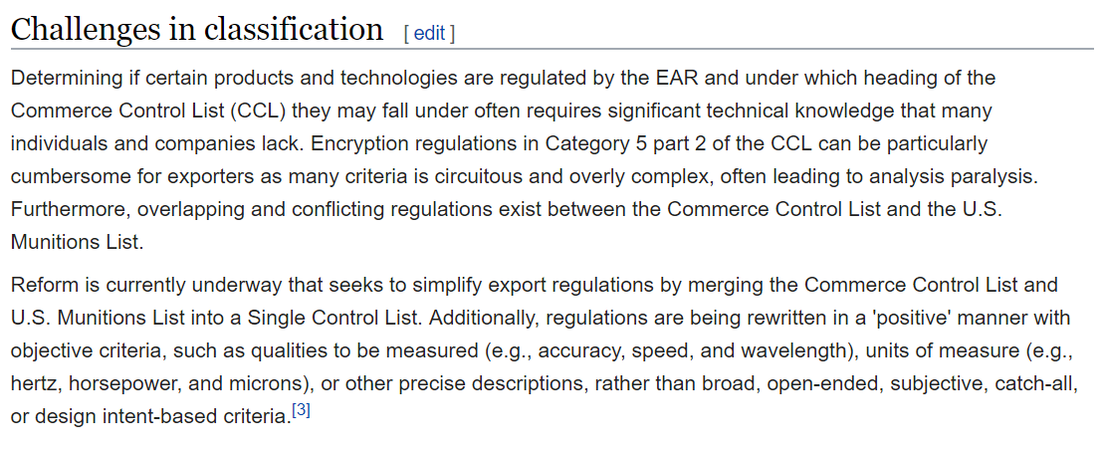
NYT oct-16, ”At Booz Allen, a vast US Spy Operation Run for Private Profit”
“Weapons Industry”, Spring 2009 report, The Industrial College of the Armed Forces,
National Defense Univ, Fort McNair, DC
DoS-DDTC (ComDep-BIS)
responsible for ITAR (EAR) under
AECA/76 and FAA/61 (EAA/79)

Slide 14
