Slide 1
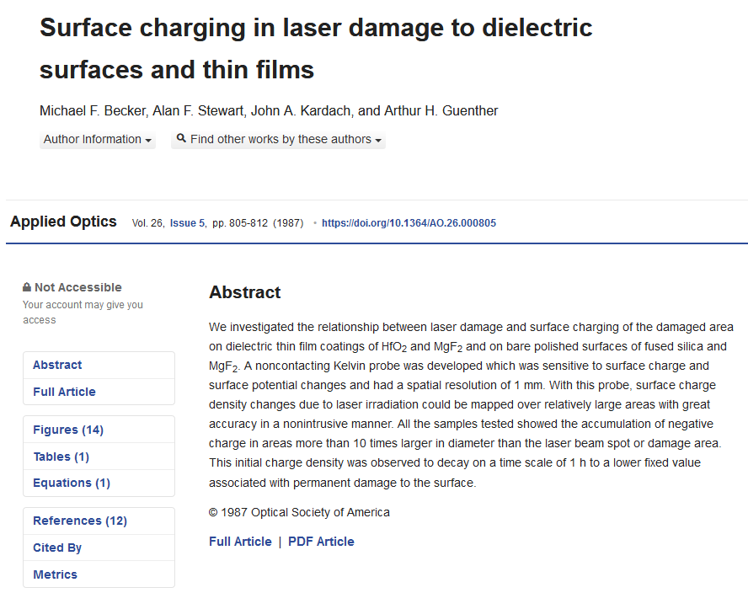

Slide 2
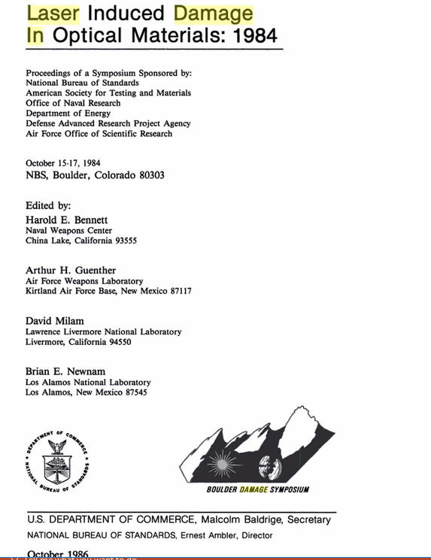

Slide 3
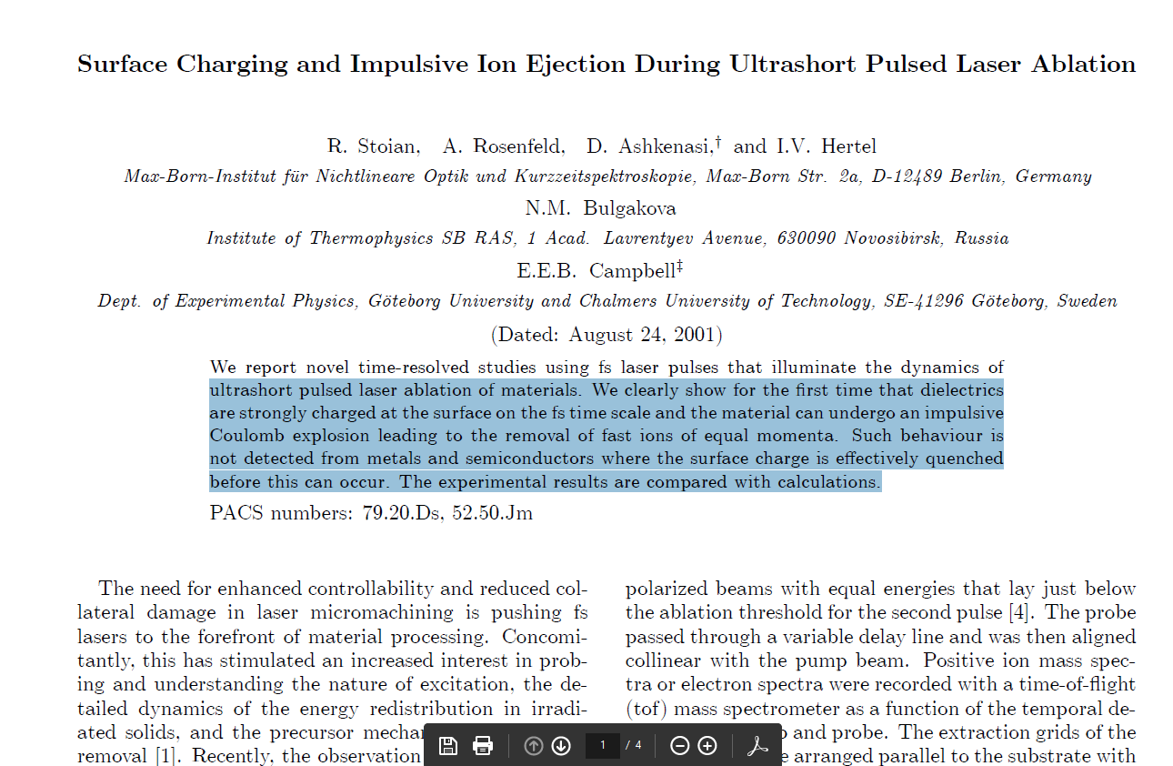

Slide 4


Slide 5
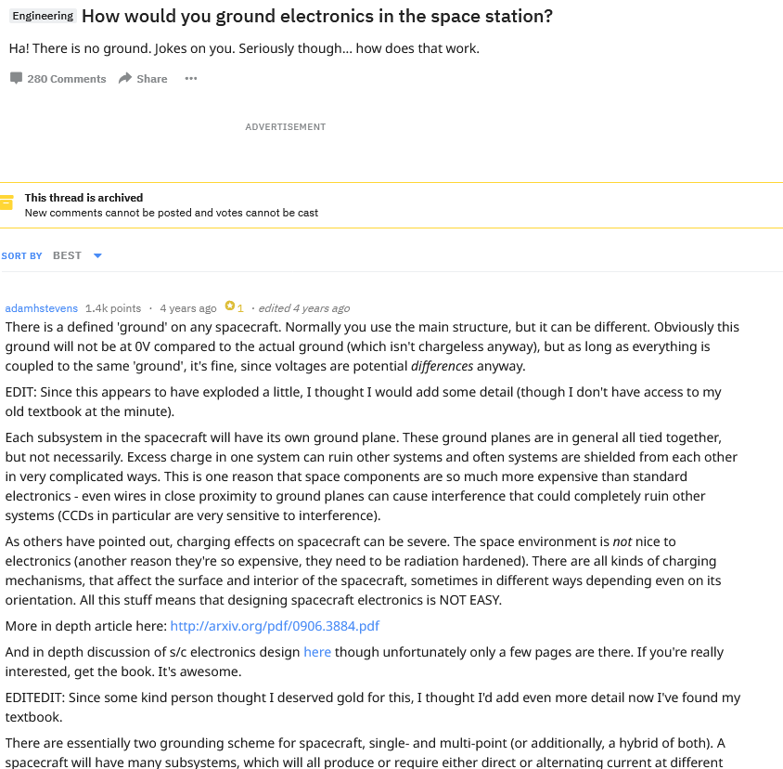

Slide 6
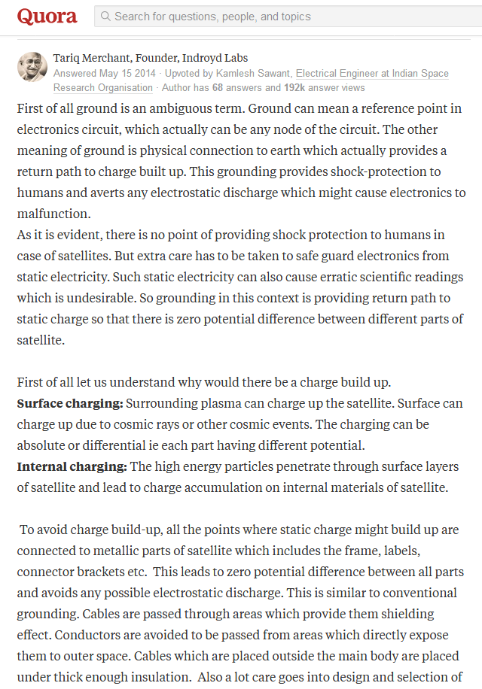

Slide 7
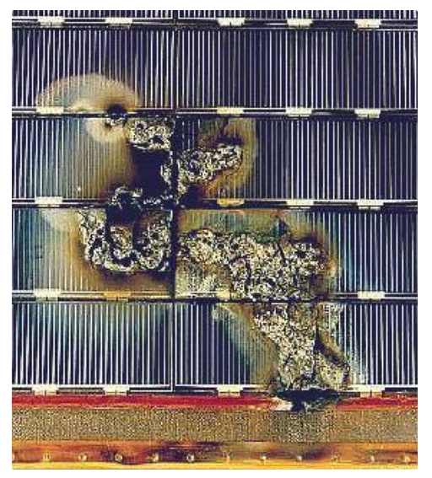
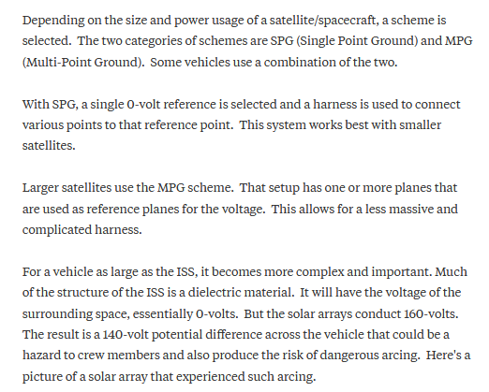

Slide 8
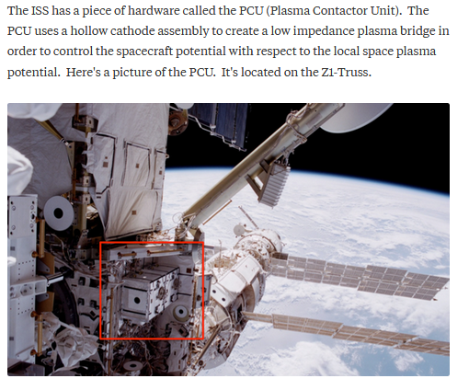

Slide 9
US SATs threatened by USSR ASATs
 | 1983 | 1989 | 2017
Total | 94 | 141 | ?
Threatened | 29 | 24 | ?

Slide 11
ASATs to kill LEO (150-1500 km) Targets
Provider | Technique | Launch ($M cost) | Range (km) | Intercept Time (mins)
Iran | Kinetic | TEL
China | Kinetic | TEL
 | HGV
North Korea | Kinetic | TEL
United States | Kinetic | F15 SM3 ABM (100) | 500 500+ | 5
 | MHV (Kinetic, Laser , Charged Particle) |  |  | Co-orbit?
 | GBL |  |  | 0 ?
Russia | Co-orbit Shrapnel charge (defeats 100 mm armor) |  | 1 – 9 | 90-200 (1-2 orbits)
 | GBL
 | HGV
India | Kinetic
Israel | Kinetic
Pakistan ?

