Slide 1
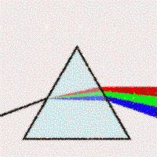



Thresher
transition
logic
unknown to
NGA/R
3000 US gov users
airspace conflate mgr
Flight Aware
Don’t know
Cant predict my airspace
Cant afford flight plan DB
Cant trust my platform info
T&E not allowed
Foe (non US Mil)
Indifferent (commercial)
ADSB ModeS
Proforma
Friend (US Mil)
Thresher
Link16

Slide 2


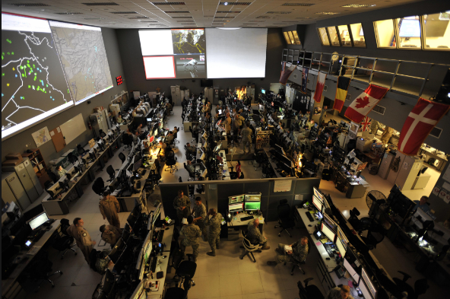





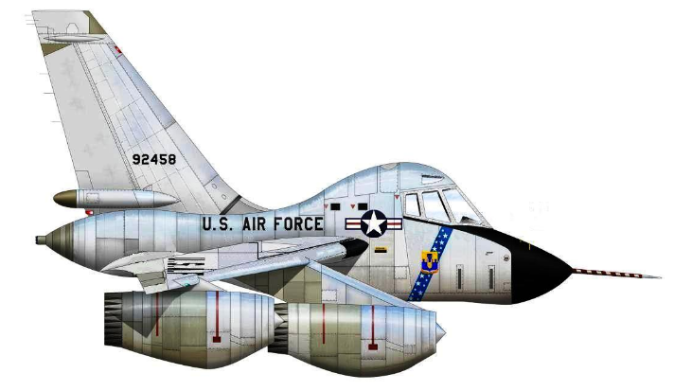

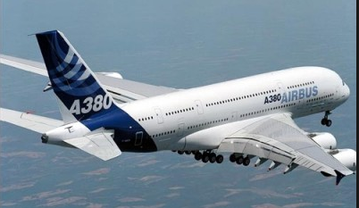
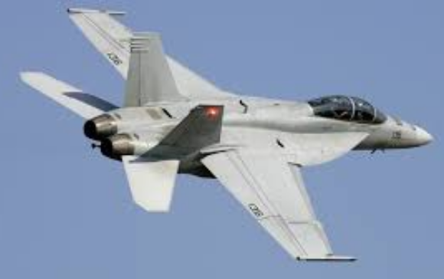


Slide 3
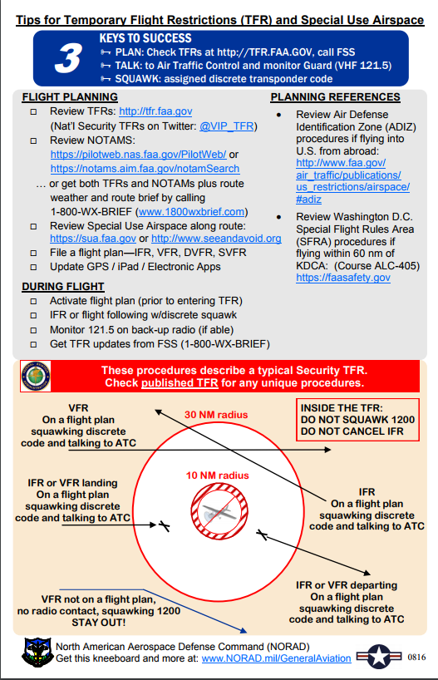
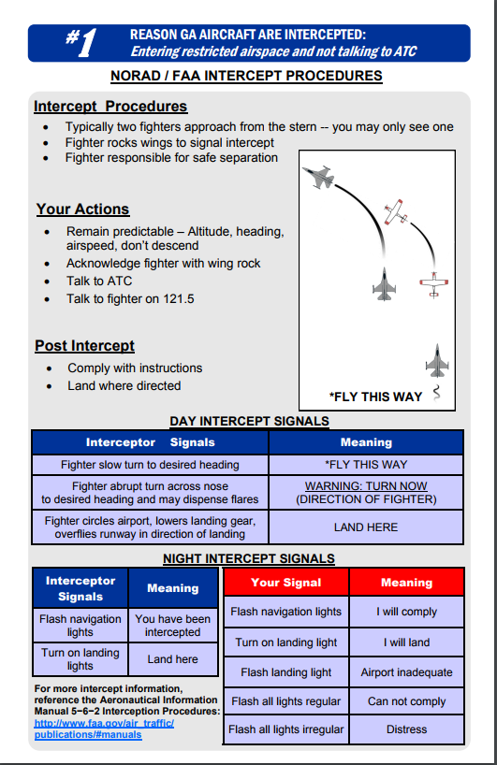

Slide 4





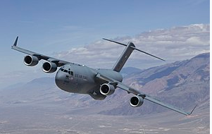

monthly
Flight
Plans
hourly
secs
DUATS (U)
Flightplans
Trajectories
FAA ?
Weather (U)
USAF
14th
Trajectories
Wind Speed
Wind Dir
Air Temp
Flight
Plan
DAFIF (U)
Corridors
NOTAMS
TFR ADIZ
Flightplans
Flight
Plan
Thresher (S)
AFIF (S)
Airport
Logistics
Link16 (S)
Flightaware (U)

Slide 5
monthly
Flight
Plans
hourly
secs
DUATS (U)
Flightplans
Trajectories
FAA ?
Weather (U)
USAF
14th
Trajectories
Wind Speed
Wind Dir
Air Temp
Flight
Plan
DAFIF (U)
Corridors
NOTAMS
TFR ADIZ
Flight
Plan
Thresher (S)
Flightplans
AFIF (S)
Airport
Logistics
Link16 (S)
Flightaware (U)

Slide 6
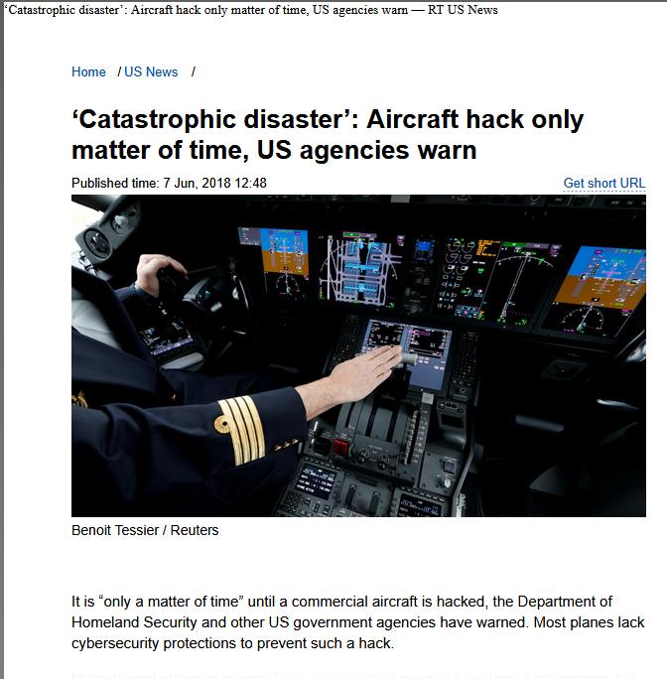
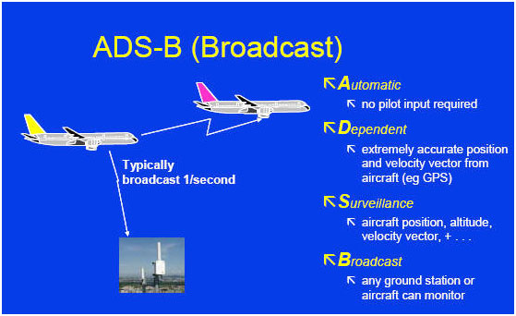

Slide 7
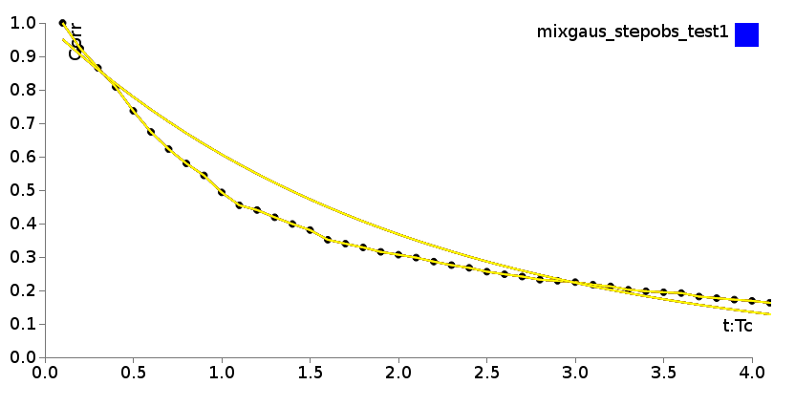

Slide 8


