Slide 1
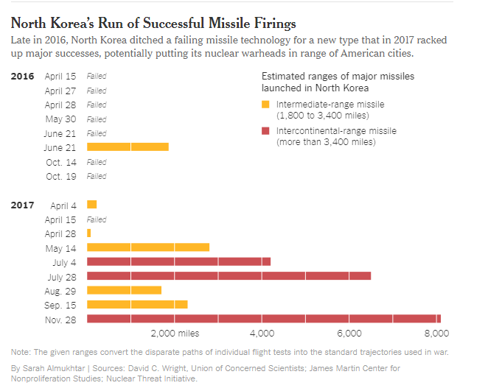

Slide 2


















Slide 3
ISP Data Pipes
NodeJS
NTM+
NTM
COM
DB
MySQL
Cluster
Accumulo
NRO GeoHUB
NGA RLE C2S
Neo4j
PostGre
AWS
Readers
Machine Learners
Modules
LWIP
Geohack
jsDB
IVA
RandPR Supervisor
MathJS
jsLAB
Flex
OSSIM
CPU
GPU
BitCoin
Atomic
Totem
Engines
GDAL
OpenCV
Caffe
Jade
SMTP
DEBE
Matlab
NLP
Theano
SocketIO
ML-JS
Matlab-JS
RNN
Python
JS
Client
Workflow
Jade
ExtJS
Cesium
NodeRed
SQL
Reveal
Voxel
TauFlow
C
jQuery
D3
Plugins
Etc …
jointJS
MathJax

