Slide 1



Slide 2
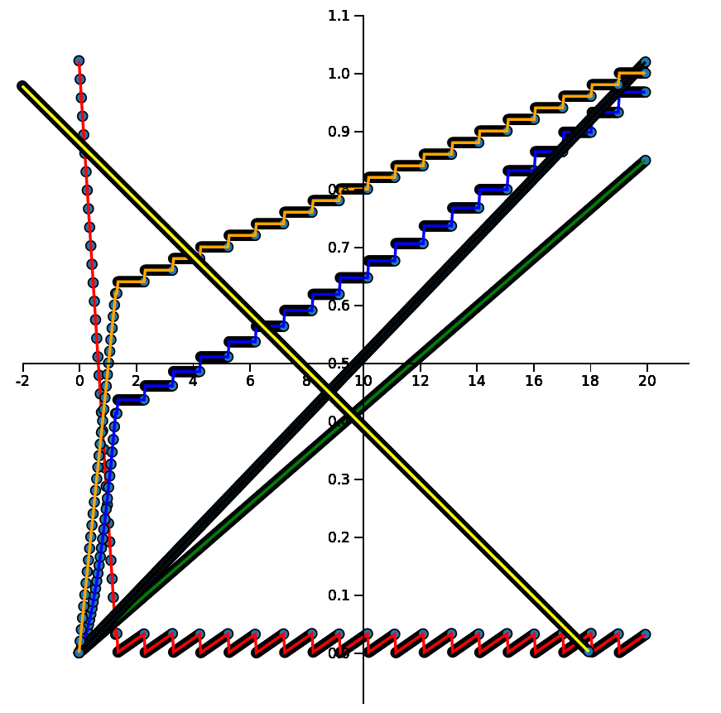
Assumptions:
R/East supplies NLP engines
2019 dollars
2 FTEs in-sourced
5.1 K docs/yr constant
10 dockerized VMs
10% of docs labelled
“gas” cost = 90 x cost to build and run the “engine”
Learning
Potential
60 cycles
DOC ACQ
51 M $
Initial
Backlog
153 K docs
VM 150 $
NRE
440 K $
Labelling
130 K $
years
5K BATCH
research
operation

