Slide 2
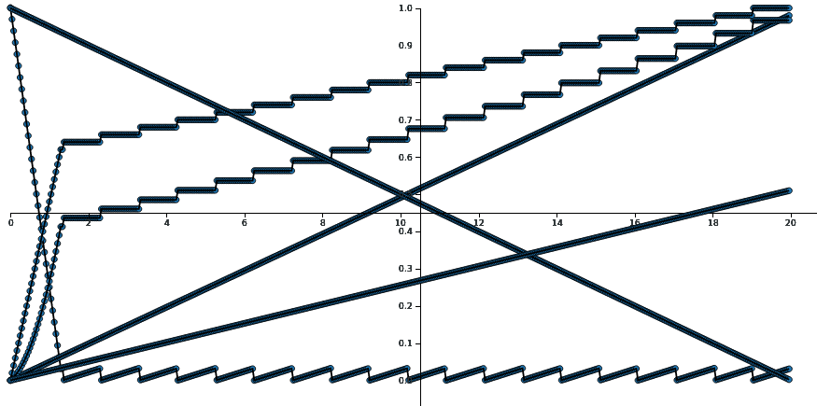
Assumptions:
R/East supplies NLP engines
2019 dollars
NRE 2 FTEs in-sourced
5.1 K docs/yr
Dockerized Vms
10% of docs labelled
Learning
Potential
60 cycles
VM 150 $
Initial
Queue
Depth
153 K
NRE
400 K$
Labelling
130 K$
DOC ACQ
51 M$
-2
years
5K BATCH
research
operation

