Slide 1
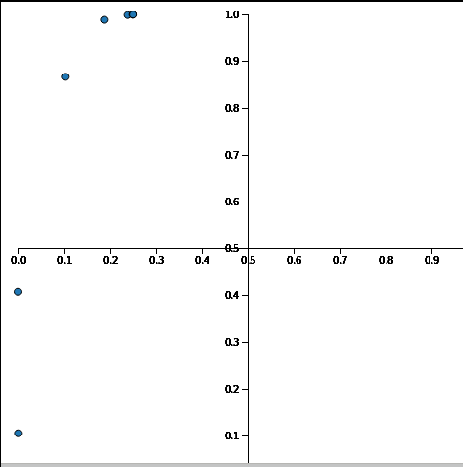
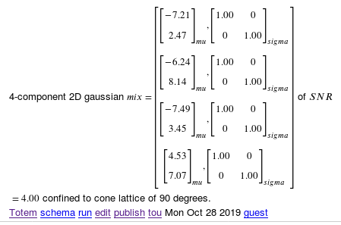
Snr=4 cone=90 gain=1 (Dim=2 mix=4)

Slide 2
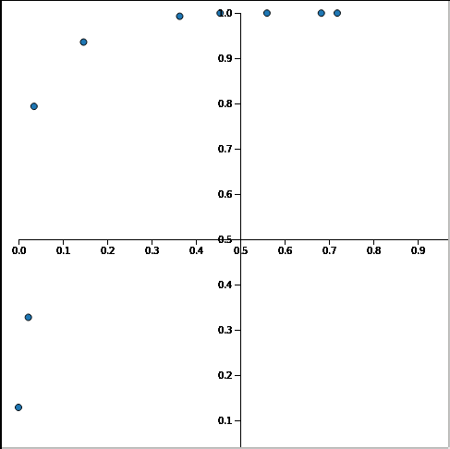
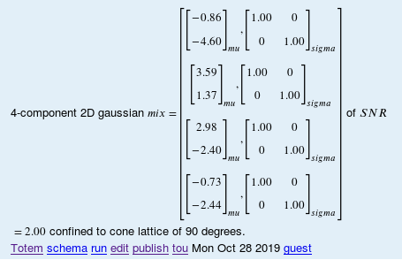
Snr=2 cone=90 gain=1 (Dim=2 mix=4)

Slide 3
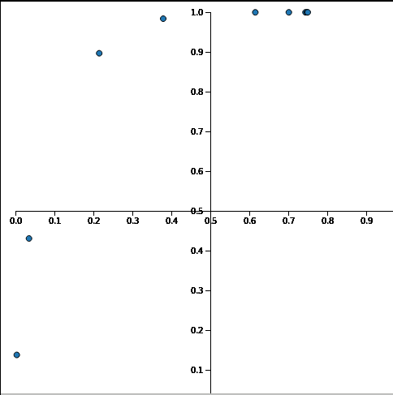
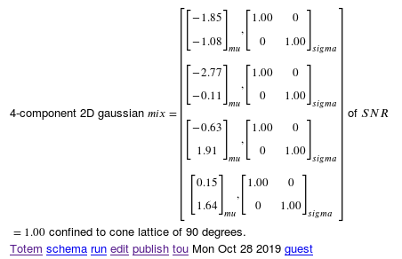
Snr=1 cone=90 mix=4 (Dim=2 gain=1)

Slide 4
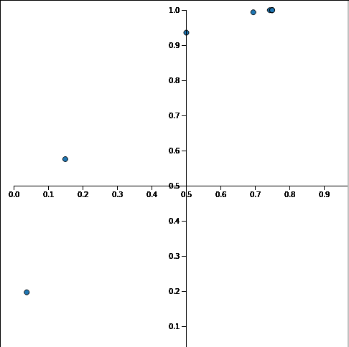

Snr=0.5 cone=90 mix=4 (Dim=2 gain=1)

Slide 5
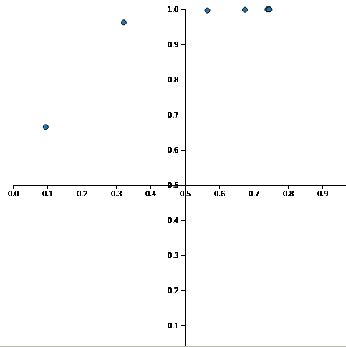
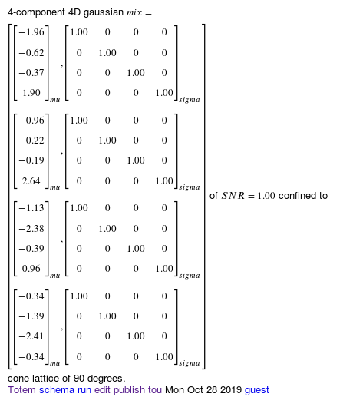
Snr=1 cone=90 gain=2 (Dim=4 mix=4 )

Slide 6
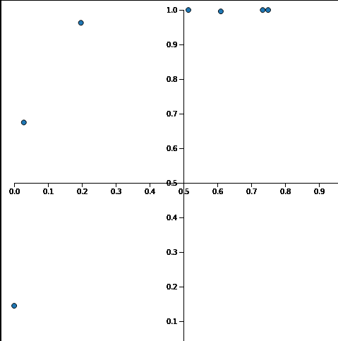
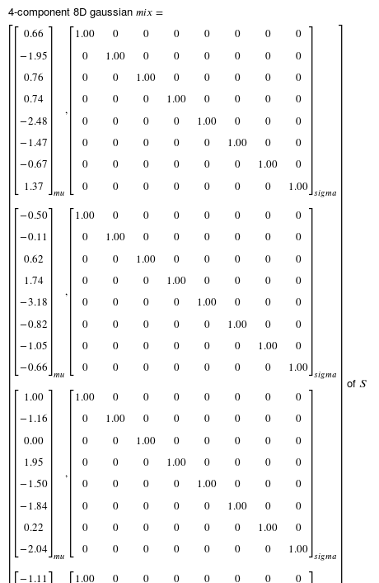
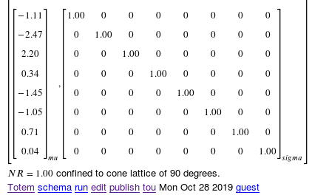
Snr=1 cone=90 gain=4 (Dim=8 mix=4 )

Slide 7
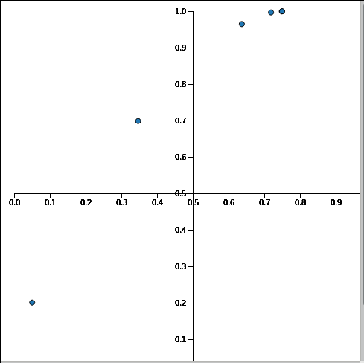
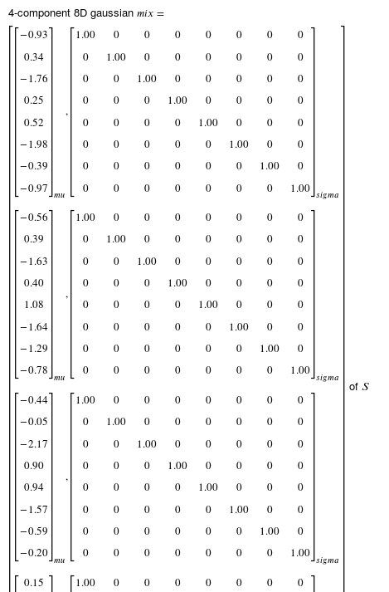
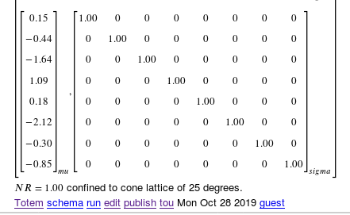
Snr=1 cone=25 gain=4 (Dim=8 mix=4 )

Slide 8
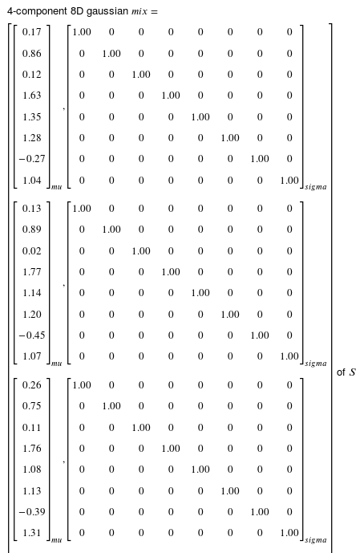
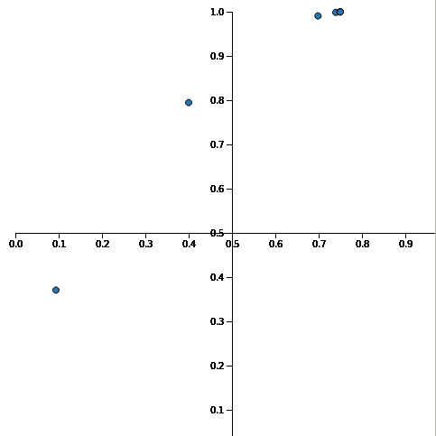
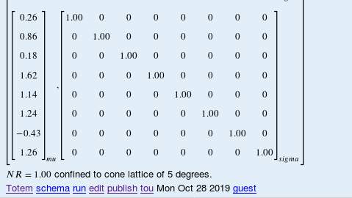
Snr=1 cone=5 gain=4 (Dim=8 mix=4 )

Slide 9
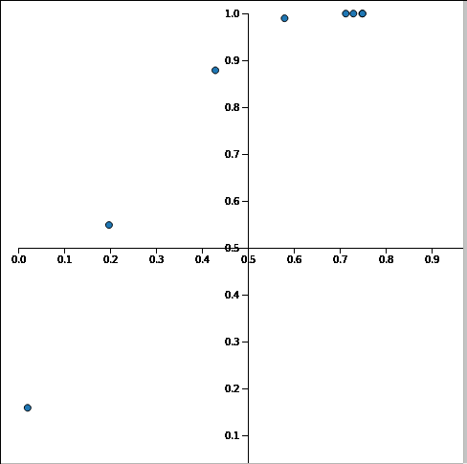
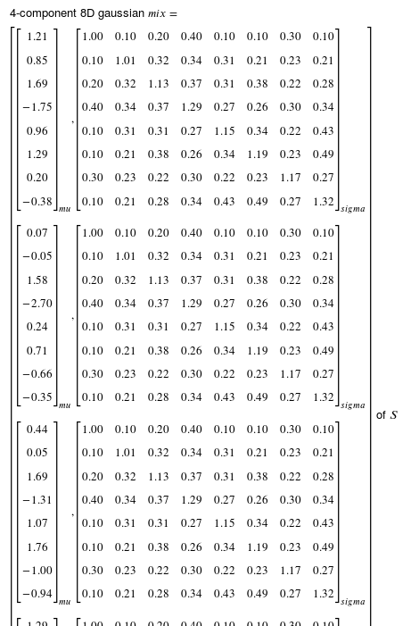
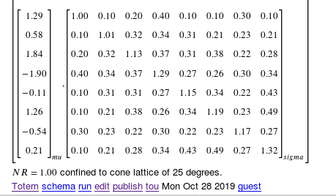
Snr=1 cone=25 gain=4 (Dim=8 mix=4 ) ellipsoids

