Slide 1
Killing A.
Alice:
Ingested 20 M reports produced by NES data provider over last 40 years
so 500 K reports / year
so 125 hyper-analyst / year to process ( $ 1.2 M / year )
vs. Alice 2000 AWS cores = $ 400 K / year
This briefing …. Lessons Learned

Slide 2
So What killed A. ?
Hint: Same thing that kills all our services.
But … what didn’t kill A. ?
A: its wasn’t its Stanford NER ...

Slide 3
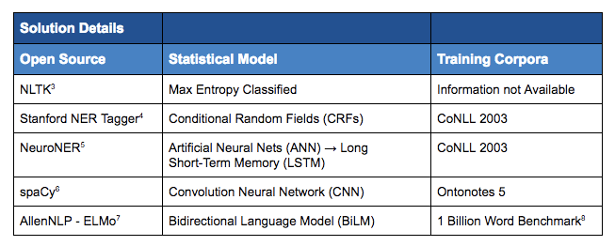

Some NER hammers ...
novetta.com

Slide 4
Other Stanford NER hammers
Apache ………………………………………….. Tika
JS ………………... ner-server, ner, stanford-ner
.NET/F#/C# ……………….... from java via IKVM
Perl
PHP
Python …………………..… pyner, NLTK, scrapy
Ruby
UIMA
according to stanford
nlp.stanford.edu/software/CRF-NER.html

Slide 5

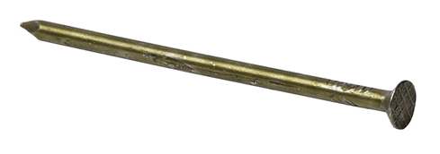
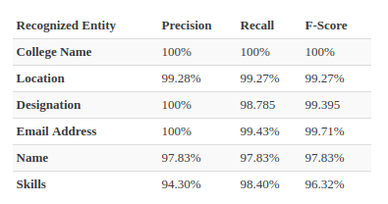
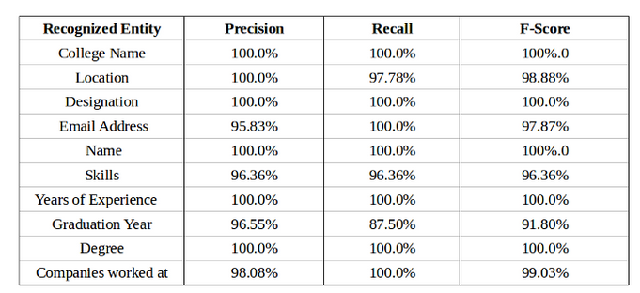
SpaCy vs. Stanford NER Resumes
spaCy
towardsdatascience.com
Training/test sets: 200 / 20
Stanford
Surprise !!!
NLP packages are about the same … only the quality of training matters.
i.e. given enough parameters all you need is data.

Slide 6
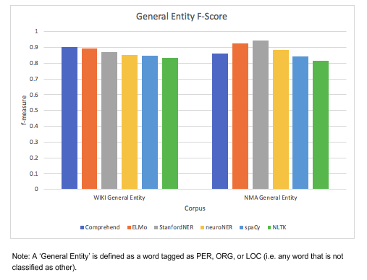
Comprehend, ELMo, Stanford, Neuro, NLTK NMA News
novetta.com

Slide 7
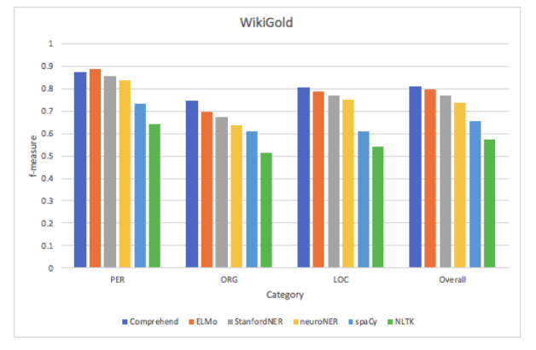
Comprehend, ELMo, Stanford, Neuro, NLTK NMA News by Person, Org, Location
novetta.com

Slide 8
So … what killed A. ?
A: the approved s/w stack
And ...

Slide 9
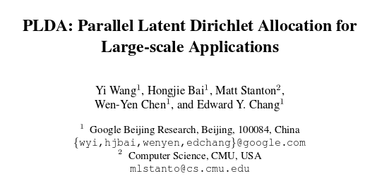


… and some complicating factors
Billion node graph: doc → facility → country → org → … etc grows fast!
Reliance of non-parallel-ized LDA. Q: why LDA when its NER already
classifies “intent” = “topic” ? A: their Stanford NER may not include.
China just released a number of parallel-ized LDAs

Slide 10
Some A. vitales
2000 cores
$ 400 K / Yr AWS or Mesos (vs $ 1.2M/Yr Hyper-analyst)
2 GOV 3 CTR
Ingested
+ 20M NES reports since 1980
+ MIDB reports
+ OPIR events
→ 1B nodes

Slide 11
GPU notes for CNN/CRF NLPs
GPU is not faster than a CPU. In fact, it’s about an order of magnitude slower. However, you get about 3000 cores. But these cores are not able to act independently, so they essentially all have to do the same calculations in lock step. Additionally, there is a data transfer cost. This means that, if you want to do 3000 of the same simple calculation all at the same time, GPUs are great, otherwise they are awful. It turns out that linear algebra does exactly the kinds of operations that are highly GPU parallel, so matrix multiplication is pretty much the canonical use case for GPUs. Broadcasted operations are another use case, but only if what’s broadcasted is “sufficiently expensive”. Usually it’s this domain where you see the whopping 150x speedups by custom writing a kernel for some mathematical problem and calling it on 3000 parameters at a time. Matrix multiply can do well, but it has a heavy data transfer cost that can offset a lot of the benefits if the matrix is only multiplied once. If you store things on the GPU and keep re-using them in subsequent operations in some iterative algorithm, you will see more of a benefit.
Note that GPUs typically are very slow at 64-bit floating point operations but much faster at 32-bit floating point operations, so you should try to use fp32 on most GPUs (other than the Tesla line, but even then fp32 is still faster).

Slide 12
Promised GPU / CPU efficiency ~ 5x = = 150/30 (1.5K/10 cores vs 300/10 W)
https://support.prodi.gy/t/will-a-gpu-make-training-faster/187/3
A brief background here: I think a lot of folks have a slightly misleading perception of the relative speed of CPU and GPU for deep learning for NLP. In computer vision, common CNN architectures are vastly more efficient on GPU. This doesn’t really apply in NLP. We still use CNNs, but the shape of our operations is very very different. It’s actually not so easy to beat good CPU code. The part that’s tricky is that CPU training is very much an unloved child for most deep learning frameworks. For instance, early versions of Tensorflow were usually installed without linkage to a decent BLAS library. This made the CPU usage about 20x slower than it should have been.
All that said, here’s what you need to do to train Prodigy models with GPU.
Make sure Thinc is installed with GPU linkage, as described here: https://spacy.io/usage/#gpu . You should be able to do import cupy, and you should also be able to do import thinc.neural.gpu_ops.
Try using the spacy train command with the -g 0 argument, and check that your GPU is actually being used. I use the nvidia-smi command for this.
Modify your Prodigy recipe so that the GPU is used. For instance, if you want to use the GPU in the ner.batch-train recipe, pass use_device=0 to the nlp.begin_training() function.

