Slide 1



Slide 2
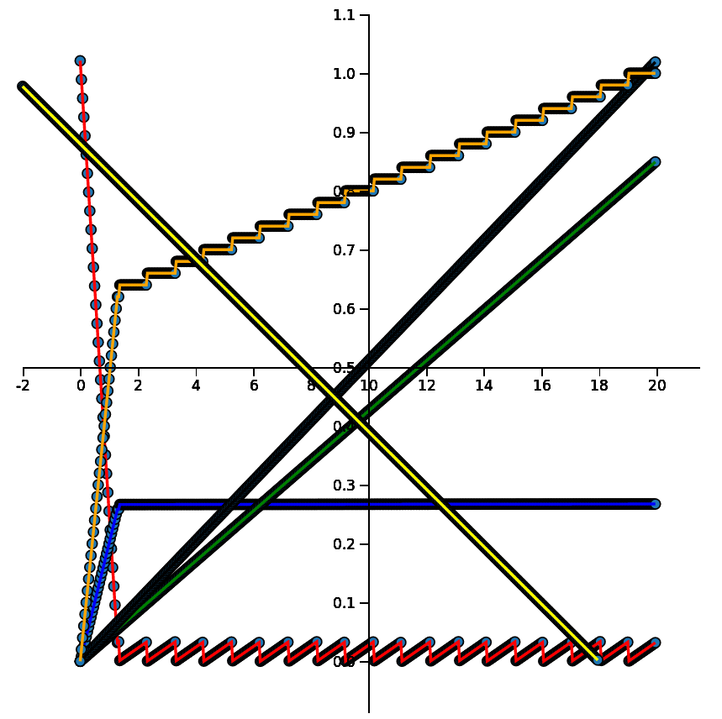
Assumptions:
R/East supplies NLP engines
2019 dollars
2 FTEs in-sourced
5.1 K docs/yr constant
10 dockerized VMs in oper
4 VMs at 100% in research
10% of docs labelled
gas cost =
85 x cost to build and run the engine
Learning
Potential
60 cycles
DOC ACQ
51 M $
Initial
Backlog
153 K docs
NRE
440 K $
Labelling
130 K $
years
VM 27 K $
5K BATCH
research
operation

Slide 3

