Slide 1










① Data Processing
③ Model Training and Performance Collecting
④ Heuristic Method
Sliding Window
Training
Log
Calculate ${Acc}_{inc}$
Accuracy
$${Acc}_{inc}$$
Category | Metric | Value
Accuracy | AUC ROC | …
 | AUC PR | …
Time | Training time | …
 | Data processing time | …
Scaling laws
Origin Training Set
Test Set
$$n_{sw_{i−2}}$$
$$n_{sw_{i−1}}$$
$$n_{sw_{i}}$$
······
Number of sliding windows
Stop Threshold $α$
Sample Size $n_{sw}$
No
Sampling Training Set
Test Set
${Acc}_{inc}<α$?
Yes
UTS-AD Methods
Best Output
Sampling Methods
LOF
AE
CNN
HBOS
$$W_{D}^{∗}$$
Latin Hypercube Sampling
Simple Random Sampling
Distance Sampling
DAGMM
LSTM-AD
······
$$A^{∗}$$
② Data Sampling
Increase Sample Size

Slide 2



① Data Processing
③ Model Training and Performance Collecting
④ Heuristic Method
Sliding Window
Training
Log
Calculate ${acc}_{inc}$
Model Accuracy
$${Acc}_{inc}$$
Category | Metric | Value
Accuracy | AUC | …
 | Precision | …
Time | Training time | …
 | Data processing time | …
Scaling laws
Origin Training Set
Test Set
$$n_{i−2}$$
$$n_{i−1}$$
$$n_{i}$$
······
Sample Size
Stop Threshold $α$
Sample Size $n_{sw}$
No
Sampling Training Set
Test Set
${acc}_{inc}<α$?
Yes
UTS-AD Methods
Best Output
Sampling Methods
LOF
AE
CNN
HBOS
$$W_{D}^{∗}$$
Latin Hypercube Sampling
Simple Random Sampling
Distance Sampling
DAGMM
LSTM-AD
······
$$A^{∗}$$
② Data Sampling
Increase Sample Size

Slide 3

③ Model Training and Performance Collecting
① Data Processing
④ Heuristic Method
Sliding Window
Training
Log
Calculate $p_{inc}$
Model Accuracy
$$p_{inc}$$
Category | Metric | Value
Accuracy | AUC | …
 | Precision | …
Time | Training time | …
 | Data processing time | …
Origin Training Set
Test Set
$$s_{i−2}$$
$$s_{i−1}$$
$$s_{i}$$
······
Sample Size
Stop Threshold $α$
Sample Size S_{i}
Sampling Training Set
Test Set
$p_{inc}<α$?
No
Yes
UTS-AD Models
Best Output
Sampling Methods
RF
AE
OC-SVM
HBOS
Sample Size $s_{i}$
Latin hypercube sampling
simple random sampling
distance sampling
COCA
DAGMM
······
UTS-AD Model $M_{i}$
② Data Sampling
Increase Sample Size $s_{i+1}$

Slide 4
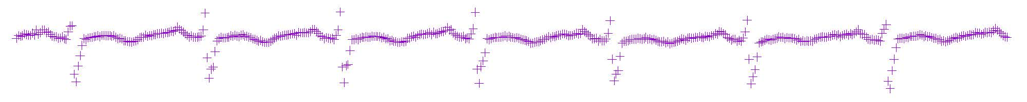
③ Model Training and Performance Collecting
① Data Processing
④ Heuristic Method
Sliding Window
Training
Log
Calculate $p_{inc}$
Model Accuracy
$$p_{inc}$$
Category | Metric | Value
Accuracy | AUC | …
 | Precision | …
Time | Training time | …
 | Data processing time | …
Origin Training Set
Test Set
$$s_{i−2}$$
$$s_{i−1}$$
$$s_{i}$$
······
Sample Size
Stop Threshold $α$
Sample Size S_{i}
Sampling Training Set
Test Set
$p_{inc}<α$?
No
Yes
UTS-AD Models
Best Output
Sampling Methods
RF
AE
OC-SVM
HBOS
Sample Size $s_{i}$
Latin hypercube sampling
simple random sampling
distance sampling
COCA
DAGMM
······
UTS-AD Model $M_{i}$
② Data Sampling
Increase Sample Size $s_{i+1}$

Slide 5
单变量时间序列异常检测5折交叉验证演示
第1折
训练集
测试集
第2折
训练集
测试集
训练集
第3折
训练集
测试集
训练集
...
......
第5折
Notes:
五折交叉验证

Slide 6
变量时间序列异常检测滑动窗口的生成
步长
......
窗口大小
Notes:
五折交叉验证

Slide 7


$$x$$
$$x′$$
$$z$$
Encoder
$$f$$
Decoder
$$g$$
Notes:
VAE

Slide 8


$$x$$
$$x′$$
$$f$$
$$μ$$
Z
X
Encoder
$$f$$
$$z$$
Decoder
$$g$$
$$g$$
$$σ$$
+
N
X
$$ε$$
Notes:
AE

Slide 9
Compression Network
$$z_{r}$$
$$x$$
$$x′$$
Estimation Network
Encoder
$$f$$
$$z_{c}$$
Decoder
$$g$$
$$z$$
$$h$$
$$\hat{π}$$
Notes:
AE

Slide 10
Input Layer
LSTM/Sigmoid Layer
LSTM/Sigmoid Layer
Output Layer

Slide 11
$$x$$
Conv1
Max Polling
Conv2
Max Polling
Dense Layer
Output

Slide 12
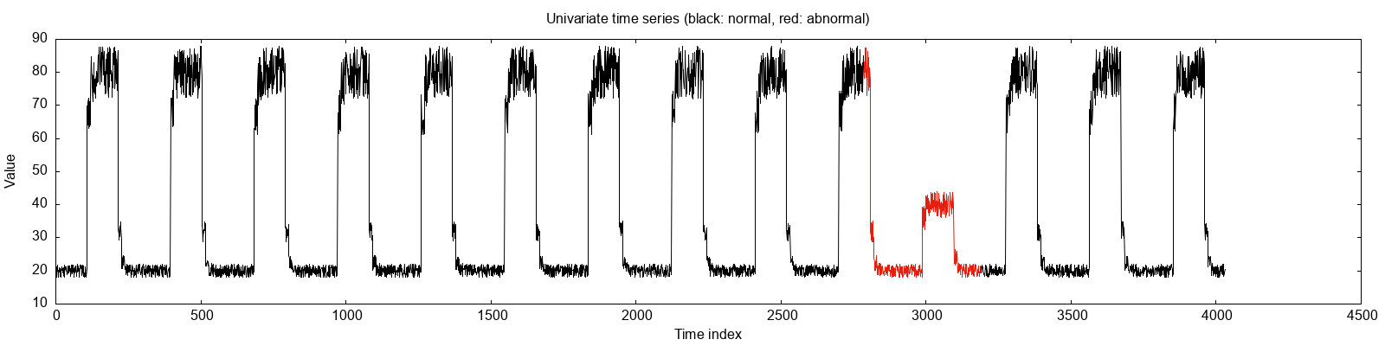
解释：“一个窗口"得到的模型精度与“全量窗口”得到的模型精度可能相等
①原始单变量时间序列数据(UTS)
②将UTS转为滑动窗口（子序列）
一个窗口
......
窗口大小
步长
③在 滑动窗口 中抽取 部分窗口 训练模型
在UTS规律的情况下，抽取到的第一个窗口已经能够代表整个UTS正常的模式了。因此对于半监督和非监督算法来说，一个窗口得到的算法精度，也可能和全部窗口得到的算法精度相等。
刚好抽到第一个窗口
算法LOF
训练
这个窗口刚好可以代表这个UTS中的正常模式

Slide 13
① Original univariate time series (UTS)
② The sliding windows of the UTS
......
③ Sampled sliding window(s)
④ Model Training
AE
LOF
VAE
HBOS
OC-SVM
DAGMM
······

Slide 14
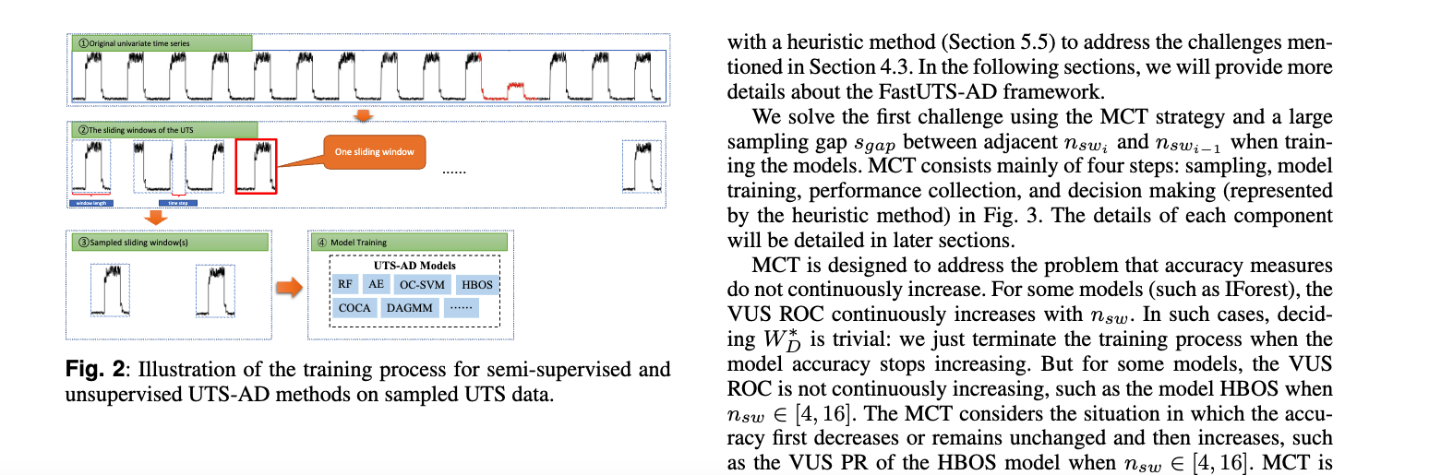
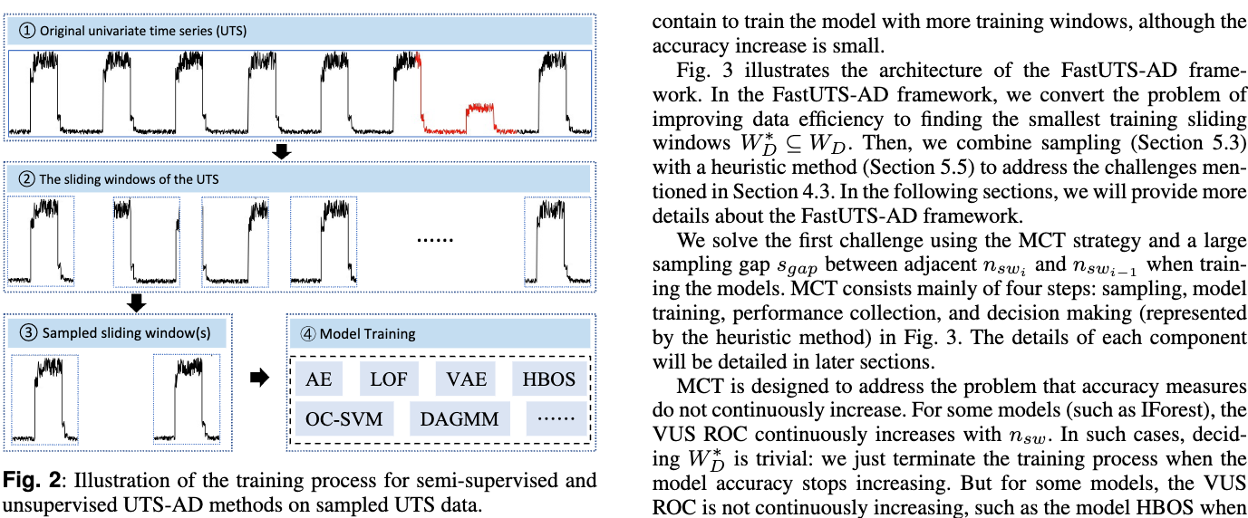
论文图2优化前后
修改前
修改后

Slide 15
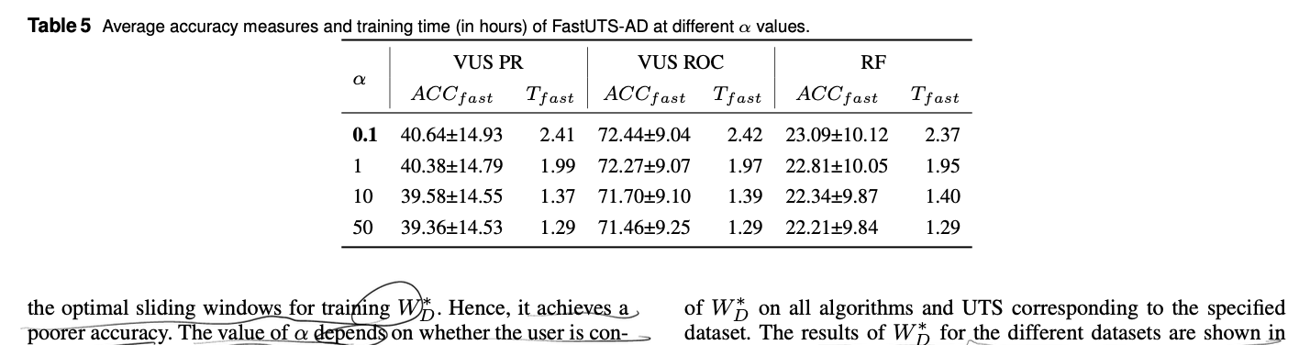
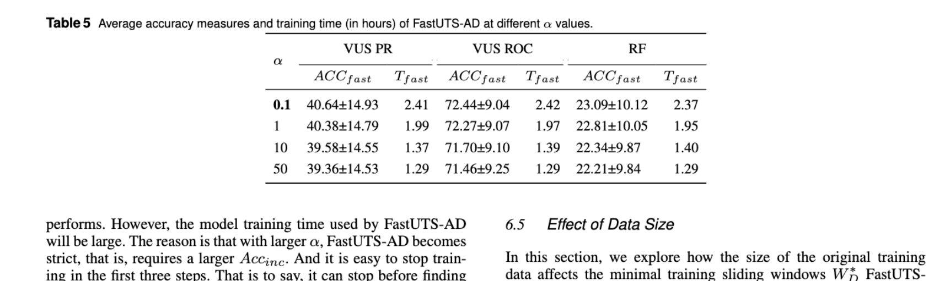
论文表5优化前后
修改前
修改后

Slide 16
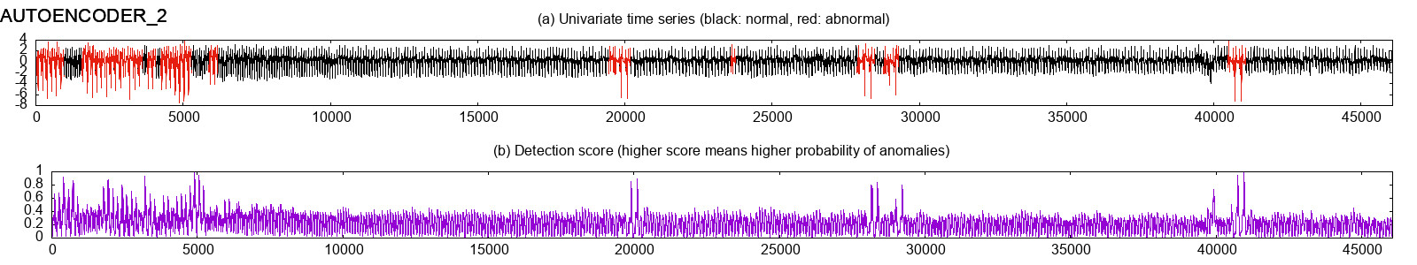
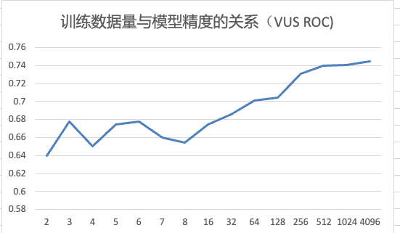
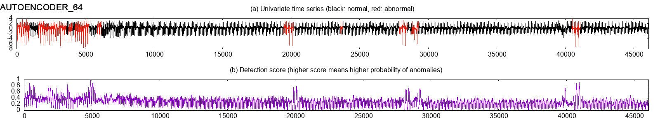
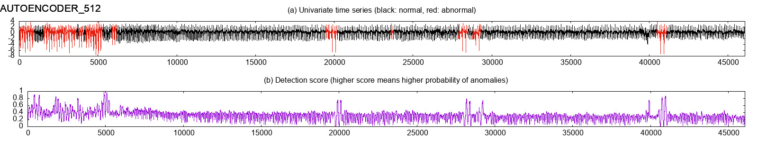
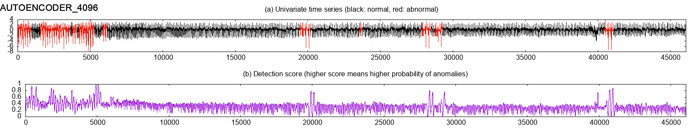
算法AutoEncoder在2个窗口、64个窗口、512个窗口、4096个窗口 score 对比
2个滑动窗口
4096个滑动窗口

Slide 17
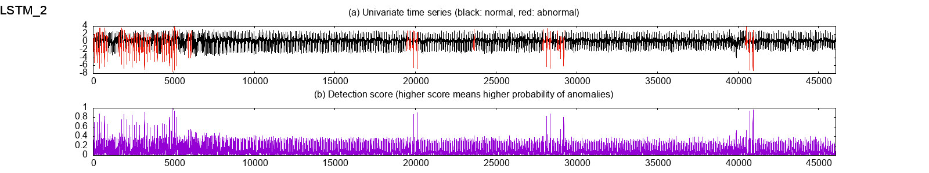
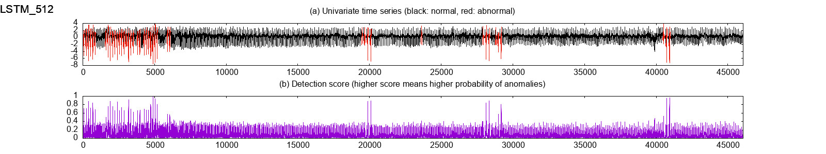
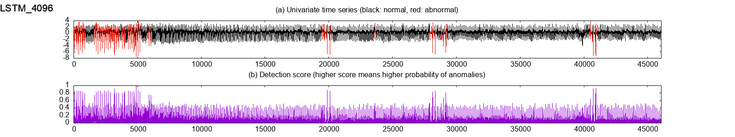
LSTM: 训练集为2个窗口、512个窗口、1024个窗口对应的score

Slide 18
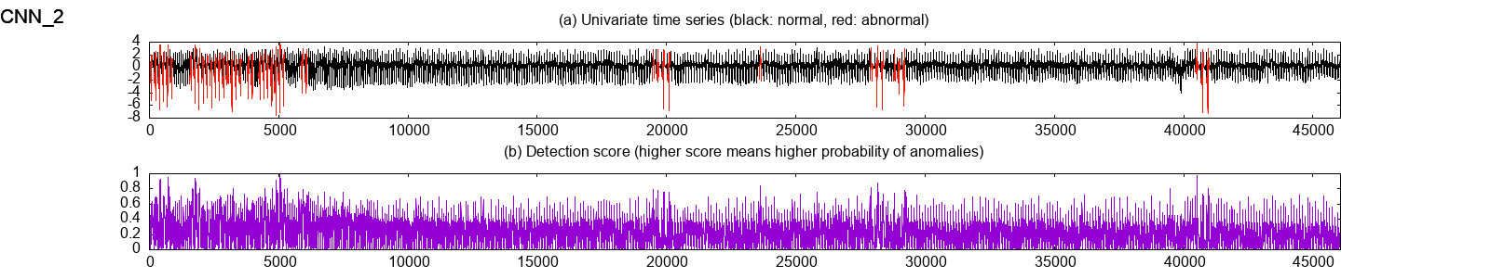
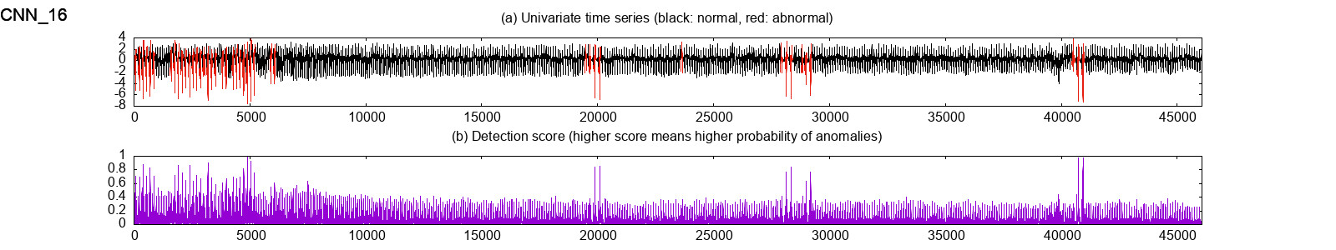
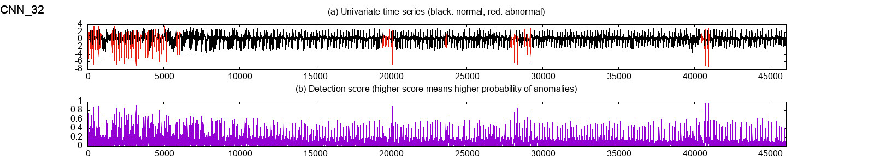
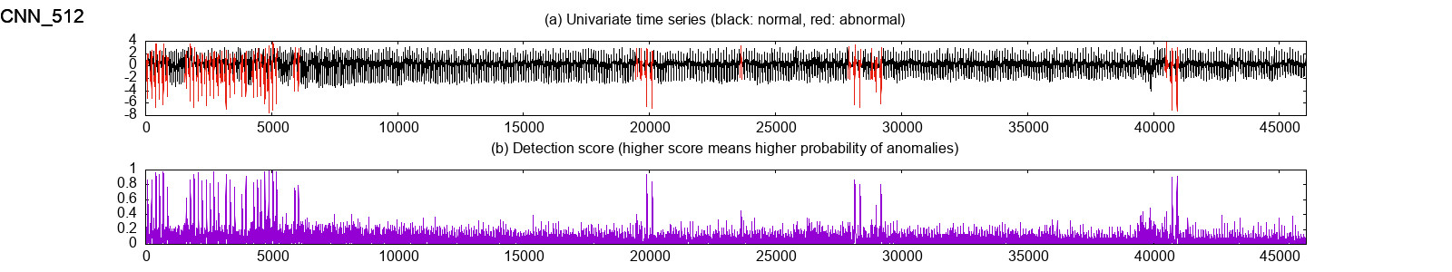
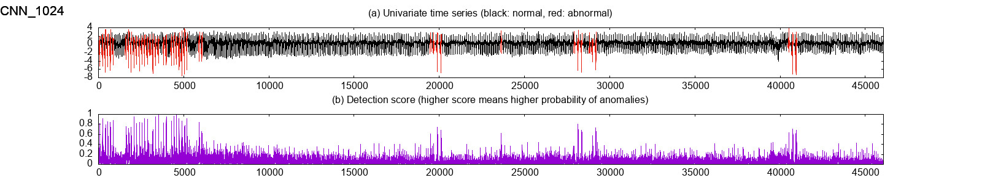
CNN: 训练集为2个窗口、512个窗口、1024个窗口对应的score

Slide 19
各模型窗口数量与精度的关系
窗口数量：[2, 8, 32, 512, 1024, 2048]
模型：['lstm-ad', 'cnn', 'lof', 'hbos', 'ocsvm', 'iforest', 'ae', 'vae', 'dagmm']
脚本：/Users/sunwu/SW-Research/sw-research-code/libs/timeseries-models/benchmark_models/tests/model_loader.py

Slide 20
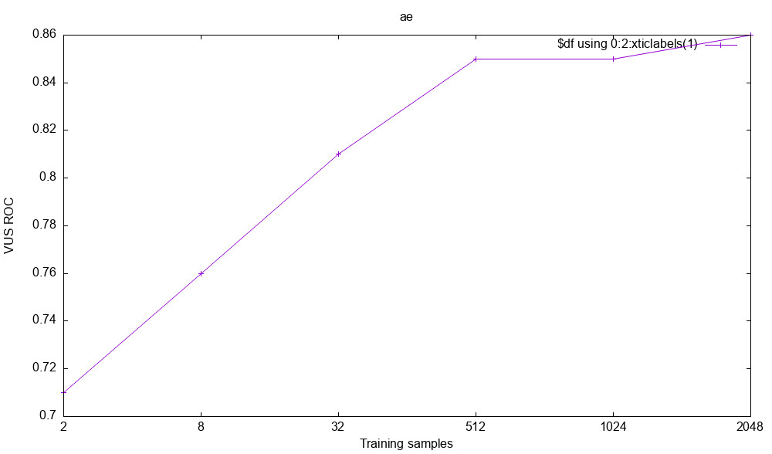
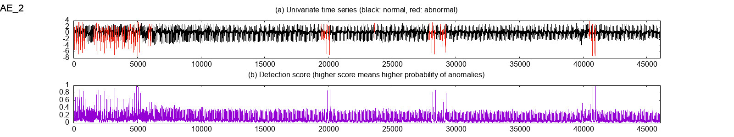
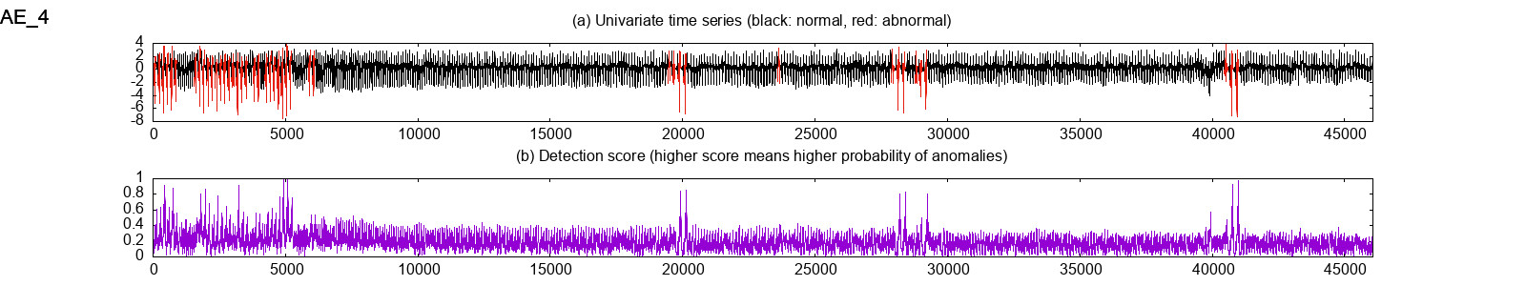
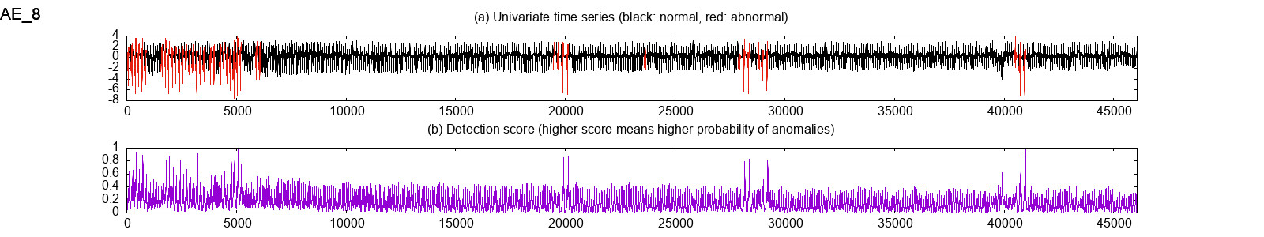
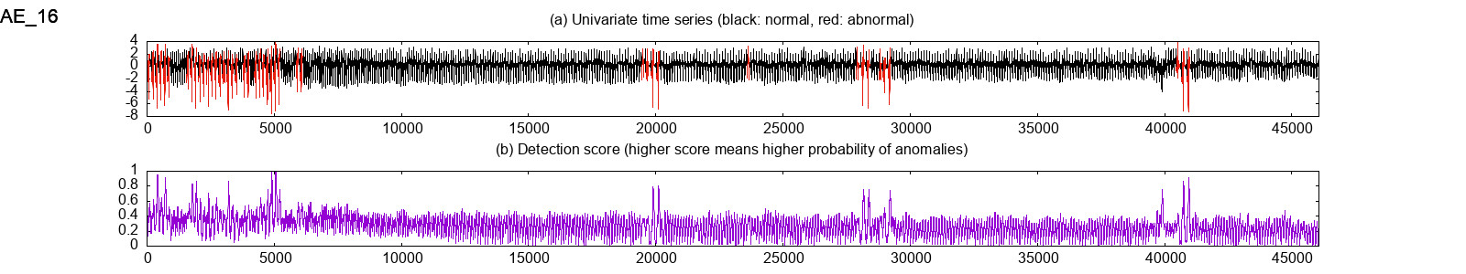
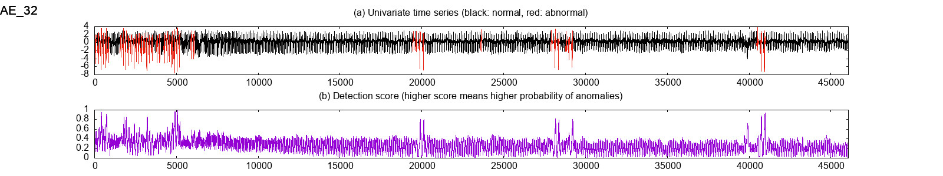



AE

Slide 21
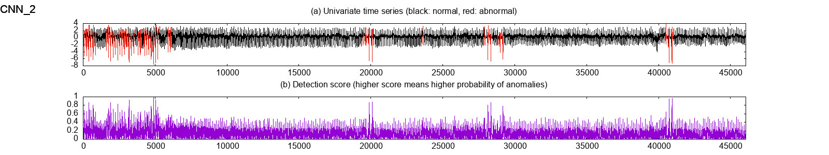
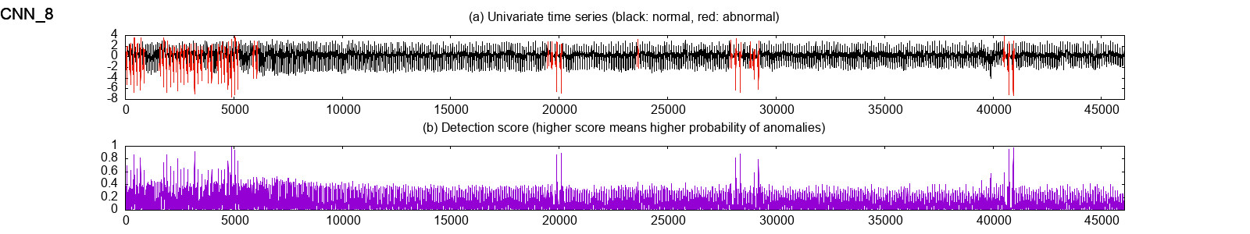
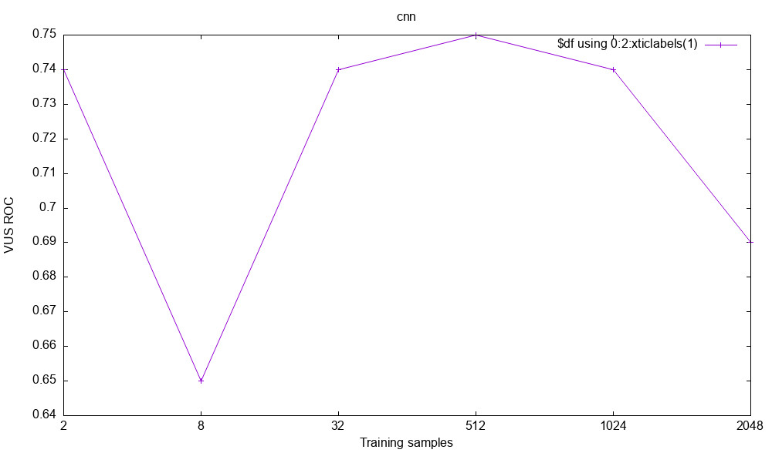
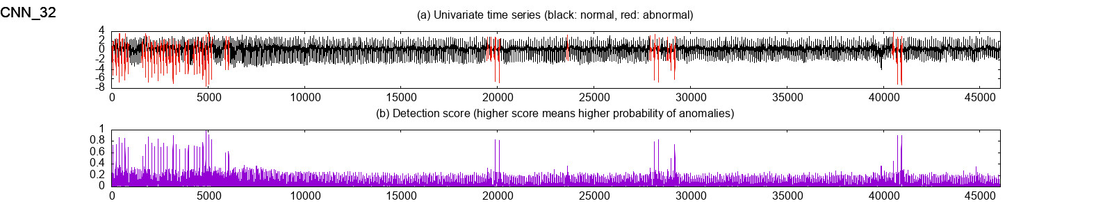
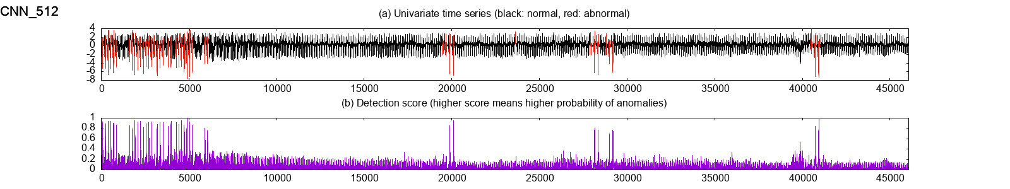
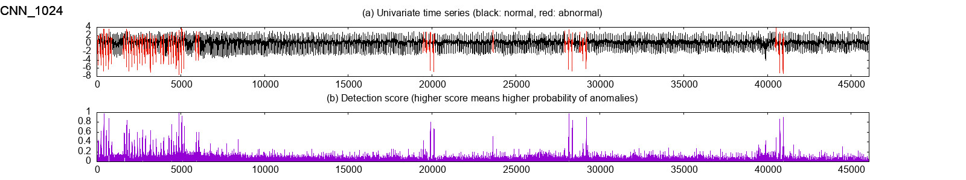
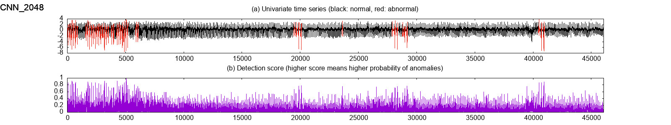
CNN
训练的窗口数量(samples)与模型精度的关系

Slide 22
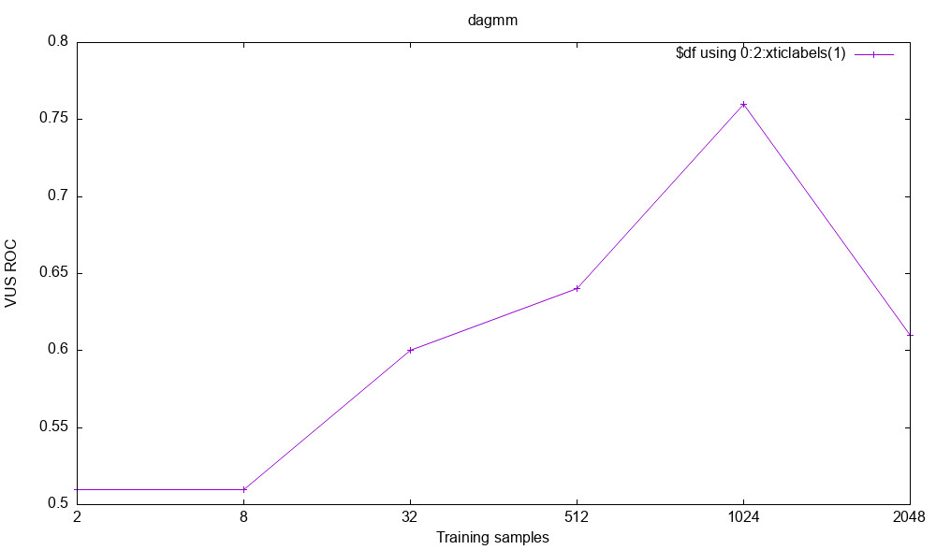
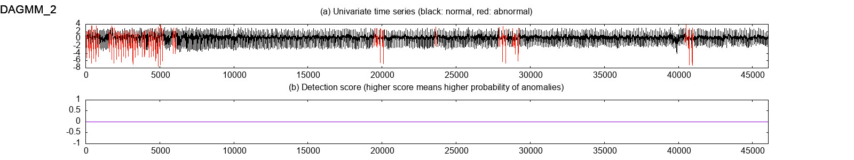
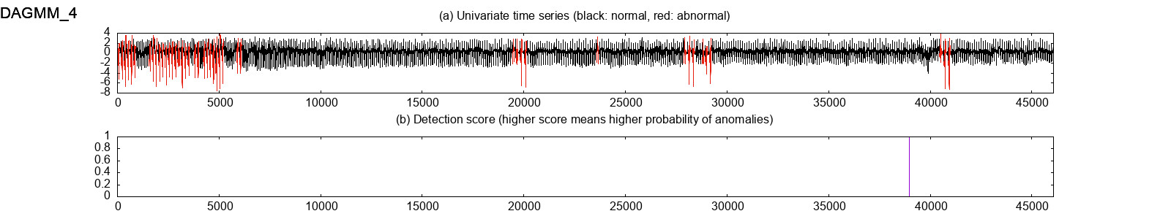
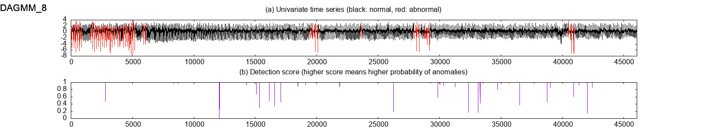
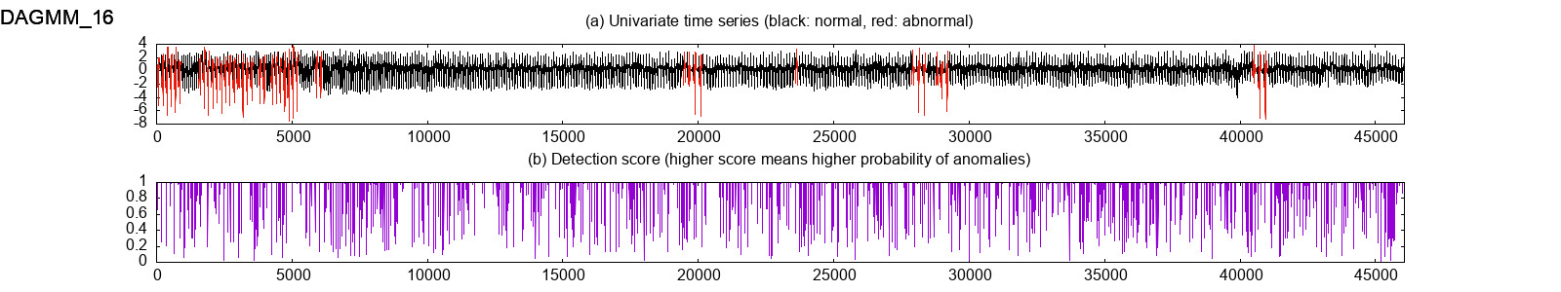
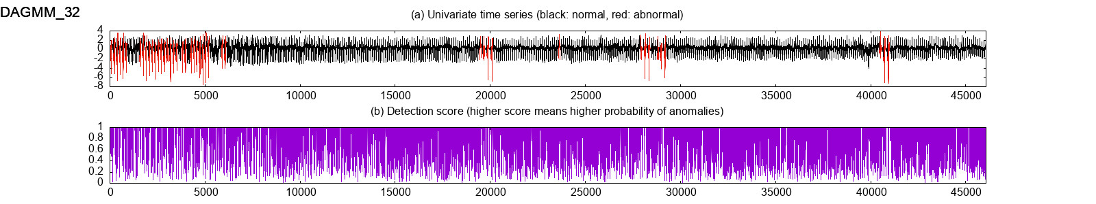
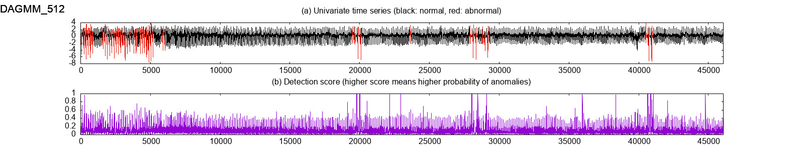
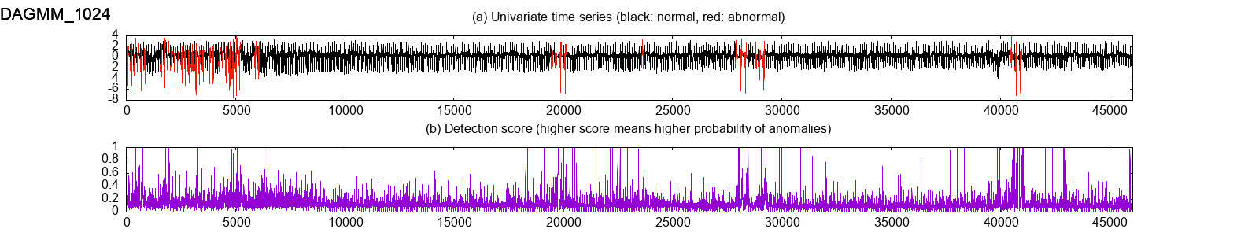
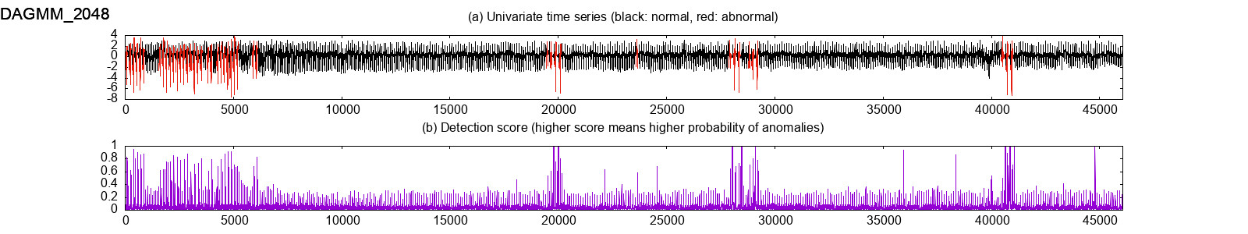
DAGMM

Slide 23
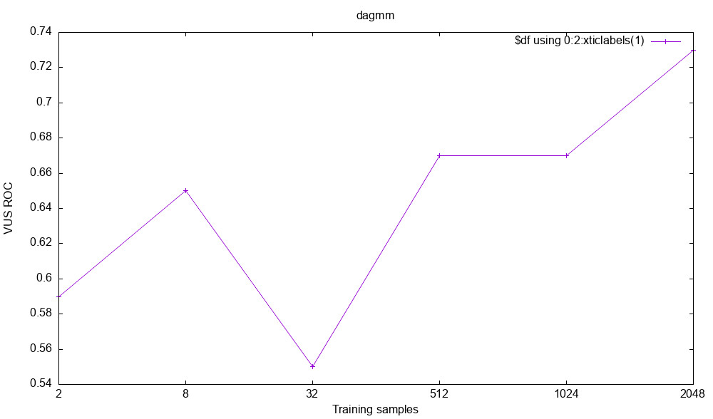
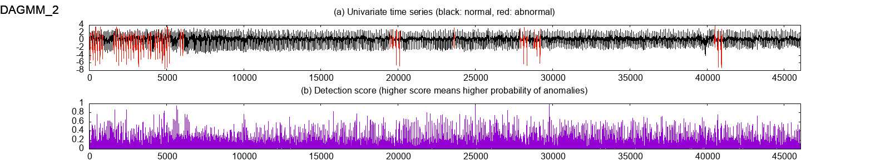
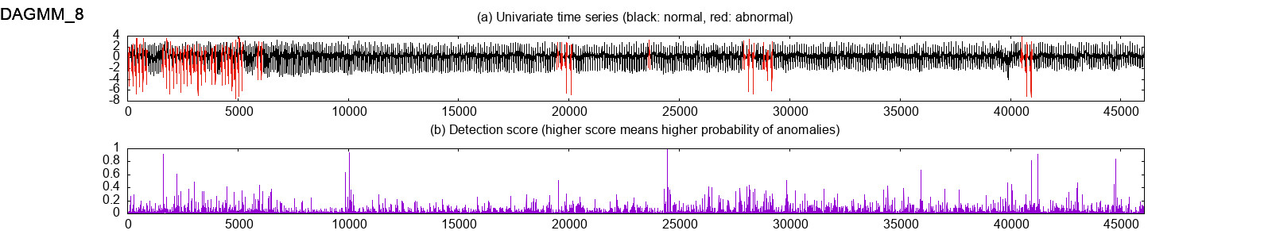
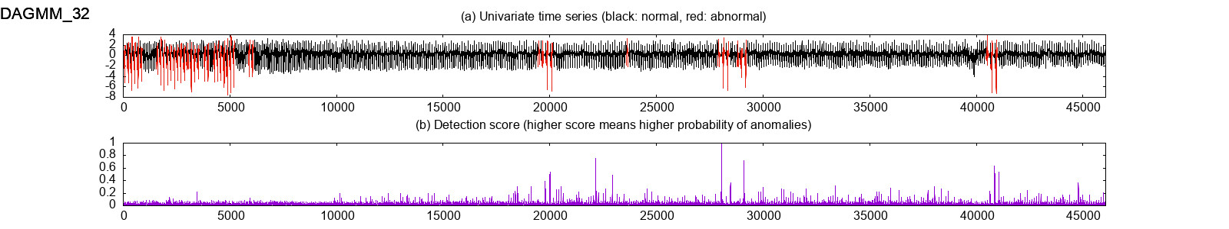
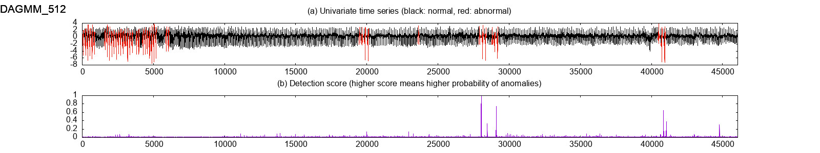
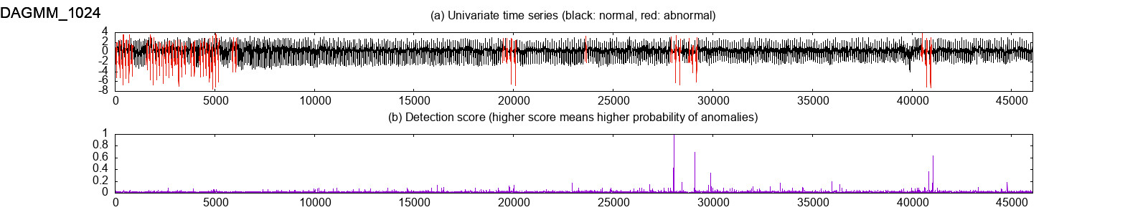
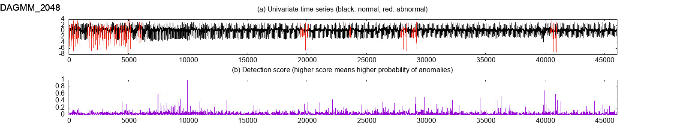
DAGMM TF2

Slide 24
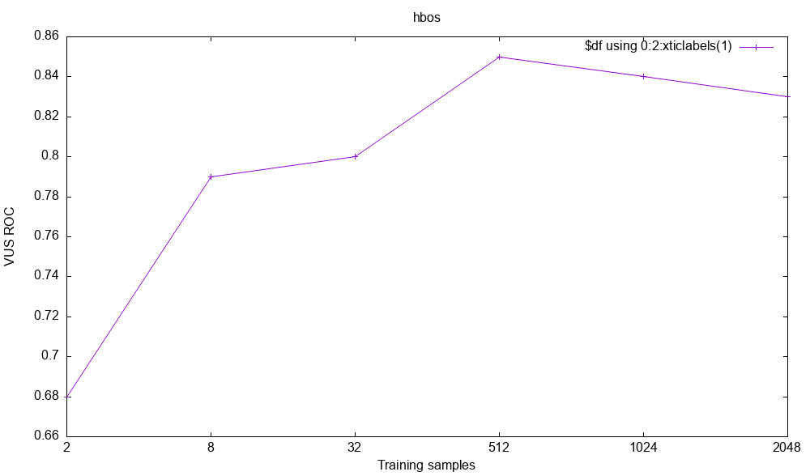
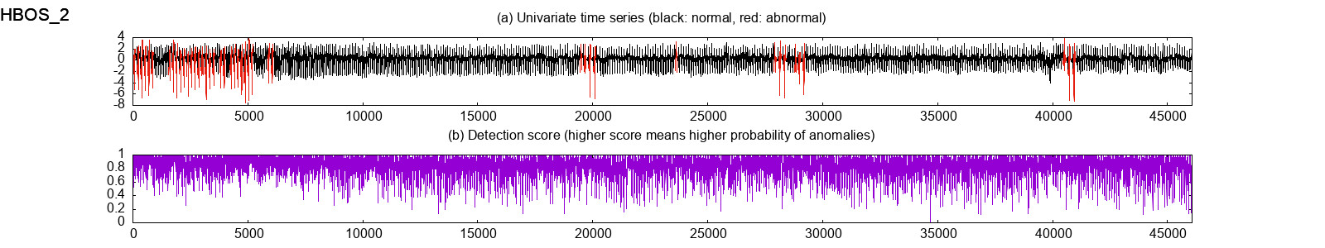







HBOS

Slide 25









IForest

Slide 26









LOF

Slide 27







LSTMAD

Slide 28









OVSVM

Slide 29









VAE

Slide 30


HBOS 训练时间异常的问题
解决前
解决后：

