Slide 1










③ Model Training and Performance Collecting
① Data Processing
④ Heuristic Method
Sliding Window
Training
Log
Calculate ${acc}_{inc}$
Model Accuracy
$${acc}_{inc}$$
Category | Metric | Value
Accuracy | AUC | …
 | Precision | …
Time | Training time | …
 | Data processing time | …
Scaling laws
Origin Training Set
Test Set
$$n_{i−2}$$
$$n_{i−1}$$
$$n_{i}$$
······
Sample Size
Stop Threshold $α$
Sample Size $n_{sw}$
No
Sampling Training Set
Test Set
${acc}_{inc}<α$?
Yes
UTS-AD Methods
Best Output
Sampling Methods
RF
AE
OC-SVM
HBOS
$$W_{D}^{∗}$$
Latin Hypercube Sampling
Simple Random Sampling
Distance Sampling
COCA
DAGMM
······
$$A^{∗}$$
② Data Sampling
Increase Sample Size

Slide 2










③ Model Training and Performance Collecting
① Data Processing
④ Heuristic Method
Sliding Window
Training
Log
Calculate $p_{inc}$
Model Accuracy
$$p_{inc}$$
Category | Metric | Value
Accuracy | AUC | …
 | Precision | …
Time | Training time | …
 | Data processing time | …
Origin Training Set
Test Set
$$s_{i−2}$$
$$s_{i−1}$$
$$s_{i}$$
······
Sample Size
Stop Threshold $α$
Sample Size S_{i}
Sampling Training Set
Test Set
$p_{inc}<α$?
No
Yes
UTS-AD Models
Best Output
Sampling Methods
RF
AE
OC-SVM
HBOS
Sample Size $s_{i}$
Latin hypercube sampling
simple random sampling
distance sampling
COCA
DAGMM
······
UTS-AD Model $M_{i}$
② Data Sampling
Increase Sample Size $s_{i+1}$

Slide 3
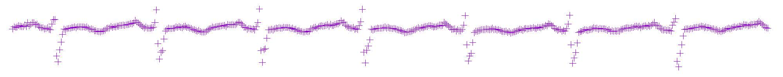





③ Model Training and Performance Collecting
① Data Processing
④ Heuristic Method
Sliding Window
Training
Log
Calculate $p_{inc}$
Model Accuracy
$$p_{inc}$$
Category | Metric | Value
Accuracy | AUC | …
 | Precision | …
Time | Training time | …
 | Data processing time | …
Origin Training Set
Test Set
$$s_{i−2}$$
$$s_{i−1}$$
$$s_{i}$$
······
Sample Size
Stop Threshold $α$
Sample Size S_{i}
Sampling Training Set
Test Set
$p_{inc}<α$?
No
Yes
UTS-AD Models
Best Output
Sampling Methods
RF
AE
OC-SVM
HBOS
Sample Size $s_{i}$
Latin hypercube sampling
simple random sampling
distance sampling
COCA
DAGMM
······
UTS-AD Model $M_{i}$
② Data Sampling
Increase Sample Size $s_{i+1}$

Slide 4
单变量时间序列异常检测5折交叉验证演示
第1折
训练集
测试集
第2折
训练集
测试集
训练集
第3折
训练集
测试集
训练集
...
......
第5折
Notes:
五折交叉验证

Slide 5
变量时间序列异常检测滑动窗口的生成
步长
......
窗口大小
Notes:
五折交叉验证

Slide 6





$$x$$
$$x′$$
$$z$$
Encoder
$$f$$
Decoder
$$g$$
Notes:
VAE

Slide 7










$$x$$
$$x′$$
$$f$$
$$μ$$
Z
X
Encoder
$$f$$
$$z$$
Decoder
$$g$$
$$g$$
$$σ$$
+
N
X
$$ε$$
Notes:
AE

Slide 8









Compression Network
$$z_{r}$$
$$x$$
$$x′$$
Estimation Network
Encoder
$$f$$
$$z_{c}$$
Decoder
$$g$$
$$z$$
$$h$$
$$\hat{π}$$
Notes:
AE

Slide 9
Input Layer
LSTM/Sigmoid Layer
LSTM/Sigmoid Layer
Output Layer

Slide 10

$$x$$
Conv1
Max Polling
Conv2
Max Polling
Dense Layer
Output

Slide 11
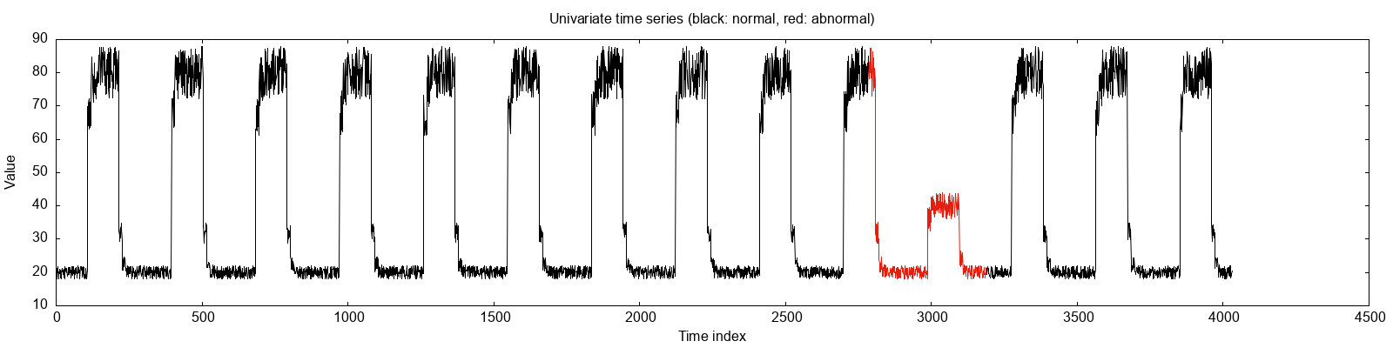
解释：“一个窗口"得到的模型精度与“全量窗口”得到的模型精度可能相等
①原始单变量时间序列数据(UTS)
②将UTS转为滑动窗口（子序列）
一个窗口
......
窗口大小
步长
③在 滑动窗口 中抽取 部分窗口 训练模型
在UTS规律的情况下，抽取到的第一个窗口已经能够代表整个UTS正常的模式了。因此对于半监督和非监督算法来说，一个窗口得到的算法精度，也可能和全部窗口得到的算法精度相等。
刚好抽到第一个窗口
算法LOF
训练
这个窗口刚好可以代表这个UTS中的正常模式

Slide 12
①Original univariate time series
②The sliding windows of the UTS
One sliding window
......
窗口大小
步长
③Sampled sliding window(s)
④ Model Training
UTS-AD Models
RF
AE
OC-SVM
HBOS
COCA
DAGMM
······

Slide 13
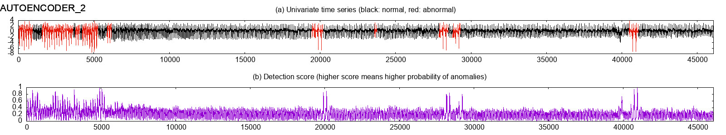
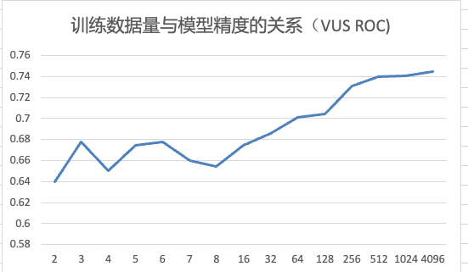
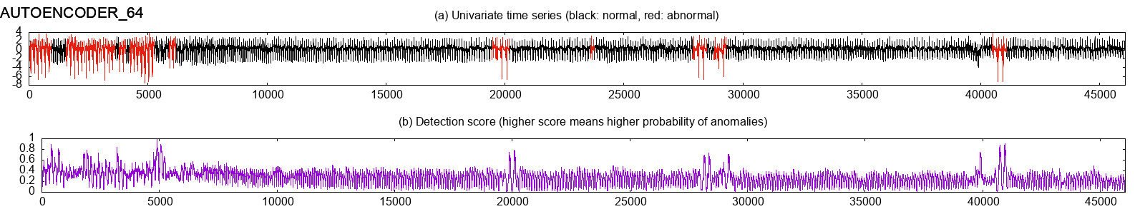
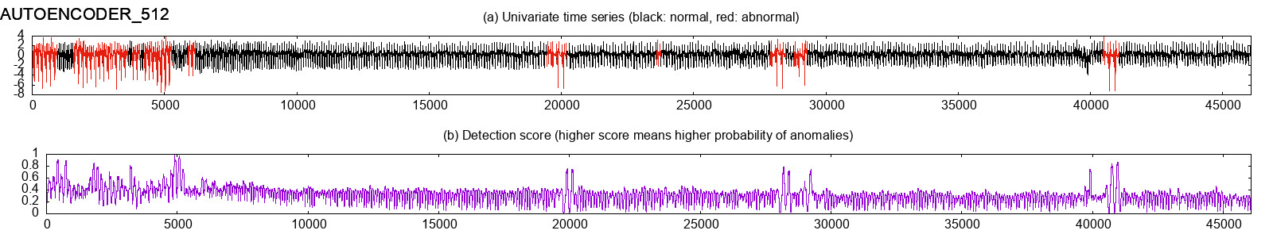
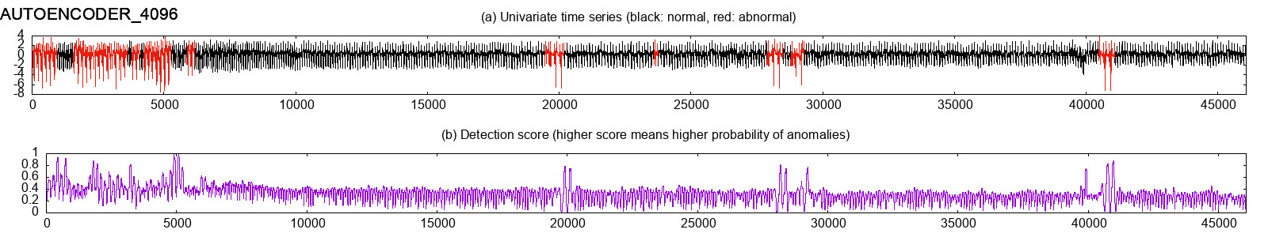
算法AutoEncoder在2个窗口、64个窗口、512个窗口、4096个窗口 score 对比
2个滑动窗口
4096个滑动窗口

Slide 14
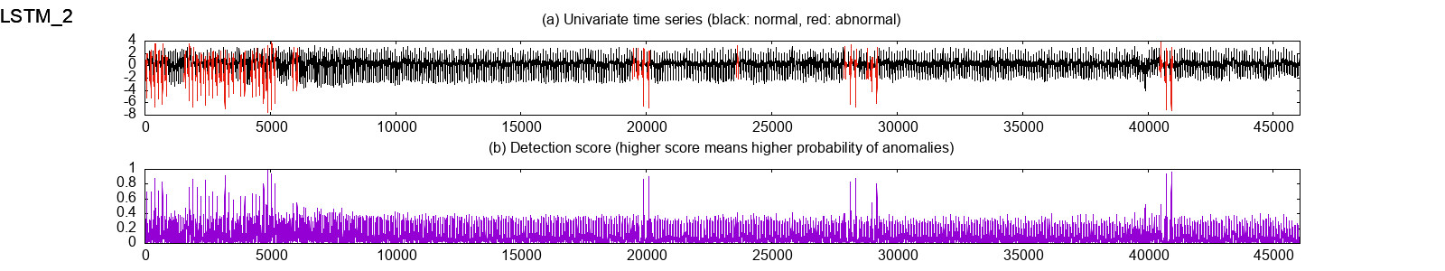
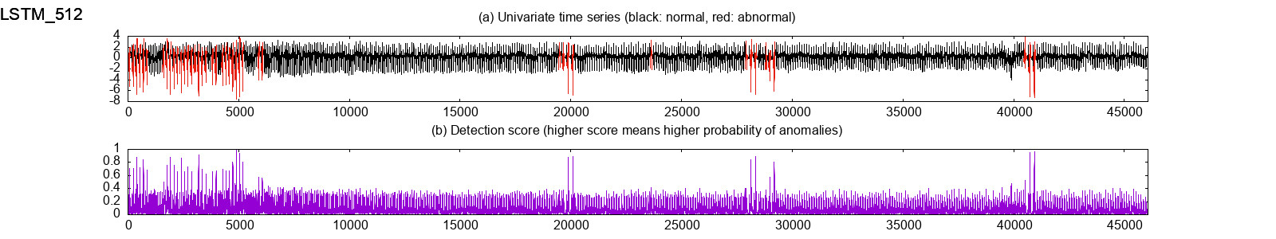
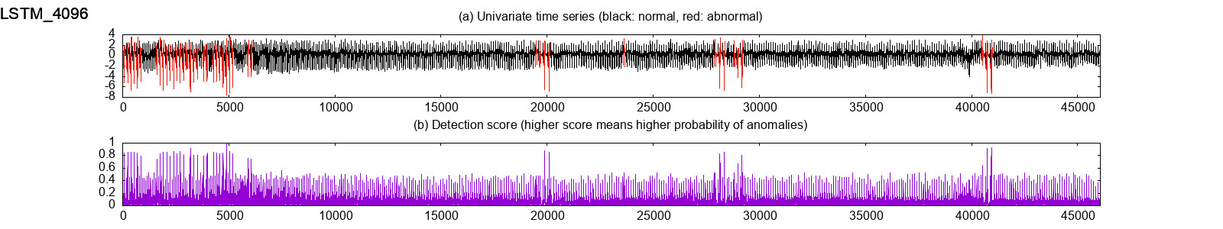
LSTM: 训练集为2个窗口、512个窗口、1024个窗口对应的score

Slide 15
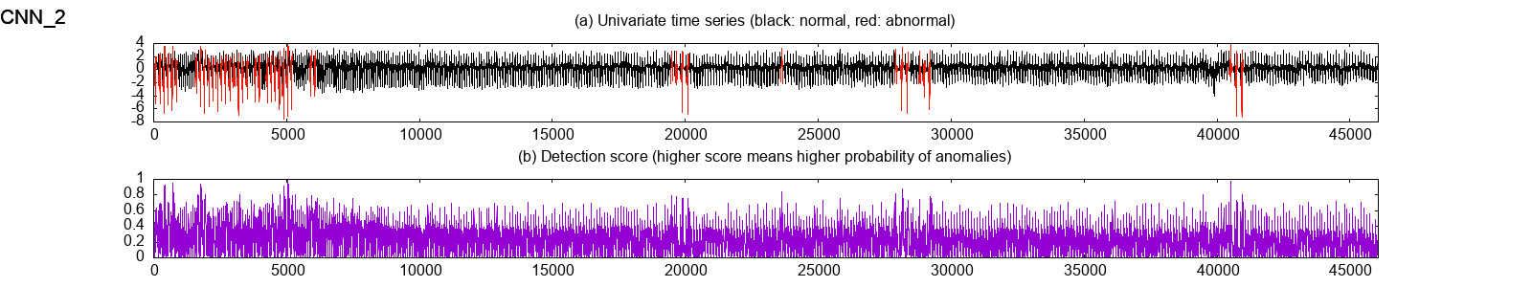
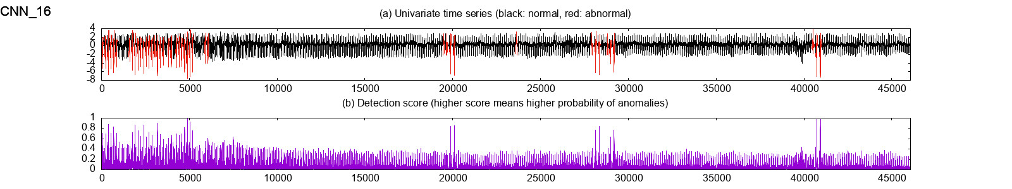
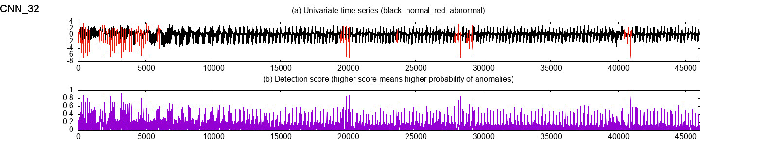
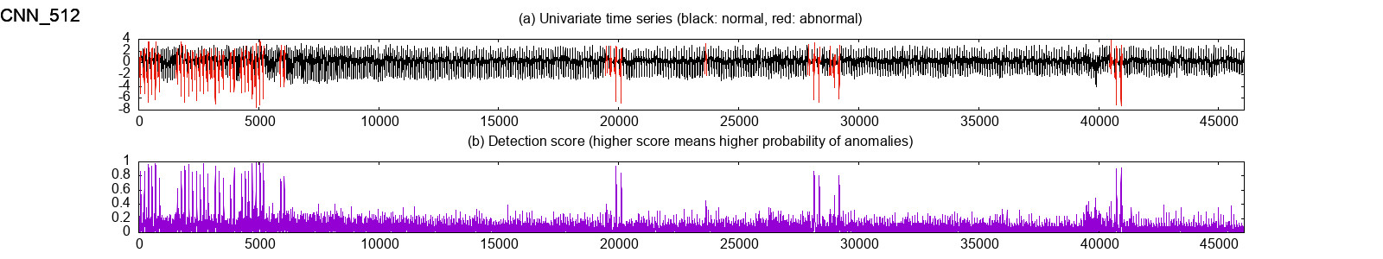
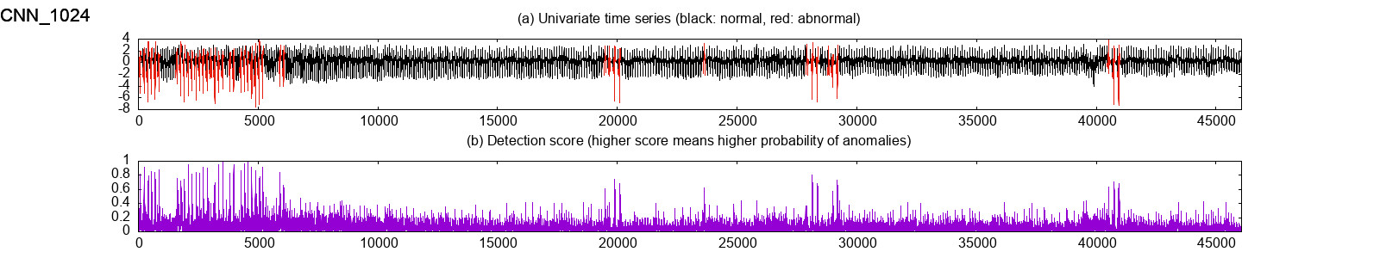
CNN: 训练集为2个窗口、512个窗口、1024个窗口对应的score

Slide 16
各模型窗口数量与精度的关系
窗口数量：[2, 8, 32, 512, 1024, 2048]
模型：['lstm-ad', 'cnn', 'lof', 'hbos', 'ocsvm', 'iforest', 'ae', 'vae', 'dagmm']
脚本：/Users/sunwu/SW-Research/sw-research-code/libs/timeseries-models/benchmark_models/tests/model_loader.py

Slide 17
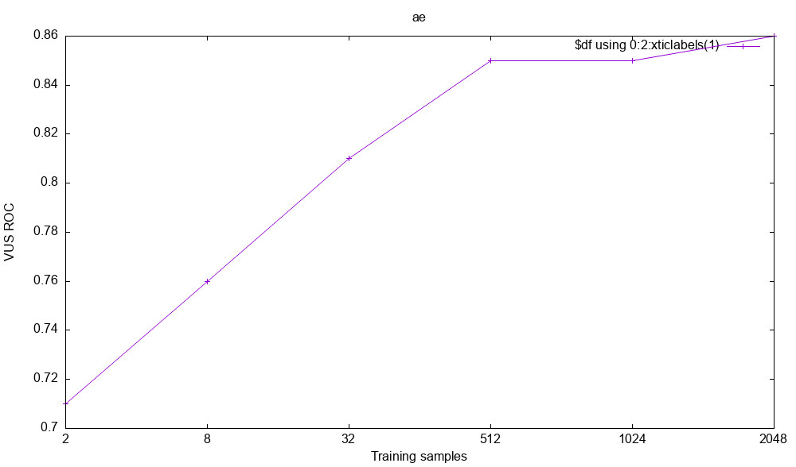
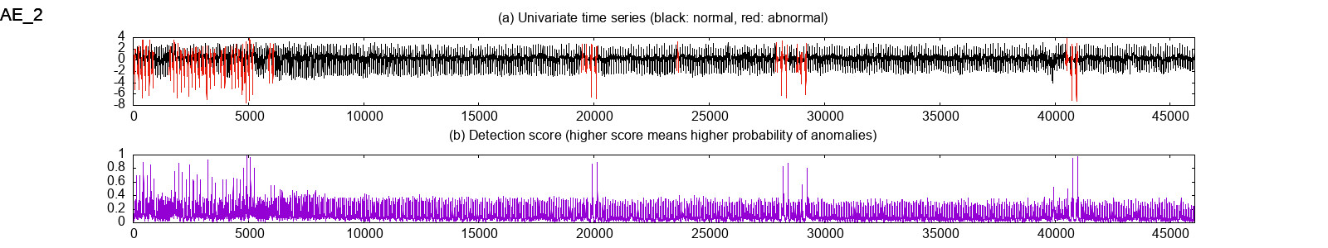
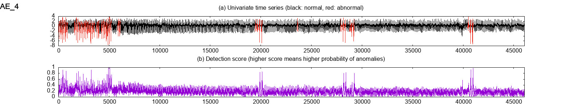
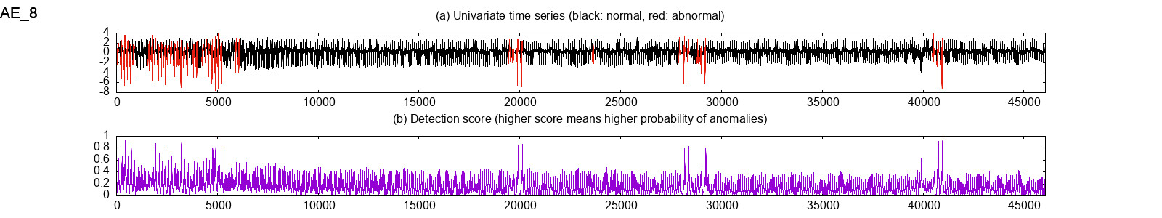
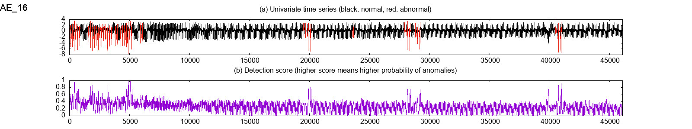
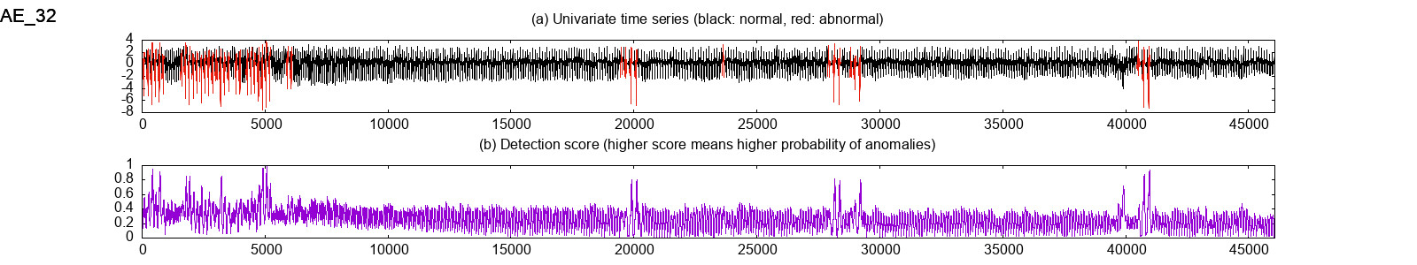



AE

Slide 18
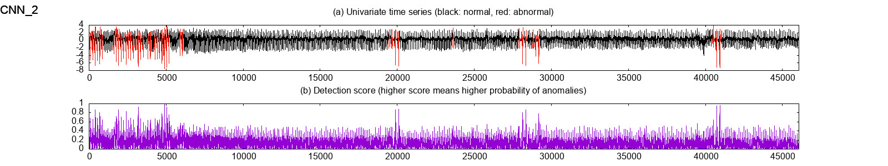
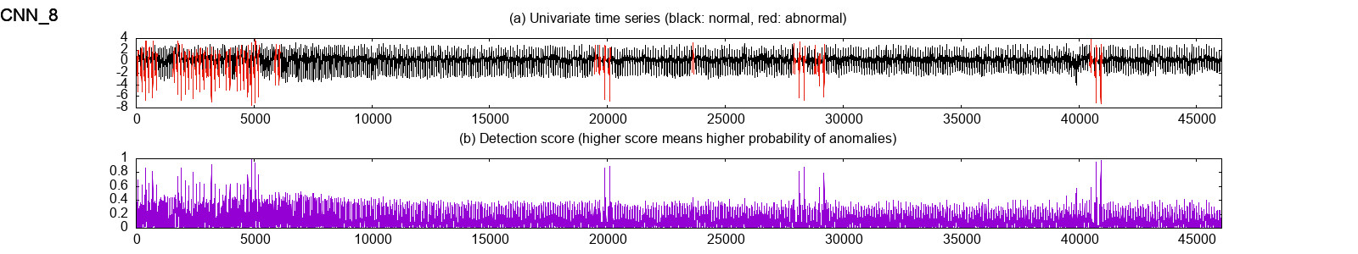
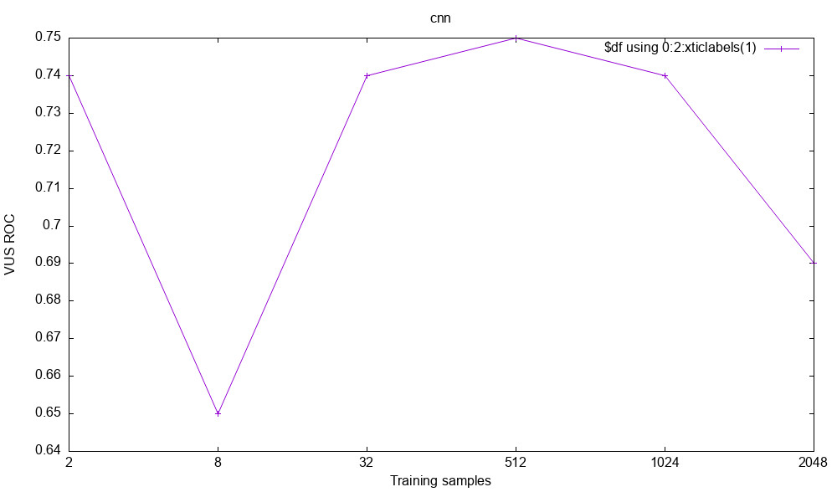
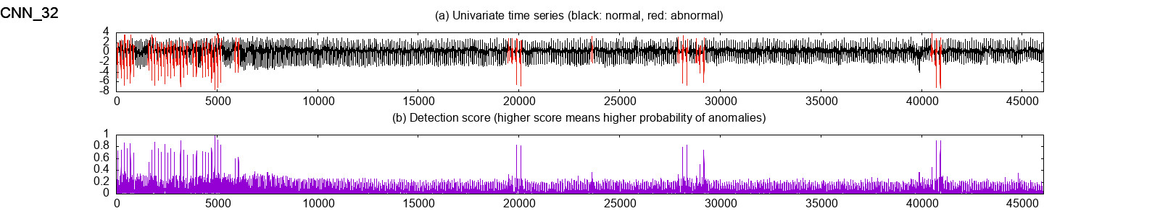
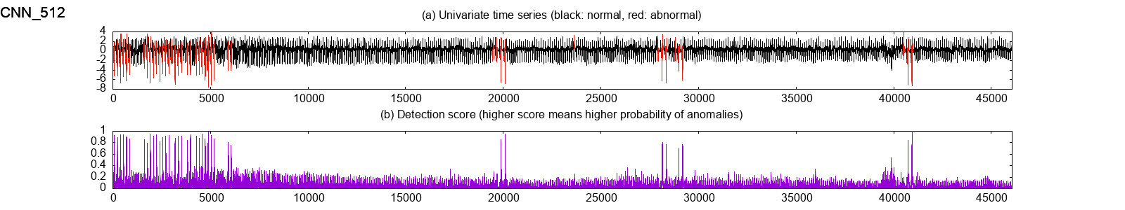
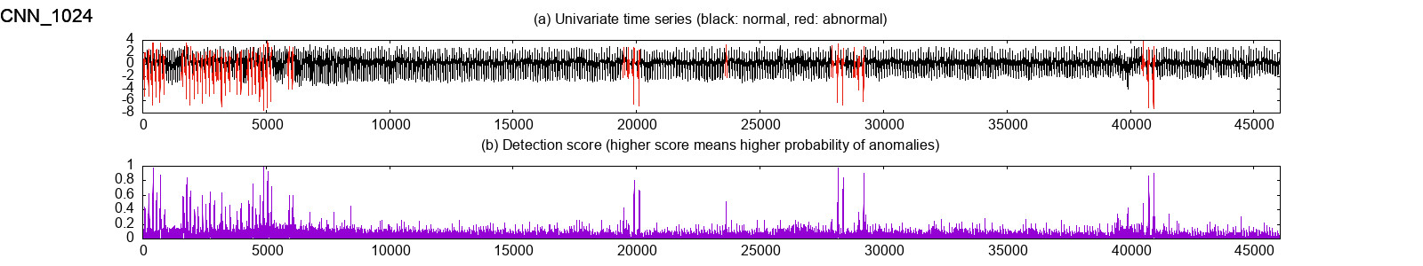
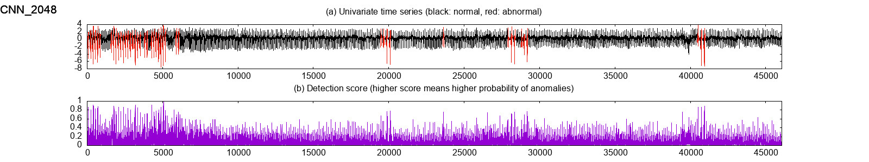
CNN
训练的窗口数量(samples)与模型精度的关系

Slide 19
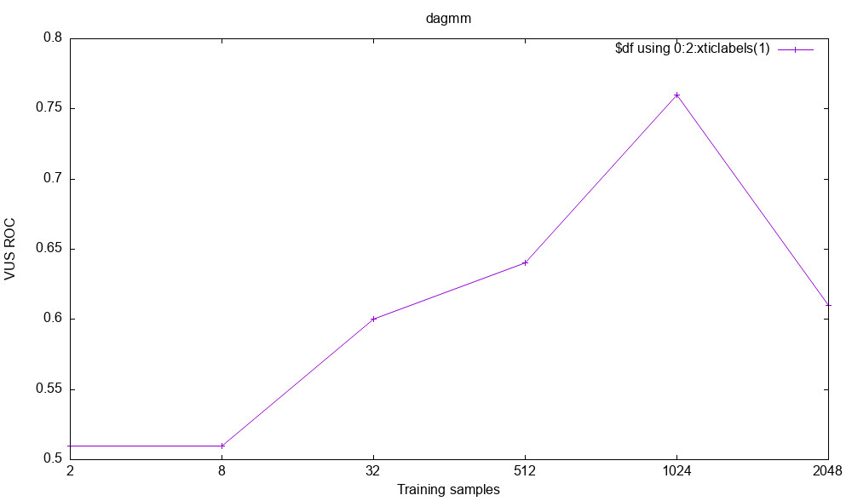
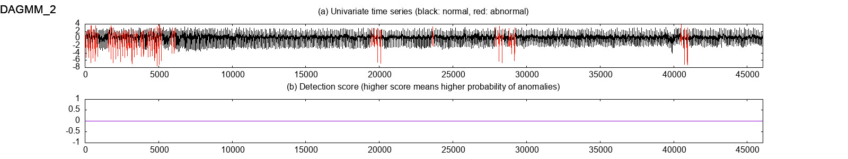
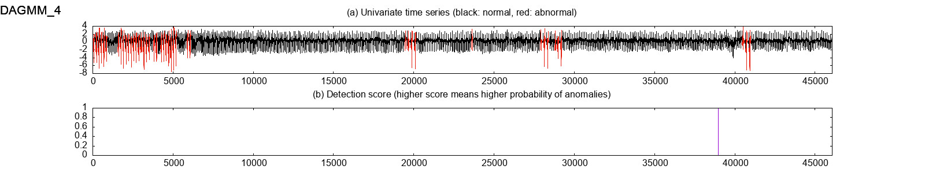
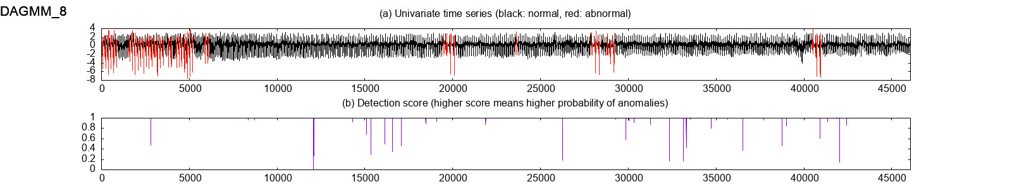
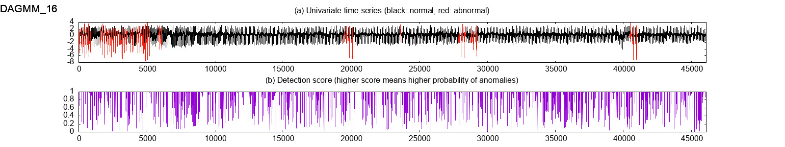
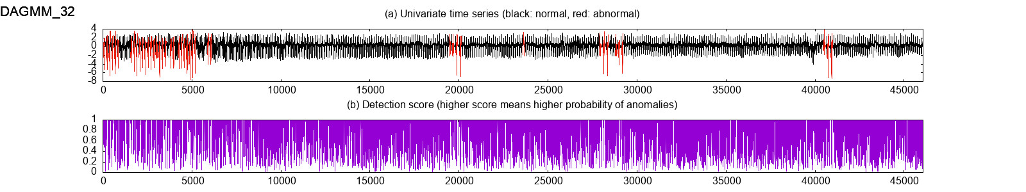
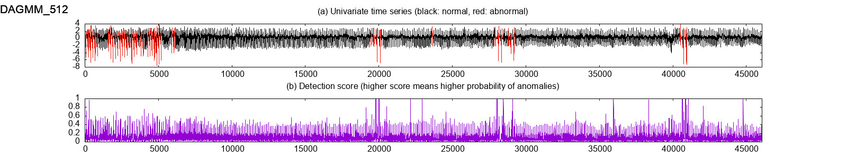
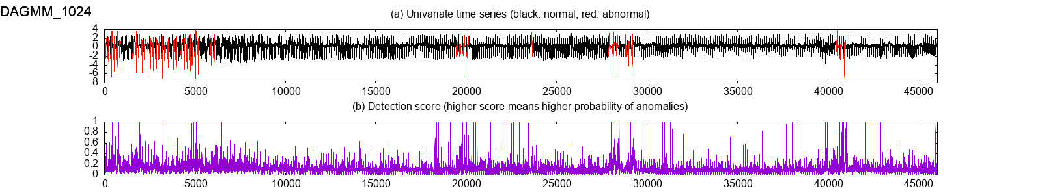
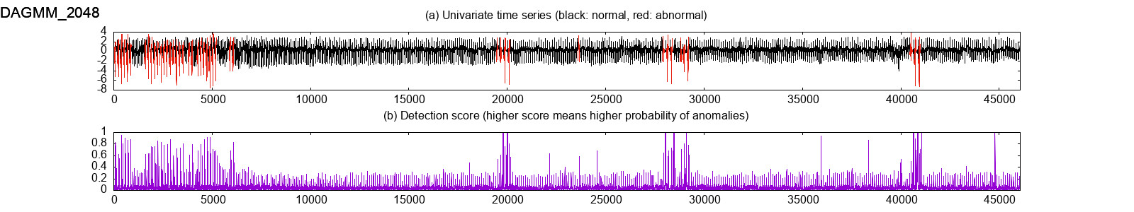
DAGMM

Slide 20
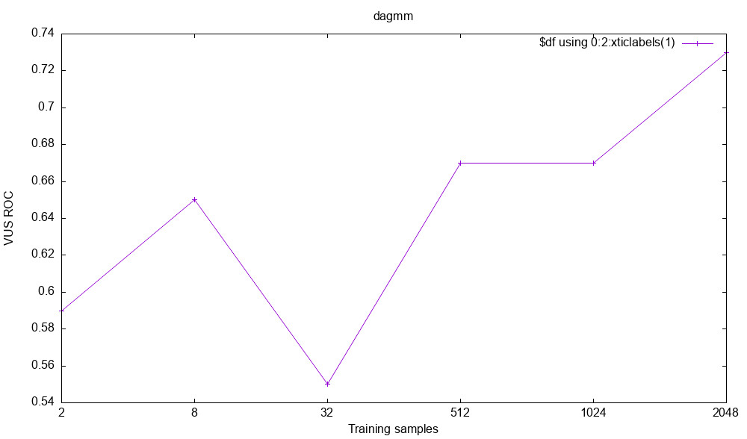
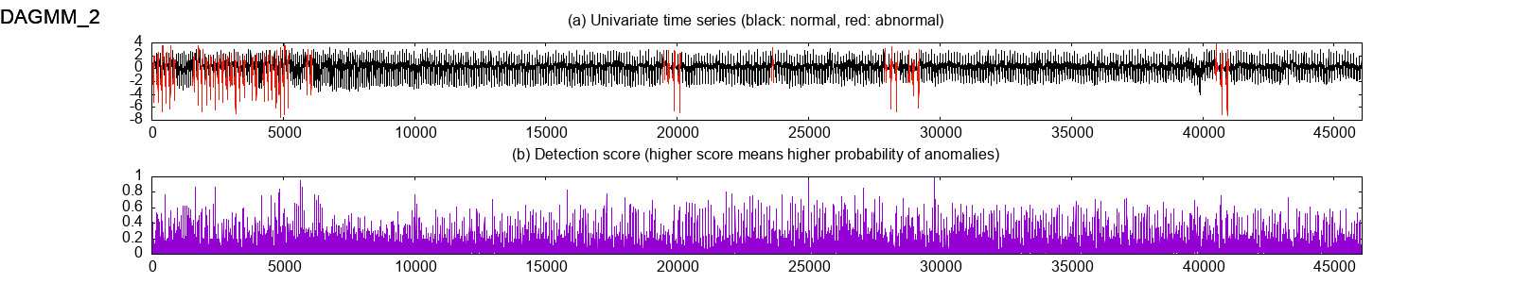
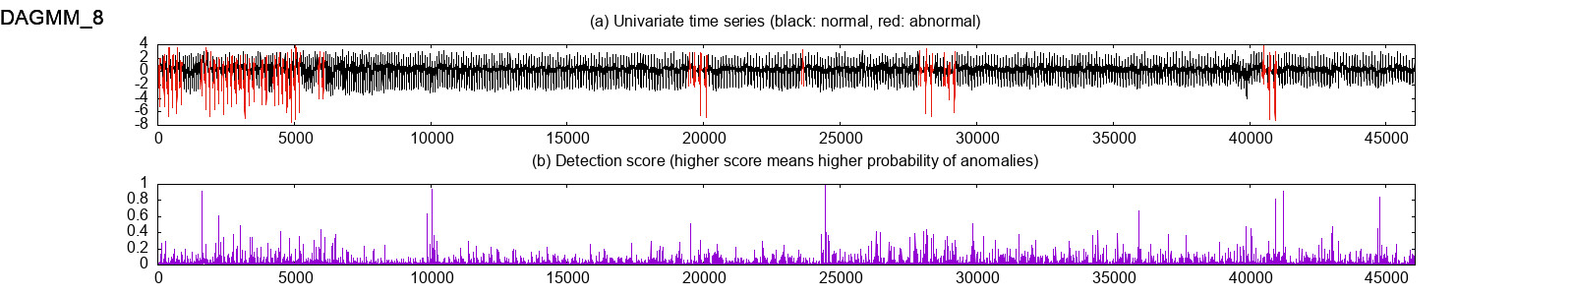
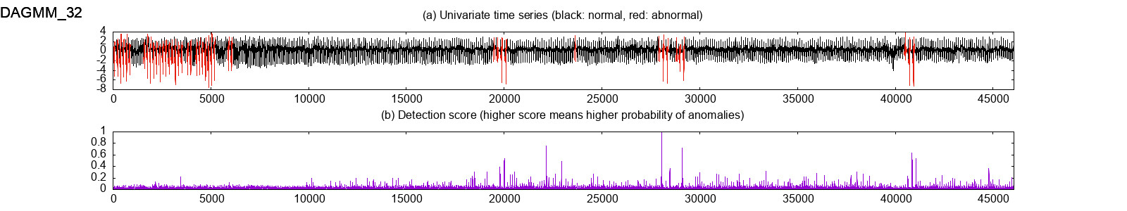
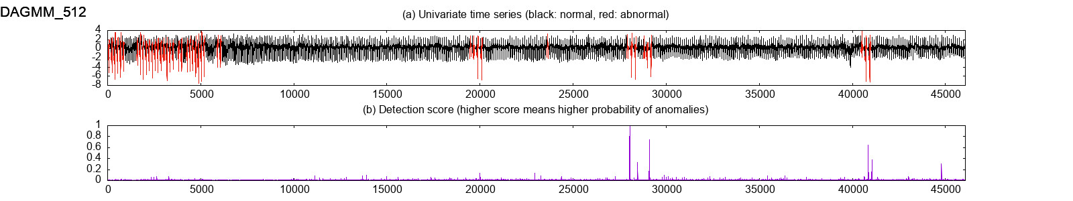
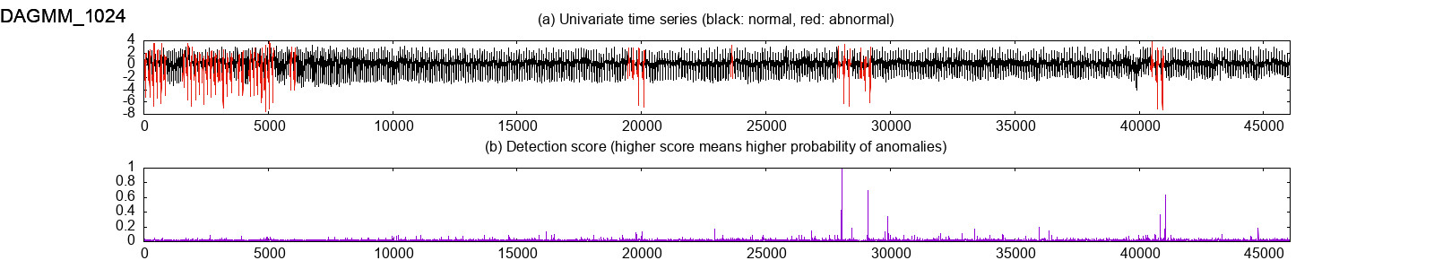
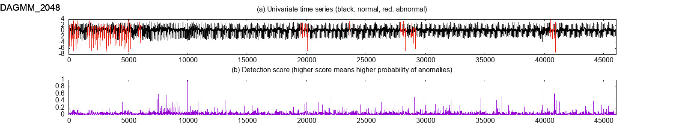
DAGMM TF2

Slide 21
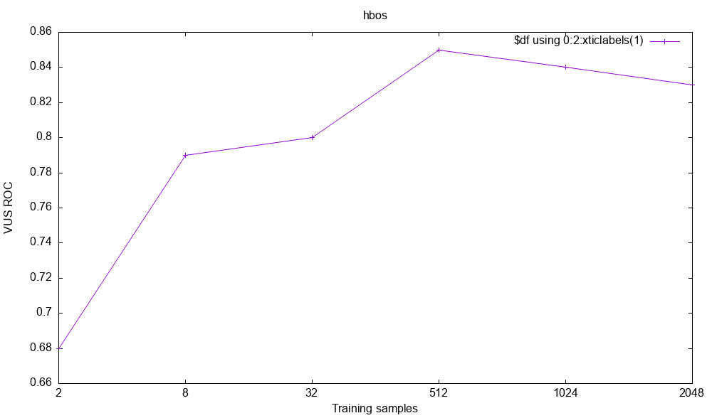
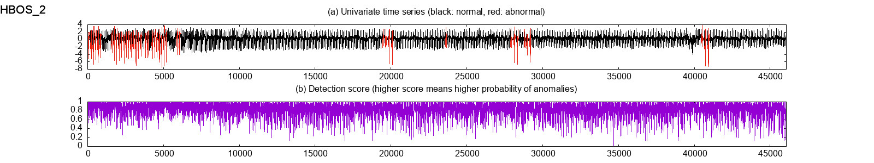
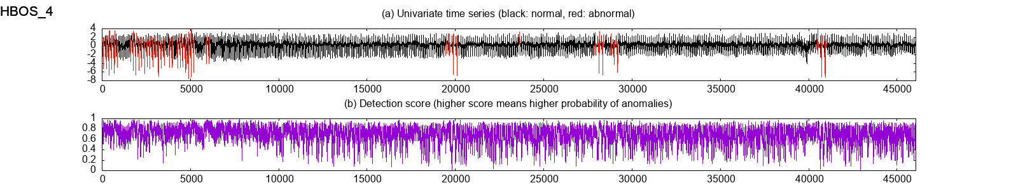
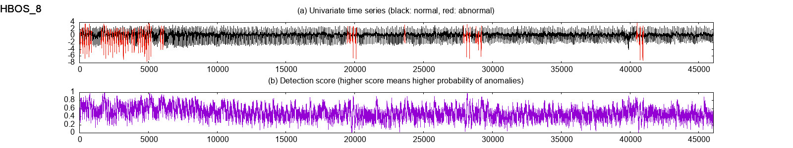
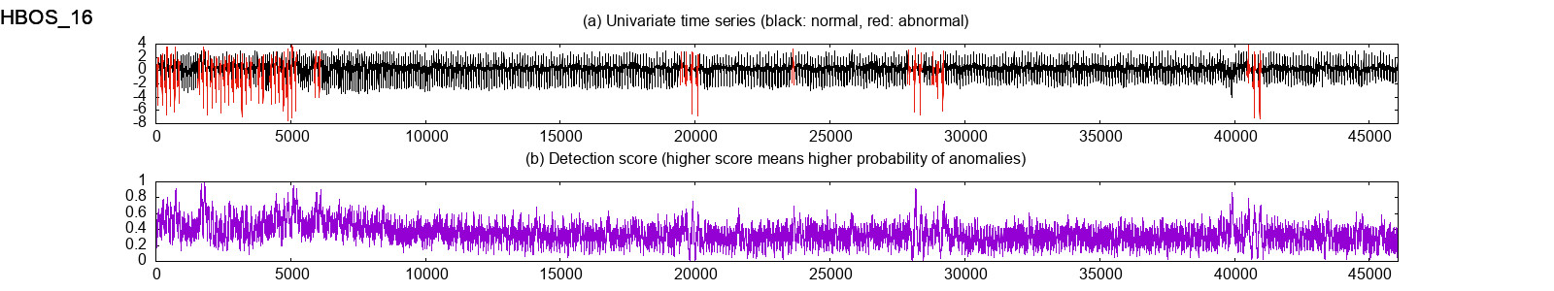
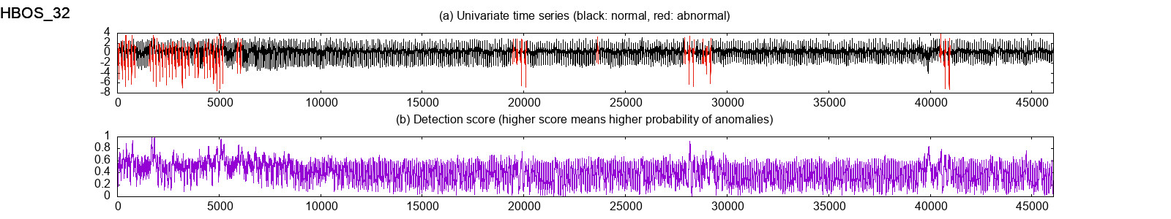



HBOS

Slide 22









IForest

Slide 23









LOF

Slide 24







LSTMAD

Slide 25









OVSVM

Slide 26









VAE

Slide 27


HBOS 训练时间异常的问题
解决前
解决后：

