Slide 1
A Brief Introduction to C++
By dafeng@ACMM

Slide 2
How about knowledge in this lecture?
Very boring
Very massive
Very effective
Very useful

Slide 3
What will we learn?
From C to C++
cin and cout
const and reference in C++
class and object
operator overloading
templates
C++ Stardard Library
containers
algorithms

Slide 4
Recommended reference
If you can’t remember something in this class, ask the reference for help instead of me. Learn from books and Internet is a necessary ability for your career.
www.cplusplus.com
C++ Primer 5th E. (not C++ Primer Plus), Stanley B. Lippman etc.
The C++ Programming Language, Bjarne Stroustrup
The C++ Standard Library : A tutorial and reference 2nd E. , Nicolai M. Josuttis
Don’t read TAN HAO QIANG!

Slide 5
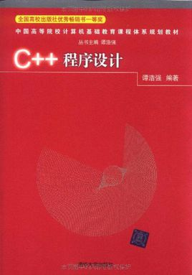

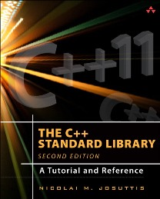
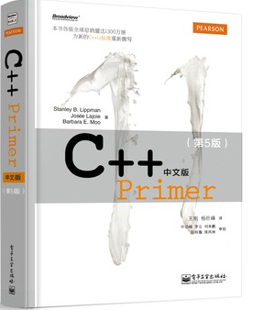
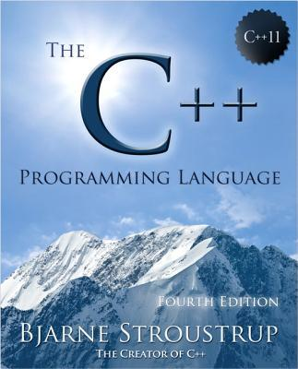
Recommended reference

Slide 6
C++ as a better C
A super set of C
Created by Bjarne Stroustrup in 1979
First named “C with classes”
Renamed to “C++” in 1983
Provides object-oriented-programming (OOP) capabilities
Has powerful standard library
Becomes the mainly used language in programming contest

Slide 7
cin and cout
int x;
scanf("%d", &x);// C method
printf("%d\n", x);
cin >> x; // C++ method
cout << x << endl;

Slide 8
What is const?
const int x = 5;
…
x = 6;
//error: assignment of read-only variable ‘x’

Slide 9
const differs in C and C++
const int maxn = 1000;
int a[maxn];// compile error in C, ok in C++

Slide 10
Reference in C++
Does it work?
void Swap(int a, int b)
{
int t = a;
a = b;
b = t;
}

Slide 11
Reference in C++
void Swap(int &a, int &b)
{
int t = a;
a = b;
b = t;
}

Slide 12
Function overloading
In C++, We can define several functions with a same name and different parameter list.
int sum(int a, int b){
return a + b;
} int sum(int a, int b, int c){
return a + b + c;
}
int x = sum(1, 2); //x = 3
int y = sum(1, 2 ,3);// y = 6;

Slide 13
Function templates
Function templates are special functions that can operate with generic types
template <typename T>
T sum(T a, T b){
return a + b;
}
double x = sum(1.0, 2.0); // x = 3.0
int y = sum(2, 4); // y = 6;

Slide 14
Basic Concept of class and object
In C++, we use keyword “struct” or “class” to define a class, in other words, a new data type.
A class has two kind of members: data and method.
Notes:
点开程序后->添加print方法

Slide 15
“class” vs. “struct”
Keyword | “class” | “struct”
Similarities | Both used to define a class in C++
Differences | Private member access by default | Public member access by default

Slide 16
Operator overloading
Operator is a special kind of function.
C = A + B;
C = operator+(A, B);
We are able to overload the operators for new classes.
We are not allowed to redefine predefined operations or create new operators.

Slide 17
Class Templates
Just like we can create function templates, we can also create class templates, allowing classes to have members that use template parameters as types.
template<typename T>
struct Point{
T x, y;
Point(T x, T y):x(x), y(y){}
void show(){
cout << x << endl;
cout << y << endl;
}
};

Slide 18
Standard Template Library
(STL)

Slide 19
Standard Template Library
The Standard Template Library (STL) is a software library for the C++ programming language that influenced many parts of the C++ Standard Library.
It provides four components:
algorithms
containers
functors
iterators

Slide 20
Difference between them
STL (Standard Template Library)
C++ Stardard Library

Slide 21
Containers
The containers are objects that store data.
Simple containers | pair
Sequence containers | vector list deque
Container adaptors | queue priority_queue stack
Associative containers | set multiset unordered_set map multimap unordered_map
Others | bitset

Slide 22
std::vector
a dynamic array
capable of random access (just like C array)
resize itself automatically when inserting or erasing an object

Slide 23
std::vector
#include <vector>
using namespace std;
//---------------------------------------------------
int n = 3;
vector<int> a(n); //a's size is initially n
a.resize(2 * n); //change a's size to 2n
a.push_back(1); //push a element to a's back()
//s.size() becomes 2n+1
a[3] = 10; //a can be visited like an array
a.clear(); //a's size becomes 0

Slide 24
std::queue
FIFO(First In, First Out) queue interface
Four fundamental operations
push()
pop()
front()
back()

Slide 25
std::stack
LIFO(Last In, First Out) stack interface
Three fundamental operations
push()
pop()
top()

Slide 26
std::priority_queue
A special queue
An element with high priority is served before an element with low priority.
Three fundamental operations
top()
pop()
push()

Slide 27
std::set
A mathematical set
Type of data must implement comparison operator < or custom comparator function must be specified; such comparison operator or comparator function must guarantee strict weak ordering, otherwise behavior is undefined.
Three fundamental operations
insert()
erase()
count()

Slide 28
std::map
An associative array; allows mapping from one data item (a key) to another (a value).
Type of data must implement comparison operator < or custom comparator function must be specified; such comparison operator or comparator function must guarantee strict weak ordering, otherwise behavior is undefined.
Four fundamental operations
operator[]
insert()
erase()
count()

Slide 29
Other associative containers
std::multiset
std::multimap
std::unordered_set
std::unordered_map

Slide 30
Iterator
Something used to visited a container
The syntax of iterators resembles that of ordinary C pointer arithmetic.
operators * -> ++ --
Several different kinds
forward iterators
bidirectional iterators
random access iterators
The iterators are created by the corresponding container class using standard methods such as begin() and end().

Slide 31
Generic Algoirithms

Slide 32
Sorting Algorithms
//sort the element in interval [beg, end)
//Complexity: O(n log n)
sort(beg, end)
sort(beg, end, comp)
stable_sort(beg, end)
stable_sort(beg, end, comp)

Slide 33
std::swap
Exchange values of two objects
Complexity
Non-array: O(1)
Array: O(n)
(performs a swap operation per element.)

Slide 34
Write Algorithms
fill(beg, end, val)
copy(beg, end, dest)
replace(beg, end, old_val, new_val);
replace_copy(beg, end, old_val, dest, new_val);

Slide 35
std::rotate
rotate(beg, mid, end)
// Rotates the order of the elements in the range [beg, end)
// in such a way that the element pointed by mid becomes the new first element.

Slide 36
Binary Search Algorithms
lower_bound(beg, end, val)
lower_bound(beg, end, val, comp)
// Returns an iterator pointing to the first element in the range [beg,end)
// which does not compare less than val (>= val).
upper_bound(beg, end, val)
upper_bound(beg, end, val, comp)
// Returns an iterator pointing to the first element in the range [beg,end)
// which compares greater than val (> val).

Slide 37
Functors (Function Objects)
std::greater
// Function object class for greater-than inequality comparison
std::less
// Function object class for less-than inequality comparison

Slide 38
Challenge
Implement Insertion Sort Algorithm as short as possible, by making good use of C++ Standard Library.

Slide 39
Challenge
template<typename Iter>
void insertion_sort(Iter first, Iter last){
for (Iter it = first; it != last; ++it)
std::rotate(std::upper_bound(first, it, *it), it, std::next(it));
}

Slide 40
Q & A

