Slide 1
ICPC@UC
Loved and cared for by ACM@UC
February 10th, 2025

Slide 2
Dynamic Programming
Talk 1/3: Introduction to Dynamic Programming Memoization
Structure
Cost

Slide 3
What is Dynamic Programming (DP)?
Not an algorithm – how we design algorithms
Breaking down overlapping problems, and only solving each problem once

Slide 4
Not Divide And Conquer!
Divide And Conquer is still recursion
Divide And Conquer should always be parallelizable! Dynamic Programming does not make this guarantee
Algorithms like FFT, mergesort (quicksort, timsort), Karatsuba are all Divide and Conquer, not Dynamic Programming.
Divide and Conquer can be analyzed by Master Theorem, Dynamic Programming cannot always be

Slide 5
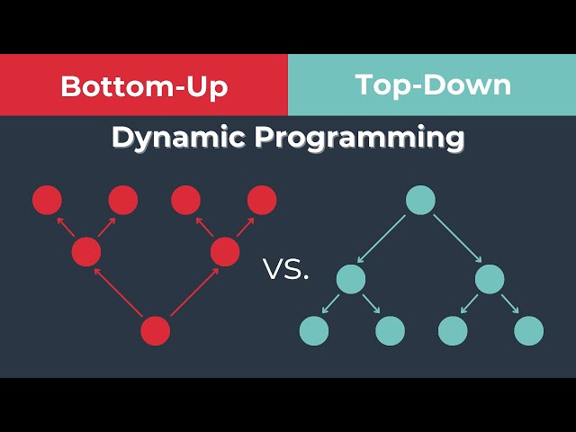
Two Big Parts
Recursive Top Down Memoization
Largest problem broken down
Iterative Bottom Up Tabulation
Smallest problems solved first

Slide 6
Fibonacci
Code time!

Slide 7
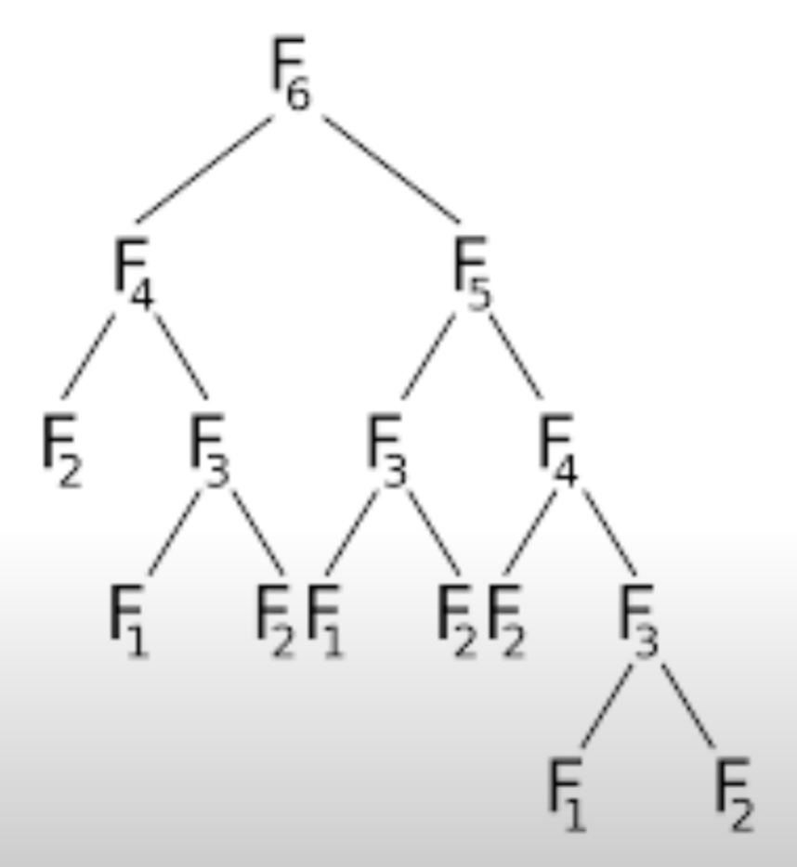
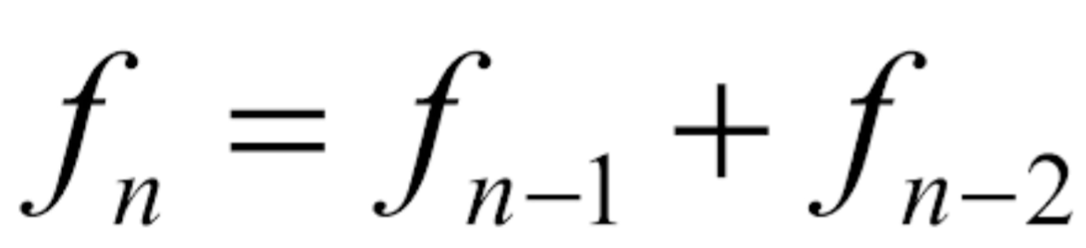
Naïve Recurrence
O(n)? O(2^n)?

Slide 8
Memoization – Not Memorization
Hash Maps store values
Only works for overlapping sub problems!
Values are created on demand – usually via some relationship we can deduce
Divide And Conquer also uses Memoization

Slide 9
Hash not Cache!
Hashes are dictionaries or maps
A cache is data which *might* be accessed by a system – both in software and hardware
We don’t need to worry about cache hit miss locality when doing competitive programming

Slide 10
Naïve Recurrence
O(n)? O(2^n)?

Slide 11
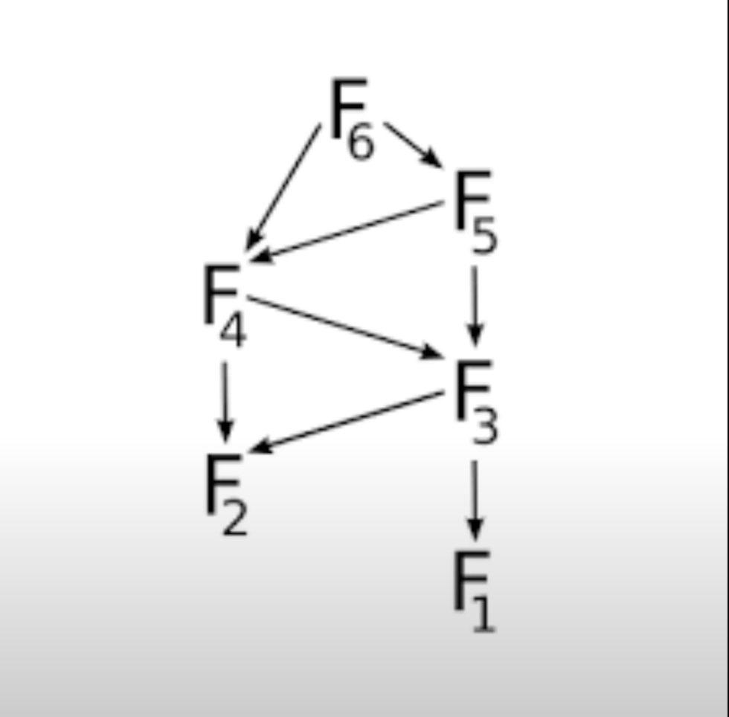
Memoized Recurrence
O(n)?

Slide 12
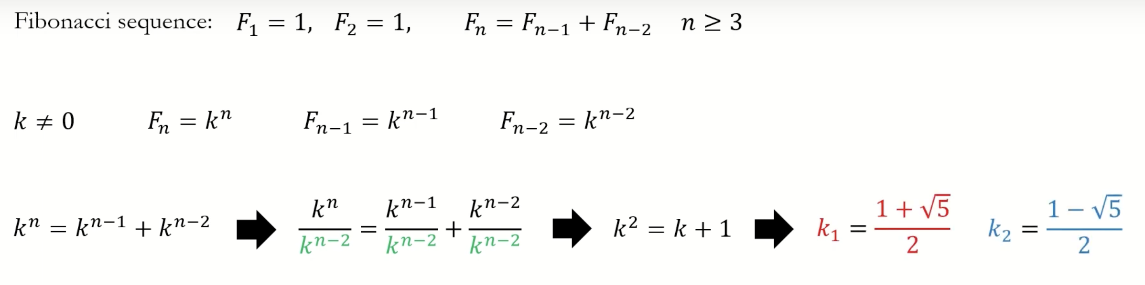
A bad example…
Fibonacci is O(1)…

Slide 13
Dynamic Programming Structure
Recurrence Relation
Follow Recursion Naturally
Build Base Cases for EVERYTHING
Move from structure toward technique, but do it gradually

Slide 14
Recurrence Relation
Actions become a function call
Repeated Actions become a recursive call
Consequences are just transitions on our graphs (iterable graphs!)
Changed variables are just new parameters (its just recursion all over again all over again)

Slide 15
Follow Recursion Naturally
Base case is super important: think about it! Make sure it is correct
Recursive Functions can be expressed as ONLY a base case. We don’t need the other fluff.
Trust your computer! Recursive calls can be ignored, IFF the base case is correct

Slide 16
EVERYTHING Needs a Base Case
Conjoin functions and what they promise: if a function does something, say what it does
Recursion is inductive, practice induction if recursion doesn’t come with a problem. Everything can be true… until it isn’t.
All calls should be couple with a base case

Slide 17
Gradual Improvement
Make problems simple
Don’t get lost in the weeds
Use For instead of While… for at least a little while.

Slide 18
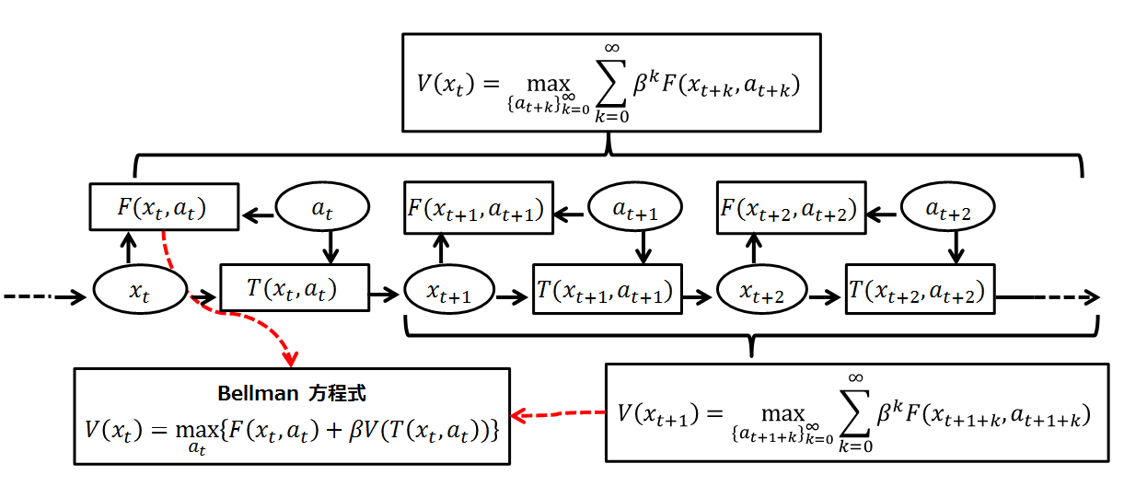
Optimization Functions
You don’t need this for now.

Slide 19
How long does it take?
Time complexity is: - (# Unique States) * (Memoized Complexity)
#Unique States
Size of our Recurrence relation
Based on our parameters (usually)
Memoization Complexity
How many things do we store?
How are we storing them, do we have to worry about indexing?
Usually not for time complexity

Slide 20
Technical Side
Function Call Stack construction is expensive!
Most compiled bits of code (python and C++) are NOT inlined, and therefore expensive
Debugging takes time

Slide 21
End (with ASM explained)
In general, this is what happens:
Arguments to the function are stored on the stack. In platform specific order.
Location for return value is "allocated" on the stack
The return address for the function is also stored in the stack or in a special purpose CPU register.
The function (or actually, the address of the function) is called, either through a CPU specific call instruction or through a normal jmp or br instruction (jump/branch)
The function reads the arguments (if any) from the stack and the runs the function code
Return value from function is stored in the specified location (stack or special purpose CPU register)
Execution jumps back to the caller and the stack is cleared (by restoring the stack pointer to its initial value).
The details of the above vary from platform to platform and even from compiler to compiler (see e.g. STDCALL vs CDECL calling conventions). For instance, in some cases, CPU registers are used instead of storing stuff on the stack. The general idea is the same though
Source: Some guy on stackoverflow https://stackoverflow.com/questions/1585137/what-happens-in-assembly-language-when-you-call-a-method-function

Slide 22
Next Meeting
Baldwin 548!
Food? Yes
February 24th
Topic: Greedy Algorithms

