Slide 1
ICPC@UC
Acknowledged by ACM@UC Execs since 2024!
March 10th, 2025

Slide 2
Dynamic Programming 2: Decomposition, Coin Problems, Regex and other DFA Problems
“Greed is Good” - Michael Douglas in Wall Street

Slide 3
Roadmap
Draw It Out
Coin Change 1
Coin Change 2
Regex

Slide 4
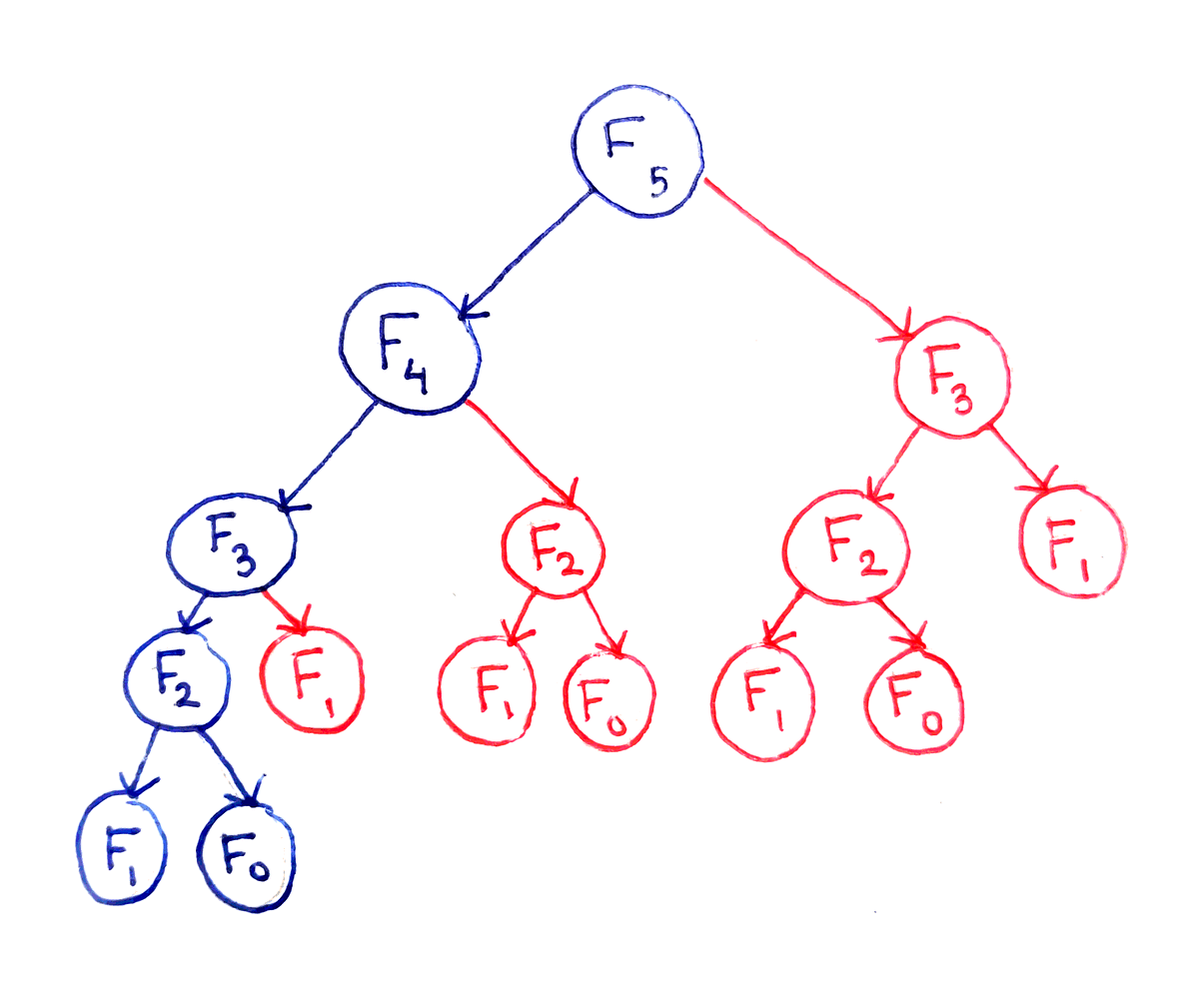
Draw It Out
Fibonacci

Slide 5
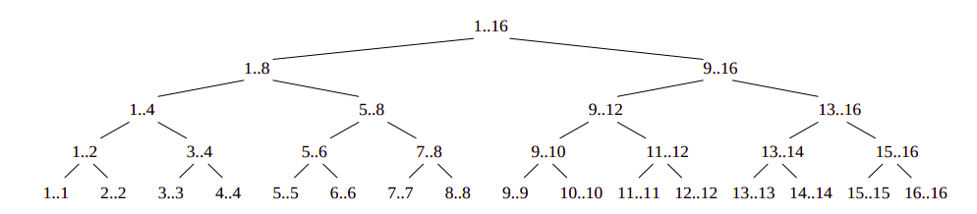
Draw It Out
Merge Sort

Slide 6
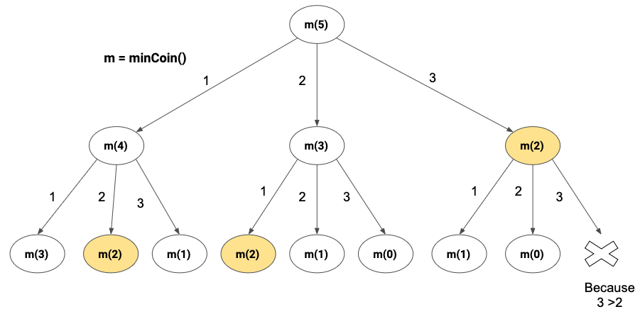
Draw It Out

Slide 7
Coin Change I
You are given an integer array coins representing coins of different denominations and an integer amount representing a total amount of money.
Return the fewest number of coins that you need to make up that amount. If that amount of money cannot be made up by any combination of the coins, return -1.
You may assume that you have an infinite number of each kind of coin.
https://leetcode.com/problems/coin-change/

Slide 8
SIMILAR – But Not the Same
Not Greedy
Consider 26 cents with the denominations: 2, 5, 6, 25

Slide 9
Draw It Out
Yikes... (2,5,6)
I spent 20 minutes working on Plotly for nothing

Slide 10
Solution
Sort Coins
Make array of (0, max) size of N
Iterate over array
Loop back in through our coins, with the range of i - C, where C is our largest coin
We take min(i (current index) - current_coin), to find smallest way to compose current value
O(n) (really O(m*n), where m is our number of coins)

Slide 11
Coin Change II
You are given an integer array coins representing coins of different denominations and an integer amount representing a total amount of money.
Return the number of combinations that make up that amount. If that amount of money cannot be made up by any combination of the coins, return 0.
You may assume that you have an infinite number of each kind of coin.
https://leetcode.com/problems/coin-change-ii/

Slide 12
Similar to Any Other Problems?
Maybe...
Combinatorials!

Slide 13
Knapsack 0/1
We covered last time momentarily...

Slide 14
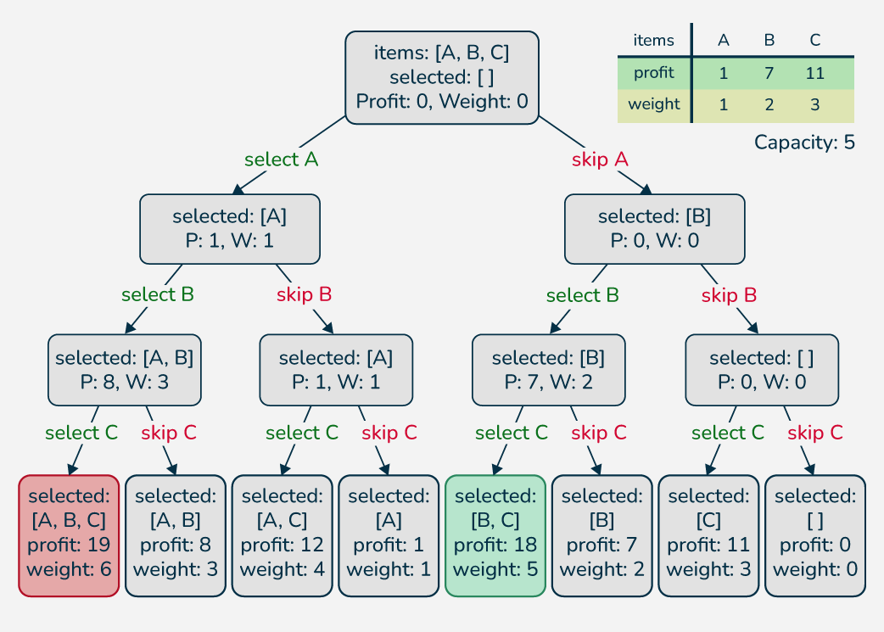
Draw it Out!

Slide 15
Draw It Out

Slide 16
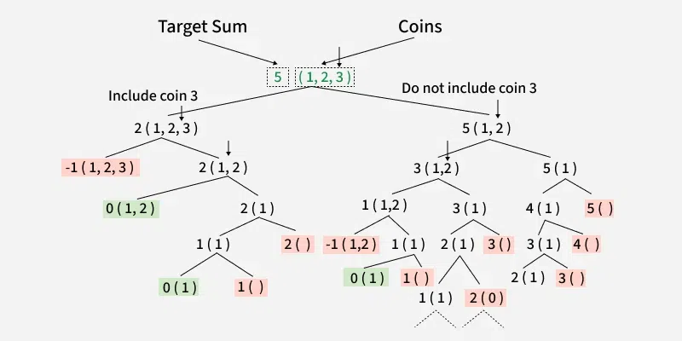
Draw It Out

Slide 17
Solution
Lots of different ways!
Bottom Up-tabulation
Memoization-bruteforce
O(n) (really O(m*n), where m is our number of coins)

Slide 18
Tabulation
The dynamic programming relation is as follows:
if (sum-coins[i-1]) is greater than 0, then dp[i][sum] = dp[i][sum-coins[i-1]] + dp[i+1][sum]
else dp[i][sum] = dp[i+1][sum]
Coins: 2 3 5 6-> Goal:10

Slide 19
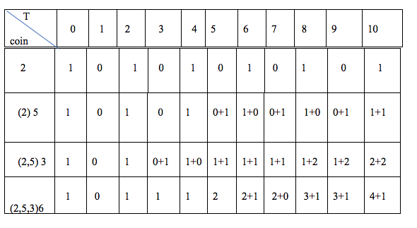
Tabulation

Slide 20
What is A Regex
Swap to other Slide Set... Thank you Badri

Slide 21
Regex
Given an input string s and a pattern p, implement regular expression matching with support for '.' and '*' where:
'.' Matches any single character.
'*' Matches zero or more of the preceding element.
https://leetcode.com/problems/regular-expression-matching

Slide 22
Draw It Out
Reduce the Character Set!

Slide 23
Next Meeting
Baldwin 548!
Food? Yes (probably Chipotle? I'll post a vote)
March 24th, 6pm! (first Monday back from Spring Break)
Topic: Divide and Conquer!

Slide 24
Resources
https://walkccc.me/CLRS/

