Slide 1
ICPC@UC
Loved and cared for by ACM@UC
February 24th, 2025

Slide 2
Greedy Algorithms
“Greed is Good” - Michael Douglas in Wall Street

Slide 3
What is a greedy algorithm?
Heuristic: a trade of optimality, completeness, accuracy, or precision for speed, or a form of reduction of complexity for ranking of value
Local Optimum: Best value in a subset of the global set by some heuristic (ranking kind)
Global Optimum: Best value in a set by some heuristic (ranking kind)
A greedy algorithm is the heuristic (trade kind) which picks the local best choice at a decision stage. It CAN but does not NECESSARILY pick the global optimum for all problems. For a subset of problems with optimal substructure, it will always pick the global optimum. A perfect greedy algorithm always picks the global optimum

Slide 4
Advantages and Challenges
Simplicity: Greedy algorithms are often easier to describe and code up than other algorithms.
Efficiency: Greedy algorithms can often be implemented more efficiently than other algorithms
Hard to design: Once you have found the right greedy approach, designing greedy algorithms can be easy. However, finding the right approach can be hard.
Hard to verify: Showing a greedy algorithm is correct often requires a nuanced argument
Very often greedy algorithms don’t work. - we will a problem
Easy to lull oneself into believing they work Many greedy algorithms possible for a problem and no structured way to find effective ones

Slide 5
Examples of Optimal Substructure
The Fractional Knapsack Problem involves selecting items to maximize total value while adhering to a weight limit. Unlike the 0/1 Knapsack, where items must be taken as a whole, Fractional Knapsack allows taking fractions of items.
Given:
N items, each with:
Weight (wᵢ)
Value (vᵢ)
A knapsack with a maximum capacity W.
Objective:
Select items (or fractions of them) such that the total value is maximized while the total weight does not exceed W.

Slide 6
Fractional Knapsack – Why this is Greedy?
Greedy Choice Property
At each step, we select the item with the highest value-to-weight ratio that fits in the knapsack.
This local optimal choice leads to a globally optimal solution since we are taking the best possible portion of an item at every step.
Optimal Substructure
If we have an optimal solution for a knapsack of capacity W, the solution for a smaller capacity W' will be a subset of the larger solution.
This means that breaking the problem into smaller parts still leads to the same greedy decision-making process.

Slide 7
Examples of Nearly Optimal Substructure
The 0/1 Knapsack problem requires items to be taken as a whole.
Given:
N items, each with:
Weight (wᵢ)
Value (vᵢ)
A knapsack with a maximum capacity W.
Objective:
Select items such that the total value is maximized while the total weight does not exceed W.

Slide 8
Examples of Optimal Substructure
The Coin Change Problem involves determining the minimum number of coins needed to make up a given amount V using a set of n coin denominations. We assume that we have unlimited supply of each type of coin.
Objective:
Find the fewest number of coins required to represent V cents
Example:
Coin Denominations- 25,10,5,1
Target – 42 Cents
Total coins used - 5

Slide 9
Coin Change – Why this is Greedy?
Optimal Substructure
Solutions to subproblems are part of the final solution.
Example:
17 cents is optimally solved using {10, 5, 1, 1}.
7 cents is optimally solved using {5, 1, 1}.
Greedy Choice Property
Each solution at Sub-problem leads to Global Solution

Slide 10
Coin Change – When Does Greedy Fails?
The greedy approach does not always guarantee the optimal solution.
Example: Coin denominations {4, 3, 1}
Target amount: 6 cents
Greedy choice: {4, 1, 1} → 3 coins
Optimal choice: {3, 3} → 2 coins
Thus, greedy algorithms do not work for all cases.
Dynamic Programming helps us , which will be covered in next Meeting
Notes:
Thank you Prasanth for making me cover coin change two next meeting LOL

Slide 11
Examples of Optimal Substructure
Constructing a Sorted Tree
Constructing a Minimum Spanning Tree
Shortest path between 2 nodes in a graph

Slide 12
Examples of Optimal Substructure: Minimum Spanning Trees! (TSM 1)
We have a travelling salesman, who needs to navigate to multiple cities, via a bus line. Each ticket costs and arbitrary amount and can be reused an unlimited number of times. How do we get the salesman to all cities for the cheapest price?

Slide 13
Examples of Nearly Optimal Substructure: Travelling Salesman! (2)
We have a travelling salesman, who needs to navigate to multiple cities, via a bus line. Each ticket costs and arbitrary amount and can be reused 1 time (2 total uses). How do we get the salesman to all cities for the cheapest price?

Slide 14
Travelling Salesman! (3)
We have a travelling salesman, who needs to navigate to multiple cities, via a bus line. Each ticket costs and arbitrary amount and cannot be reused. How do we get the salesman to all cities for the cheapest price?

Slide 15
Travelling Salesman! (4)
We have a travelling salesman, who needs to navigate to multiple cities, via a bus line. Each ticket costs and arbitrary amount and cannot be reused. How do we get the salesman to all cities for the cheapest price?
Exact answer: O(n^2 * 2^n)
Brute force: O(n!)
Held-Karp Algo…

Slide 16
Held-Karp Algo for Travelling Salesman! (5)
function algorithm TSP (G, n) is
for k := 2 to n do
g({k}, k) := d(1, k)
end for
for s := 2 to n−1 do
for all S ⊆ {2, ..., n}, |S| = s do
for all k ∈ S do
g(S, k) := min_{m≠k,m∈S} [g(S\{k}, m) + d(m, k)]
end for
end for
end for
opt := min_{k≠1} [g({2, 3, ..., n}, k) + d(k, 1)]
return (opt
)end function

Slide 17
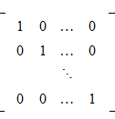
Optimal Substructure: Matroid
Linearly Independent Combinatorial Vector – that’s it This creates the properties:
Hereditary (any subset of a matroid is also a matroid)
Exchange
Below are other terms to look out for when dealing with matroids:
Independent Sets
Bases and circuits
Rank Functions
Closure Operations
Flats
Hyperplanes
Graphoids
Etc.

Slide 18
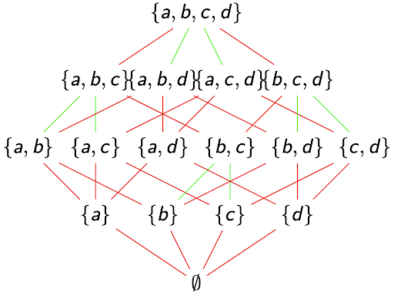
Optimal Substructure: Matroid
Remember: Anything with a standard basis is a Matroid
Matroids map ONTO (surjectively, everything in codomain maps to one thing in the domain) combinatorials, graphs, etc.
All matroids are optimally and correctly solvable via greedy algorithms, as they are minimum spanning trees when mapped in simplest form

Slide 19
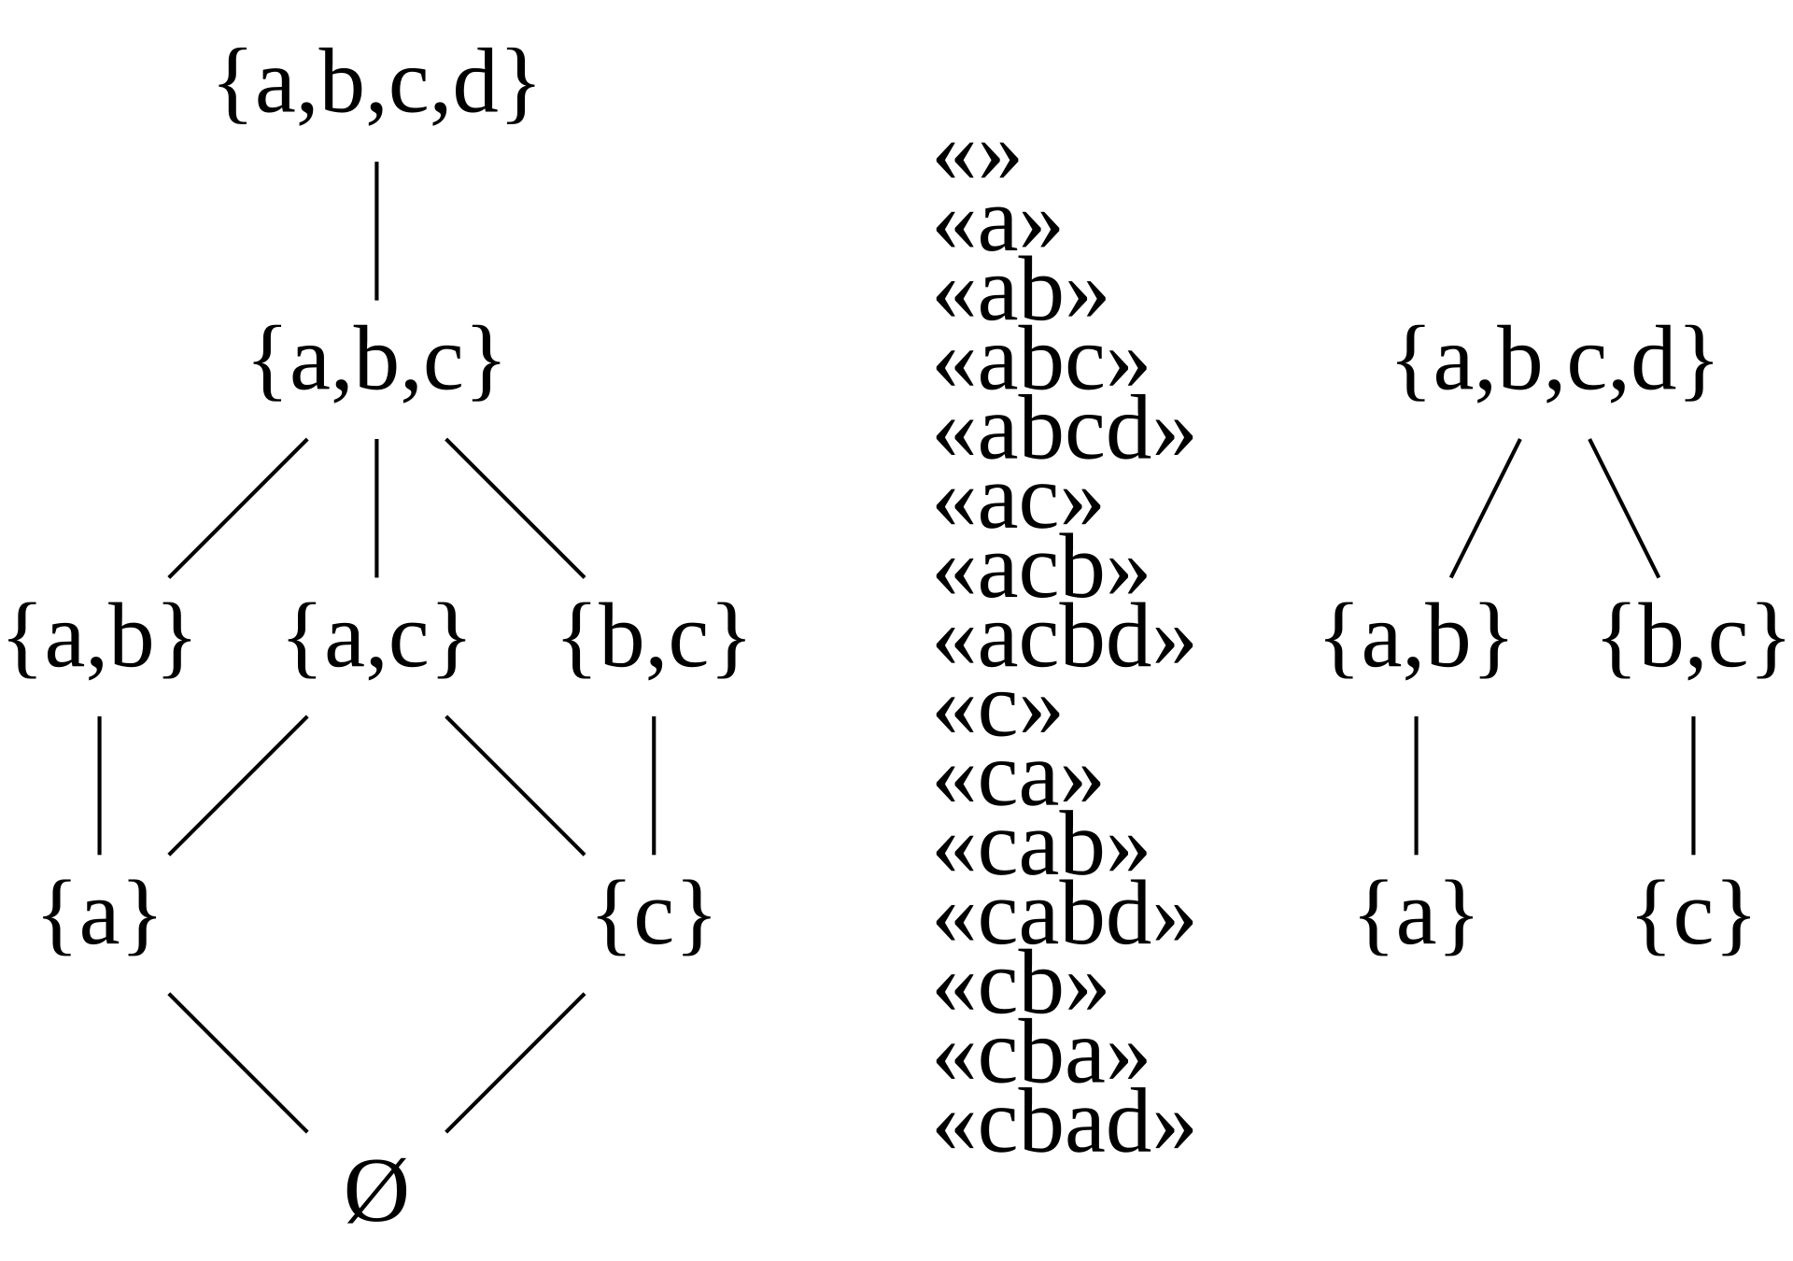
Optimal Substructure: Antimatroid
Defined by bijective cryptomorphism as a set system: ignore the fancy words, just means that we have a set with unique domain outputs from a codomain which are equivalent but not obviously
Also bijectivity cryptomorphic to formal strings (ordered)
Better stated as a set of states which are dependent upon each other in some way
Properties: - Closed under unions: all sets produced by the union of two antimatroids are still an antimatroid
Accessibility: any feasible set except the empty set can remove at least one element and still be a valid set
Still maps onto graphs, matrices, etc.

Slide 20
Chess as an Antimatroid (chain antimatroid)
Initial Set
White's King (WK) at c6, White's Rook (WR) at f6, Black's King (BK) at a7.
Each step represents a legal game progression. The feasible set of a rook, king, king checkmate:
F0 ​= {(c6,f6,a7)} (Base Feasible Set, WK, WR, BK)
F1 ​= F0​ ∪ {(c6,f7,a7)}(After WK moves to h5 to restrict the BK.)
F2​ = F1​ ∪ {(c6,f7,a8)}
F3​= F2 ​∪ {(c7,f7,a8)} Reminder: ∪ is union, or combination of sets!

Slide 21
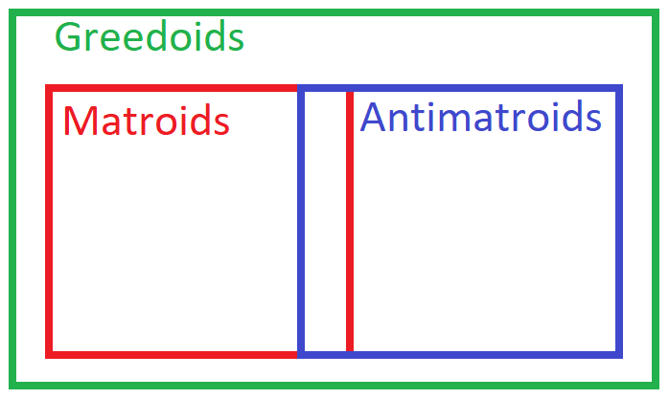
Greedoids
Any finite, accessible set which:
For ALL X, Y within set F, |X|>|Y| (meaning the cardinality or number of items in X is greater than Y) there is some value Z such that;
Z is within the set of X\Y (all elements in set X are not in set Y, known as set difference)
Such that:
Y ∪ Z is within the original set, F.
ALL GREEDOIDS ARE PERFECTLY SOLVED AND OPTIMALLY SOLVED BY A GREEDY ALGORITHM!

Slide 22
I’m in a competition…
I think this uses a greedy algorithm, but I don’t know? My answer fails only 1 test…
What do I do after checking typos, edge cases etc?

Slide 23
MOVE ON! USE DP! USE BACKTRACKING! USE BRUTE FORCE! SOMETHING ELSE!
If you already have the matroid, antimatroid, or greedoid you’ve already solved the problem… if you have the induction to prove it works for every problem, then you have your greedy algorithm

Slide 24
Remarks
In today's programming contests (ICPC and IOI), problems rarely follow the classic versions of well-known algorithms. Using a Greedy algorithm for a non-standard problem can be risky. While it usually runs fast and avoids Time Limit Exceeded (TLE) errors, it often results in a Wrong Answer (WA).
Proving that a problem has the necessary properties for a Greedy approach—such as optimal substructure—can be difficult during a contest. So, a good rule of thumb is:
If the input size is small enough for Complete Search or Dynamic Programming (DP) to work efficiently, use those methods since they guarantee a correct answer.
Use a Greedy algorithm only if the input size is too large for even the best Complete Search or DP solutions.
However, contest organizers often design problems with tricky input limits, making it hard to determine the best approach just by looking at the input size.

Slide 25
More Advance Problems
https://open.kattis.com/problems/greedyincreasingsubsequences
https://leetcode.com/problems/best-time-to-buy-and-sell-stock-ii/description/
https://leetcode.com/problems/candy/description
https://codeforces.com/contest/2034/problem/D

Slide 26
How to solve this ?
Thinking Greedy is sometimes really HARD !! Try to solve this
UVa 10382 - Watering Grass (Interval Covering)
Problem description: n sprinklers are installed in a horizontal strip of grass L meters long and W meters wide. Each sprinkler is centered vertically in the strip. For each sprinkler, we are given its position as the distance from the left end of the center line and its radius of operation. What is the minimum number of sprinklers that should be turned on in order to water the entire strip of grass? Constraint: n ≤ 10000.

Slide 27
Next Meeting
Baldwin 548!
Food? Yes
March 11th, 6pm!
Topic: Dynamic Programming Part 2: Decomposition, Subproblem Optimality (non-Matroidic), Regex and Other DFA Problems

