Slide 1
ACM - ICPC meeting
Backtracking
University of Cincinnati

Slide 2
Backtracking
Recursive algorithmic technique for solving problems incrementally, making choices, and “backing up” when the chosen path leads to a dead end or success.

Slide 3
Backtracking
Start
Success!
Success!
Problem space consists of states (nodes) and actions (paths that lead to new states).
If a node leads to failure go back to its "parent” node. Try other alternatives. If these all lead to failure, then more backtracking may be necessary.

Slide 4
Backtracking – Core Algorithm
Core Components:
Recursive function: How decisions are made and undone.
State representation: How to represent the current state of the problem.
Base case: When a solution is found or when the search must stop.

Slide 5
Backtracking – PseudoCode
def backtrack(state):
if is_solution(state):
record_solution(state)
return
for option in valid_options(state):
make_choice(state, option)
backtrack(state)
undo_choice(state, option)

Slide 6
Backtracking
Sudoku
8/N - queens problem
Finding Path in Maze
Graph-coloring problem
are examples of backtracking method

Slide 7
Backtracking – Simple Example
Permutations of an array
https://leetcode.com/problems/permutations/
vector<vector<int>> permute(vector<int>& nums) {
vector<vector<int>> ans;
solve(0,nums,ans);
return ans;
}
void solve(int idx,vector<int> &nums,vector<vector<int>> &ans){
if(idx == nums.size()){
ans.push_back(nums);
return;
}
for(int i=idx; i<nums.size(); i++){
swap(nums[idx],nums[i]);
solve(idx+1,nums,ans);
swap(nums[idx],nums[i]);//backtracking
}
}

Slide 8
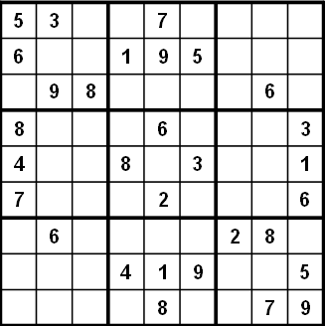
Backtracking – Concrete example
Sudoku solver https://leetcode.com/problems/sudoku-solver/
- if not open cells, solved
- scan cells from left to right, top to bottom for first open cell.
- When an open cell is found start looping through digits 1 to 9.
- When a digit is placed, check that the set up is legal
now solve the board
After placing a number, Did you see the recursive problem?

Slide 9
Backtracking – Solving
1
1
2
1
2
4
1
2
4
8
1
2
4
8
9
Deadend? Time to Backtrack
9

Slide 10
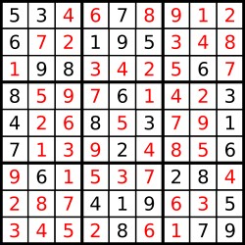
Backtracking – Backing Up
1
2
4
9
When reached a deadend, back up to the previous cell and fill with next digit.
Backs up to cell with a 9 and turns out to be a dead end as well.
We try all the numbers and none of them works in our cell, we need to report back the things and check all possibilities. Insights
Suduko Puzzle can be solved using recursive backtracking.
Recursive because later versions of the problem are just simpler versions of the original
Backtracking because we try different alternatives.

Slide 11
Backtracking - Code
bool isValid(int row, int col, char ch, vector<vector<char>>& board) {
for (int i = 0; i < 9; i++) {
if (board[row][i] == ch) {
return false;
}
if (board[i][col] == ch) {
return false;
}
if (board[3 * (row / 3) + i / 3][3 * (col / 3) + i % 3] == ch) {
return false;
}
}
return true;
}
bool solve(vector<vector<char>>& board) {
for (int i = 0; i < board.size(); i++) {
for (int j = 0; j < board[i].size(); j++) {
if (board[i][j] == '.') {
for (char ch = '1'; ch <= '9'; ch++) {
if (isValid(i, j, ch, board)) {
board[i][j] = ch;
if (solve(board)) {
return true;
} else {
board[i][j] = '.';
}
}
}
// No valid character found for this cell, backtrack.
return false;
}
}
}
return true; // All cells are filled correctly.
}

Slide 12
Backtracking – Features and Goals
Form of brute force algorithm, eventhough optimizations exists and vary.
Easy to implement
Possible Goals
Find a path to success
Find all paths to success
Find the best path to success

Slide 13
Backtracking – Key Points
You must practice!!!
Learn to recognize a pattern that fits the problem.
Is a kickoff method needed?(simple start and repeat that) - Recursion
All solutions or a solution?(Tracking)

Slide 14
Thank You

