Slide 1
计算几何
陈琰宏
zufe_graphics@163.com

Slide 2
概念
由函数逼近论、微分几何、代数几何、计算数学等形成的边缘学科，研究几何形体的计算机表示、分析和综合。它是计算机图形学、计算机辅助设计的数学基础。

Slide 3
相关学科的关系
图像生成（计算机图形学）
数字图像
数据模型
图像变换
（图像处理）
模型变换
（计算几何）
模型（特征）提取
（计算机视觉，模式识别）

Slide 4
㈠ 点的基本运算
1. 平面上两点之间距离
2. 判断两点是否重合
3. 矢量叉乘
4. 矢量点乘
5. 判断点是否在线段上
6. 求一点绕某点旋转后的坐标
7. 求矢量夹角

Slide 5
㈡ 线段及直线的基本运算
1. 点与线段的关系
2. 求点到线段所在直线垂线的垂足
3. 点到线段的最近点
4. 点到线段所在直线的距离
5. 点到折线集的最近距离
6. 判断圆是否在多边形内
7. 求矢量夹角余弦
8. 求线段之间的夹角

Slide 6
㈡ 线段及直线的基本运算
9. 判断线段是否相交
10.判断线段是否相交但不交在端点处
11.求线段所在直线的方程
12.求直线的斜率
13.求直线的倾斜角
14.求点关于某直线的对称点
15.判断两条直线是否相交及求直线交点
16.判断线段是否相交，如果相交返回交点

Slide 7
㈢ 多边形常用算法模块
1. 判断多边形是否简单多边形
2. 检查多边形顶点的凸凹性
3. 判断多边形是否凸多边形
4. 求多边形面积
5. 判断多边形顶点的排列方向
7. 射线法判断点是否在多边形内
8. 判断点是否在凸多边形内
9. 寻找点集的graham算法
10.寻找点集凸包的卷包裹法
11.判断线段是否在多边形内
12.求简单多边形的重心
13.求凸多边形的重心

Slide 8
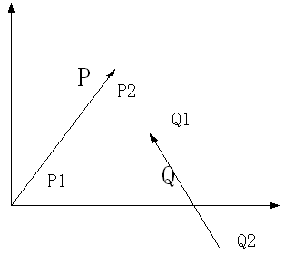

1.1矢量的概念
如果一条线段的端点是有次序之分的，我们把这种线段称为有向线段(directed segment)。如果有向线段p1p2的起点p1 在坐标原点，我们可以把这个有向线段称为矢量(vector)p2。
**向量Q= =Q1(x,y)-Q2(x,y)

Slide 9
1.2 矢量的运算
设二维矢量P = ( x1, y1 )，Q = ( x2 , y2 )
则矢量加法定义为： P + Q = ( x1 + x2 , y1 + y2 )
矢量减法定义为： P - Q = ( x1 - x2 , y1 - y2 )。
显然有性质 P + Q = Q + P，P - Q = - ( Q - P )。

Slide 10
1.3 矢量叉积
矢量叉积是与直线和线段相关算法的核心部分
定义：设矢量P = ( x1, y1 )，Q = ( x2, y2 )，
则P × Q = x1*y2 - x2*y1
几何意义：矢量叉积为由(0,0)、p1、p2和p1+p2所组成的平行四边形的带符号的面积，其结果是一个标量。显然有性质 P × Q = - ( Q × P ) 和 P × ( - Q ) = - ( P × Q )。

Slide 11
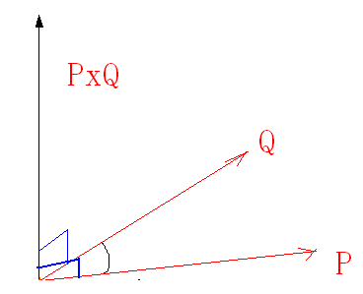
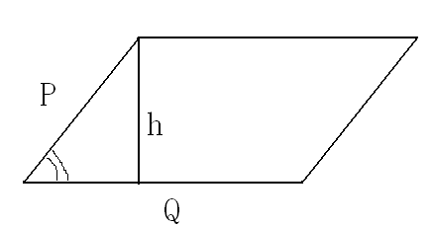
矢量叉积
||p × q||=||p||.||q||sin(角度)
|| p × q ||等于以p和q为两边的平行四边形的面积

Slide 12
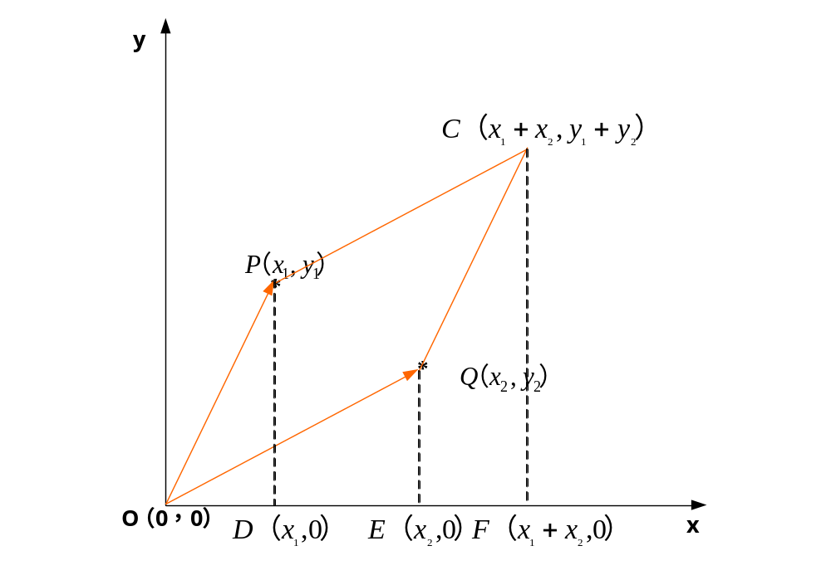
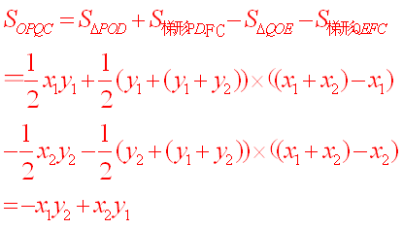
叉积的几何意义

Slide 13
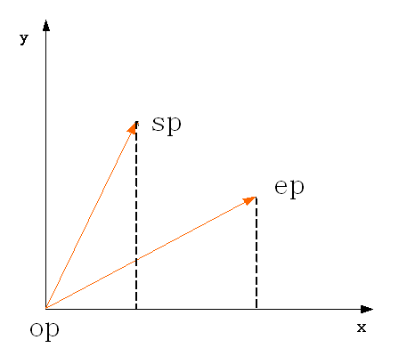
double multiply(POINT sp,POINT ep,POINT op)
{
}
return((sp.x-op.x)*(ep.y-op.y)-
(ep.x-op.x)*(sp.y-op.y));

Slide 14
struct POINT
{
double x;
double y;
POINT(double a=0, double b=0) { x=a; y=b;} //constructor
};

Slide 15
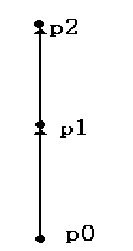
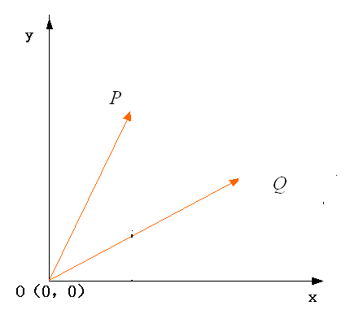
1.4 矢量叉积的作用
1.4.1 叉积的一个非常重要性质：可以通过它的符号判断两矢量相互之间的顺逆时针关系：
  若 P × Q > 0 , 则P在Q的顺时针方向。
  若 P × Q < 0 , 则P在Q的逆时针方向。
  若 P × Q = 0 , 则P与Q共线，但可能同向也可能反向
右手螺旋定理

Slide 16
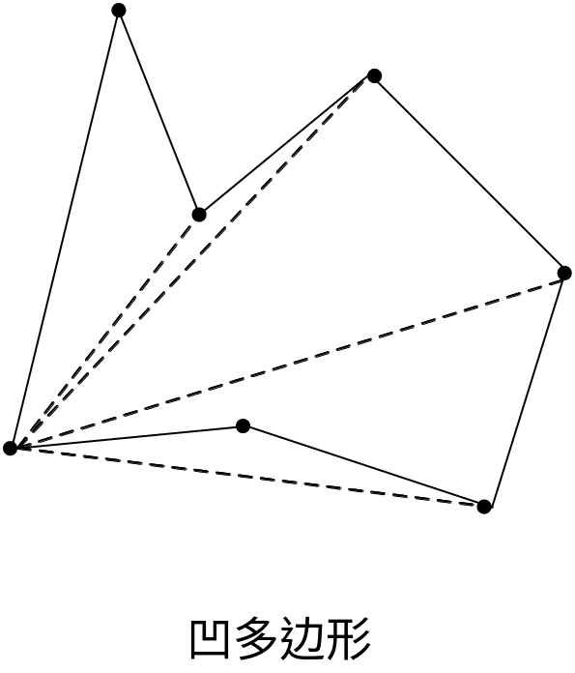
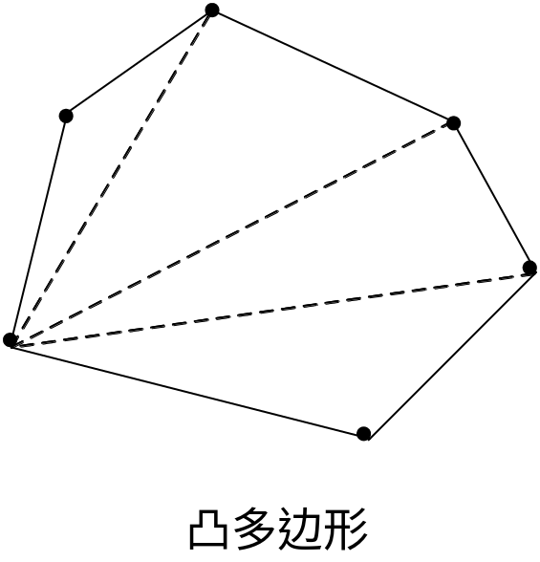
矢量叉积的作用
1.4.2 计算面积

Slide 17
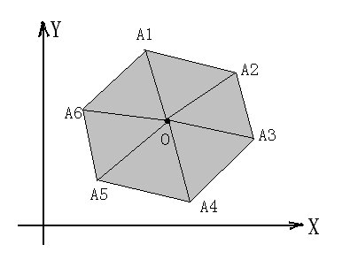
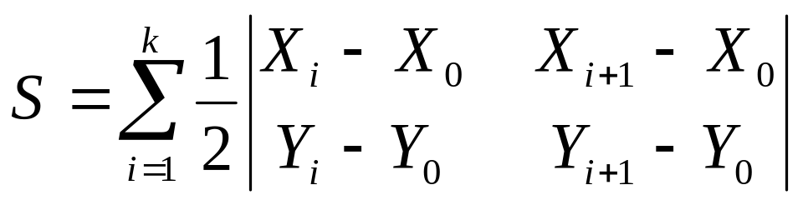
例1：求解任意多边形面积
假设笛卡儿坐标系中的一个任意多边形1A2A3……Ak，各点的坐标分别是A1(X1,Y1)，A2(X2,Y2)，A3(X3,Y3)，……，Ak(Xk,Yk)，设O(X0,Y0)任意一点， 求解该多边形面积。

Slide 18
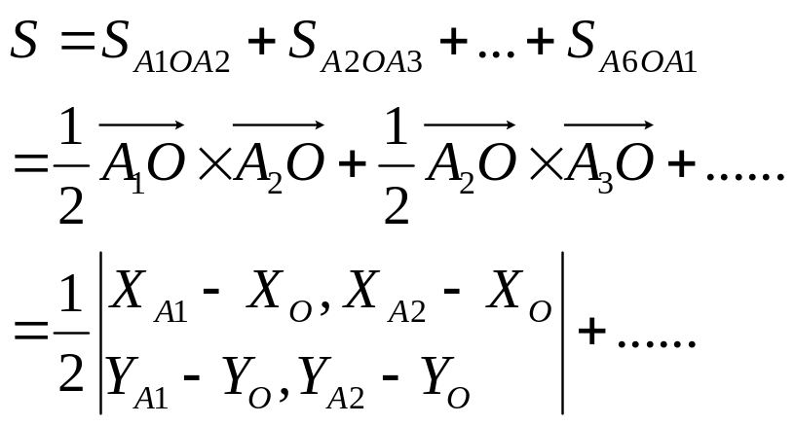
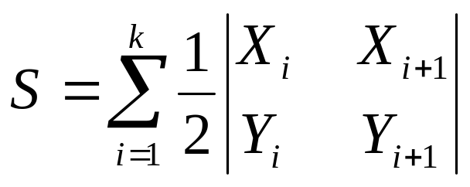
O取在多边形内（外）

Slide 19
//计算面积
for( i = 0; i < n - 1; i++ ) {
S += p[i].x * p[i + 1].y;
}
S += p[n - 1].x * p[0].y;
for( i = 1; i < n; i++ ) {
S -= p[i].x * p[i - 1].y;
}
S -= p[0].x * p[n - 1].y;
S = fabs(S) / 2;

Slide 20
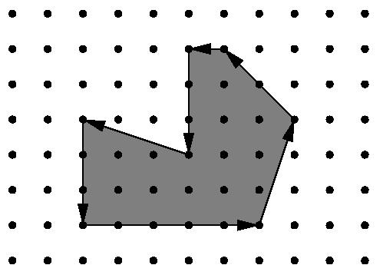
http://acm.zju.edu.cn/show_problem.php?pid=1032
Area 2
Background
Being well known for its highly innovative (创新的)products, Merck would definitely be a good target for industrial espionage（间谍）. To protect its brand-new （崭新的）research and development facility ，the company has installed the latest system of surveillance robots patrolling the area. These robots move along the walls of the facility and report suspicious observations to the central security office. The only flaw（缺点） in the system a competitor’s agent could find is the fact that the robots radio their movements unencrypted（未被加密的）. Not being able to find out more, the agent wants to use that information to calculate the exact size of the area occupied by the new facility. It is public knowledge that all the corners of the building are situated on a rectangular grid and that only straight walls are used. Figure 1 shows the course of a robot around an example area.

Slide 21
Problem
You are hired to write a program that calculates the area occupied by the new facility from the movements of a robot along its walls. You can assume that this area is a polygon with corners on a rectangular grid. However, your boss insists that you use a formula he is so proud to have found somewhere. The formula relates the number I of grid points inside the polygon, the number E of grid points on the edges, and the total area A of the polygon. Unfortunately, you have lost the sheet on which he had written down that simple formula for you, so your first task is to find the formula yourself.

Slide 22
Input
The first line contains the number of scenarios.
For each scenario, you are given the number m, 3<=m<100, of movements of the robot in the first line. The following m lines contain pairs “dx dy” of integers, separated by a single blank, satisfying . -100<=dx, dy<=100 and (dx, dy)!=(0, 0). Such a pair means that the robot moves on to a grid point dx units to the right and dy units upwards on the grid (with respect to the current position). You can assume that the curve along which the robot moves is closed and that it does not intersect or even touch itself except for the start and end points. The robot moves anti-clockwise around the building, so the area to be calculated lies to the left of the curve. It is known in advance that the whole polygon would fit into a square on the grid with a side length of 100 units

Slide 23
Output
The output for every scenario begins with a line containing “Scenario #i:”, where i is the number of the scenario starting at 1. Then print a single line containing I, E, and A, the area A rounded to one digit after the decimal point. Separate the three numbers by two single blanks. Terminate the output for the scenario with a blank line.

Slide 24
Sample Input
2
4
1 0
0 1
-1 0
0 -1
7
5 0
1 3
-2 2
-1 0
0 -3
-3 1
0 -3
Sample Output
Scenario #1:
0 4 1.0
Scenario #2:
12 16 19.0

Slide 25
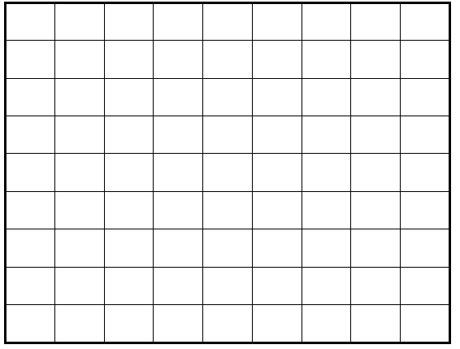
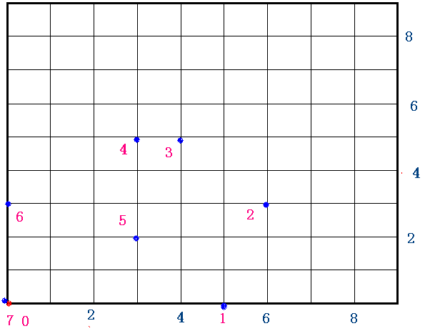
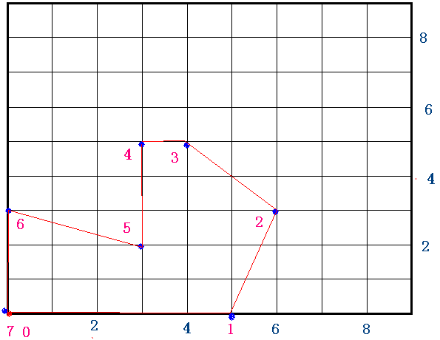

Slide 26
7
5 0
1 3
-2 2
-1 0
0 -3
-3 1
0 -3

Slide 27
求面积
double area_polygon(int n, point *p)
{
int i;
double ret=0;
for (i=0; i<n; ++i)
ret += xmult(p[i].x,p[i].y,p[i+1].x,p[i+1].y);
ret += xmult(p[n-1].x,p[n-1].y,p[0].x,p[0].y);
return ret/2;
}

Slide 28
皮克定理
给定顶点座标均是整点（或正方形格点）的简单多边形，皮克定理说明了其面积A和内部格点数目i、边上格点数目b的关系：
A = i + b/2 - 1。

Slide 29
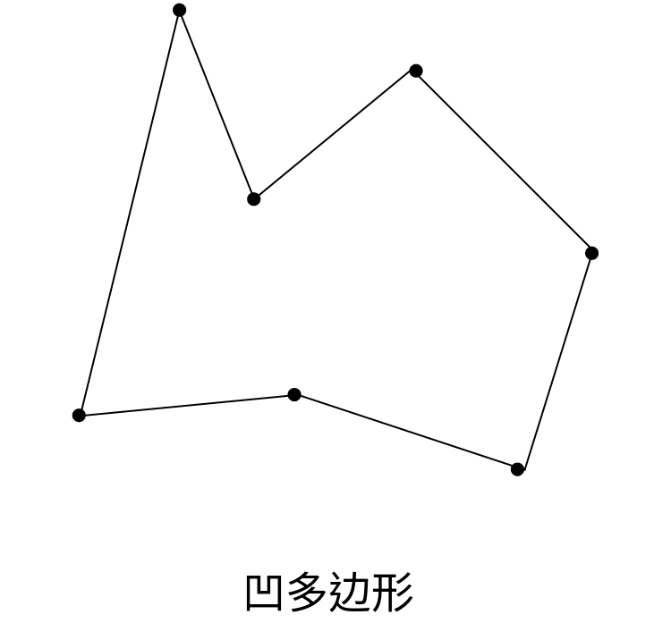
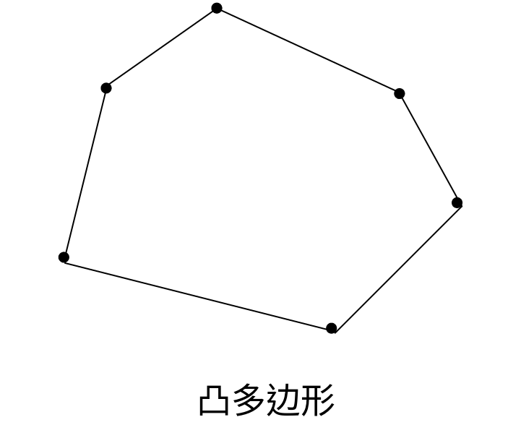
矢量叉积的作用
1.4.3 判断凹凸多边形
  把多边形的任何一条边向两方延长，如果多边形的其他各边都在延长所得直线的同一旁，这样的多边形叫做凸多边形

Slide 30
只需依次计算多边形相邻两边矢量的叉积
(1)全部为零，则多边形各边共线；
(2)部分为正，部分为负，则为凹多边形；
(3)全部大于零或等于零，则为凸多边形；
(4)全部小于零或等于零，则为凸多边形

Slide 31
1.4.4 折线段的拐向判断(由方向推导得)
折线段的拐向判断方法可以直接由矢量叉积的性质推出。对于有公共端点的线段p0p1和p1p2，通过计算(p2 - p0) × (p1 - p0)的符号便可以确定折线段的拐向：
若(p2 - p0) × (p1 - p0) > 0,则p0p1在p1点拐向右侧后得到p1p2。
若(p2 - p0) × (p1 - p0) < 0,则p0p1在p1点拐向左侧后得到p1p2。
若(p2 - p0) × (p1 - p0) = 0,则p0、p1、p2三点共线

Slide 32
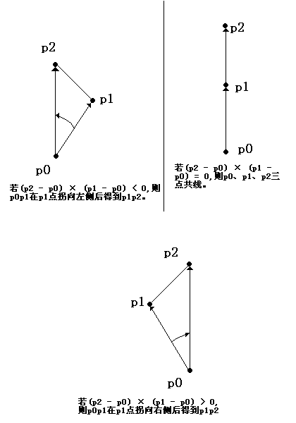

Slide 33
例2：判断点是否在线段上
利用叉积性质来判断点是否在线段上
设点为Q，线段为P1P2 ，判断点Q在该线段上的依据是：( Q - P1 ) × ( P2 - P1 ) = 0 且 Q 在以 P1，P2为对角顶点的矩形内。前者保证Q点在直线P1P2上，后者是保证Q点不在线段P1P2的延长线或反向延长线上

Slide 34
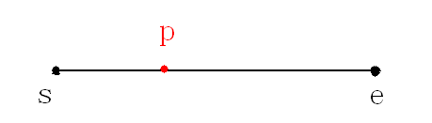
/*判断点p是否在线段l上，条件：(p在线段l所在的直线上)&& (点p在 以线段l为对角线的矩形内)
设点为Q，线段为P1P2 ，判断点Q在该线段上的依据是：
( Q - P1 ) × ( P2 – P1 ) = 0 且 Q 在以 P1，P2为对角顶点的矩形内。
前者保证Q点在直线P1P2上，后者是保证Q点不在线段P1P2的延长线或反向延长线上 * */
bool online(LINESEG l,POINT p)
{
return((multiply(l.e,p,l.s)==0)
&&( ( (p.x-l.s.x)*(p.x-l.e.x)<=0 )&&( (p.y-l.s.y)*(p.y-l.e.y)<=0 ) ) );
}

Slide 35
struct LINESEG //边
{
POINT s;
POINT e;
LINESEG(POINT a, POINT b) { s=a; e=b;}
LINESEG() { }
};
struct LINE // 直线的解析方程 a*x+b*y+c=0 为统一表示，约定 a >= 0
{
double a;
double b;
double c;
LINE(double d1=1, double d2=-1, double d3=0) {a=d1; b=d2; c=d3;}
};

Slide 36
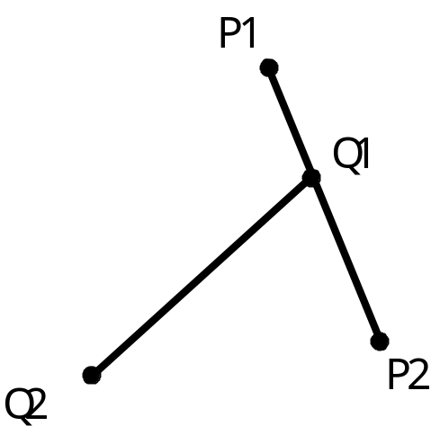
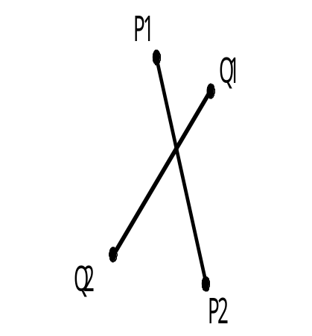
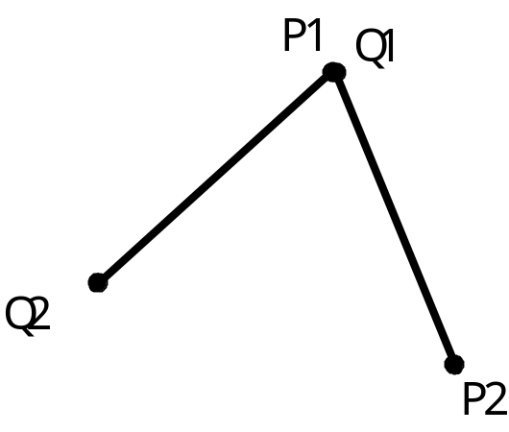
例3：判断两线段是否相交
利用叉积性质，判断两条线段是否相交
A） 内交
B） 端点相交
C） 端点相交

Slide 37
相交：
  两线段内交是指两线段相交且交点不在两线段的端点
  在端点相交
A） 内交
B） 端点相交
C） 端点相交

Slide 38
方法一：
  求交点
  判断交点是否在直线上（存在什么问题？）
方法二：
  测试法

Slide 39
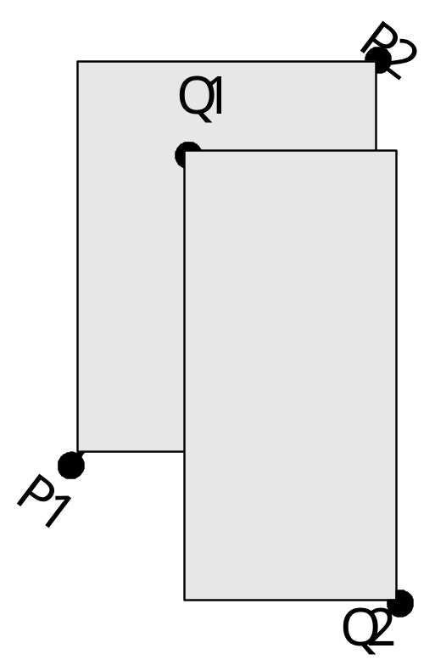
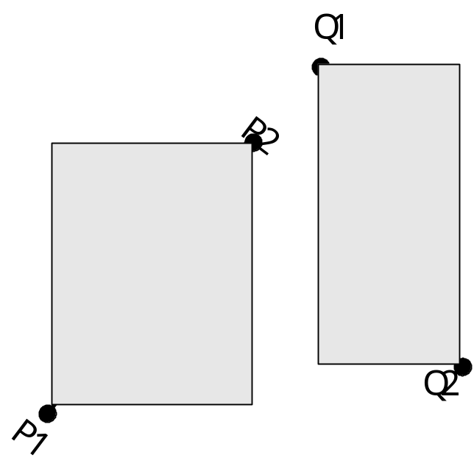
测试法：
  分两步：快速排除法 和 跨立试验

Slide 40
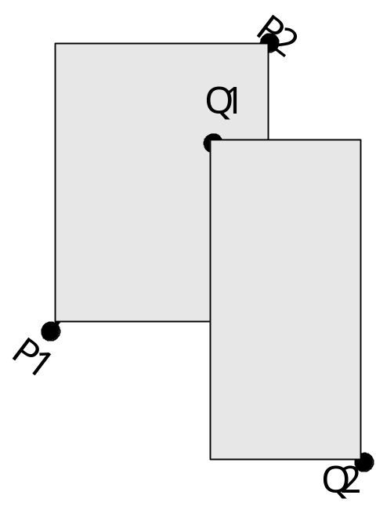

快速排除法
  设以线段 P1P2 为对角线的矩形为R， 设以线段 Q1Q2 为对角线的矩形为T，如果R和T不相交，显然两线段不会相交。

Slide 41
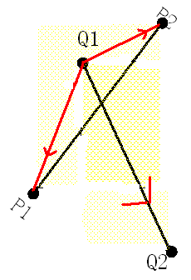
跨立试验
  如果两线段相交则两线段必然相互跨立对方。
    若P1P2跨立Q1Q2
    则矢量 ( P1 - Q1 ) 和( P2 - Q1 )位于矢量( Q2 - Q1 ) 的两侧，即( P1 - Q1 ) × ( Q2 - Q1 ) * ( P2 - Q1 ) × ( Q2 - Q1 ) < 0。上式可改写成( P1 - Q1 ) × ( Q2 - Q1 ) * ( Q2 - Q1 ) × ( P2 - Q1 ) > 0。

Slide 42
跨立试验
    当 ( P1 - Q1 ) × ( Q2 - Q1 ) = 0 时，说明 ( P1 - Q1 ) 和 ( Q2 - Q1 )共线，但是因为已经通过快速排斥试验，所以 P1 一定在线段 Q1Q2上；同理，( Q2 - Q1 ) ×(P2 - Q1 ) = 0 说明 P2 一定在线段 Q1Q2上。
    所以判断P1P2跨立Q1Q2的依据是：( P1 - Q1 ) × ( Q2 - Q1 ) * ( Q2 - Q1 ) × ( P2 - Q1 ) >= 0。
    同理判断Q1Q2跨立P1P2的依据是：( Q1 - P1 ) × ( P2 - P1 ) * ( P2 - P1 ) × ( Q2 - P1 ) >= 0。

Slide 43
// 如果线段u和v相交(包括相交在端点处)时，返回true
bool intersect(LINESEG u,LINESEG v)
{ return((一条线段的最大值要大于另一线段的最小值)
//排斥实验
(Max(u.s.x,u.e.x)>=Min(v.s.x,v.e.x))&& (Max(v.s.x,v.e.x)>=min(u.s.x,u.e.x))&&
(Max(u.s.y,u.e.y)>=min(v.s.y,v.e.y))&&
(Max(v.s.y,v.e.y)>=min(u.s.y,u.e.y))&&
//跨立实验 (multiply(v.s,u.e,u.s)*multiply(u.e,v.e,u.s)>=0)&&
(multiply(u.s,v.e,v.s)*multiply(v.e,u.e,v.s)>=0));
}

Slide 44
// (线段u和v相交)&&(交点不是双方的端点) 时返回true
bool intersect_A(LINESEG u,LINESEG v)
{
return((intersect(u,v))&&
(!online(u,v.s))&&
(!online(u,v.e))&&
(!online(v,u.e))&&
(!online(v,u.s)));
}

Slide 45
// 线段v所在直线与线段u相交时返回true；方法：判断线段u是否跨立直线v
bool intersect_l(LINESEG u,LINESEG v)
{
return multiply(u.s,v.e,v.s)*multiply(v.e,u.e,v.s)>=0;
}

Slide 46
http://acm.zju.edu.cn/show_problem.php?pid=1648
Circuit Board
On the circuit board, there are lots of circuit paths. We know the basic constrain is that no two path cross each other, for otherwise the board will be burned.
Now given a circuit diagram, your task is to lookup if there are some crossed paths. If not find, print "ok!", otherwise "burned!" in one line.
A circuit path is defined as a line segment on a plane with two endpoints p1(x1,y1) and p2(x2,y2).
You may assume that no two paths will cross each other at any of their endpoints.

Slide 47
Input
The input consists of several test cases. For each case, the first line contains an integer n(<=2000), the number of paths, then followed by n lines each with four float numbers x1, y1, x2, y2.
Output
If there are two paths crossing each other, output "burned!" in one line; otherwise output "ok!" in one line

Slide 48
Sample Input
1
0 0 1 1
2
0 0 1 1
0 1 1 0
Sample Output
ok!
burned!

Slide 49
#include<iostream>
#include<string>
using namespace std;
struct Point{
double x;
double y;
};
struct segmemt{
Point s;
Point t;
};
double MAX(double a,double b){
if(a>b)return a;
return b;
}
double MIN(double a,double b){
if(a<b)return a;
return b;
}

Slide 50
double mulpti(Point ps , Point pe , Point p) /* 叉积*/
{ double m;
m=(pe.x-ps.x)*(p.y-ps.y)-(p.x-ps.x)*(pe.y-ps.y);
return m;
}
bool inser(Point p1, Point p2 , Point p3, Point p4)
{//相交判断
if(MAX(p1.x,p2.x)>=MIN(p3.x,p4.x) &&
MAX(p3.x,p4.x)>=MIN(p1.x,p2.x) &&
MAX(p1.y,p2.y)>=MIN(p3.y,p4.y) &&
MAX(p3.y,p4.y)>=MIN(p1.y,p2.y) &&
mulpti(p1,p2,p3)*mulpti(p1,p2,p4)<=0 &&
mulpti(p3,p4,p1)*mulpti(p3,p4,p2)<=0)
return true;
Else
return false;
}

Slide 51
int main()
{
int n,i,j;
bool flag;
segmemt list[2000];
while(cin>>n)
{ flag = true;
for(i=0;i<n;i++)
{
cin>>list[i].s.x>>list[i].s.y;
cin>>list[i].t.x>>list[i].t.y;
}

Slide 52
if(n>1)
{
for(i=0;i<n-1;i++)
{ for(j=i+1;j<n;j++) {
if(inser(list[i].s,list[i].t,list[j].s,list[j].t)) {
flag = false;
break;
}
}
if(flag == false)
break;
}
}
if(flag)
cout<<"ok!"<<endl;
else
cout<<"burned!"<<endl;
}

Slide 53
例4：判断点是否在多边形中
http://acm.zju.edu.cn/show_problem.php?pid=1081
判断点P是否在多边形中是计算几何中一个非常基本但是十分重要的算法。
以点P为端点，向左方作射线L，由于多边形是有界的，所以射线L的左端一定在多边形外，考虑沿着L从无穷远处开始自左向右移动，遇到和多边形的第一个交点的时候，进入到了多边形的内部，遇到第二个交点的时候，离开了多边形，……所以很容易看出当L和多边形的交点数目C是奇数的时候，P在多边形内，是偶数的话P在多边形外。

Slide 54
但是有些特殊情况要加以考虑。如图下图(a)(b)(c)(d)所示。在图(a)中，L和多边形的顶点相交，这时候交点只能计算一个；在图(b)中，L和多边形顶点的交点不应被计算；在图(c)和(d) 中，L和多边形的一条边重合，这条边应该被忽略不计。如果L和多边形的一条边重合，这条边应该被忽略不计。
做射线L的方法是：设P'的纵坐标和P相同，横坐标为正无穷大（很大的一个正数），则P和P'就确定了射线L。

Slide 55
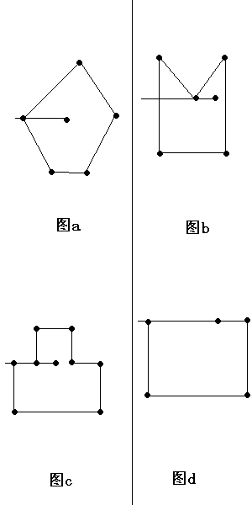

Slide 56
/* 射线法判断点q与多边形polygon的位置关系，要求polygon为简单多边形，顶点逆时针排列
如果点在多边形内返回0 如果点在多边形边上： 返回1
如果点在多边形外： 返回2 const double ESP = 1e-5;
*/ int insidepolygon(int vcount,POINT Polygon[],POINT q)
{ int c=0,i,n; //n表示顶点数
LineSegment line;
bool bintersect_a,bonline1,bonline2,bonline3;
double r1,r2;
if (n == 1) { //判断两点是否重合
return ( (fabs(polygon[0].x - point.x) < ESP) && (fabs(polygon[0].y - point.y) < ESP) ); }
else if (n == 2) { //判断点是否在线上
LineSegment side;
side.pt1 = polygon[0];
side.pt2 = polygon[1];
return IsOnline(point, side);
}

Slide 57
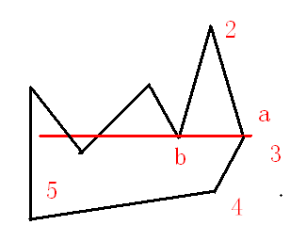
line.pt1 = point; //射线
line.pt2.y = point.y;
line.pt2.x = - INFINITY; //无穷大
n=vcount;
For( int i = 0; i < n; i++ ) {
// 得到多边形的一条边
LineSegment side;
side.pt1 = polygon[i]; side.pt2 = polygon[(i + 1) % n];
//取得一条边
if( IsOnline(point, side) )
{ return true; } //所求点在边上
if( fabs(side.pt1.y - side.pt2.y) < ESP )
{ continue; } // 如果side平行x轴则不作考虑
对一条线段的两个端点都进行判断，因为这两个端点分别属于不同的线段，

Slide 58
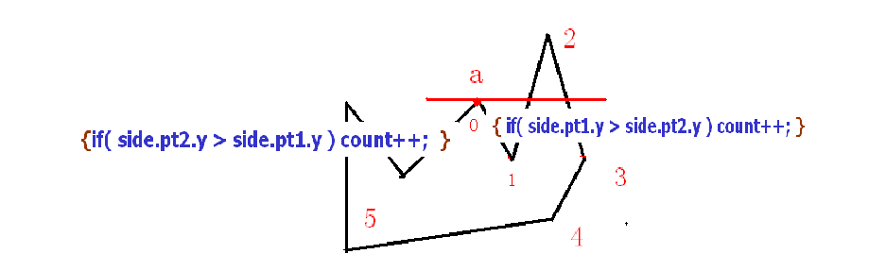
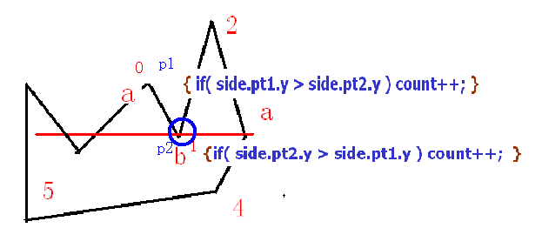
if( IsOnline(side.pt1, line) )
{ if( side.pt1.y > side.pt2.y ) count++; }
else if( IsOnline(side.pt2, line) ) //对一条线段的两个端点都进行判断
{if( side.pt2.y > side.pt1.y ) count++; }
//对于01：1点相交；1为P2；P2.y<p
else if( Intersect(line, side) )
{ count++; }
} //保证极值点相交点数即为偶数
return ( count % 2 == 1 );
对于b，在线段01中，它被记为p2点，p2.y<p1.y，count不变；对于b点，在线段12中它被记为p1点，p1.y<p2.y， count不变；b极小值交点数为0
对于a，在线段50中，它被记为p2点，p2.y>p1.y，count加1；对于a点，在线段01中它被记为p1点，p1.y>p2.y， count加1；a为极大值交点数为2

Slide 59
// 计算叉乘 |P1P0| × |P2P0|
double Multiply(Point p1, Point p2, Point p0)
{
return ( (p1.x - p0.x) * (p2.y - p0.y) - (p2.x - p0.x) * (p1.y - p0.y) );
}
// 判断线段是否包含点point
bool IsOnline(Point point, LineSegment line)
{
return( ( fabs(Multiply(line.pt1, line.pt2, point)) < ESP ) &&
( ( point.x - line.pt1.x ) * ( point.x - line.pt2.x ) <= 0 ) &&
( ( point.y - line.pt1.y ) * ( point.y - line.pt2.y ) <= 0 ) );
}
// 判断线段相交
bool Intersect(LineSegment L1, LineSegment L2)
{
return( (max(L1.pt1.x, L1.pt2.x) >= min(L2.pt1.x, L2.pt2.x)) &&
(max(L2.pt1.x, L2.pt2.x) >= min(L1.pt1.x, L1.pt2.x)) &&
(max(L1.pt1.y, L1.pt2.y) >= min(L2.pt1.y, L2.pt2.y)) &&
(max(L2.pt1.y, L2.pt2.y) >= min(L1.pt1.y, L1.pt2.y)) &&
(Multiply(L2.pt1, L1.pt2, L1.pt1) * Multiply(L1.pt2, L2.pt2, L1.pt1) >= 0) &&
(Multiply(L1.pt1, L2.pt2, L2.pt1) * Multiply(L2.pt2, L1.pt2, L2.pt1) >= 0)
);
}

Slide 60
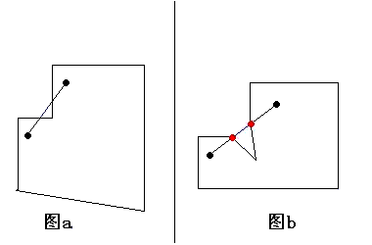
例5：判断线段是否在多边形内
线段在多边形内的一个必要条件是线段的两个端点都在多边形内，但由于多边形可能为凹，所以这不能成为判断的充分条件。
如果线段和多边形的某条边内交（两线段内交是指两线段相交且交点不在两线段的端点），因为多边形的边的左右两侧分属多边形内外不同部分，所以线段一定会有一部分在多边形外(见图a)。于是我们得到线段在多边形内的第二个必要条件：线段和多边形的所有边都不内交。

Slide 61
线段和多边形交于线段的两端点并不会影响线段是否在多边形内；但是如果多边形的某个顶点和线段相交，还必须判断两相邻交点之间的线段是否包含于多边形内部（反例见图b)。

Slide 62
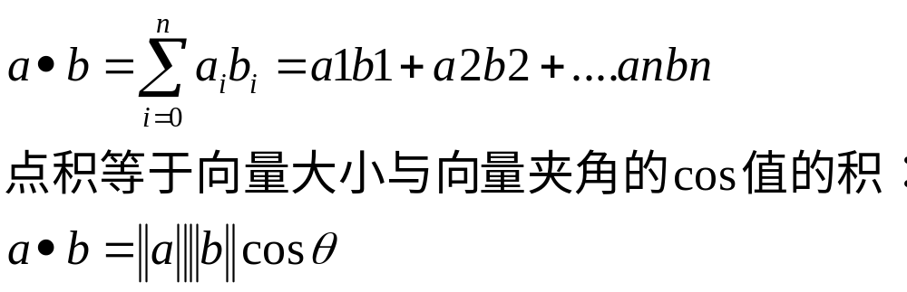
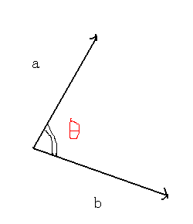
2.1 向量的点积

Slide 63
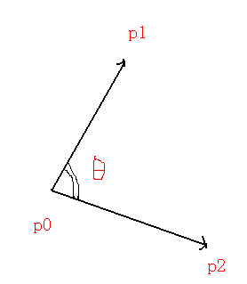
double dotmultiply(POINT p1,POINT p2,POINT p0)
{ return ((p1.x-p0.x)*(p2.x-p0.x)+(p1.y-p0.y)*(p2.y-p0.y));
}
r=dotmultiply(p1,p2,op)
得到矢量(p1-op)和(p2-op)的点积

Slide 64
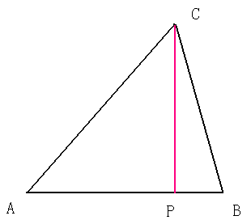
定义r=AP/AB
AC dot AB
r = --------- ---
||AB||^2
|AC||AB|COS(角cab)
= --------- ------
||AB||^2
||AC|| AP
= --- ------ COS(角cab)= --------- ------
P是点C到线段AB所在直线的垂足
R>0:两矢量夹角为锐
r=0：两矢量夹角为直角；
R<0:两矢量夹角为钝角
||AB||
||AB||

Slide 65
2.2 判断点与线段的关系
r has the following meaning:
r=0 P = A
r=1 P = B
r<0 P is on the backward extension of AB
r>1 P is on the forward extension of AB
0<r<1 P is interior to AB
AC dot AB
r = ---------
||AB||^2
(Cx-Ax)(Bx-Ax) + (Cy-Ay)(By-Ay)
= ------------------------------- -----------------
L^2

Slide 66
double relation(POINT p,LINESEG l)
{
LINESEG tl;
tl.s=l.s;
tl.e=p;
return dotmultiply(tl.e,l.e,l.s)/(dist(l.s,l.e)*dist(l.s,l.e));
}

Slide 67
求点C到线段AB所在直线的垂足 P
POINT perpendicular(POINT p,LINESEG l)
{
double r=relation(p,l);
POINT tp;
tp.x=l.s.x+r*(l.e.x-l.s.x);
tp.y=l.s.y+r*(l.e.y-l.s.y);
return tp;
}

Slide 68
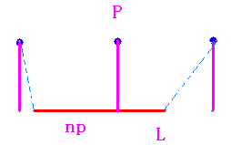
求点p到线段l的最短距离,返回线段上距该点最近的点np
注意：np是线段l上到点p最近的点，不一定是垂足
double ptolinesegdist(POINT p,LINESEG l,POINT &np)
{
double r=relation(p,l);
if(r<0)
{
np=l.s;
return dist(p,l.s);
}
if(r>1)
{
np=l.e;
return dist(p,l.e);
}
np=perpendicular(p,l);
return dist(p,np);
}

Slide 69
求点p到线段l所在直线的距离,请注意本函数与上个函数的区别
double ptoldist(POINT p,LINESEG l)
{
return abs(multiply(p,l.e,l.s))/dist(l.s,l.e);
} // 面积=边长×高

Slide 70
计算点到折线集的最近距离,并返回最近点
double ptopointset(int vcount,POINT pointset[],POINT p,POINT &q)
{
int i;
double cd=double(INF),td;
LINESEG l;
POINT tq,cq;
for(i=0;i<vcount-1;i++)
{
l.s=pointset[i];
l.e=pointset[i+1];
td=ptolinesegdist(p,l,tq);
if(td<cd)
{ cd=td;
cq=tq;
}
}
q=cq;
return cd;
}
注意：调用的是ptolineseg()函数

Slide 71
判断圆是否在多边形内
/*ptolineseg()函数的应用2 */
bool CircleInsidePolygon(int vcount,POINT center,double radius,POINT polygon[])
{
POINT q;
double d;
q.x=0;
q.y=0;
d=ptopointset(vcount,polygon,center,q);
if(d<radius||fabs(d-radius)<EP)
return true;
else
return false;
}

Slide 72
2.3 点与点的关系
double dist(POINT p1,POINT p2) // 返回两点之间欧氏距离
{
return( sqrt( (p1.x-p2.x)*(p1.x-p2.x)+(p1.y-p2.y)*(p1.y-p2.y) ) );
}
bool equal_point(POINT p1,POINT p2) // 判断两个点是否重合
{
return ( (abs(p1.x-p2.x)<EP)&&(abs(p1.y-p2.y)<EP) );
}

Slide 73
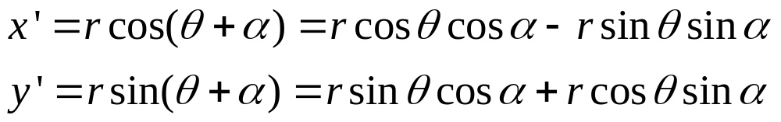
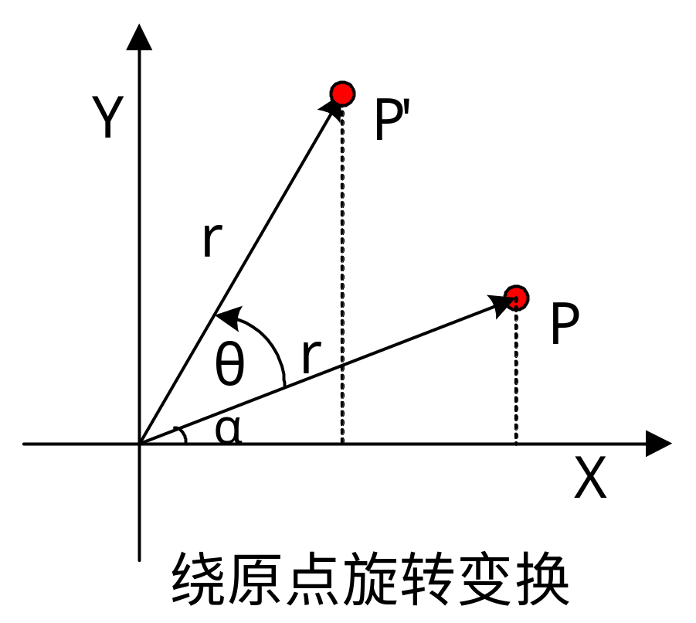
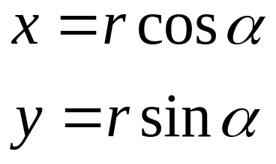
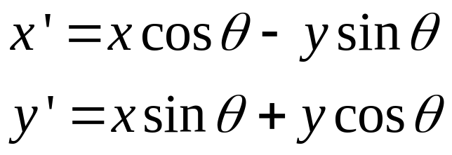
2.4 返回点p以点o为圆心逆时针旋转alpha(单位：弧度)后所在的位置

Slide 74
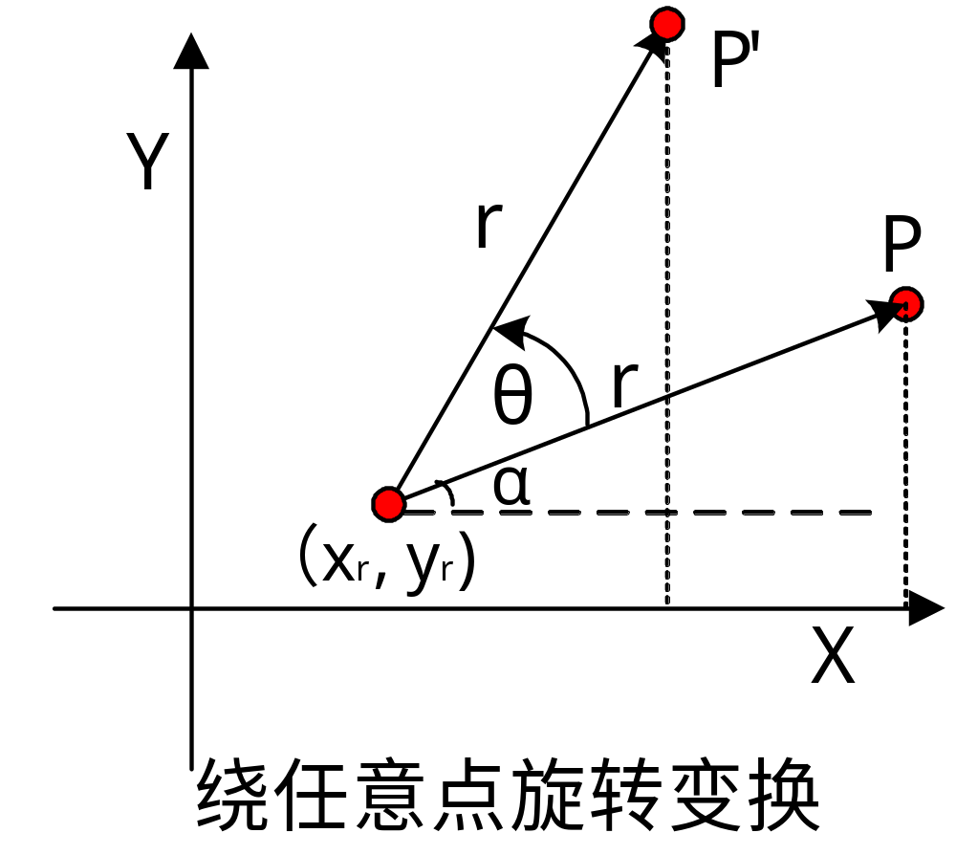
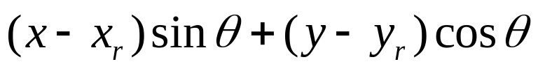
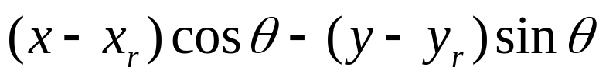
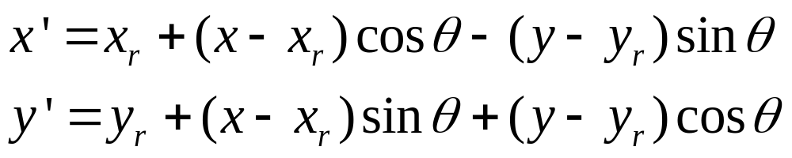

Slide 75
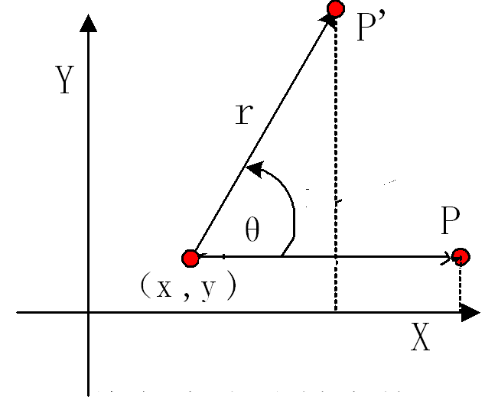
POINT rotate(POINT o,double alpha,POINT p)
{
POINT tp;
p.x-=o.x;
p.y-=o.y;
tp.x= o.x +p.x*cos(alpha)-p.y*sin(alpha);
tp.y= o.y +p.y*cos(alpha)+p.x*sin(alpha);
return tp;
}

Slide 76
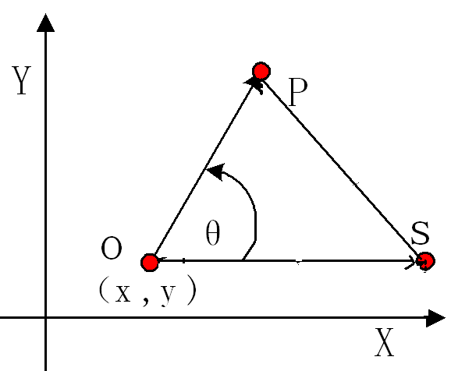
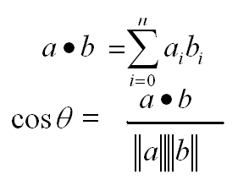
2.5 返回顶角在o点，起始边为os，终止边为op的夹角(单位：弧度)
角度小于pi，返回正值 角度大于pi，返回负值
可以用于求线段之间的夹角
double angle(POINT o,POINT s,POINT e)
{
double cosfi,fi,norm;
double dsx = s.x - o.x;
double dsy = s.y - o.y;
double dex = e.x - o.x;
double dey = e.y - o.y;
cosfi=dsx*dex+dsy*dey;
norm=(dsx*dsx+dey*dey)*(dex*dex+dey*dey); //点积
cosfi /= sqrt( norm );
if (cosfi >= 1.0 ) return 0;
if (cosfi <= -1.0 ) return -3.1415926;
fi=acos(cosfi);
if (dsx*dey-dsy*dex>0) return fi; // 说明矢量os 在矢量 oe的顺时针方向
return -fi;
}

Slide 77
2.6 返回两个矢量l1和l2的夹角的余弦(-1 --- 1)
注意：如果想从余弦求夹角的话，注意反余弦函数的定义域是从 0到pi
double cosine(LINESEG l1,LINESEG l2)
{
return (((l1.e.x-l1.s.x)*(l2.e.x-l2.s.x) + (l1.e.y-l1.s.y)*(l2.e.y- l2.s.y)) /(dist(l1.e,l1.s)*dist(l2.e,l2.s))) );
} 点积/距离

Slide 78
// 根据直线解析方程返回直线的斜率k,水平线返回 0,竖直线返回 1e200
double slope(LINE l)
{
if(abs(l.a) < 1e-20)return 0;
if(abs(l.b) < 1e-20)return INF;
return -(l.a/l.b);
}

Slide 79
// 返回直线的倾斜角alpha ( 0 - pi)
double alpha(LINE l)
{
if(abs(l.a)< EP)return 0;
if(abs(l.b)< EP)return PI/2;
double k=slope(l);
if(k>0)
return atan(k);
else
return PI+atan(k);
}

Slide 80
如果两条直线 l1(a1*x+b1*y+c1 = 0), l2(a2*x+b2*y+c2 = 0)相交，返回true，且返回交点p
bool lineintersect(LINE l1,LINE l2,POINT &p)
{
double d=l1.a*l2.b-l2.a*l1.b;
if(abs(d)<EP) // 不相交 ,平行
return false;
p.x = (l2.c*l1.b-l1.c*l2.b)/d;
p.y = (l2.a*l1.c-l1.a*l2.c)/d;
return true;
}

Slide 81
例1：http://acm.zju.edu.cn/ show_problem.php?pid=2748
Free Kick
In a soccer game, a direct free kick is also awarded to the opposing team if a player commits any of the offences.

Slide 82



Slide 83
Let's make the problem easier on a simplified field map, shown as above. The two ends of the goal locate at (-a,0) and (a,0) respectively, and the free kick position is (x, y). Assuming the body width of every defender is always W, your task is to determine how many defenders are required at the least to make up the "WALL", so that they can help their goalie receive the shooting angle. According to FIFA's law, all the defender must keep a distance not less than D from the free kick position. The goalie will feel safe if the remaining shooting angle after the "WALL" is strictly less than A degree

Slide 84
Input
The input consists of several test cases. In each case, there are six numbers in a single line, indicating a, W, x, y, D and A respectively.
Constraints:
a, W, D, A are all positive numbers;
The distance between the goal and the free kick position is guaranteed greater than D;
The absolute value of each non-zero number is in the range [10⁻⁶, 10⁶].
Proceed until the end of file.
Output
For each case, print an integral number on a single line, which denotes the minimal number of defenders is required to make the goalie safe. Note that this number may be greater than 11.

Slide 85
Sample Input
3.66 0.5 5 20.2 9.15 10
3.66 0.5 -5 -20.3 9.15 10
Sample Output
4
3

Slide 86
#include<iostream>
#include<cmath>
using namespace std;
int main()
{
double l,w,x,y,d,a,aa,bb,cc,A,dd;
double n;
int nn;

Slide 87
while(cin>>l>>w>>x>>y>>d>>a)
{
aa=2*l;
bb=sqrt((x-l)*(x-l)+y*y);
cc=sqrt((x+l)*(x+l)+y*y);
A=acos((bb*bb+cc*cc-aa*aa)/(2*bb*cc));
dd=(A-a*acos(double(-1))/180)/2;
if(dd<0)
nn=0;
else
{
n=tan(dd)*d*2/w;
if(n==int(n))
nn=n;
else nn=int(n)+1;
}
cout<<nn<<endl;
}
return 0;
}

Slide 89
例2：http://acm.zju.edu.cn/ show_problem.php?pid=1199
Point of Intersection
Given two circles on the same plane which are centered at (x1,y1) and (x2,y2) ,with radiuses r1 and r2, respectively.We can see that they have two common tangent lines in most of the cases.Now you are asked to write a programme to calculate the point of intersection of the two tangents if there exists one. ( See Figure 1 )

Slide 90


Input
The input data consists of the information of several figures.The first line of the input contains the number of figures.
Each figure is described by two lines of data.Each line contains 3 integers constituting the coordinates of the center (x, y) and the radius r (>0) of a circle.
Output
For each figure, you are supposed to output the coordinates (x, y) of the point of intersection if it exists.The x and y must be rounded to two decimal places and be separated by one space.If there is no such point exists simply output "Impossible."

Slide 91
Sample Input
2 0 0 10 0 0 5 0 0 10 10 0 1
Output for the Sample Input
Impossible. 11.11 0.00
Notice

Slide 92
//求2个圆的公共外切线的交点
//x1,y1,r1,x2,y2,r2都是整数
//根据等比性(x-x1)/r1=(x-x2)/r2，得出x=(double)(r1*x2-r2*x1)/(double)(r1-r2);
//同理y=(double)(r1*y2-r2*y1)/(double)(r1-r2);
#include <iostream>
#include <iomanip>
using namespace std;
int main()
{
int x1,y1,r1,x2,y2,r2;
int kase,i;
cin >> kase;

Slide 93
for(i=0; i<kase; i++)
{
cin >>x1 >>y1 >>r1 >>x2 >>y2 >>r2;
double x,y;
cout <<setiosflags(ios::fixed) <<setprecision(2);
if( (r1==r2) || (x1-x2)*(x1-x2) + (y1-y2)*(y1-y2) <= (r1-r2)*(r1-r2) )
cout <<"Impossible." <<endl;
else
{
x=(double)(r1*x2-r2*x1)/(double)(r1-r2);
y=(double)(r1*y2-r2*y1)/(double)(r1-r2);
cout <<x <<" " <<y <<endl;
}
}
return 0;
}

Slide 94


例3：http://acm.zju.edu.cn/ show_problem.php?pid=1193
Reflections

Slide 95
All objects in the scene are totally reflective (mirror) spheres. When a ray of light hits such a sphere, it is reflected such that the angle of the incoming ray and the leaving ray against the tangent are the same:
Your task is to write a program, that given a scene description and a ray entering the scene, determines which spheres are hit by the ray.

Slide 96
Input
The input consists of a series of scene descriptions. Each description starts with a line containing the number n (n <= 25) of spheres in the scene. The following n lines contain three integers xi, yi, ri each, where (xi, yi) is the center, and ri > 0 is the radius of the i-th sphere. Following this is a line containing four integers x, y, dx, dy, which describe the ray. The ray originates from the point (x,y) and initially points in the direction (dx, dy). At least one of dx and dy will be non-zero.
The spheres will be disjoint and non-touching. The ray will not start within a sphere, and never touch a sphere tangentially.
A test case starting with n = 0 terminates the input. This case should not be processed.

Slide 97
Output
For each scene first output the number of the scene. Then print the numbers of the spheres that the ray hits in its first ten deflections (the numbering of spheres is according to their order in the input).
If the ray hits at most ten spheres (and then heads towards infinity), print inf after the last sphere it hits. If the ray hits more than 10 spheres, print three points (...) after the tenth sphere.
Output a blank line after each test case.

Slide 98
Sample Input
3
3 3 2
7 7 1
8 1 1
3 8 1 -4
2
0 0 1
5 0 2
2 0 1 0
0
Sample Output
Scene 1
1 2 1 3 inf
Scene 2
2 1 2 1 2 1 2 1 2 1 ...

Slide 99

思路分析：
1、确定光线与哪个球相遇（求解圆与直线相交的问题）
2、计算光线反射后的角度
为了计算光线与最近的那个球相遇，
光线的方程采用参数方程：
x=x0+t*dx; (x0,y0)为初始点
y=y0+t*dy;(dx,dy为增量)
把参数方程转换一下：
t=(x-x0)/dx=(y-y0)/dy
x*dy-y*dx+(y0*dx-x0*dy)=0

Slide 100
求解圆与直线相交的问题
计算光线与每个球的圆心距离：
d=abs(ax+by+c)/sqrt(a*a+b*b)
d=abs(dy*x[i]-y[i]*dx+y0*dx-x0*dy)/sqrt(dy*dy+dx*dx)
//x[i],y[i]为圆心坐标
if d<圆的半径 则相交
{// 求交点 }
else
{没有交点}

Slide 101
求交点
{ 设交点为t，把刚才的参数方程带入圆方程
圆的方程： (x-xr)* (x-xr)+(y-yr)*(y-r)=r*r
把x=x0+t*dx; y=y0+t*dy
代入圆方程，得到：
t*t(dx*dx+dy*dy)+2t[(x0-xr)dx+(y0yr)dy]-r*r=0
解的t, t=b*b-4ac
如果t<0, 表示射线反方向射出
所以要淘汰，t>=0,则取来
}

Slide 102

求解角度

