Slide 1
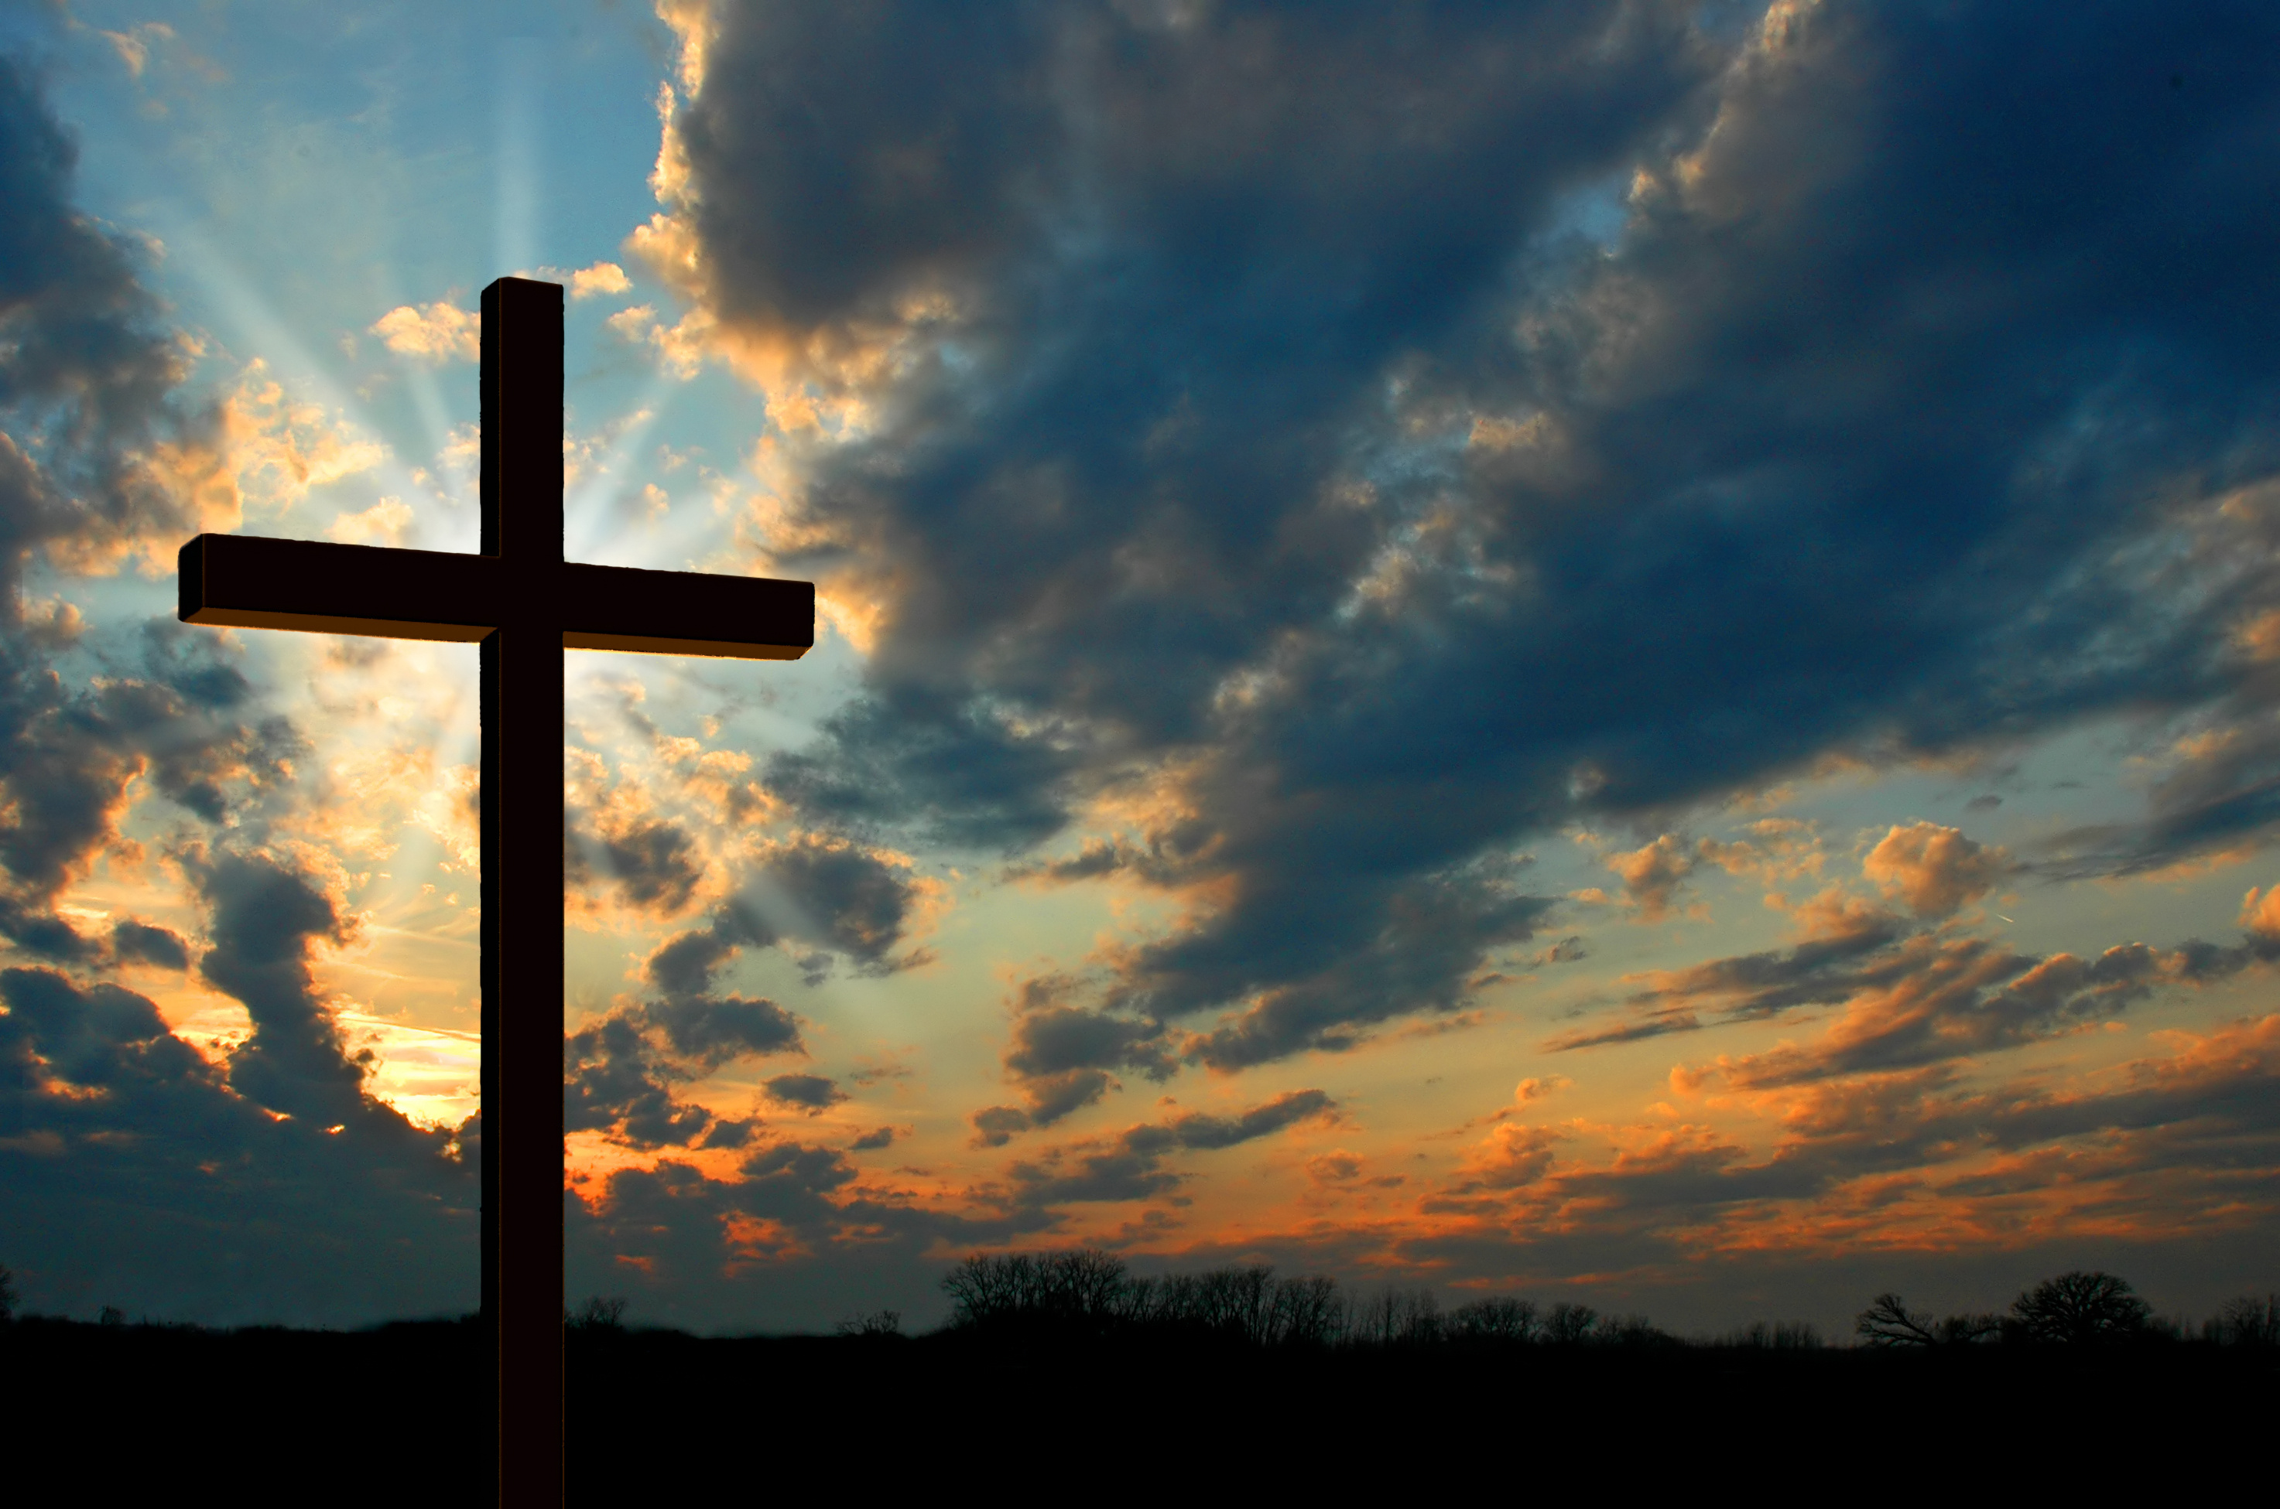
PAANO AKO MALILIGTAS AT PAANO AKO MAGLILIGTAS NG IBA?
Roma 3:23

Slide 2
ROMA 3:23
23 Sapagkat ang lahat ay nagkasala, at walang sinumang nakaabot sa kaluwalhatian ng Diyos.

Slide 3
john 3:1-7 (AMP)
1 Now there was a certain man among the Pharisees named Nicodemus, a ruler (member of the Sanhedrin) among the Jews,
2 who came to Jesus at night and said to Him, “Rabbi (Teacher), we know [without any doubt] that You have come from God as a teacher; for no one can do these signs [these wonders, these attesting miracles] that You do unless God is with him.”

Slide 4
john 3:1-7 (AMP)
3 Jesus answered him, “I assure you and most solemnly say to you, unless a person is born again [reborn from above—spiritually transformed, renewed, sanctified], he cannot [ever] see and experience the kingdom of God.”
4 Nicodemus said to Him, “How can a man be born when he is old? He cannot enter his mother’s womb a second time and be born, can he?”
5 Jesus answered, “I assure you and most solemnly say to you, unless one is born of water and the Spirit he cannot [ever] enter the kingdom of God.

Slide 5
john 3:1-7 (AMP)
6 That which is born of the flesh is flesh [the physical is merely physical], and that which is born of the Spirit is spirit.
7 Do not be surprised that I have told you, ‘You must be born again [reborn from above—spiritually transformed, renewed, sanctified].’

Slide 6
PAANO AKO MALILIGTAS?

Slide 7
I. BORN AGAIN
6 That which is born of the flesh is flesh [the physical is merely physical], and that which is born of the Spirit is spirit.

Slide 8
a. Personal relationship
ROMANS 5:11 (NLT)
11 So now we can rejoice in our wonderful new relationship with God because our Lord Jesus Christ has made us friends of God.

Slide 9
a. Personal relationship
ROMANS 5:18 (NLT)
18 Yes, Adam’s one sin brings condemnation for everyone, but Christ’s one act of righteousness brings a right relationship with God and new life for everyone.

Slide 10
a. Personal relationship
COLOSSIANS 1:28 (NLT)
28 So we tell others about Christ, warning everyone and teaching everyone with all the wisdom God has given us. We want to present them to God, perfect in their relationship to Christ.

Slide 11
a. Personal relationship
2 JOHN 9 (NLT)
9 Anyone who wanders away from this teaching has no relationship with God. But anyone who remains in the teaching of Christ has a relationship with both the Father and the Son.

Slide 12
B. BORN IN THE SPIRIT
JOHN 3:3 (ESV)
3 Jesus answered him, “Truly, truly, I say to you, unless one is born again he cannot see the kingdom of God.”

Slide 13
B. BORN IN THE SPIRIT
Galacia 5:16-17 (ASND)
16 Kaya mamuhay kayo nang ayon sa nais ng Banal na Espiritu para hindi ninyo mapagbigyan ang pagnanasa ng laman.
17 Sapagkat ang ninanasa ng laman ay laban sa nais ng Espiritu, at ang nais ng Espiritu ay laban sa ninanasa ng laman. Magkalaban ang dalawang ito, kaya hindi ninyo magawa ang gusto ninyong gawin.

Slide 14
B. BORN IN THE SPIRIT
Roma 8:10
10 Ngunit dahil naninirahan sa inyo si Cristo, mamatay man ang inyong mga katawan dahil sa kasalanan, ang espiritu naman ninyo ay buháy sapagkat itinuring na kayong matuwid ng Diyos.

Slide 15
C. ENCOUNTER WITH GOD (experience)
Genesis 32:24-28
24 So Jacob was left alone, and a man wrestled with him till daybreak.
25 When the man saw that he could not overpower him, he touched the socket of Jacob’s hip so that his hip was wrenched as he wrestled with the man.

Slide 16
C. ENCOUNTER WITH GOD (experience)
Genesis 32:24-28
26 Then the man said, “Let me go, for it is daybreak.” But Jacob replied, “I will not let you go unless you bless me.”
27 The man asked him, “What is your name?” “Jacob,” he answered.

Slide 17
C. ENCOUNTER WITH GOD (experience)
Genesis 32:24-28
28 Then the man said, “Your name will no longer be Jacob, but Israel, because you have struggled with God and with humans and have overcome.”

Slide 18
D. FAITH IN GOD
Romans 10:9-10 (AMPC)
9 Because if you acknowledge and confess with your lips that Jesus is Lord and in your heart believe (adhere to, trust in, and rely on the truth) that God raised Him from the dead, you will be saved.

Slide 19
D. FAITH IN GOD
Romans 10:9-10 (AMPC)
10 For with the heart a person believes (adheres to, trusts in, and relies on Christ) and so is justified (declared righteous, acceptable to God), and with the mouth he confesses (declares openly and speaks out freely his faith) and confirms [his] salvation.

Slide 20
E. REPENTANCE
2 Chronicles 7:14 (NIV)
14 if my people, who are called by my name, will humble themselves and pray and seek my face and turn from their wicked ways, then I will hear from heaven, and I will forgive their sin and will heal their land.

Slide 21
E. REPENTANCE
2 Peter 3:9
9 The Lord is not slow in keeping his promise, as some understand slowness. Instead he is patient with you, not wanting anyone to perish, but everyone to come to repentance.

Slide 22
E. REPENTANCE
Mga gawa 3:19
19 Kaya nga, magsisi kayo at magbalik-loob sa Diyos upang patawarin ang inyong mga kasalanan,

Slide 23
PAANO AKO MALILIGTAS?
BORN AGAIN
A. Personal Relationship
B. Born in the Spirit
C. Encounter with God
D. Faith in God
E. Repentance

Slide 24
PAANO AKO MAGLILIGTAS NG IBA?

Slide 25
SHARE HIS WORD
(OIKOS)

Slide 26
Proverbs 11:30 (niv)
30 The fruit of the righteous is a tree of life, and the one who is wise saves lives.

Slide 27
SINU-SINO BA ANG MGA OIKOS?

Slide 28
1. BIOLOGICAL
Mga literal na kadugo at legal na kapamilya natin.

Slide 29
1. BIOLOGICAL
Mga literal na kadugo at legal na kapamilya natin.
Ex. Magulang, kapatid, pinsan, tito, tita and in laws

Slide 30
1. BIOLOGICAL
Lucas 16:27-28 (RTPV05)
“Ngunit sinabi ng mayaman, ‘Kung gayon po, Amang Abraham, ipinapakiusap ko pong papuntahin na lamang ninyo si Lazaro sa bahay ng aking ama

Slide 31
2. VOCATIONAL
Mga kasama sa trabaho, school o business.

Slide 32
2. VOCATIONAL
Lucas 15:7
7 Sinasabi ko sa inyo, magkakaroon ng higit na kagalakan sa langit dahil sa isang makasalanang tumatalikod sa kasalanan kaysa siyamnapu't siyam na matuwid na di nangangailangang magsisi.”

Slide 33
3. GEOGRAPHICAL
Mga taong nasa immediate geographical community tulad ng mga kapit-bahay at kabarangay.

Slide 34
3. GEOGRAPHICAL
Mga Gawa 5:42
42 At araw-araw, sa Templo at sa mga bahay-bahay, walang tigil silang nagturo at nangaral ng magandang balita tungkol kay Jesus, ang Cristo.

Slide 35
4. VOLITIONAL
Mga taong sinasamba natin by choice (volition) – mga katropa, kalaro sa sports, kapareho ng interes, kumara, kumpare, etc.

Slide 36
4. VOLITIONAL
Santiago 5:20
20 dapat ninyong malaman na ang nagpabalik sa isang makasalanan mula sa kanyang masamang pamumuhay ay nagliligtas ng kaluluwa ng taong iyon sa kamatayan, at magdudulot ng kapatawaran ng maraming kasalanan.

Slide 37
SINU-SINO ANG MGA OIKOS?
Biological
Vocational
Geographical
Volitional

