Slide 1
Design Phase - James River Runners
Erik Tiltman – Project Manager
Chris Calbi – Business Analyst
Ronny Georgi – Systems Analyst
Adam Noonan – Programming Coordinator

Slide 2
Overview
Hardware/Software Specifications
Non-Functional Requirements
Diagrams (ERD, DFD Level 0, 1, Navigation Diagram)
Mock-ups
Programming Plan

Slide 3
Current Status
Working with James River Runners, legal document carrier company
Business Process Automation through new company website
Alert System for Owner
Online Forms for Costumers

Slide 4
Hardware and Software Specifications
Utilize laptop/desktop computer or mobile device with internet connectivity to access website
Full functionality on all common web browsers
Automatic backup to protect against disruptions
Availability 24/7

Slide 5
Non-Functional Requirements
Orders must be limited to Central and Eastern Virginia
Automated backup of customer data
Displayed screen must refresh within 2 seconds
Apache Server with MySQL

Slide 6
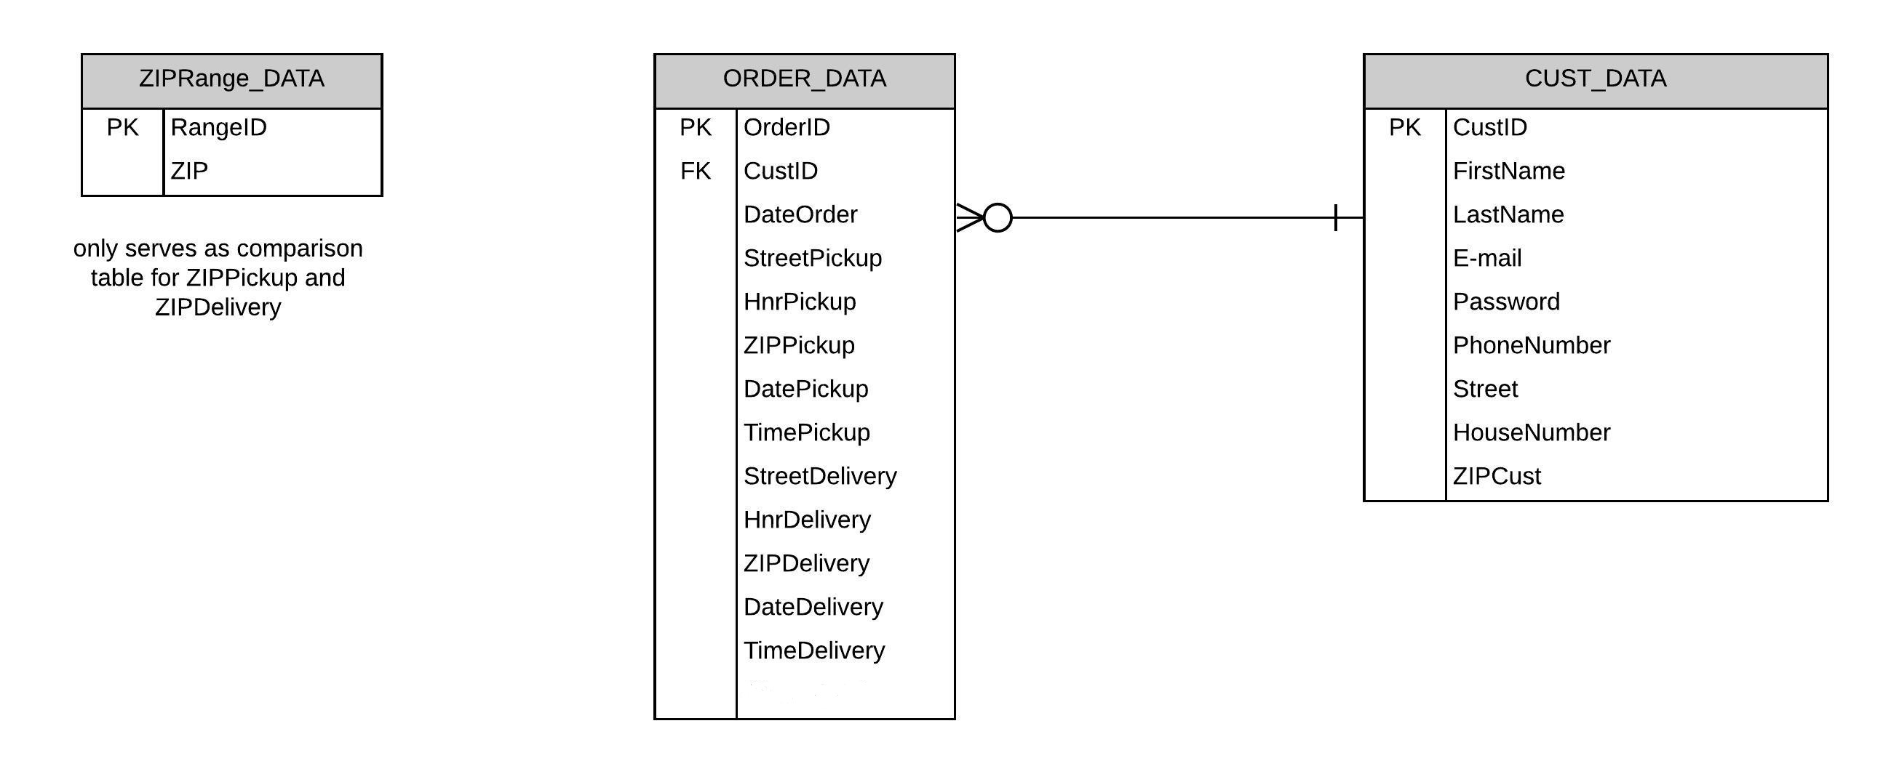
Entity Relationship Diagram (ERD)

Slide 7
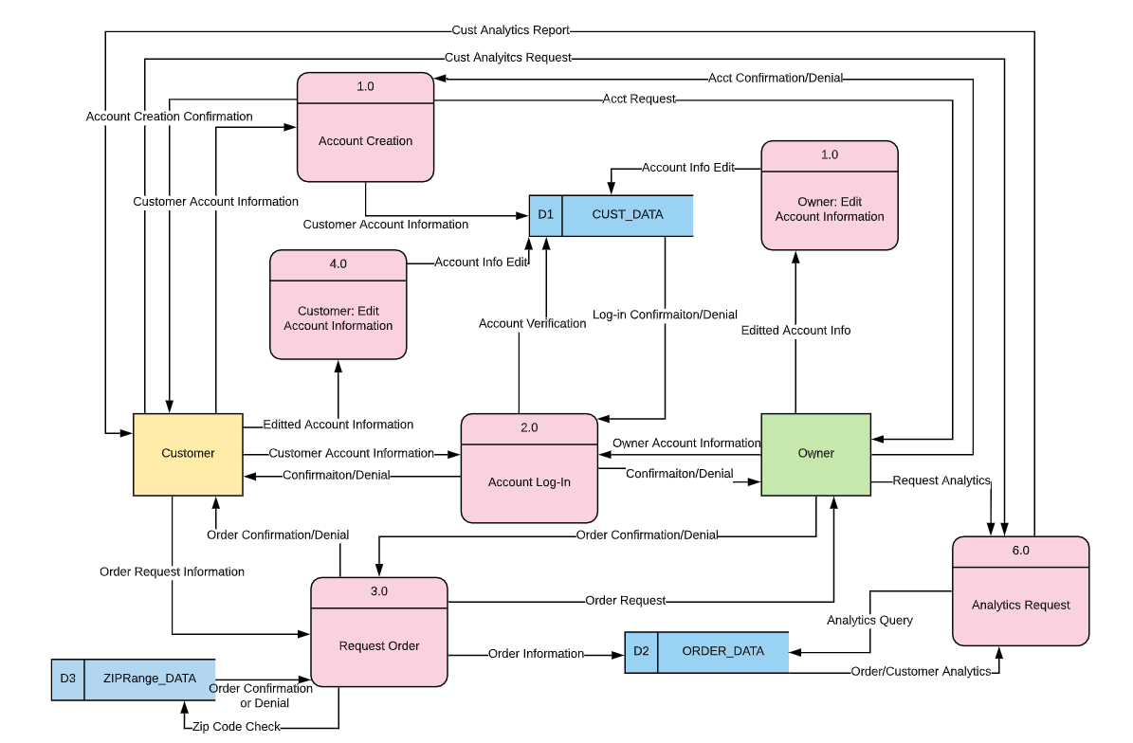
Data Flow Diagram (Level 0)

Slide 8
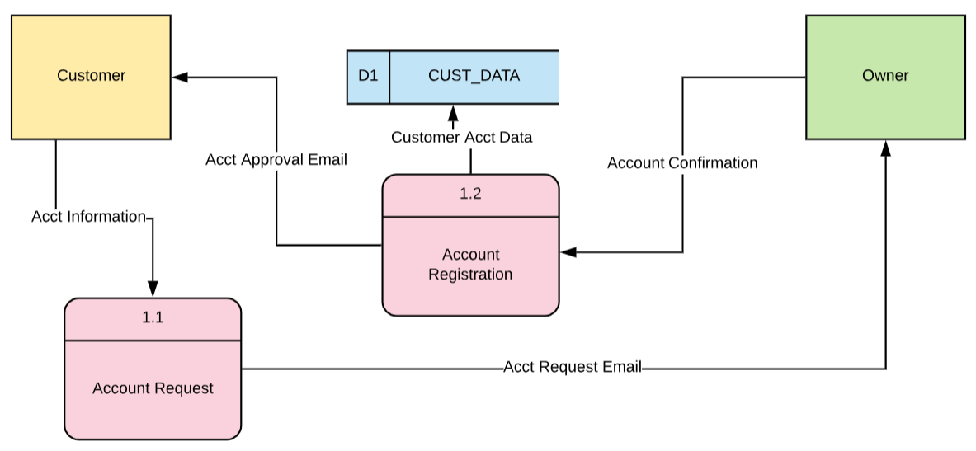
Account Creation DFD (Level 1)

Slide 9
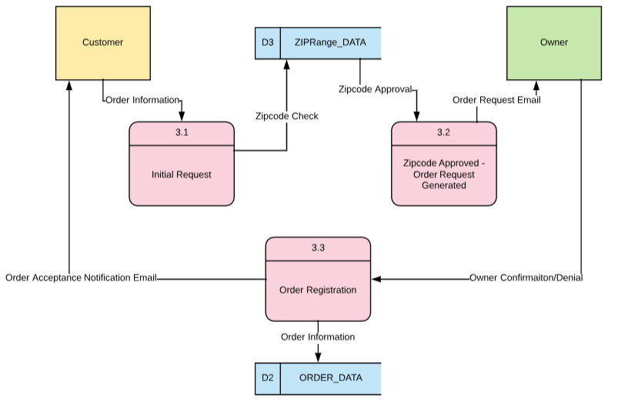
Order Request DFD (Level 1)

Slide 10
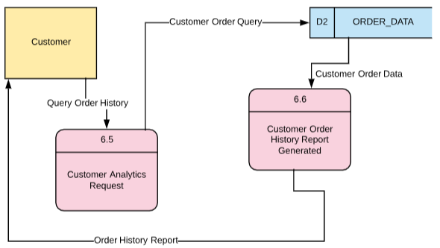
Customer Order Analytics Request DFD (Level 1)

Slide 11
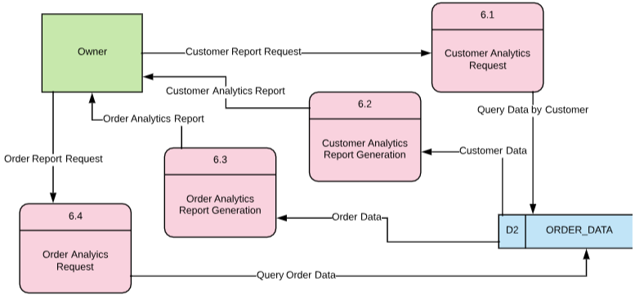
Owner Analytics Request DFD (Level 1)

Slide 12
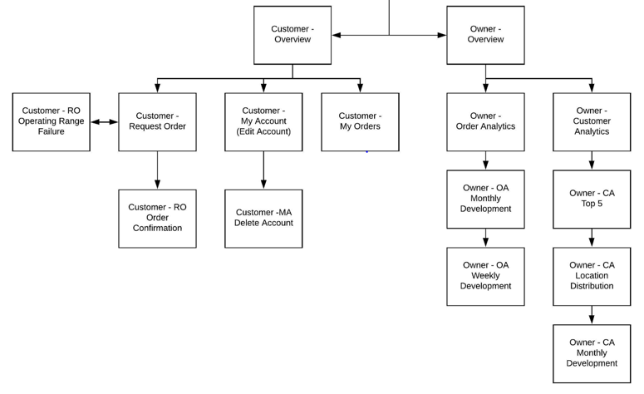
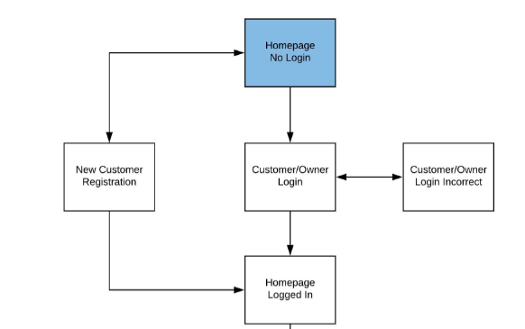
Navigation Diagram

Slide 13
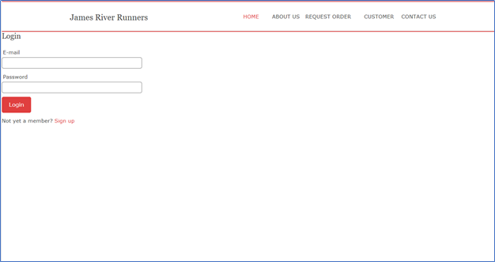
Mock-Ups of Website
Customer/Owner Login

Slide 14
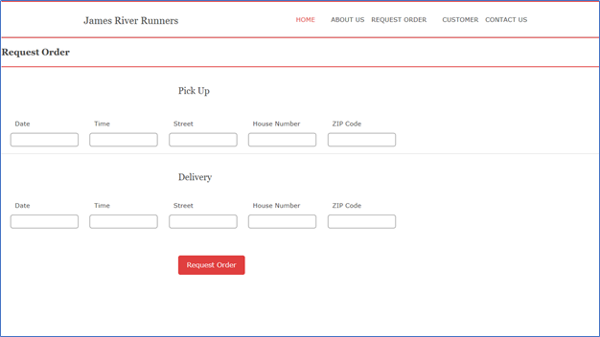
Customer – Request Order

Slide 15
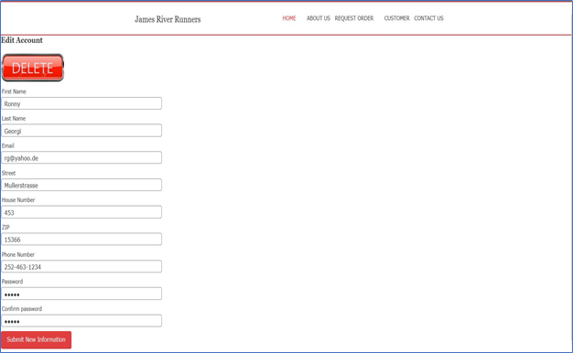
Customer – My Account

Slide 16
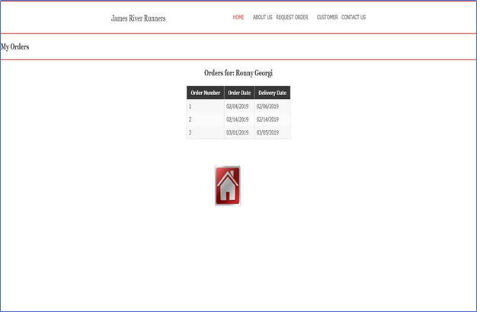
Customer – My Orders​

Slide 17
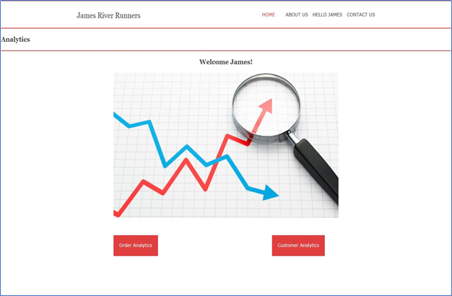
Owner - Overview​​

Slide 18
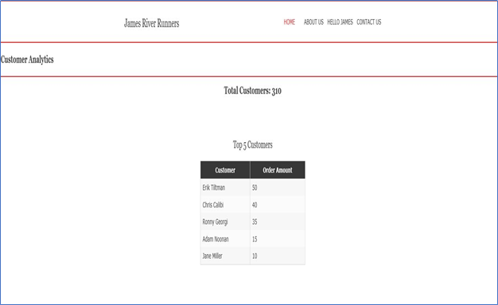
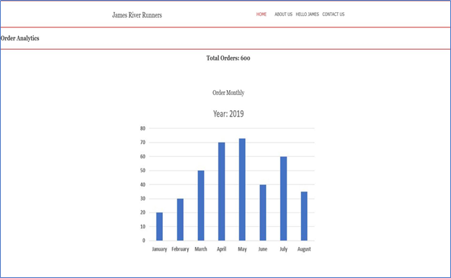
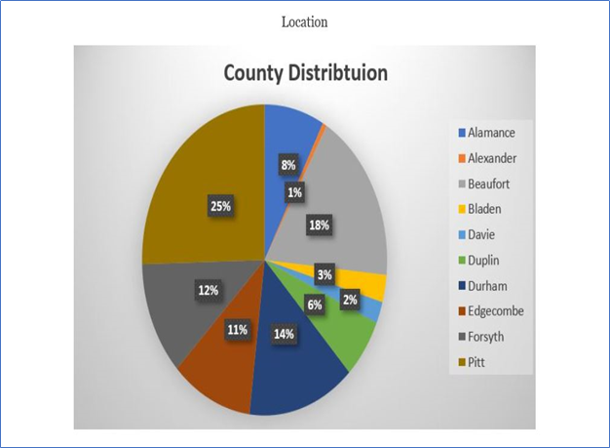

Slide 19
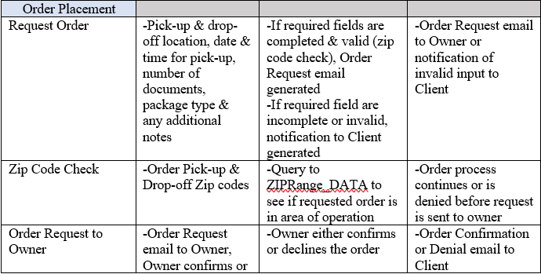
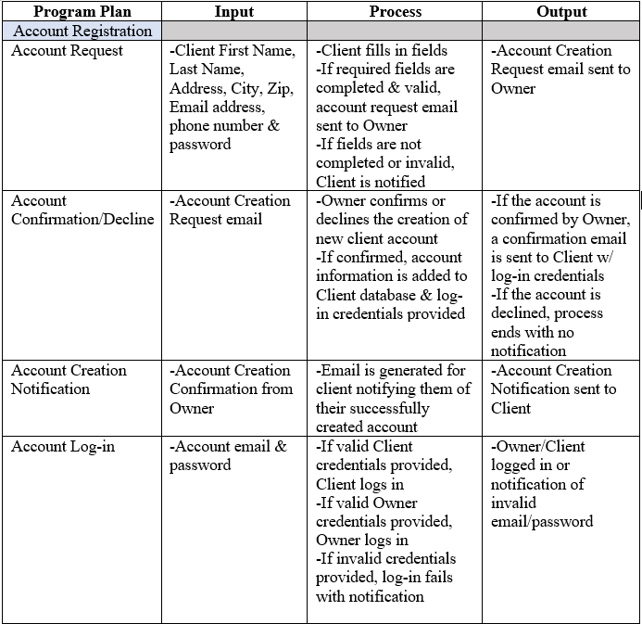
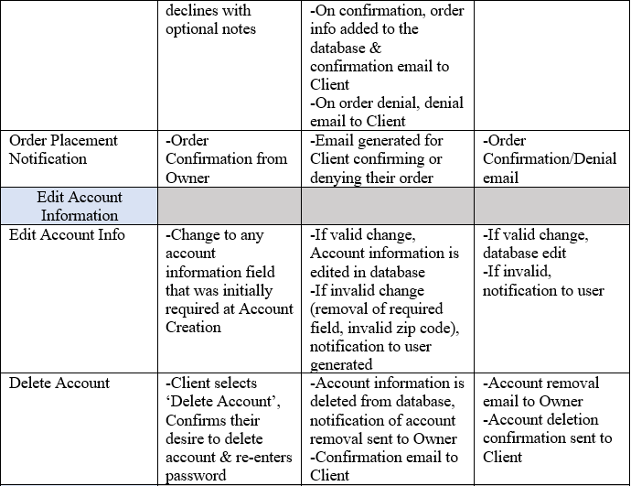
Program Plan Sample

Slide 20
Any Question/Concerns

